Slide 1
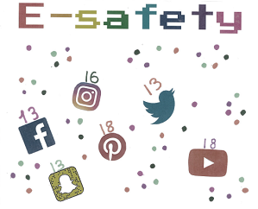

Slide 2


What do you think E-Safety means?
E-Safety at a simple level means being safe on the internet. Some people also include the safe use of technology in this as well.

Slide 3
What do you use the internet for?
Discuss with a partner.
Discuss as a while class.

Slide 4






Did you know there are ages you are supposed to be to go on different apps and games.
What age do you think you have to be to use these games/apps?
7+
12+
13+
7+
13+
13+

Slide 5
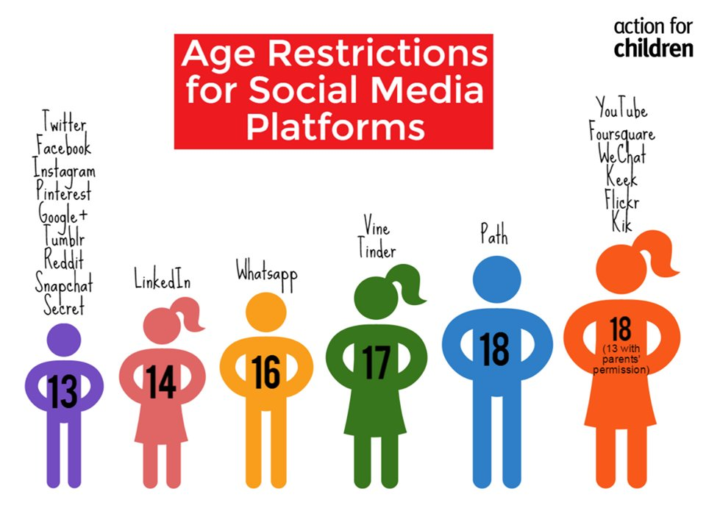
Always remember to speak to your grown ups before using a new game/ app and ask if it is okay for you to use it.
Not all apps/games are suitable for children so make sure you stay safe and always tell a grown up if something is wrong.

