Slide 1


Slide 3

1) How do you spell 7?
2) 5 + 5 = ?
3) How many equal groups?
4) How many are in each group?

Slide 4
seven
1) How do you spell 7?
2) 5 + 5 = ?
3) How many equal groups?
4) How many are in each group?
10
2
3

Slide 6


Circle half
Have a think
There are 4 bananas
Half of 4 is
2

Slide 7

Circle half
Have a think
There are 8 cherries
Half of 8 is
4

Slide 8
Have a go at question 1 on the worksheet

Slide 9
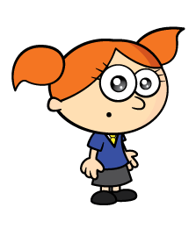

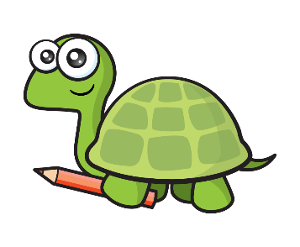
Colour half
Have a think
There are 6 faces.
Half of 6 is
3
I thought of a different way!

Slide 10
Colour half
There are 6 faces.
3
is half of 6

Slide 11
Have a go at question 2 on the worksheet

Slide 12

Have a think
Half of 10 is
5
5
is half of 10

Slide 13

Have a think
Half of 14 is
7
7
is half of 14

Slide 14
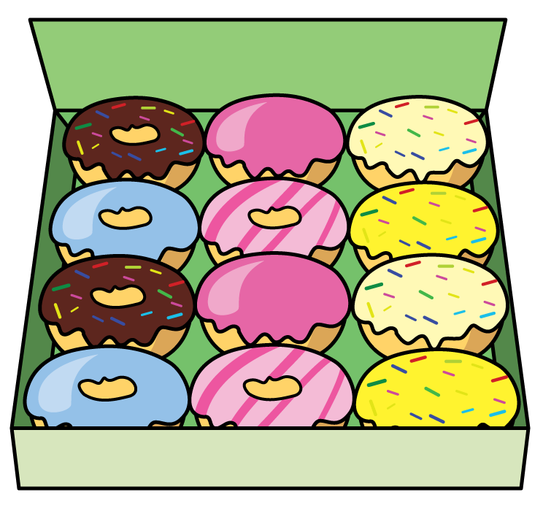
Have a think
12
6
Half of is

Slide 15
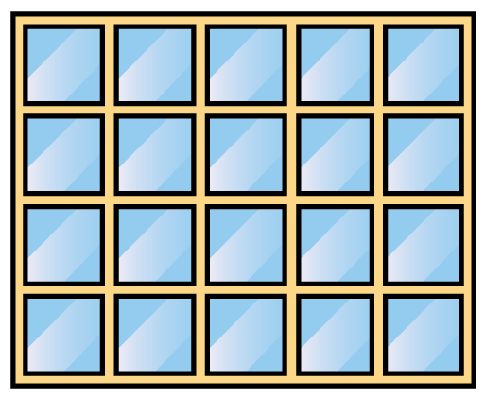
Have a think
20
10
Half of is

Slide 16
Have a go at questions 3 and 4 on the worksheet

