Slide 1

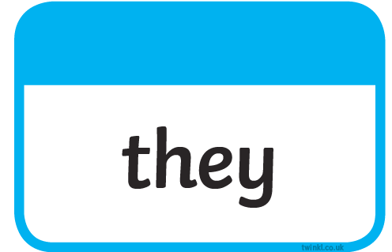
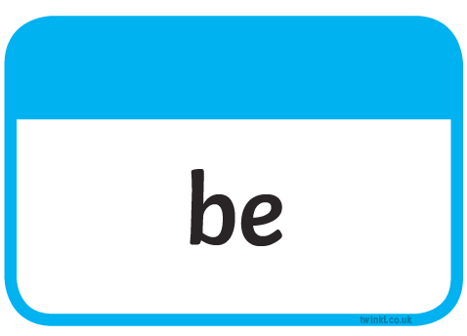
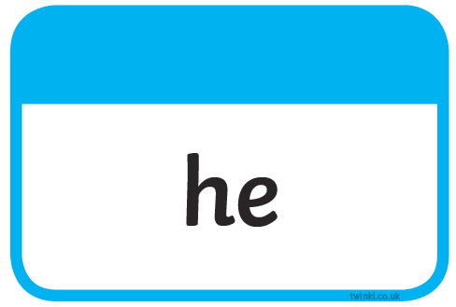



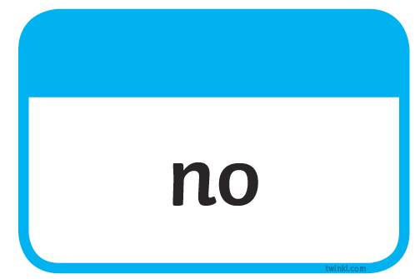

Slide 2
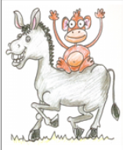


Our Set 3 phoneme for today is….ey
donkey turkey
honey
monkey
chimney
money
I can count my money.
This honey is sweet.
monkey on a donkey

Slide 3
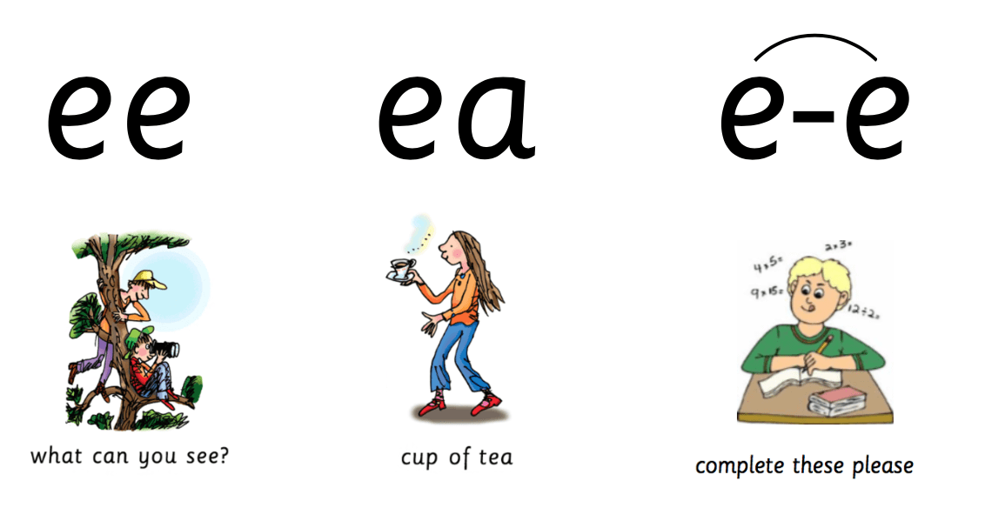
ey
Monkey on a donkey
sleep
these
leap
honey
creep
theme
cream
monkey

Slide 4
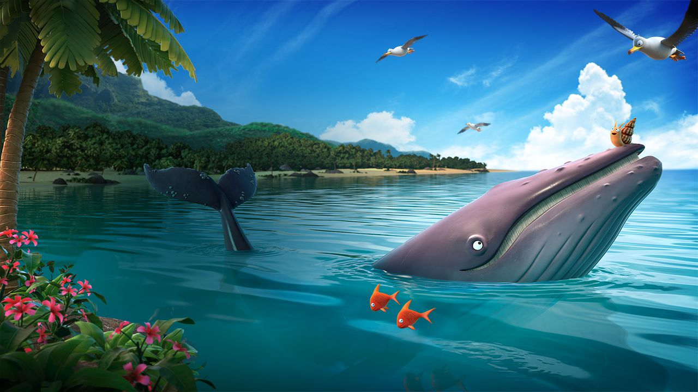
Wednesday 16th June 2021
LO: To use onomatopoeia to write a description of a storm.

Slide 5
In the story the snail and the whale, the characters go through a terrible storm.
Let’s recap that part of the story.

Slide 6
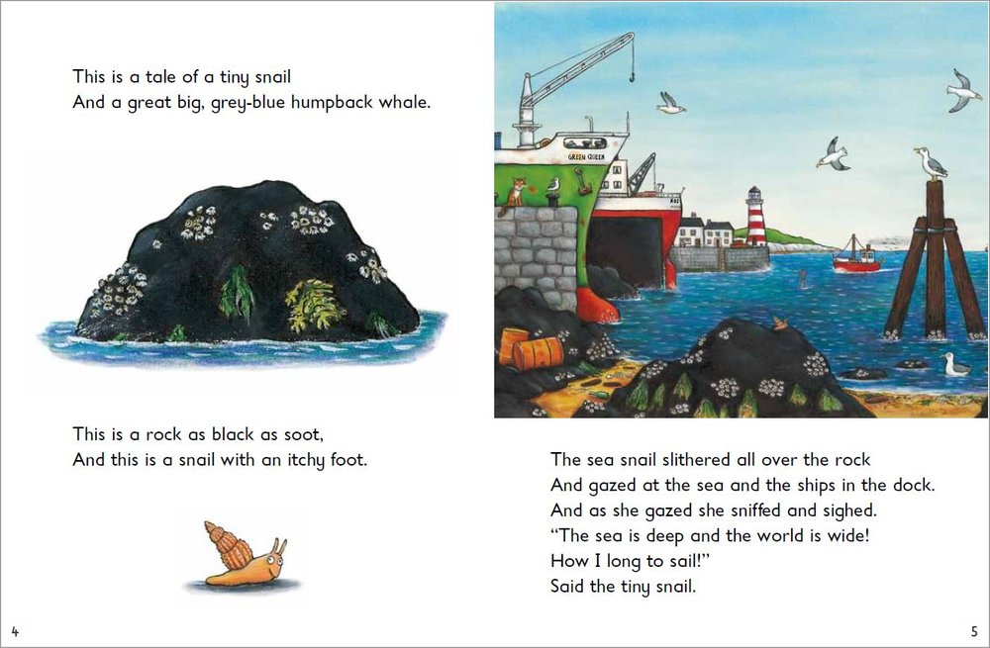

Slide 7
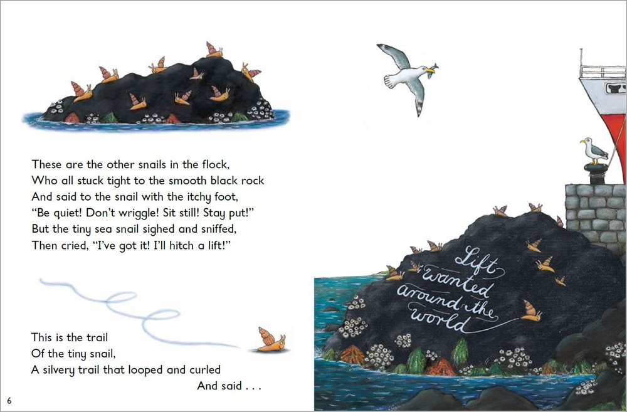

Slide 8
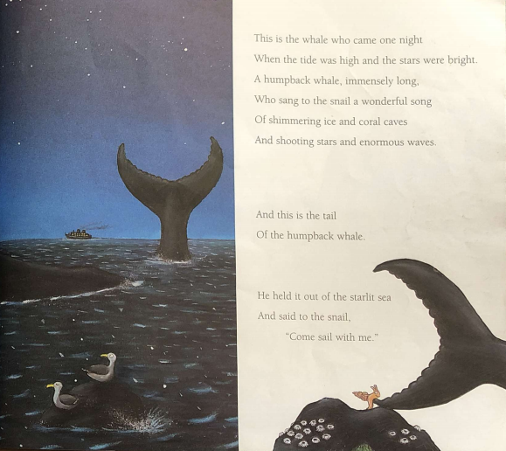

Slide 9
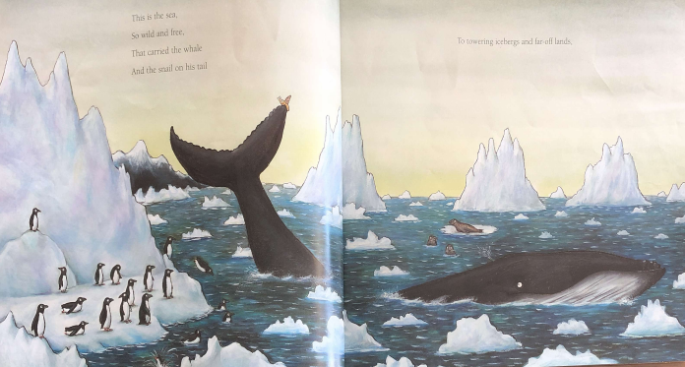

Slide 10
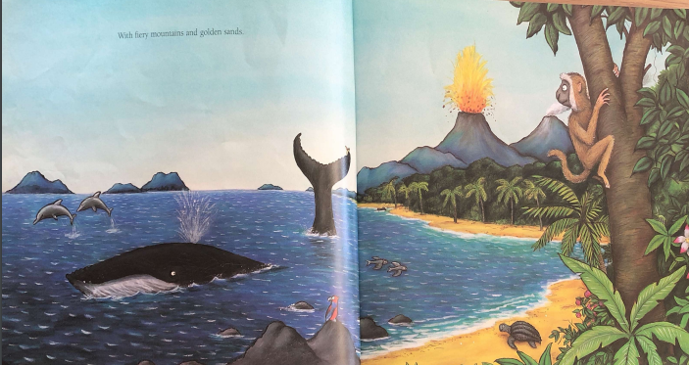

Slide 11
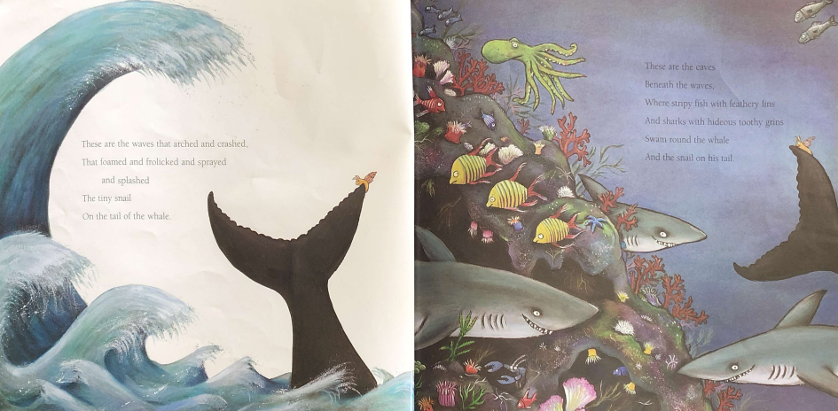

Slide 12
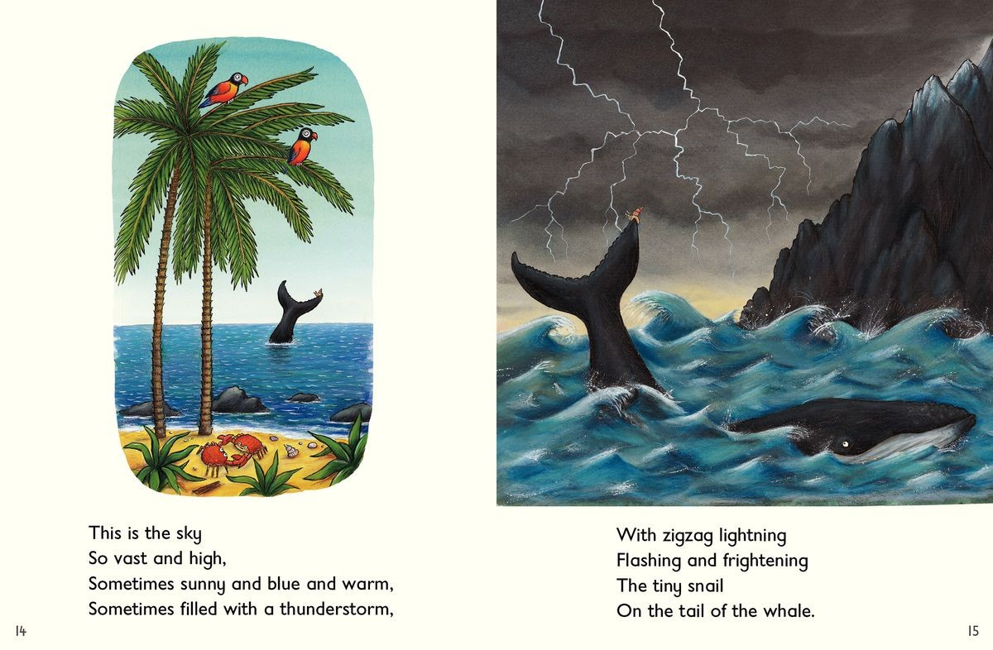

Slide 13
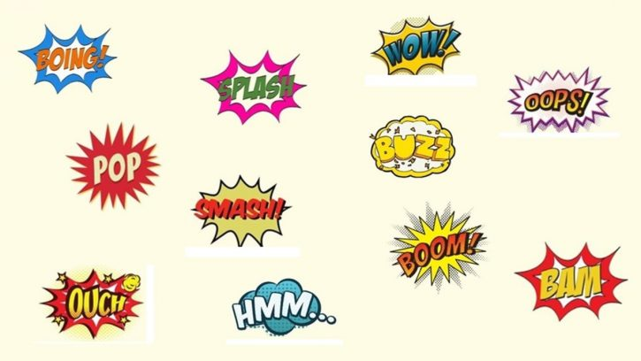
What is onomatopoeia?
https://www.bbc.co.uk/bitesize/topics/z4mmn39/articles/z8t3g82
Onomatopoeia is a word that also makes a sound e.g. bang, crash, boom.

Slide 14
Can you find the onomatopoeia in these sentences
I squeezed the big bottle of tomato sauce.
In the night, the wind was howling.
The leaves crunched under my feet as I walked through the woods.

Slide 15
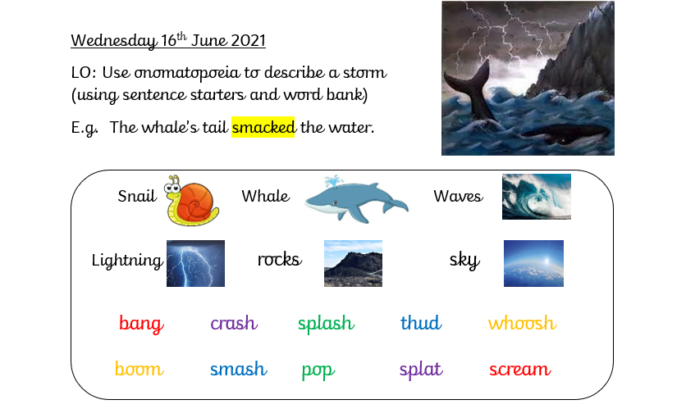
Your task: Write sentences using onomatopoeia to describe the storm from the story.

