Slide 1


Slide 3


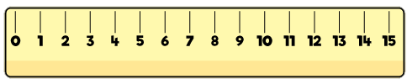
1) What number is missing? 50, 60, 70, ___
2) What number is missing? 66, 67, 68, ___
3) What is the missing part?
4) How long is this pencil?
45
40

Slide 4
1) What number is missing? 50, 60, 70, ___
2) What number is missing? 66, 67, 68, ___
3) What is the missing part?
4) How long is this pencil?
80
69
45
40
5
7 cm

Slide 6
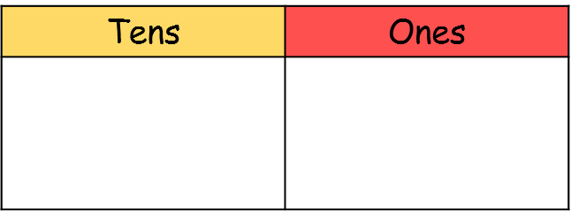
34 is 3 tens and 4 ones
Using a chart

Slide 7
43 is 4 tens and 3 ones
Using a chart

Slide 8

Comparing using a chart
Have a think
3
4
4
3
Which number is the greatest?
How do you know?

Slide 9
Have a go at question 1 on the worksheet

Slide 10
Comparing using a chart
8
5
9
1
85
<
91

Slide 11
Comparing using a chart
1
3
3
1
7
7
2
9
13
<
31
77
>
29

Slide 12
Comparing without using a chart
96
<
99
76
>
67
40
>
14
88
>
9
Have a think

Slide 13
Have a go at questions 2 and 3 on the worksheet

Slide 14
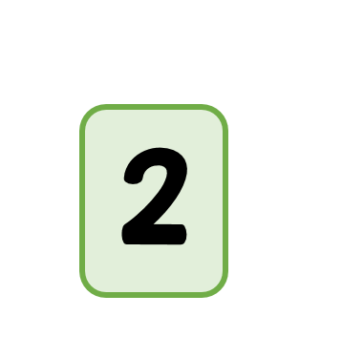


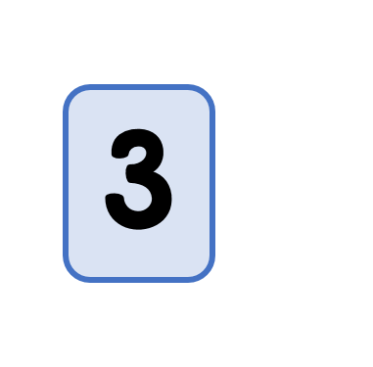


Have a think
Can you make a number…
Equal to thirty- five?
Less than 20?
I made a different number
Greater than 40?

Slide 15
Have a go at question 4 on the worksheet

Slide 16

Have a think
Can you guess my number?
It is greater than 50.
It has seven tens and two ones.
It has 7 tens and some ones.
Is it….
72
78
52

Slide 17
Have a go at question 6 on the worksheet

