Slide 1
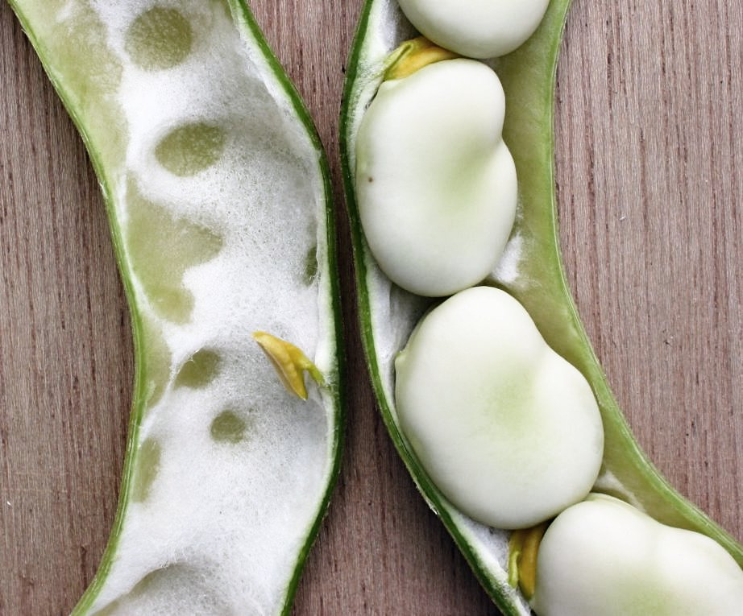
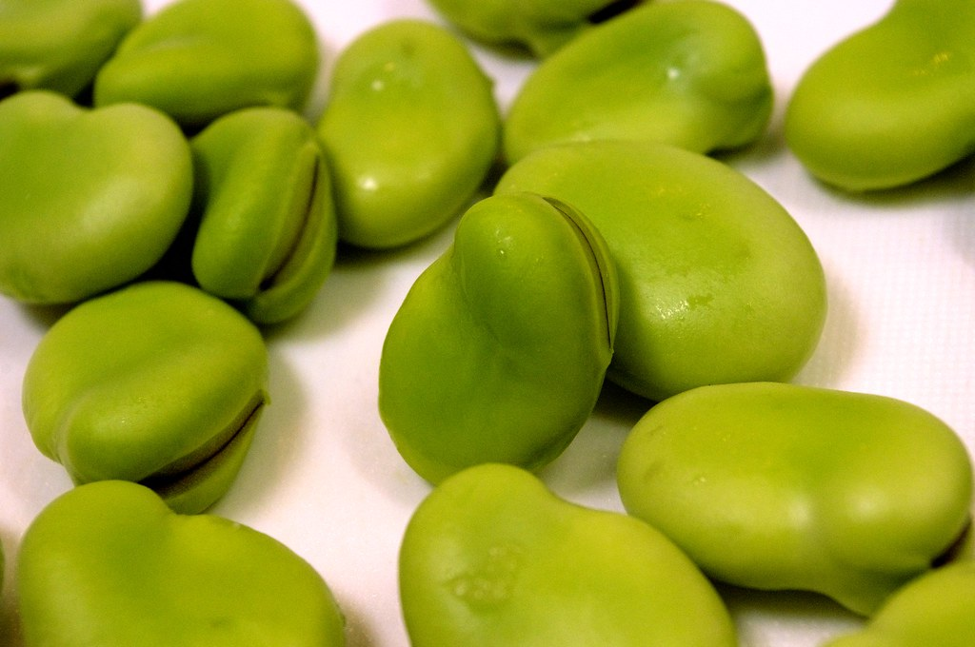
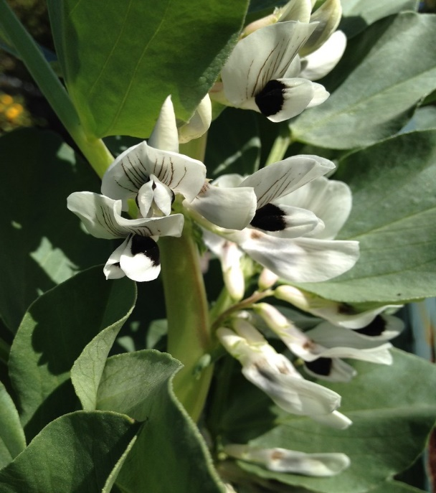
Science
Tuesday 6th July
L.O. To plant a broad bean seed and observe its growth.

Slide 2
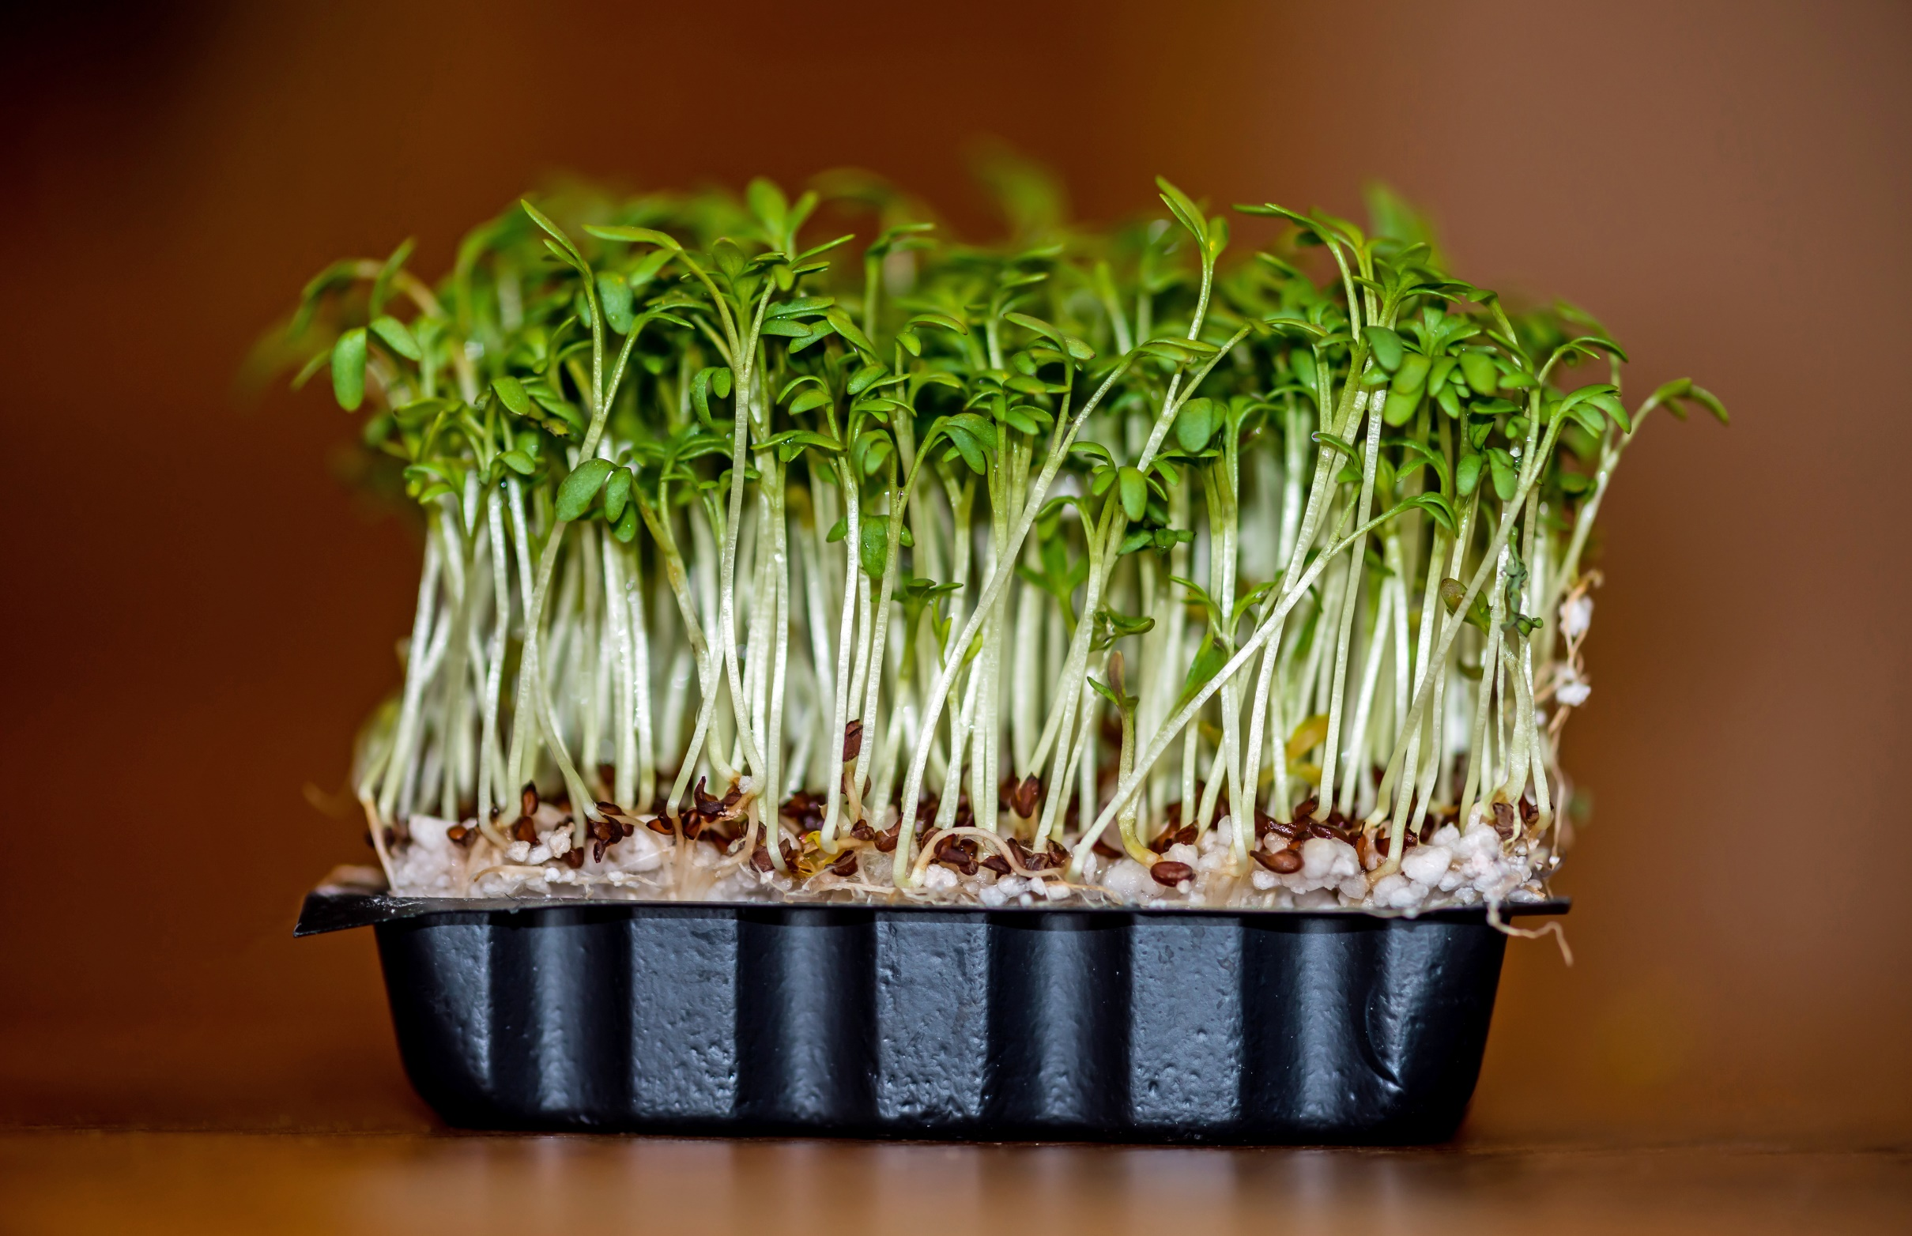
Think about our cress seed investigation.
What did the seeds need to begin growing?
light
water
warmth
air
nutrients

Slide 3
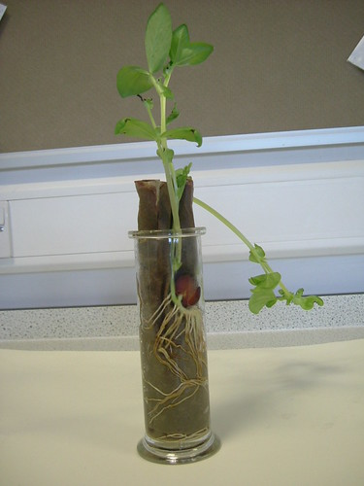
We will plant a broad bean seed into a clear cup so that we can observe how it grows.
First of all we will look at the stages in a flowering plant (broad bean) life cycle.

Slide 5


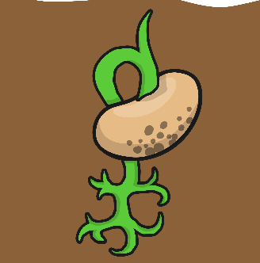

Germination
Seed Dispersal
1
Roots
5
Bean
Plant
2
4
3
Flowering
Leaves

Slide 6

1. Germination
The seed starts to grow when condition are suitable.
Back

Slide 7

2. Roots
Roots grow, usually underground.
Back

Slide 8
3. Leaves
A stem and leaves form, and the plant makes its own food (photosynthesis).
Back

Slide 9
4. Flowering
The pollen in the flowers is used to make seeds.
Back

Slide 10
5. Seed Dispersal
Seeds are spread out so they can grow where they are not fighting for space with the parent plant.
Back

Slide 11


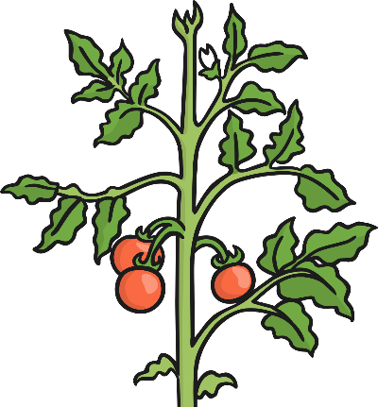
Other Flowering Plants
Sunflower
Orchid
Tomato plant

Slide 12
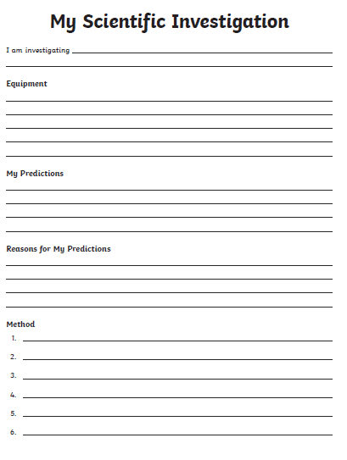
Our Task
Plant a broad bean seed in a clear cup.
Write up the first side of the investigation sheet.
Also draw the picture in the box on the other side.
Next week we will put in our results and reflection.

