Slide 1









Slide 2
LO: To create the necklace commissioned by Antipholus of Ephesus
Tuesday 6th July 2021

Slide 3

Let’s Read some more of the story
Read p. 38 to p.44
On the road, Antipholus of Sycaruse was summoned by a goldsmith who gave him a chain. Antipholus declared that the chain was not his, but the goldsmith insisted that it had been made on his special orders, and leaving the chain in his hand, he left.
Antipholus of Ephesus had ordered it for his wife Adriana… but it had been given to Antipholus of Sycaruse instead!

Slide 4
Your Task:
Think about the design that you made yesterday for the necklace.
You will be making your necklace using different materials and it will be put on display as part of our Comedy of Errors showcase.

Slide 5



Remember the colours you may wish to paint your pasta.
gold
silver
rose gold

Slide 6
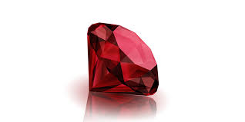
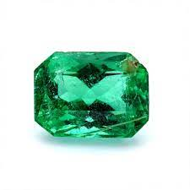

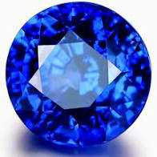
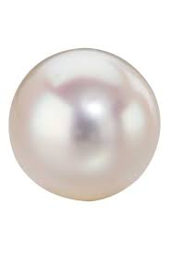
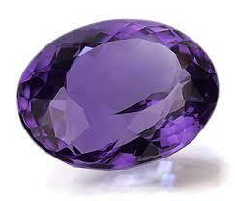
Don’t forget to think about attaching some gems.
ruby
emerald
diamond
sapphire
pearl
amythest

Slide 7
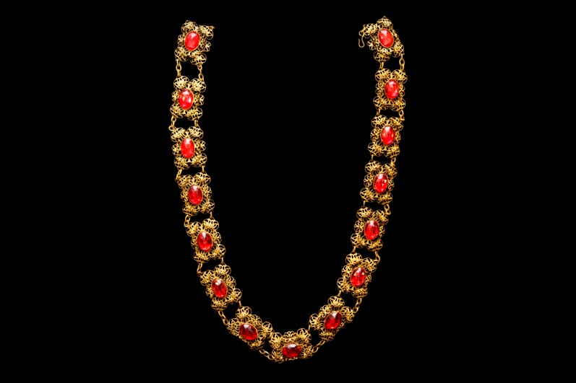
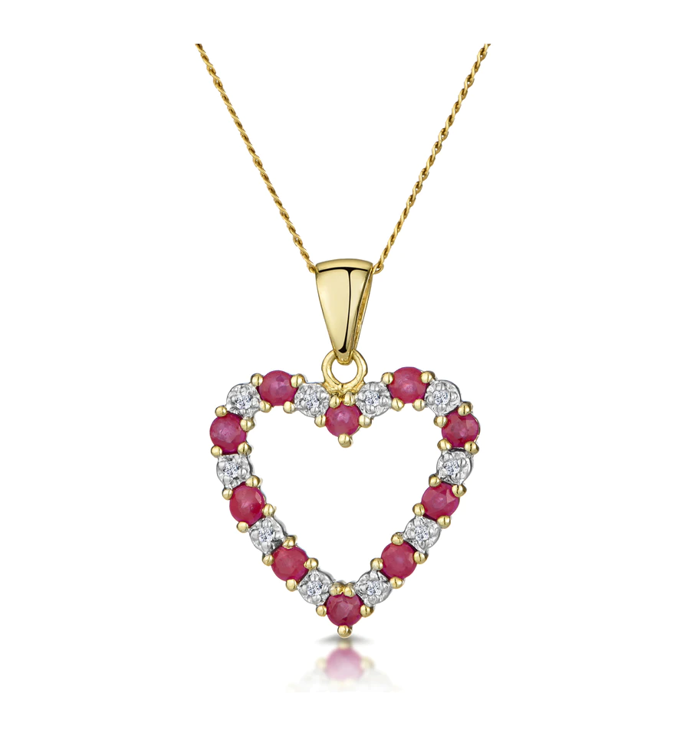
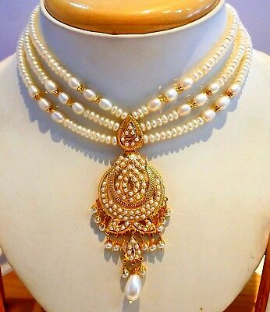
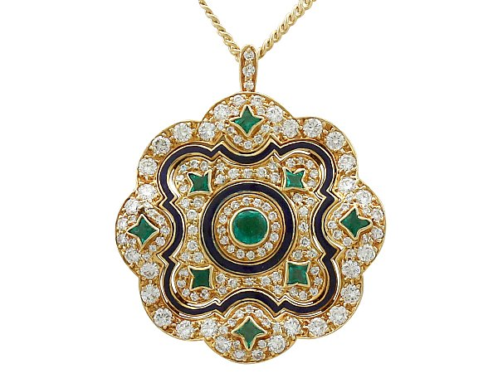
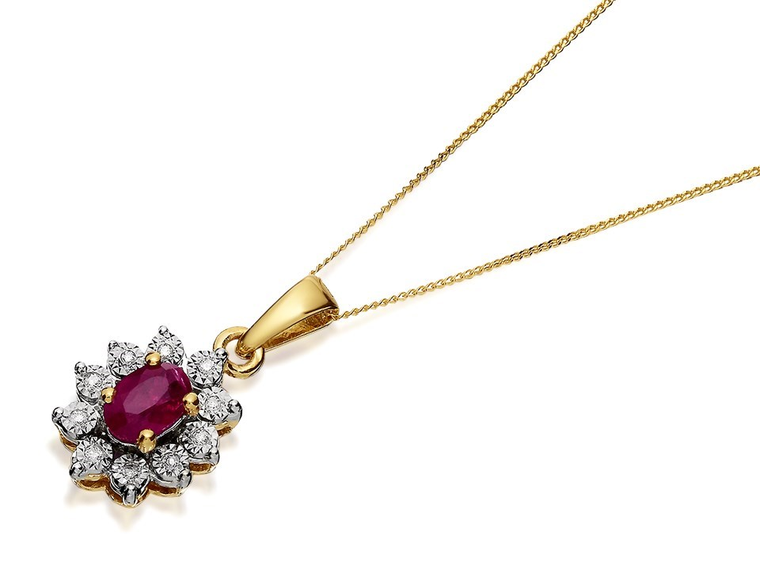
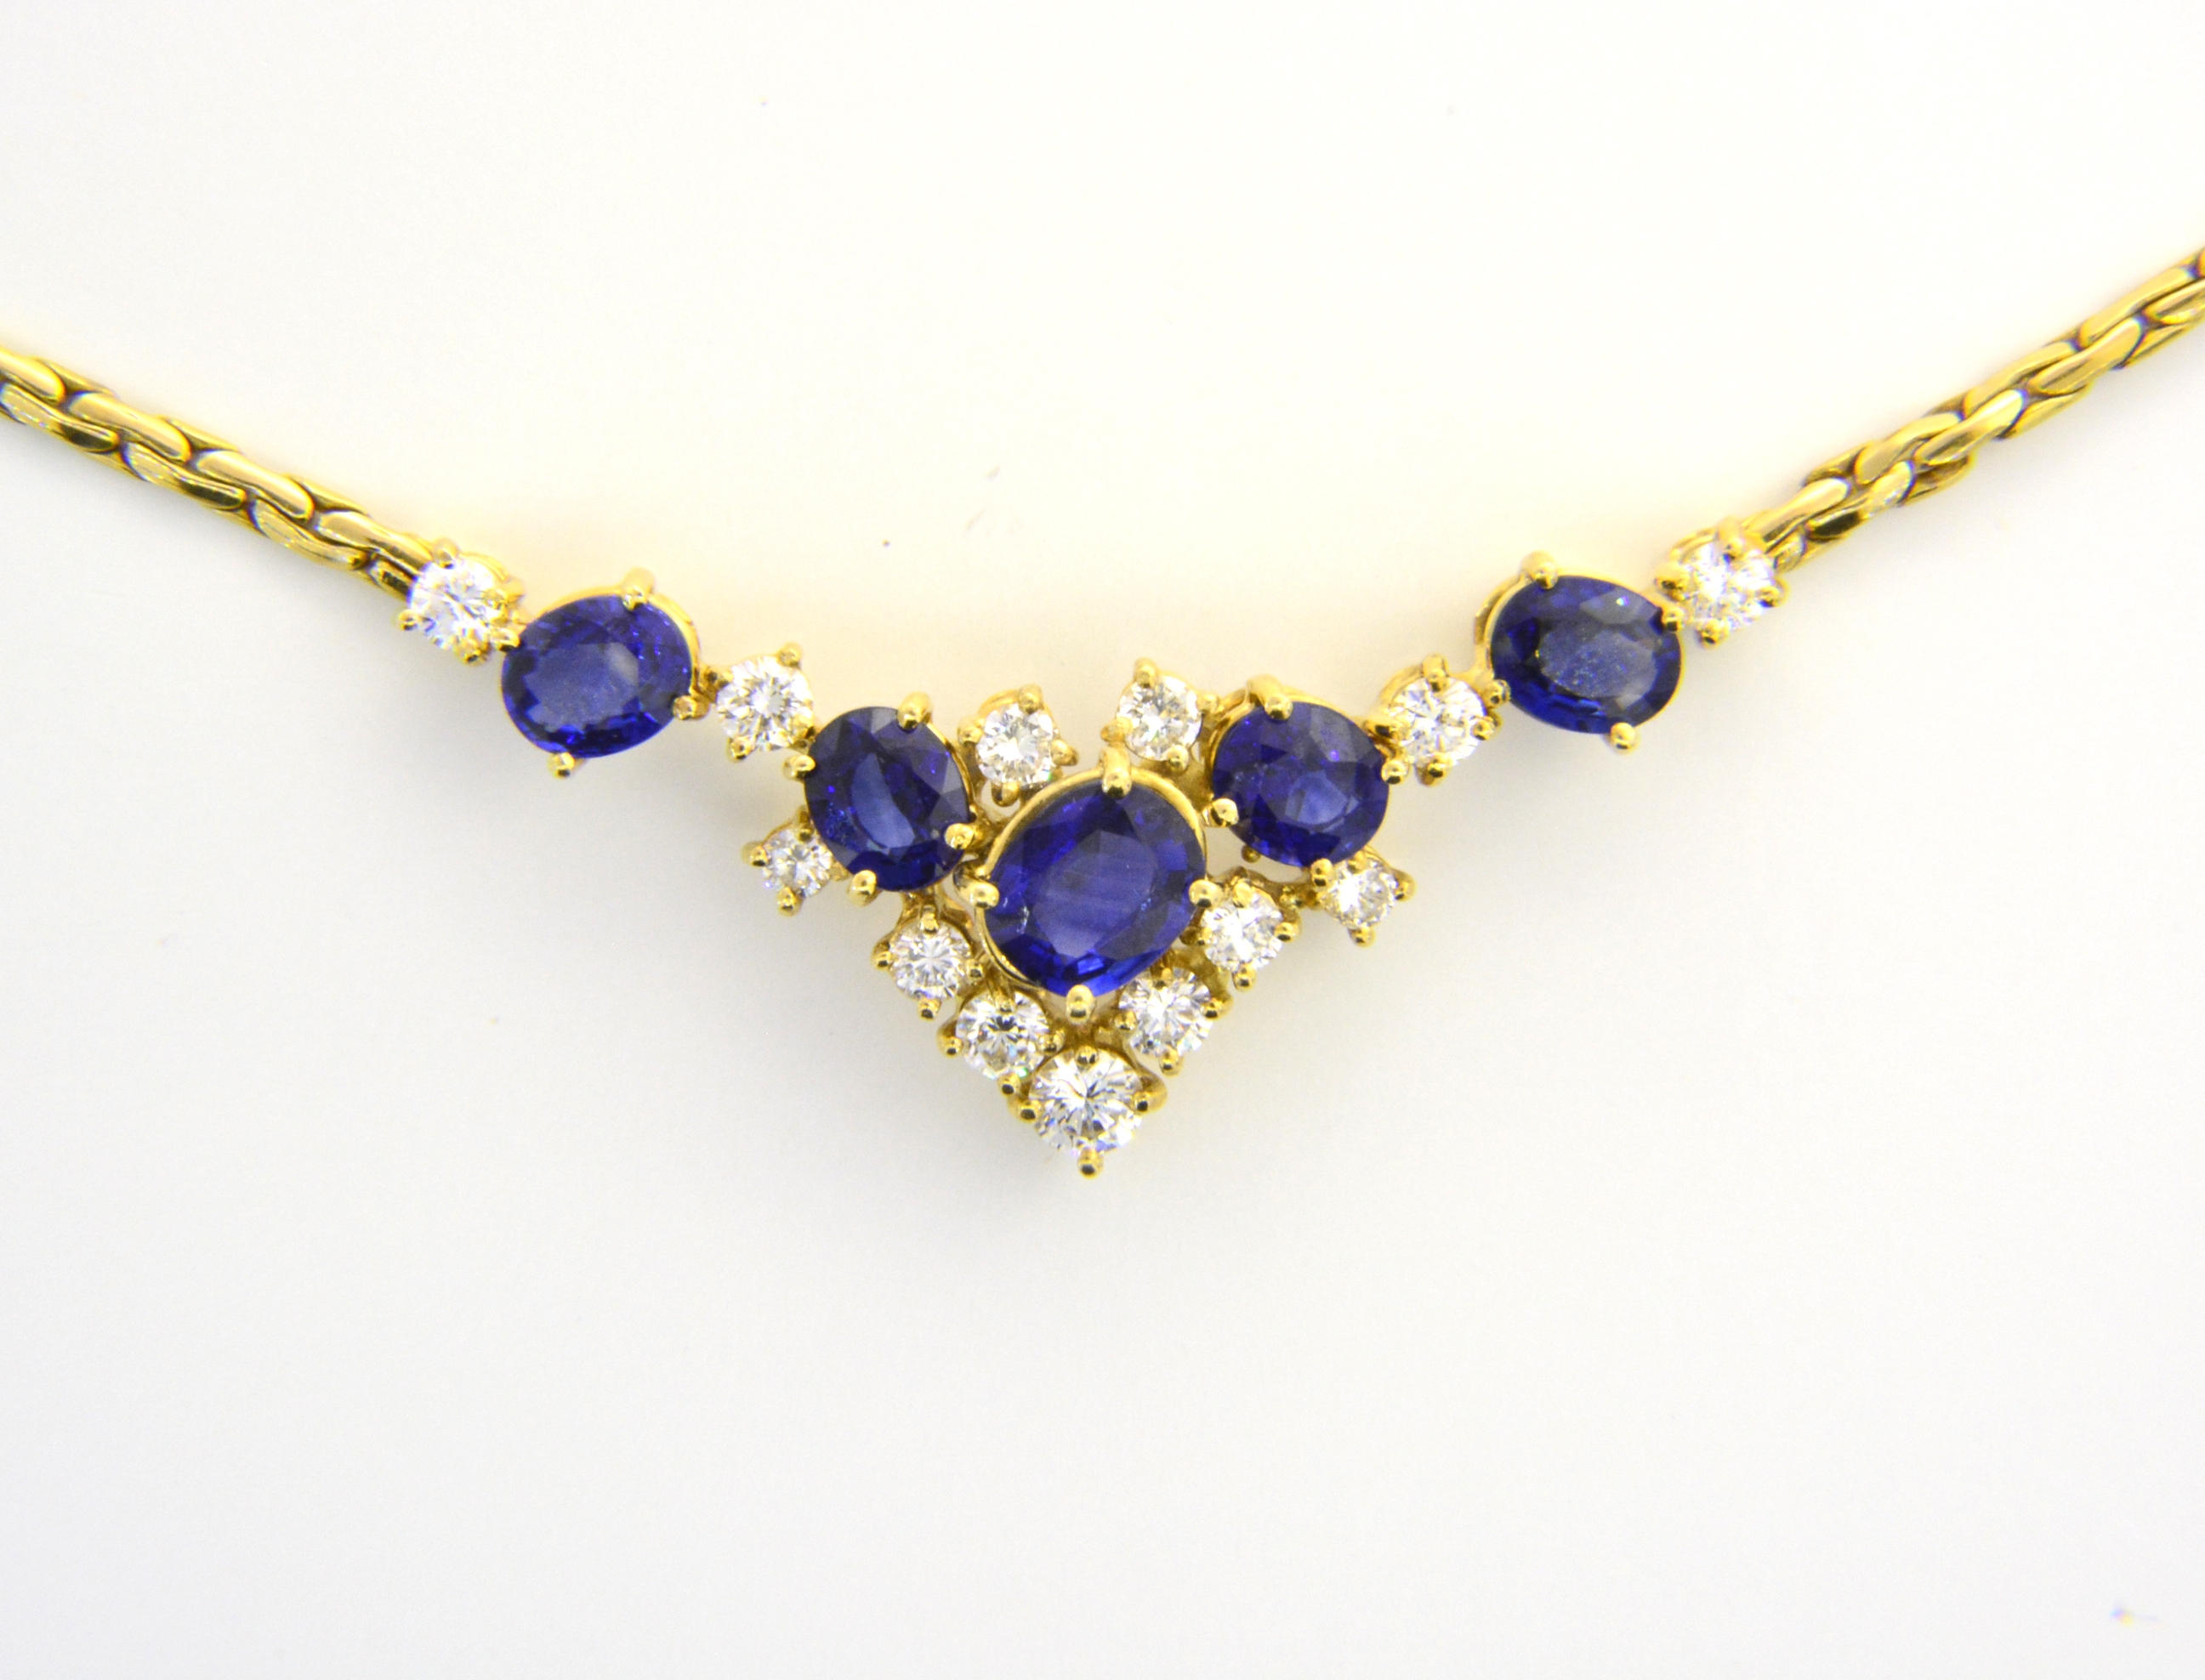
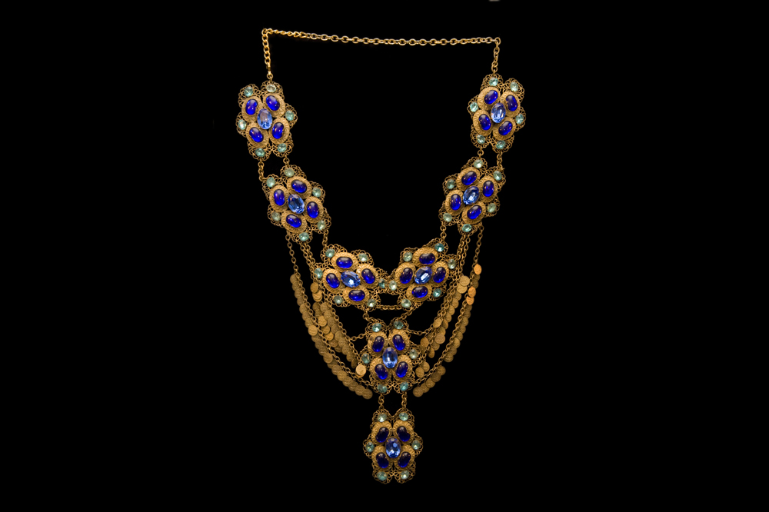
Here are some different styles of necklace

Slide 8
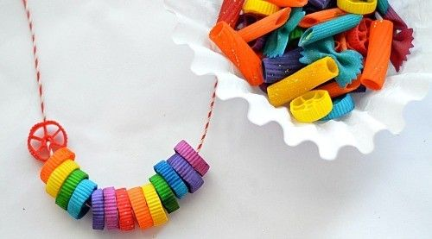
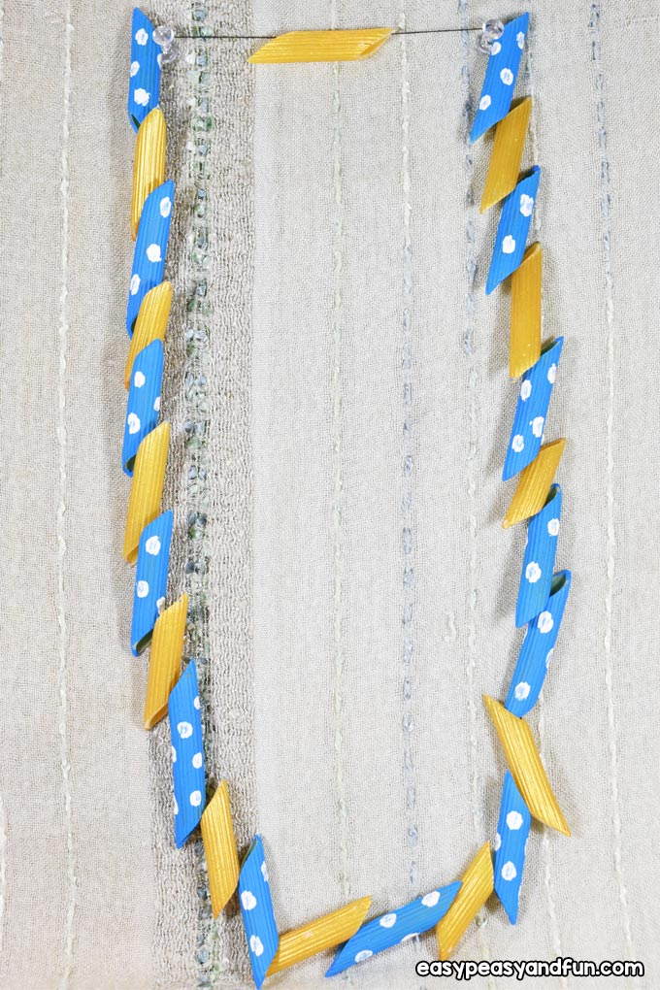
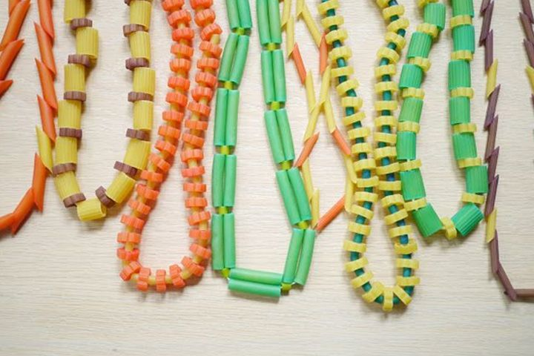
There’s so many ideas you can use to create your necklace! How can you make your pasta look extra special?

