Slide 1


Slide 3




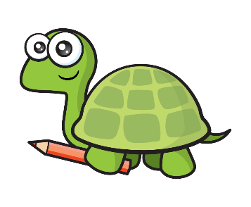

1) How many straws?
2) How many counters?
3) What is one less than 70?
4) Tiny has coloured in a ______

Slide 4
1) How many straws?
2) How many counters?
3) What is one less than 70?
4) Tiny has coloured in a ______
34
16
69
half

Slide 6



Partitioning numbers
Have a think
How many sweets?
75
10
10
10
10
10
10
10
There are 7 bags of 10 sweets.
There are 5 individual sweets.
There are 75 sweets altogether.

Slide 7

Partitioning numbers
Have a think
There are 4 full ten frames.
There are 3 extra counters.
There are 43 counters altogether.

Slide 8
Have a go at question 1 on the worksheet

Slide 9


Partitioning numbers
Have a think
There are 7 tens.
There are 6 ones.
There are 76 counters altogether.

Slide 10
Partitioning numbers
Have a think
76 has 7 tens and 6 ones.

Slide 11

Have a think
What is the same?
What is different?
49 has 4 tens and 9 ones.
94 has 9 tens and 4 ones.
These numbers have the same digits:
4 …. 9

Slide 12
Have a go at questions 2 and 3 on the worksheet

Slide 13

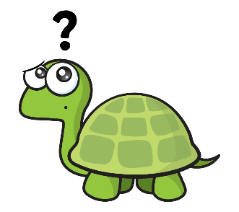
Have a think
Can you guess my number?
It is greater than 70.
It has seven tens and two ones.
It is greater than 50.
Is it….
72
78
52

Slide 14
Have a go at questions 4 and 5 on the worksheet

