Slide 1



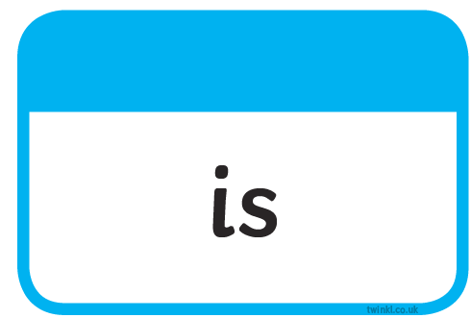





Slide 2
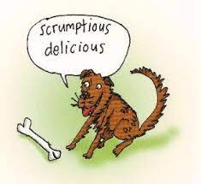
8.6.21 Our Set 3 phoneme for today is….tious
Can you read these?
ambitious cautious
in fec tious infectious
nut ri tious nutritious
ssuper sti tious superstitious

Slide 3
LO: To write about why the snail wishes to travel.
Tuesday 8th June 2021

Slide 4
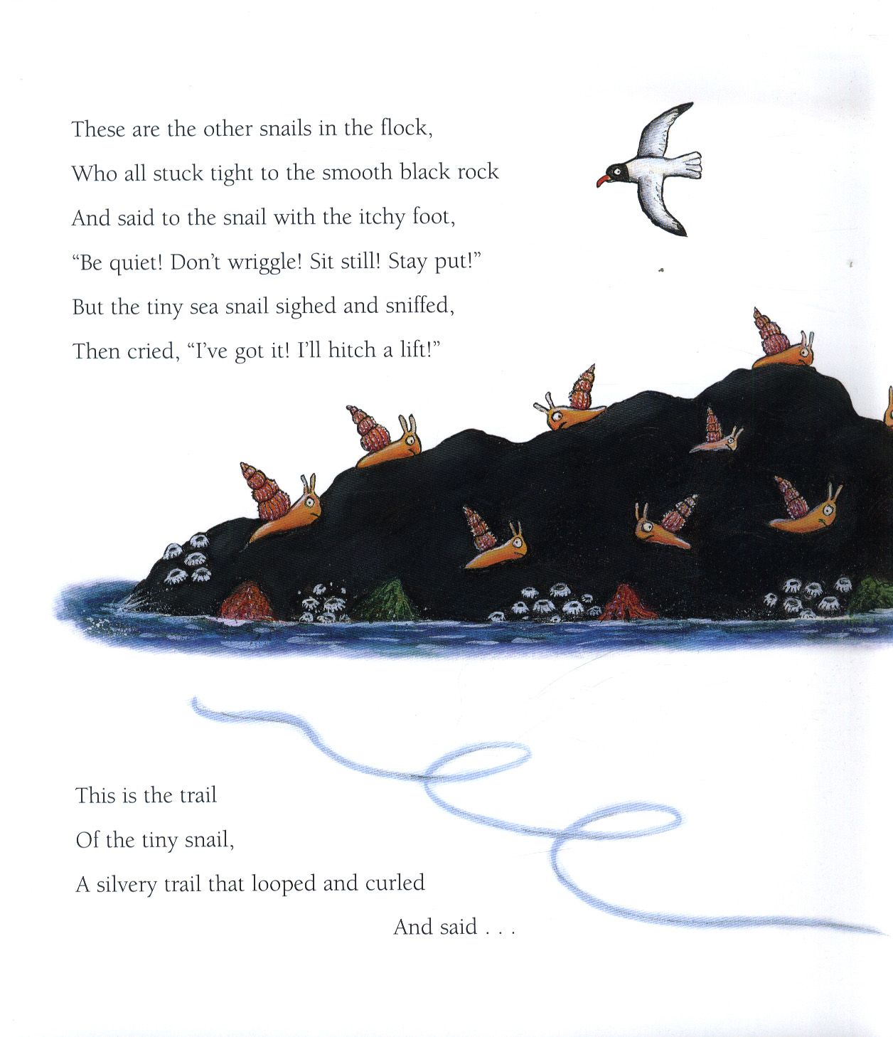
What do you think ‘the snail with the itchy foot means?’

Slide 5

Why do you think the snail would like to go on a trip?

Slide 6
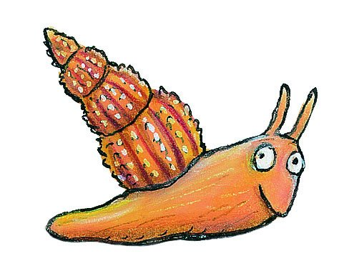
Discuss:
Where would you tell the snail to go for her first adventure?

Slide 7
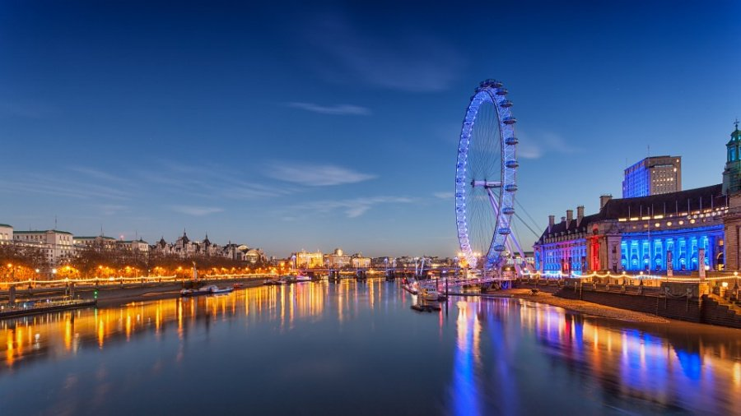

Look at this example
I would send the snail to see London and the River Thames.
The snail would love it because it is exciting to visit the huge London Eye and the shining lights of a big city.

Slide 8
Your Task:
Option 1 – To write simple sentences about where you would send the snail.
- Use the conjunctions ‘and’
Option 2 - To write compound sentences about where you would send the snail.
- Use the conjunctions ‘and’ and ‘because’
- Use adjectives (describing words) for effect

