Slide 1






Guidance for Video/Audio in PowerPoints
1. Open the folder and copy all the files.
2. Paste the copied files into a new folder.
3. Open the PowerPoint file, enable editing and enter presentation mode (start the slide show).
Please note the embedded audio may not be compatible with early versions of PowerPoint.
You may wish to delete this slide before beginning the presentation.

Slide 3

Teach
Today, we are learning to read words containing
-tion.

Slide 4
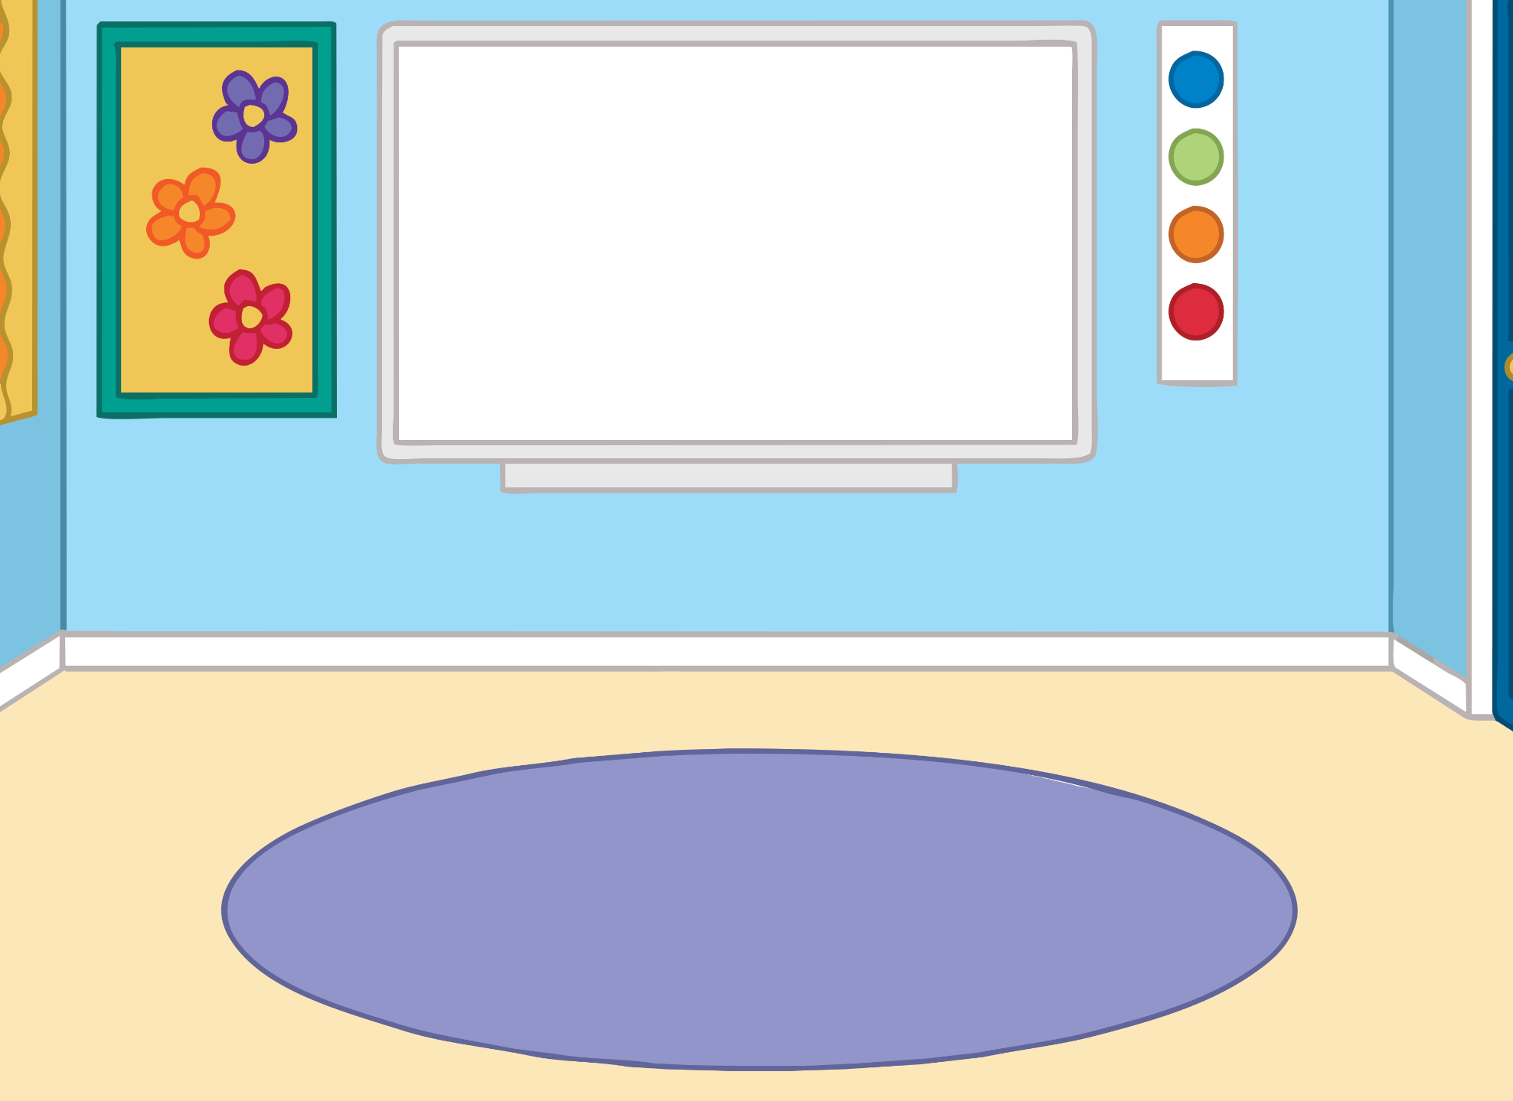









?
X
Teach
?
What was special about March in Kit and Sam’s school?
March was charity month at school and each class was visiting and raising awareness for their chosen charity. Year 1 chose to raise money for Fluff’s Rescue and Adoption Centre. Mr Phillips showed the class a slideshow about the centre. “Will we get to stroke the animals?” asked Sam.

Slide 5
?
X
Teach
?
Why do you think some of the animals might be nervous?
“I am sure there will be a chance to stroke some of the animals but some of them may be very nervous so we will have to follow the instructions very carefully,” answered Mr Phillips. The class buzzed with excitement as Mr Phillips reminded them to stay together, listen carefully and be polite whilst they were on the outing.

Slide 6



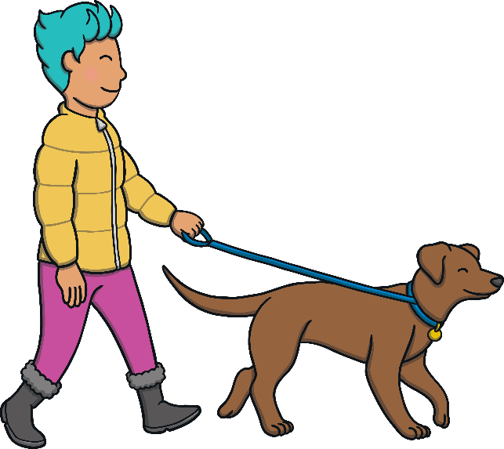
Teach
Mr Phillips had arranged for a coach to collect the class and take them straight to the rescue centre. The bus left the station and pulled into the car park. There were volunteers walking dogs and a woman waving to staff as she took her new cat home.

Slide 7








Teach
The class followed Mr Phillips into the centre. The reception had lots of notices and pictures of animals in their new homes on the walls and notice board.

Slide 8
Teach
When we see -tion in a word, it makes the sound /shun/.
Look at these words below:
attention
potion
section
mention

Slide 9

Teach
Kit and Sam can hear some dogs barking. Can you read the words containing -tion? Click on the dogs to reveal a word to read.

Slide 10








Teach
information
portion
fiction
question
station
direction
location
option

Slide 11


Reception Noticeboard
Practise
The class are in the reception room, looking at the notice board.
Can you match the words to the right notices?

Slide 12


Practise
information
caution
injection
questions
directions
adoption

Slide 13

Practise
information
caution
injection
questions
directions
adoption

Slide 14

Practise
information
caution
injection
questions
directions
adoption

Slide 15
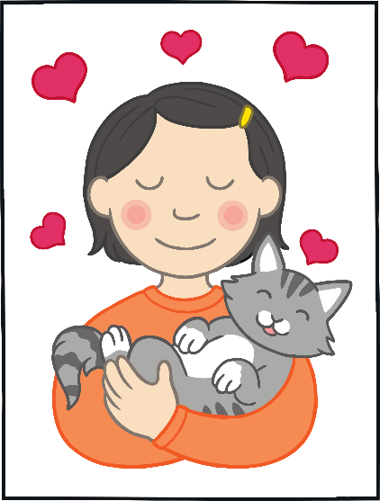
Practise
information
caution
injection
questions
directions
adoption

Slide 16

Practise
information
caution
injection
questions
directions
adoption

Slide 17
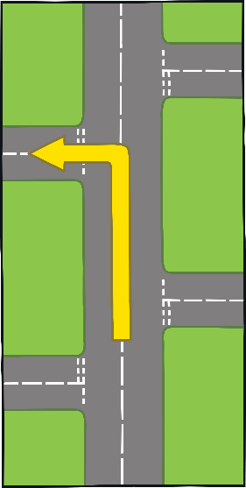
Practise
information
caution
injection
questions
directions
adoption

Slide 18








?
X
Apply
?
What is Mel’s job?
A lady from the rescue centre introduced herself. “Hi, everyone. My name is Mel and I am in charge of organising the adoption of our cats and dogs. While I check some things with Mr Phillips, take a look at our new webpage on the screen over there,” she said as she pointed to the screen.

Slide 19

Text Detectives
Apply
The centre’s webpage is showing on a large screen.
Can you read it and spot any words containing -tion?

Slide 20




Apply
Welcome to Fluff’s Rescue and Adoption Centre
Welcome to Fluff’s Rescue and Adoption Centre
We have descriptions
of all the animals and their needs, including their weight.
Competition!
Send us your suggestions for a name for our new puppy to win a prize.
Questions That
We Might Ask:
Is your family in a
position to take on a
new pet straight away?
Can you give an animal the attention that it deserves?
We have descriptions
of all the animals and their needs, including their weight.
Competition!
Send us your suggestions for a name for our new puppy to win a prize.
Questions That
We Might Ask:
Is your family in a
position to take on a
new pet straight away?
Can you give an animal the attention that it deserves?
Check

Slide 21

Apply
“OK, we are all ready for you,” said Mel. “Would you like to follow me to the kennels first? Some of the dogs will get excited and bark but don’t worry – they are just saying hello.” The class lined up and followed Mel straight through the door.

Slide 22


Today, we have learnt to spell words containing
-tion
The adventure continues next lesson!

