Slide 1
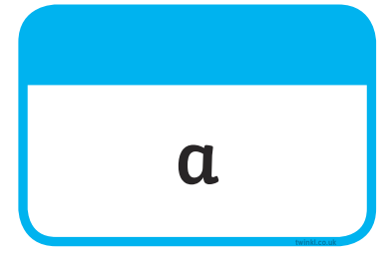





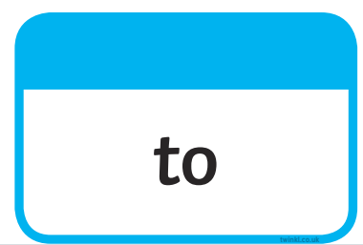
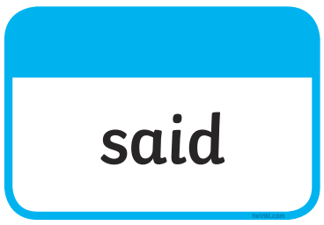
Tricky Words

Slide 2
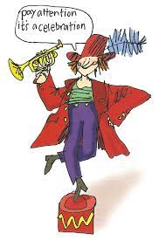
7.6.21 Our Set 3 phoneme for today is….tion
Can you read these?
mention condition
celebration
attention
caution
tradition
adoption
addition

Slide 3
LO:To create a freeze frame depicting characters.
Monday 7th June 2021

Slide 4
What is a freeze frame?
How might you demonstrate these creatures in a scene?
Think about their size, movements, speed, actions and what they might say.
As part of this drama activity, you will be asked to ‘freeze’ for a photo and show the characteristics of this creature for a photo.
You will be asked to move when I say ‘action’…how will you show me how your creature moves?

Slide 5

This will be our book!

Slide 6
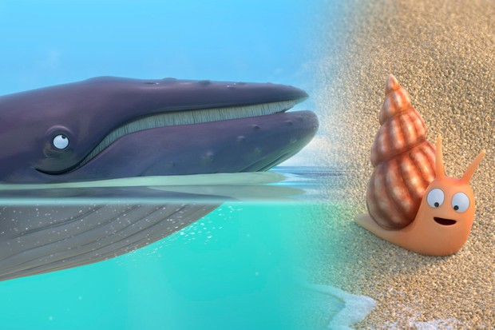
Pick a creature…show me how you might show them as a freeze frame and as a moving element.

Slide 7
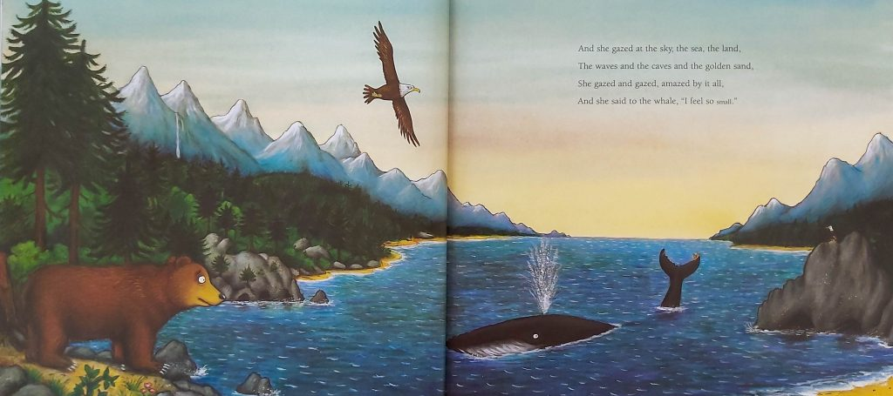
Pick a creature…show me how you might show them as a freeze frame and as a moving element.

Slide 8
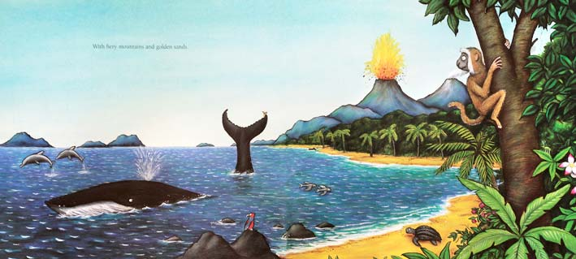
Pick a creature…show me how you might show them as a freeze frame and as a moving element.

Slide 9
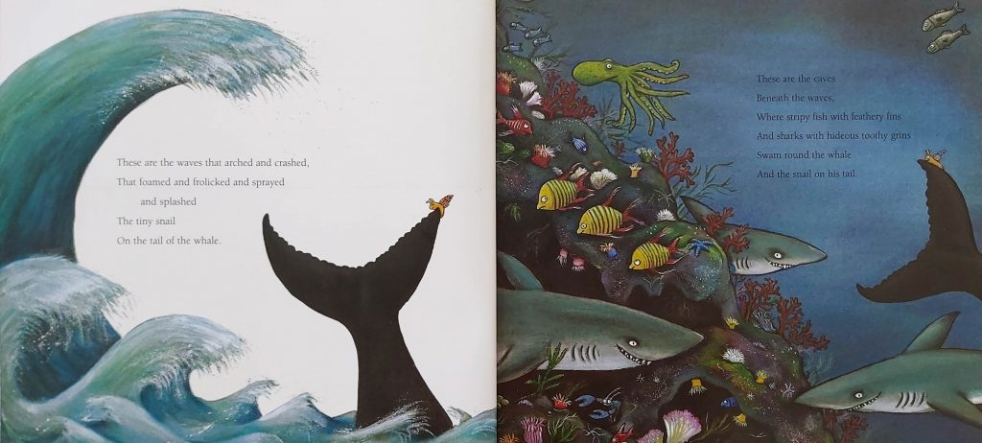
Pick a creature…show me how you might show them as a freeze frame and as a moving element.

Slide 10
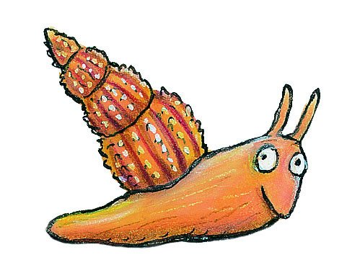
Discuss:
What was the difference between ‘freezing’ or creating an ‘action’ scene for your creatures?
Which was easier? Why?

