Slide 1
Monday 7th June
PSHE
L.O. How do different expressions show how characters are feeling?

Slide 2



What do we mean by an expression (on our face)?
An expression is how our face can look to show different emotions or feelings.
Can you name some different emotions or feelings?
Can you show different expressions to show different emotions?

Slide 3
We are going to look at the expressions of the flock of sea snails in our book ‘The Snail and the Whale’.
What do their expressions tell us about how they are feeling?
We can read this page of the book again.
What might the different snails be saying?
Which snail is looking happy and excited? Do you know why?

Slide 4
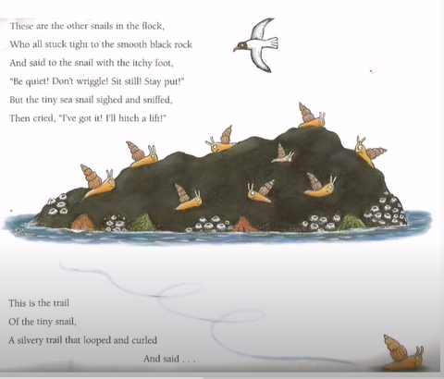

Slide 5




Task: PSHE Monday 7th June.
L.O. To write a speech bubble to match the different expressions the snails show.

