Slide 1


Slide 3
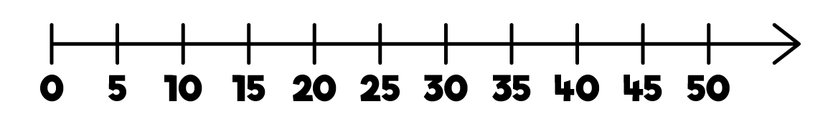


1) How do you spell 8?
2) What number is missing?
3) What number is missing?
4) Are these equal or unequal?

Slide 4
1) How do you spell 8?
2) What number is missing?
3) What number is missing?
4) Are these equal or unequal?
eight
40
14

Slide 6



Make equal groups - sharing
2
How many horses?
How many carrots?
10
10 carrots shared equally between
2 horses is
5

Slide 7

Make equal groups - sharing
How many apples?
3
9
How many horses?
9 apples shared equally between
3 horses is
3

Slide 8
Have a go at questions 1 and 2 on the worksheet

Slide 9




How many fish?
8
Have a think
Share the fish equally between 2 bowls.
How many fish will go in each bowl?
4

Slide 10



How many sweets?
15
Have a think
Share the sweets into 3 bags.
This array has
3 rows!
5
5
?
5
?
?
5
Each bag gets sweets.

Slide 11


Have a think
20
Share the sweets between 4 friends.
?
Each friend gets sweets.
5

Slide 12
Have a think
20
Share the sweets between 5 friends.
?
Each friend gets sweets.
4

Slide 13
Have a think
20
Share the sweets between 2 friends.
?
Each friend gets sweets.
10

Slide 14
Have a go at questions 3 and 4 on the worksheet

