Slide 2
Wednesday 5th May 2021
LO: To sort statements about two stories. ***
The Last Wolf
Little Red Riding Hood
Both

Slide 3
The wolf is bad.
Grandma is eaten.
Little Red plants trees.
The wolf wears glasses.
There is a wolf in the story .
Little Red goes for a walk in the wood.
Little red is a good person.
Little Red goes hunting.
The wolf is bad.
Grandma is eaten.
Little Red plants trees.
The wolf wears glasses.
There is a wolf in the story .
Little Red goes for a walk in the wood.
Little red is a good person.
Little Red goes hunting.
Grandma is eaten.
The wolf is bad.
Little Red plants trees.
The wolf wears glasses.
Little Red goes for a walk in the wood.
There is a wolf in the story .
Little red is a good person.
Little Red goes hunting.

Slide 4
Wednesday 5th May 2021
LO: To sort statements about two stories. **
The Last Wolf
Little Red Riding Hood
Both

Slide 5
The wolf is bad.
Grandma is eaten.
Little Red plants trees.
There is a wolf in the story .
Little Red goes hunting.
Little red is a good person.
The wolf is bad.
Grandma is eaten.
Little Red plants trees.
There is a wolf in the story .
Little Red goes hunting.
Little red is a good person.
The wolf is bad.
Grandma is eaten.
Little Red plants trees.
There is a wolf in the story .
Little Red goes hunting.
Little red is a good person.

Slide 6
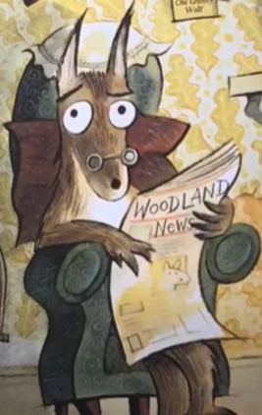
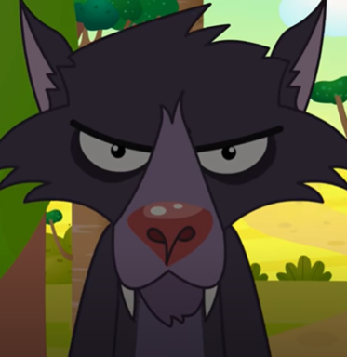
Wednesday 5th May 2021
LO: To sort statements about two characters. *
The Last Wolf
Little Red Riding Hood
Both

Slide 7
The wolf is bad.
The wolf is good.
The wolf can speak.
The wolf wears Grandma’s clothes.
The wolf eats people.
The wolf is bad.
The wolf is good.
The wolf can speak.
The wolf wears Grandma’s clothes.
The wolf eats people.
The wolf is bad.
The wolf is good.
The wolf can speak.
The wolf wears Grandma’s clothes.
The wolf eats people.

