Slide 1



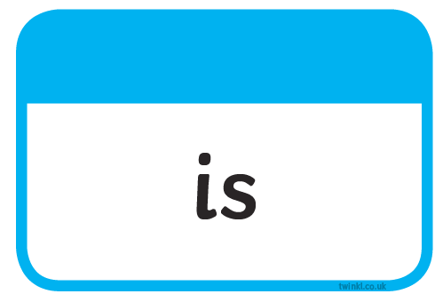


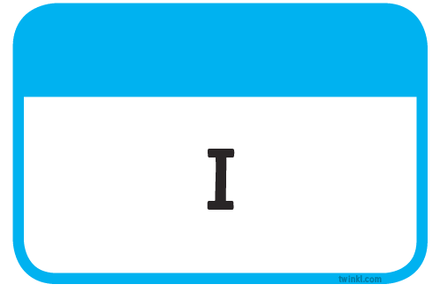


Slide 2
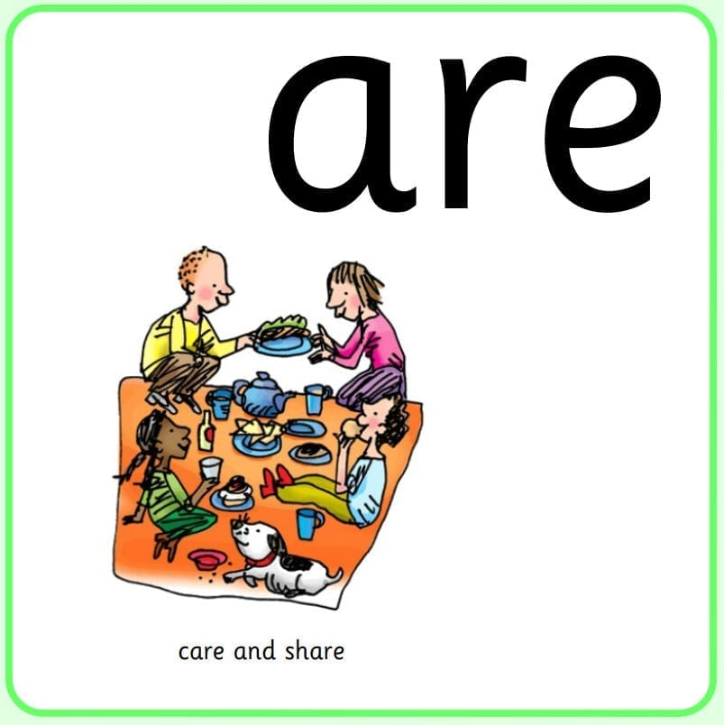
Our Set 3 phoneme for today is….are
square flare
care
share
spare
scare

Slide 3
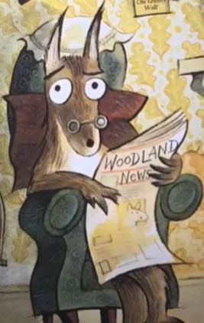
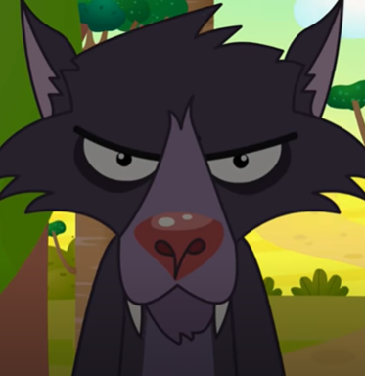
LO: To compare two stories based on the same theme
Wednesday 5th May 2021

Slide 4
Yesterday we read the story of Little Red Riding Hood. It’s a story we all know and love.
Sometimes authors write a story that is based on a well known story, which allows us to compare the two tales and think about things in a different way.
Let’s watch the story of The Last Wolf.
The Last Wolf Youtube Clip

Slide 5
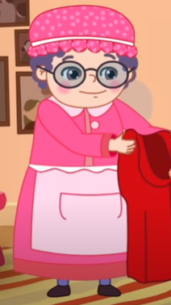
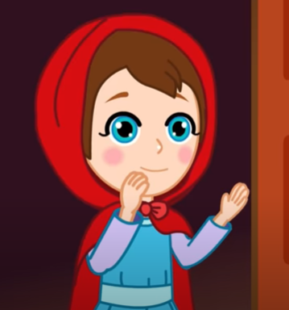
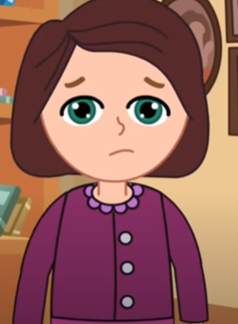

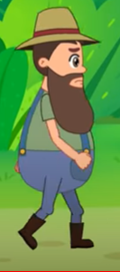
Now we have heard both stories, we need to think about some important things.
Who are the main characters in Little Red Riding Hood?
Wolf
Little Red Riding Hood
Mum
Huntsman
Grandma

Slide 6
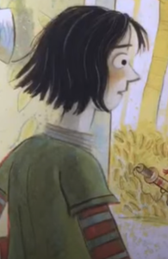
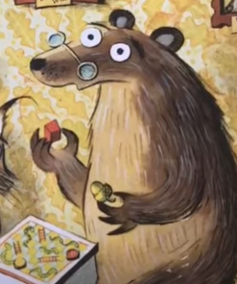

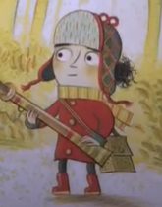
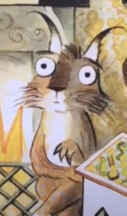
Now let’s think about the story of The Last Wolf.
Who are the main characters in The Last Wolf?
Little Red Riding Hood
The Last Wolf
Mum
The Last Bear
The Last lynx

Slide 7
I want you to think about these statements and think if they match Little Red Riding Hood, The Last Wolf OR both stories.
The Last Wolf
Little Red Riding Hood
Both
There is a wolf in the story .

Slide 8
I want you to think about these statements and think if they match Little Red Riding Hood, The Last Wolf OR both stories.
The Last Wolf
Little Red Riding Hood
Both
There is a wolf in the story .

Slide 9
I want you to think about these statements and think if they match Little Red Riding Hood, The Last Wolf OR both stories.
The Last Wolf
Little Red Riding Hood
Grandma is eaten.
Both
There is a wolf in the story .

Slide 10
I want you to think about these statements and think if they match Little Red Riding Hood, The Last Wolf OR both stories.
The Last Wolf
Little Red Riding Hood
Both
Grandma is eaten.
There is a wolf in the story .

Slide 11
I want you to think about these statements and think if they match Little Red Riding Hood, The Last Wolf OR both stories.
The Last Wolf
Little Red Riding Hood
Both
Little Red has a red cape.
Grandma is eaten.
There is a wolf in the story .

Slide 12
I want you to think about these statements and think if they match Little Red Riding Hood, The Last Wolf OR both stories.
The Last Wolf
Little Red Riding Hood
Both
Grandma is eaten.
There is a wolf in the story .
Little Red has a red cape.

Slide 13
I want you to think about these statements and think if they match Little Red Riding Hood, The Last Wolf OR both stories.
The Last Wolf
Little Red Riding Hood
Both
Little Red goes hunting.
Grandma is eaten.
There is a wolf in the story .
Little Red has a red cape.

Slide 14
I want you to think about these statements and think if they match Little Red Riding Hood, The Last Wolf OR both stories.
The Last Wolf
Little Red Riding Hood
Both
Little Red goes hunting.
Grandma is eaten.
There is a wolf in the story .
Little Red has a red cape.

Slide 15
I want you to think about these statements and think if they match Little Red Riding Hood, The Last Wolf OR both stories.
The Last Wolf
Little Red Riding Hood
Both
The wolf is a goodie.
Little Red goes hunting.
Grandma is eaten.
There is a wolf in the story .
Little Red has a red cape.

Slide 16
I want you to think about these statements and think if they match Little Red Riding Hood, The Last Wolf OR both stories.
The Last Wolf
Little Red Riding Hood
Both
Little Red goes hunting.
Grandma is eaten.
There is a wolf in the story .
Little Red has a red cape.
The wolf is a goodie.

Slide 17
Your Task
Your task is to sort the statements into the venn diagram.
Think carefully. Some might be about Little Red Riding Hood, some might be about The Last Wolf and some might be true about BOTH stories.
If it is true about both stories it goes in the middle section!

Slide 18
Can you think of a statement that could go in the venn?
Think about the statements you sorted.
Talk with the person sat next to you, can you come up with a statement that could fit in the Venn diagram.
Which section would it go in?

