Slide 1
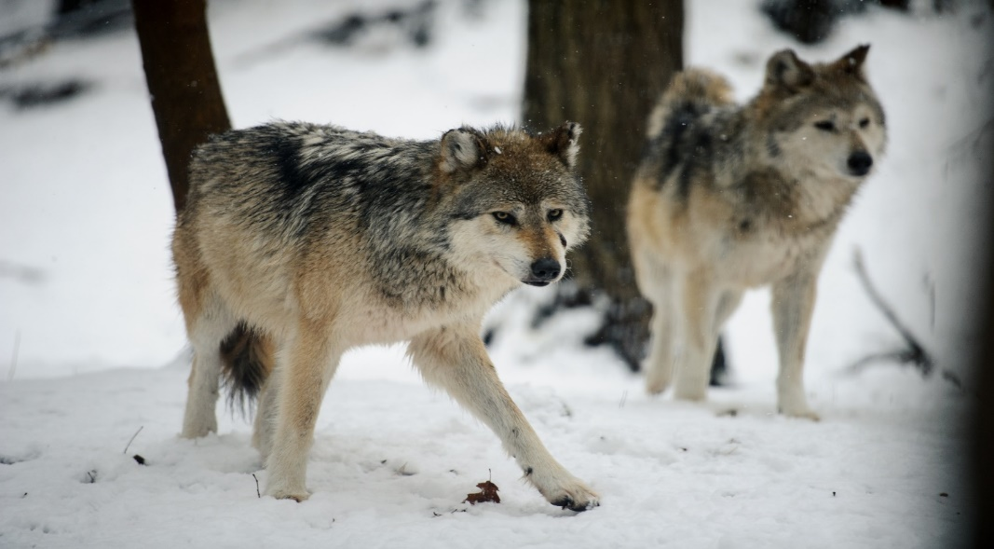
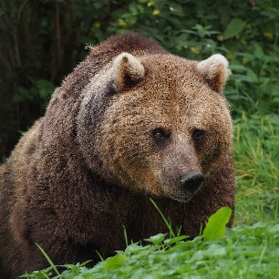
Thursday 6th May
L.O. To find out facts about wild animals that used to roam in the UK.

Slide 2
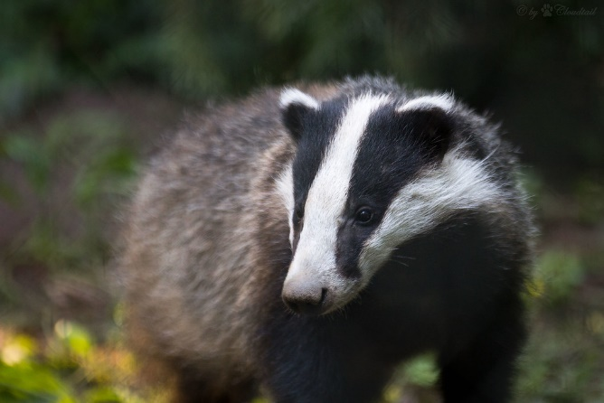
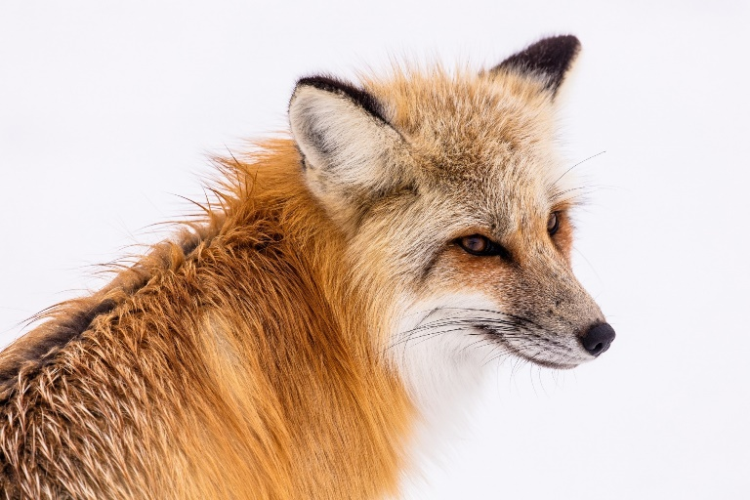
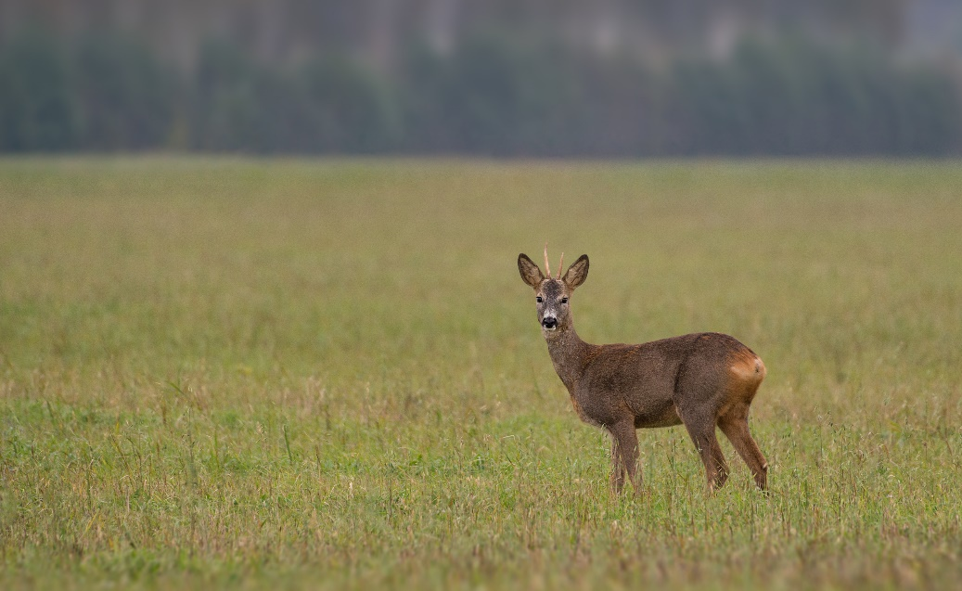
What is a wild animal?
How is it different from a pet animal?
Can you name any wild animals that we would find living in the UK today?

Slide 3
Hundreds of years ago, there were other wild animals that lived in the UK.
We will watch the video clip and find out what they were.
https://www.youtube.com/watch?v=HjxFfUNlD-M

Slide 4
Some of the animals in the video still live in wild in woodlands today.
These are:
Badgers, Dormice, Wood mice, Tawny owls
Other animals no longer used to live wild in the woods, but no longer do.
These are:
Wild boar, Lynx, Wolves, Brown bears.
Let’s find out a bit more about them.

Slide 5
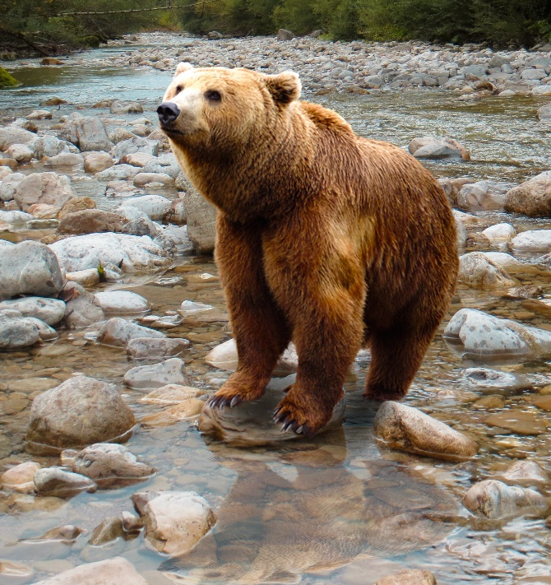
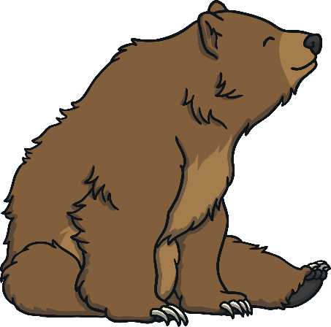
The Brown Bear
This species of bear eats mainly mushrooms,
roots and fish.
The entire alpine population of brown bears is about 50 individuals, most of them live in the Brenta nature park in Italy.
Ten Slovenian brown bears were reintroduced
to the northern Italian regions in 1998 and in the following years, some bears have wandered to South Tyrol, the Swiss Eastern Alps, Bavaria
and the Central Alps.

Slide 6
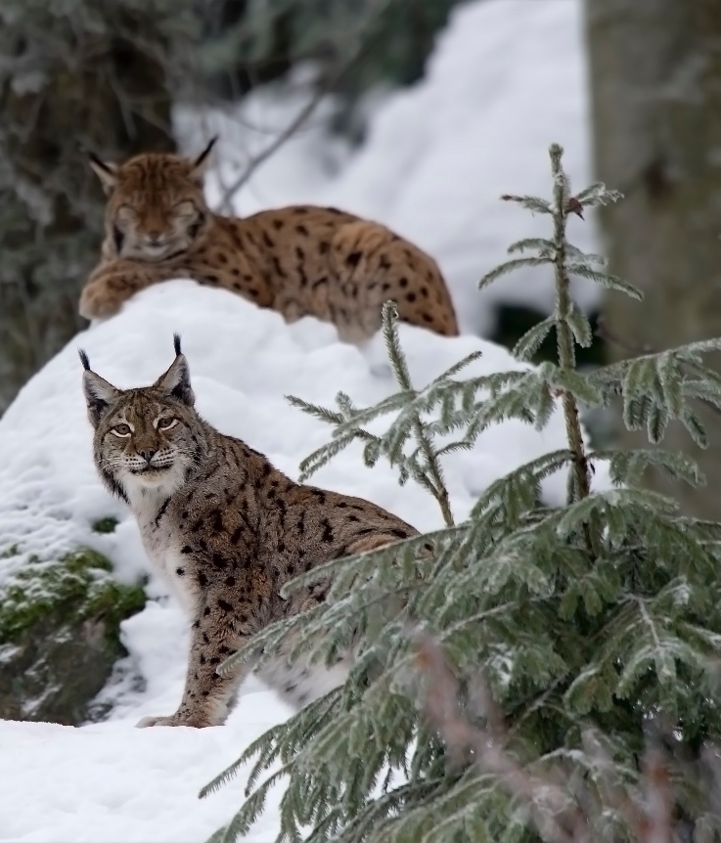
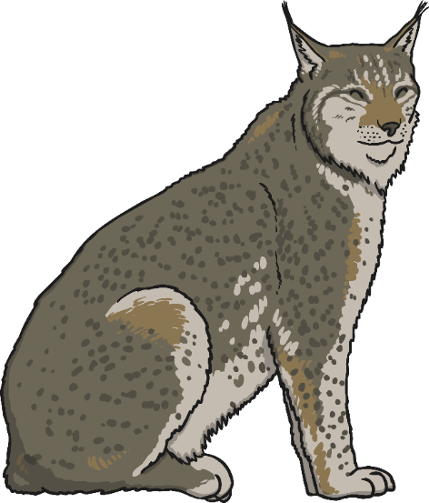
The European Lynx
A century ago, the lynx became extinct in many Central and Western European countries, but many reintroduction projects have been successful.
The colour of the coat of the European lynx
is very variable: it goes from a uniform dark
grey to a reddish brown, with evident spots.
The hind legs are longer than the front ones, making it easier for the lynxes to make big,
fast leaps.
They have been observed to mew, hiss,
growl, and purr, and, like domestic cats,
will chatter at prey that is out of reach.

Slide 7
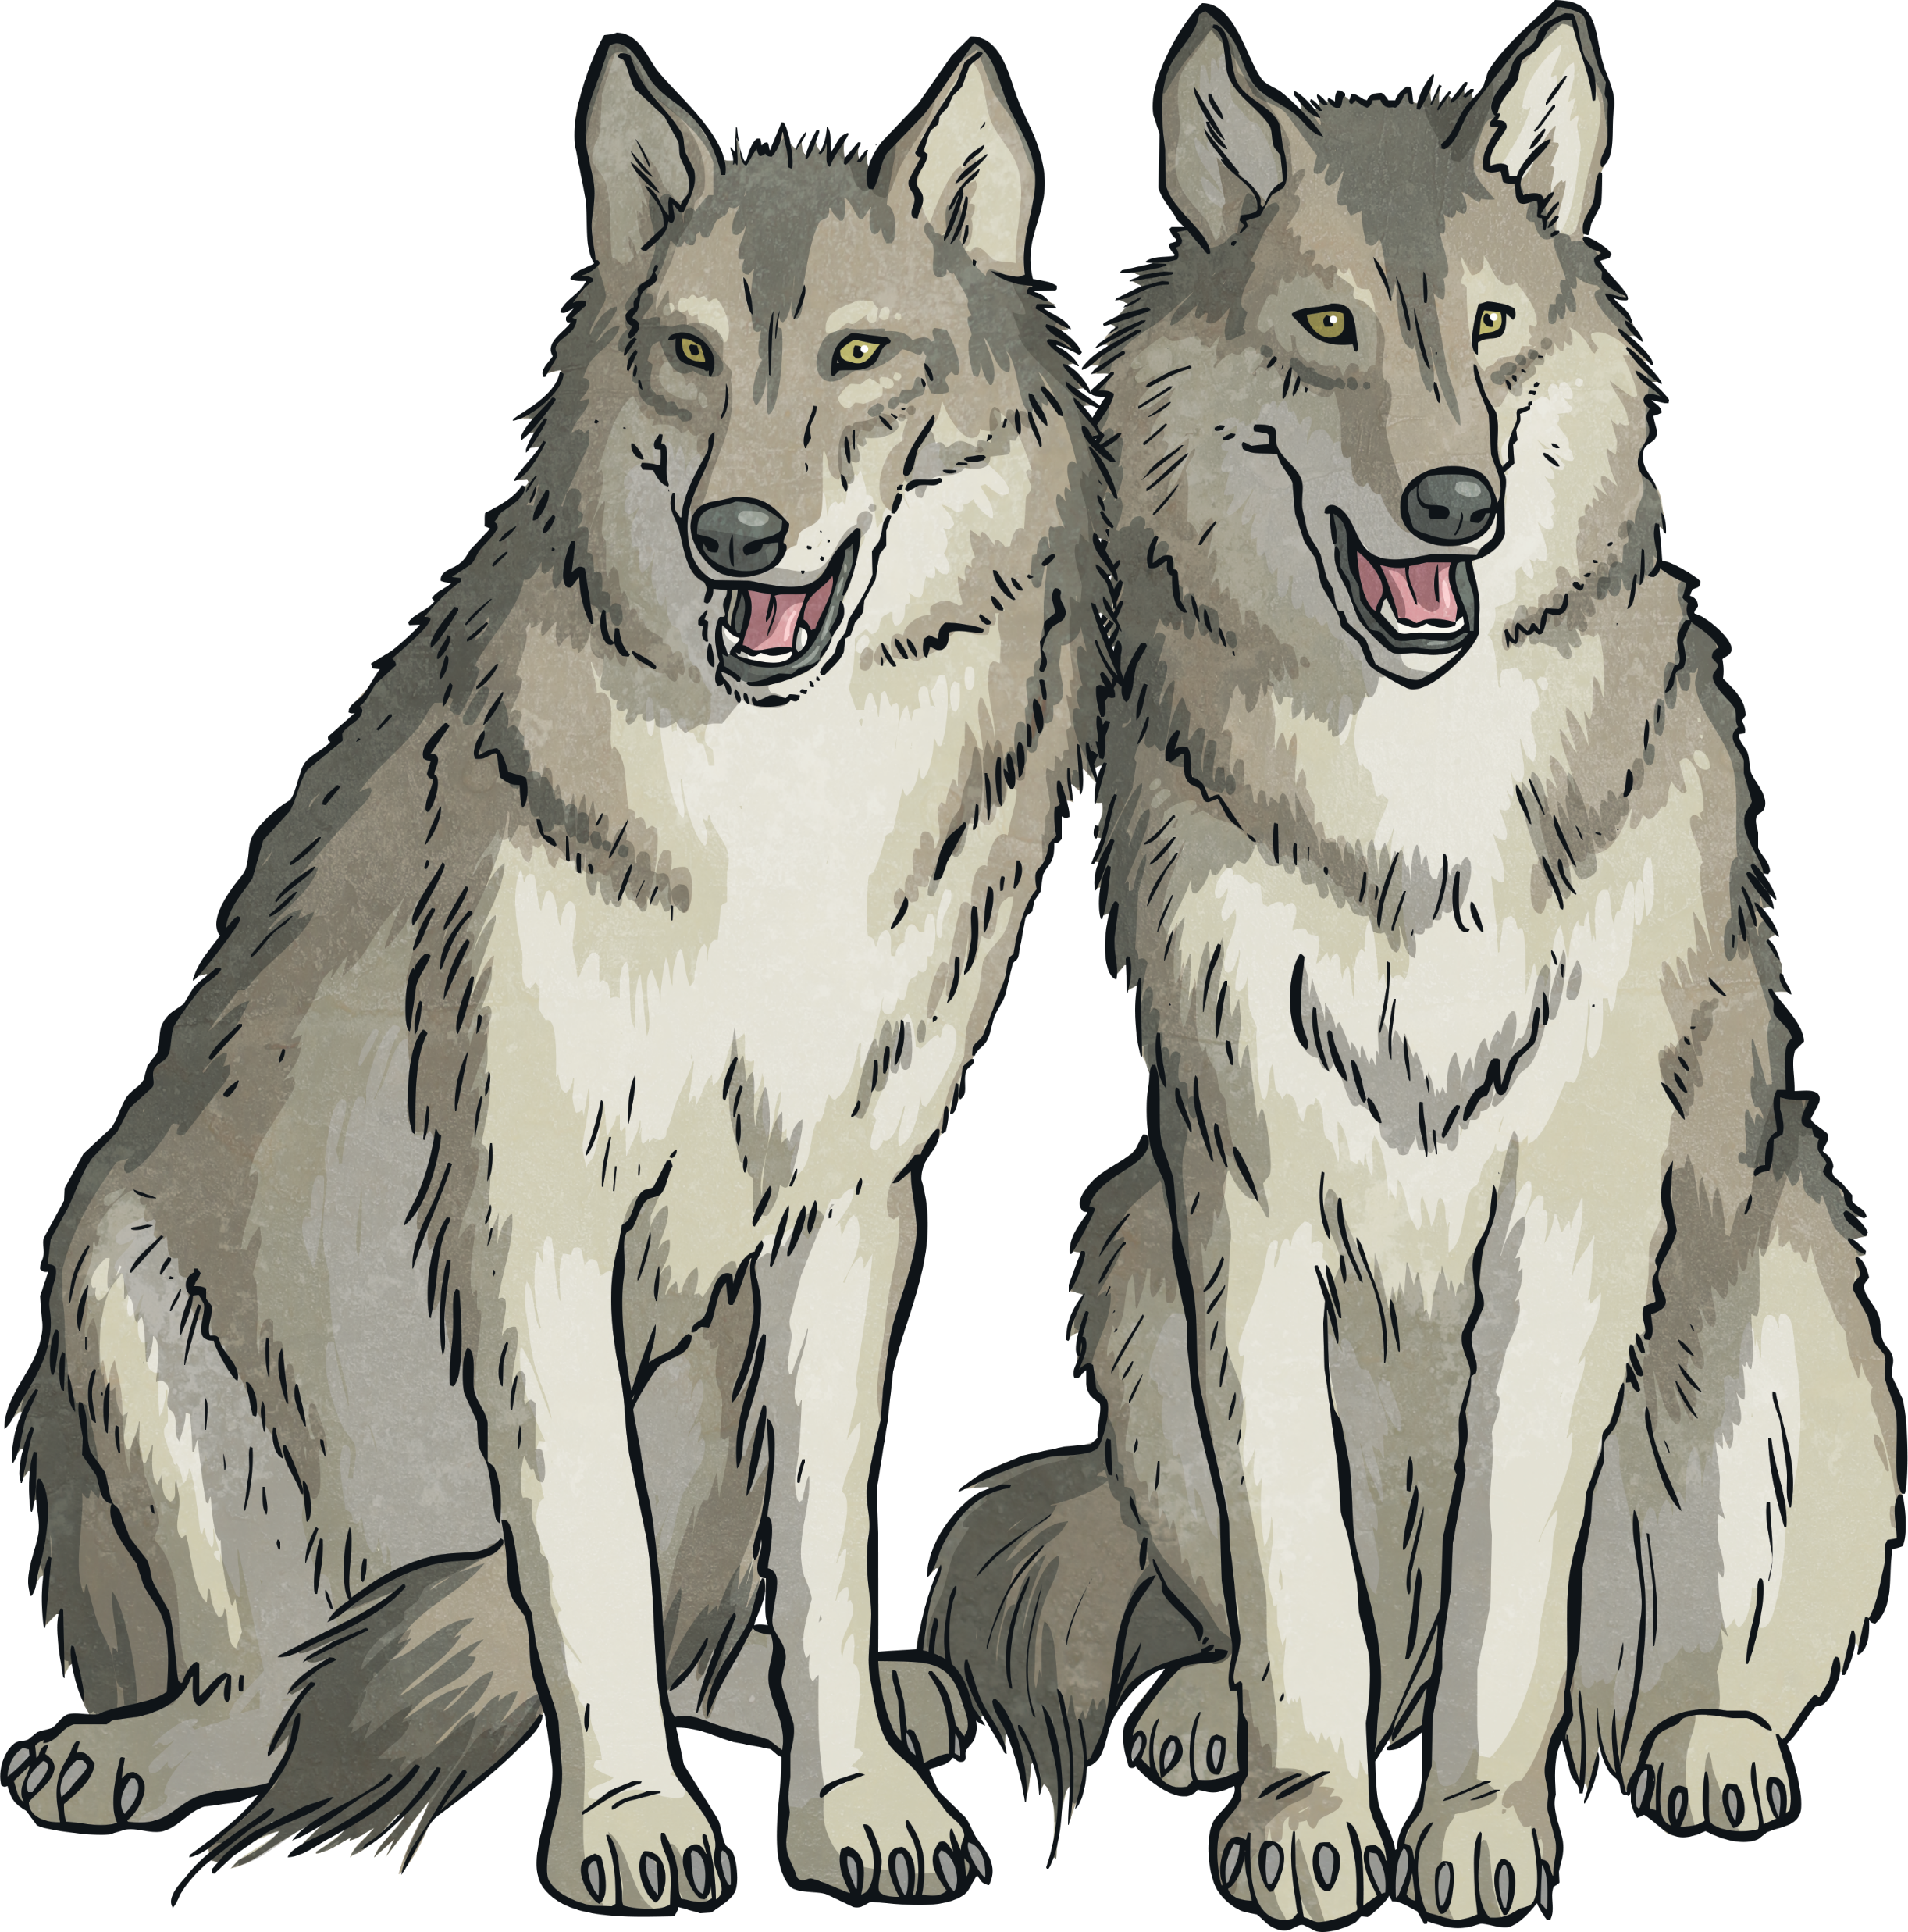
Fast Facts
Wolves are the largest member of the dog family. They are part of the canine group, along with other species, such as foxes and coyotes.
Wolves have been in existence for over 1.5 million years.
The scientific name of the gray wolf is Canis lupus.
Wolves are mammals.
Wolves vary in size but can grow up to 2m in
length. On average, they weigh about 40kg, but
this can vary from 18kg to 75kg.
Wolves eat when food is available. They can
eat up to 9kg of food in one sitting!

Slide 8
Thursday 6th May L.O. To group animals: Those that live wild in the UK now and those that used to live in the UK.
Wild animals that live in the UK today | Wild animals that used to live in the UK

