Slide 1
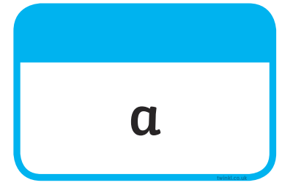





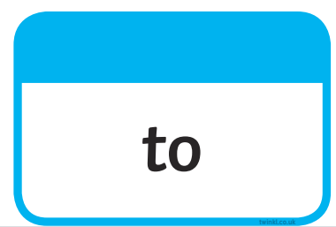
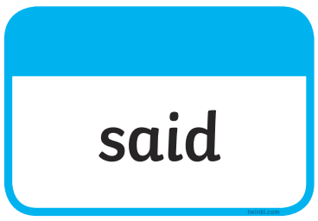
Tricky Words

Slide 2
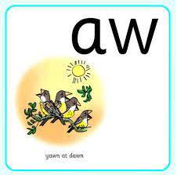
Our Set 3 phoneme for today is….aw
straw yawn
saw
claw
crawl
dawn

Slide 3
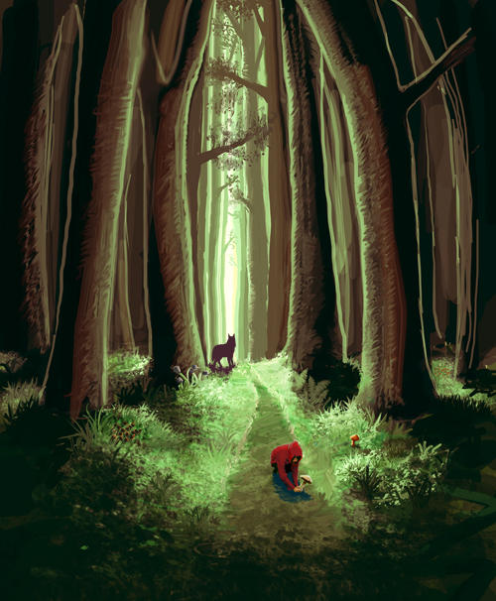
Tuesday 4th May 2021
LO: To create a diary from the viewpoint of the wolf.

Slide 4
What do you know about the story
‘Little Red Riding Hood’?
Watch a video of the story:
https://www.youtube.com/watch?v=LDMWJCrDVMI

Slide 5
What are the main events of the story?
Little Red Riding Hood is sent to her Grandma’s house
with food.
2. On her way she meets the Big Bad Wolf.
3. The Big Bad Wolf ran through the forest to Grandma’s Cottage.
4. The Wolf ate Grandma and then pretended to be Grandma.
5. The Wolf tricked Little Red and ate her too.
6. A woodsman heard a scream so came running into the cottage he turned the wolf upside down and Little Red and Grandma came tumbling out.
7. The woodsman, Little Red and Grandma all chased the Big Bad Wolf out of the cottage.
8. The Big Bad Wolf was never seen again.

Slide 6
Your Task: Today you will be pretending that you are the
Big Bad Wolf and have just been chased away by the other characters. You will be writing a diary all about what happened that day.

Slide 7

Writing a Diary Entry
When you write a diary entry, you are writing about a day in the life of a real person or character.
The diary entry needs to sound as if the person or character has written it, so it needs to be written from their point of view.
It also needs to be exciting
and interesting to read.
To get this right,
just follow a few easy steps...

Slide 8
Diary Writing Must...
use the words ‘I’, ‘my’, ‘we’ and ‘our’
These words are special because they tell us the diary is being
written by someone and they are talking about themselves.
We call this kind of writing ‘first person’. Look at these two examples. Which one uses the correct words to be written in ‘first person’?
I looked around my temporary new home.
When the small girl comes through the door I feel very excited to see her.
First person!
He looked around his temporary new home. When the small girl comes through the door he feels very excited.t first person!
Not first person!

Slide 9

Diary Writing Must...
use time linking words, e.g. ‘next’, ‘first’ and ‘then’
A diary is usually describing lots of events.
To make sense of when these events happened it is helpful to include time linking words, such as ‘next’, ‘first’ and ‘then’.
If we just use one word, such as ‘and’ to link the events
in our diary it can get very boring!
Look at the example below. Can you think of different time words the writer could use at the start of each sentence to make their diary entry more interesting?

Slide 10
Diary Writing Must...
write as if you were there
When we write a diary, we have to make the reader think we were really there.
We can do this by including lots of detail and description.
What extra detail and description could you add to make it sound as if it was written by someone who was really there?

Slide 11
Diary Writing Must...
describe feelings
A diary is usually a secret place to write how you feel about what has happened to you in the day.
In a diary, you might include feelings, hopes or fears that you wouldn’t want anyone to know about.
Question: What might the tree feel if it saw someone with an axe?
How might it feel if the man walked away?

Slide 12
Tuesday 4th May 2021
Dear Diary,
I have had a very rough day. I woke up this morning and went for a long walk in the woods. My tummy started to rumble so I looked all over for something to eat, but all I could find were some berries.
Then I heard someone coming, so I hid behind a tree. I was worried it was a huntsman looking for me but I was very happy to see it was a delicious smelling little girl wearing a bright red cloak.
Next I went over to talk to her, she told me that she was on her way to see her Grandma, my tummy growled again so I came up with a plan to go to her Grandma’s house.
I ran as fast as I could and snuck into the tiny cottage, I then saw the old lady lying in bed. I crept over and swallowed her whole, she was a bit stale and I was still hungry, I couldn’t wait for the delicious smelling girl to arrive.

Slide 13
Use the main events of the story to help you remember what happens.
Little Red Riding Hood is sent to her Grandma’s house
with food.
2. On her way she meets the Big Bad Wolf.
3. The Big Bad Wolf ran through the forest to Grandma’s Cottage.
4. The Wolf ate Grandma and then pretended to be Grandma.
5. The Wolf tricked Little Red and ate her too.
6. A woodsman heard a scream so came running into the cottage he turned the wolf upside down and Little Red and Grandma came tumbling out.
7. The woodsman, Little Red and Grandma all chased the Big Bad Wolf out of the cottage.
8. The Big Bad Wolf was never seen again.

