Slide 1
PSHE and Citizenship
Living in the Wider World | Respecting Rights
PSHE and Citizenship | Year 2 | Living in the Wider World | Respecting Rights | Respecting Others | Lesson 3

Slide 3
Aim
I can show respect for the rights of others and understand why this is important.
Success Criteria
I understand that all people have the same rights.
I can explain what respect means.
I can decide if people’s rights are being respected or not.
I can think about how people might feel if their rights are not respected.
This resource is fully in line with the Learning Outcomes and Core Themes outlined in the PSHE Association’s Programme of Study.

Slide 4
The Big Questions

Slide 5

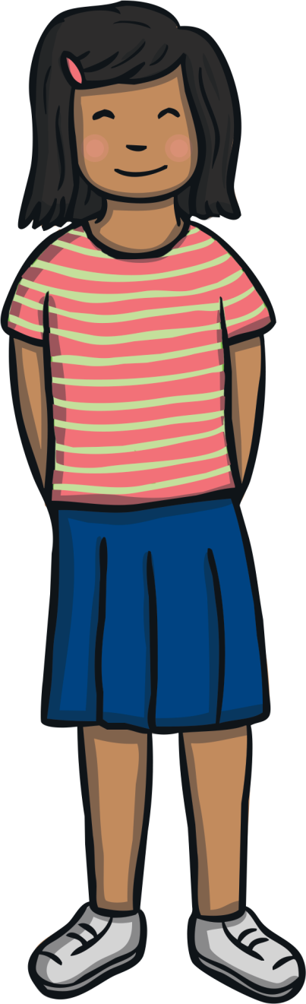
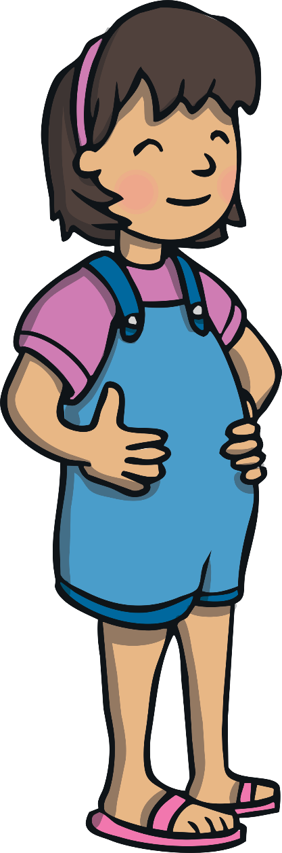
The Big Questions
What could happen if we didn’t show respect for the rights of others?
How can we show respect for the rights of others?

Slide 6
Reconnecting

Slide 7

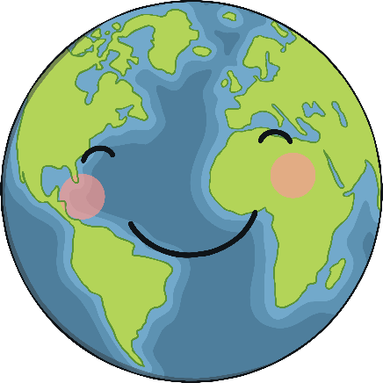
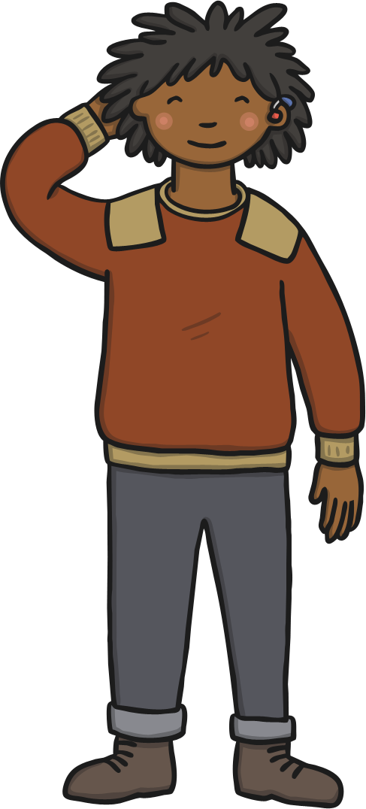
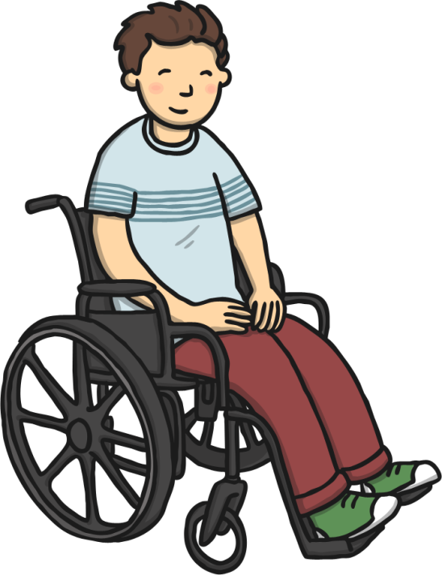
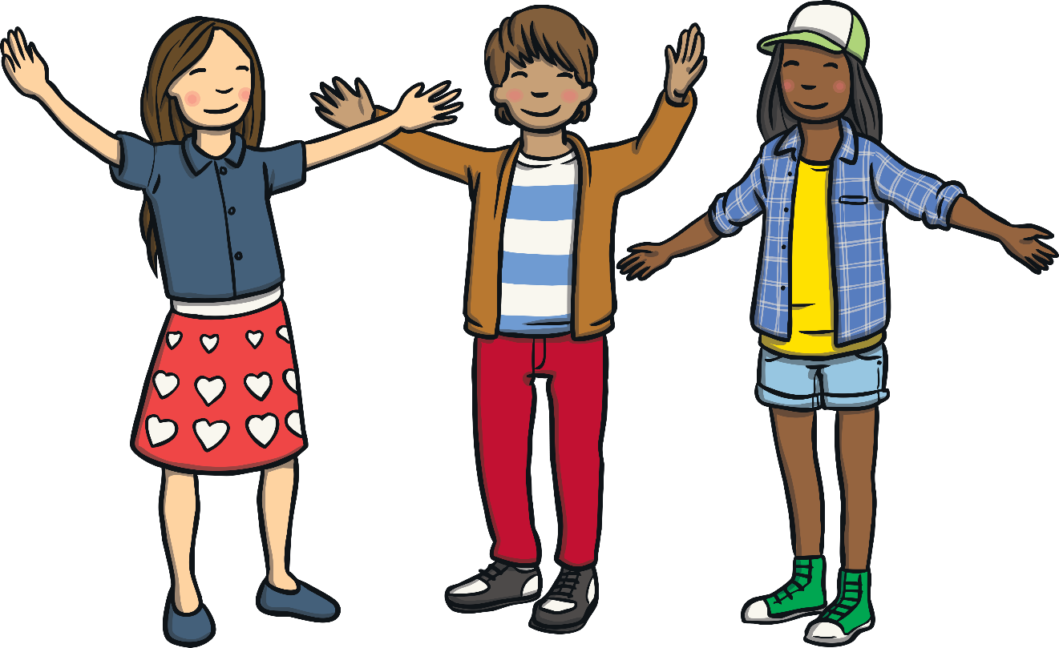
We All Share the Same Rights
Human rights show that every person in the whole world is important.
Human rights help make the world a better place.
They help people to be treated fairly and to have what they need to be happy and healthy.
A right is something that every person should have because they are a human being.
All people, no matter who they are or where they are in the world, have the same human rights.
Human beings are all different.
This makes the world an exciting and wonderful place to live!
With a partner, think of one right that all people share.
Then, when asked, share your idea with the class.

Slide 8
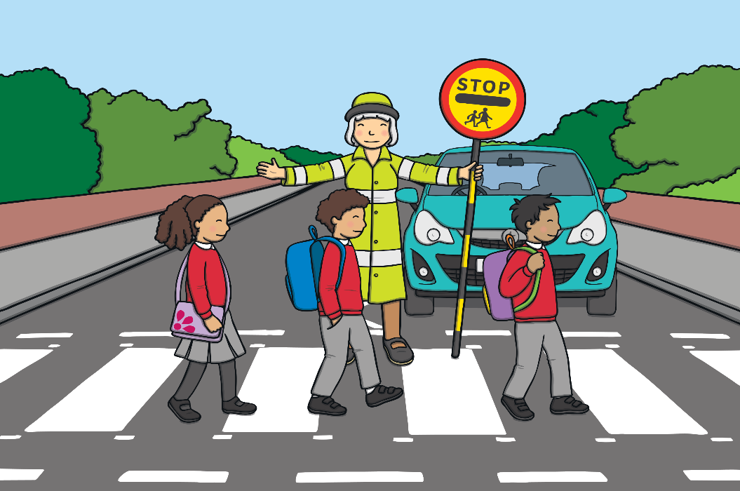
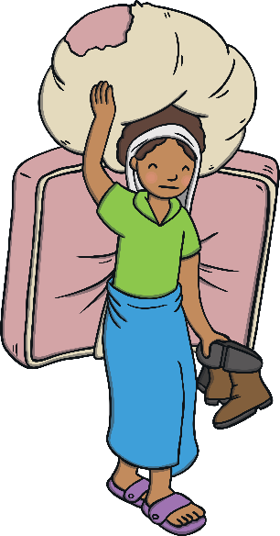
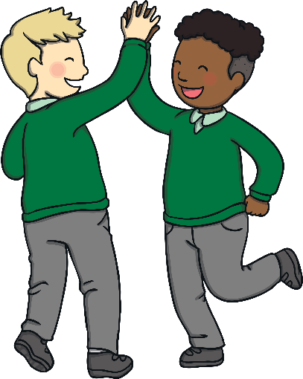
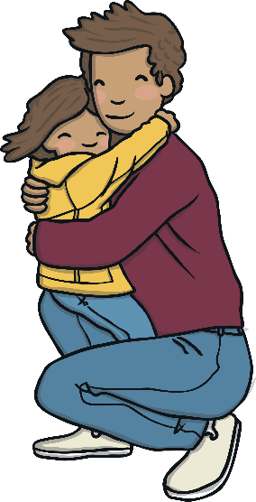
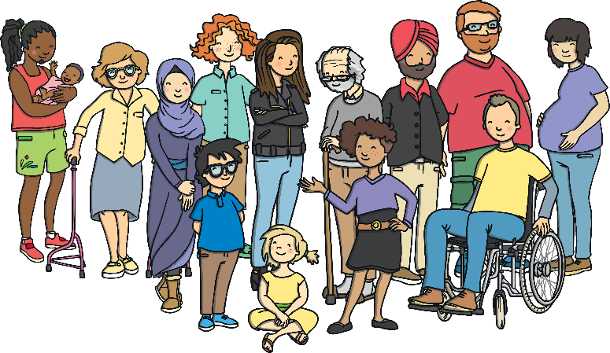
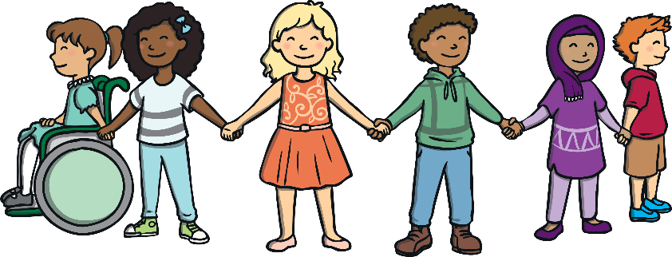
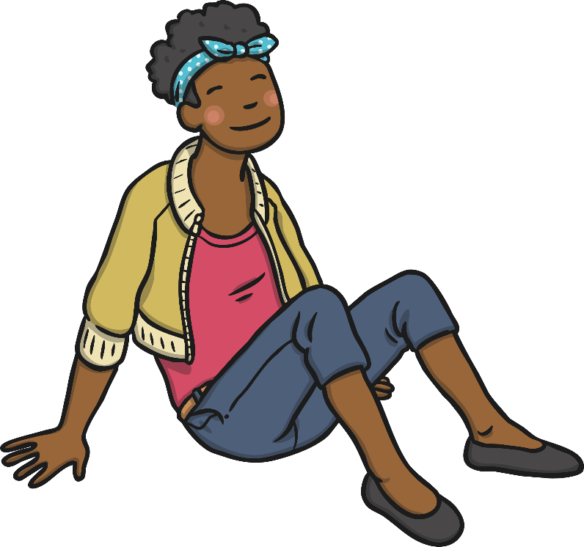
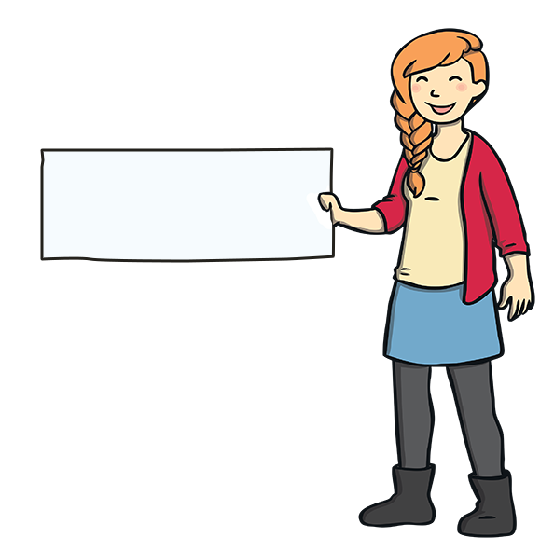
We All Share the Same Rights
There are lots of rights that all people share.
All people have the right to:
leave their country if they are not safe;
be who they want
to be.
be treated with kindness and respect;
feel valued;
be treated fairly;
be safe;

Slide 9
Exploring

Slide 10

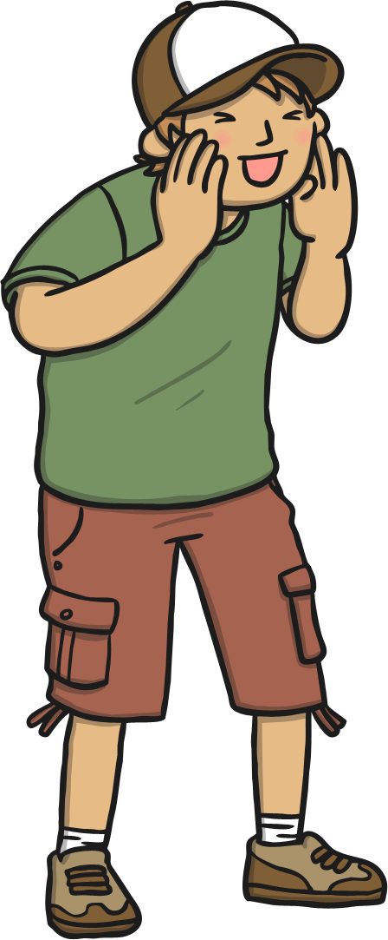
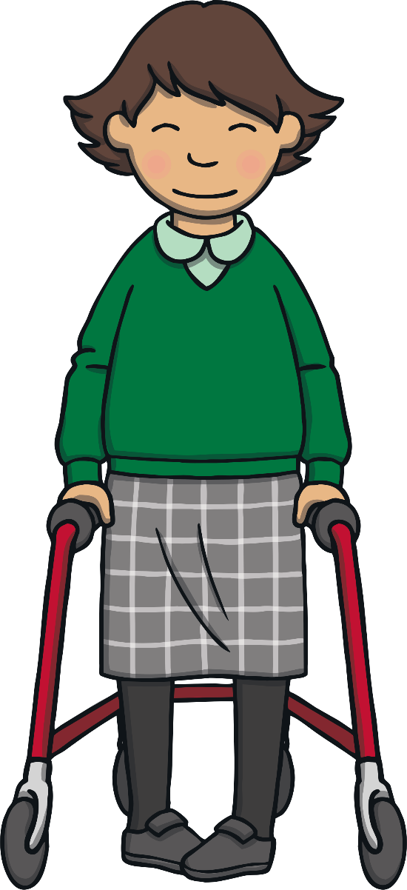
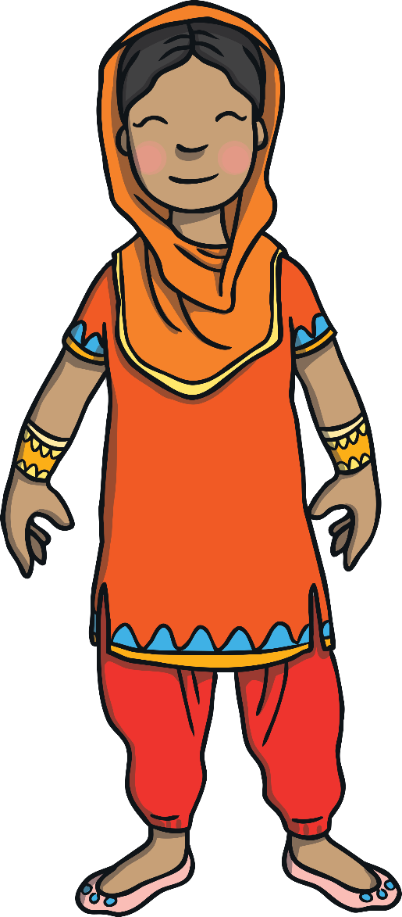
Respect
What does ‘respect’ mean?
Respect means you think carefully about the feelings, wishes and rights of others.
Showing respect for others is important – it helps them feel safe, happy loved and cared for.
Share your ideas with
the class.
You show respect through the choices you make, the way you behave and the things that you say.

Slide 11
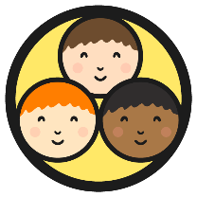
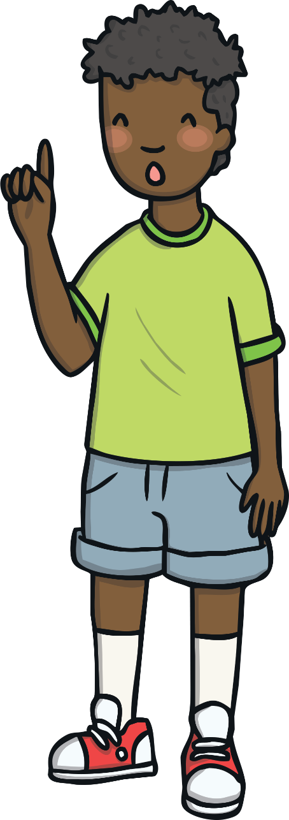


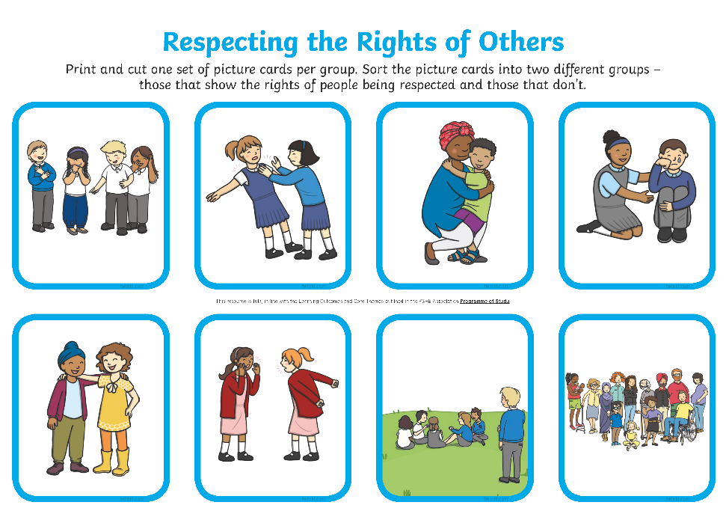


Respecting the Rights of Others
Remember, all people share the right to be safe, to be treated fairly, to be treated with kindness and respect, to feel valued, to leave their country if they are not safe and to be who they want to be.
With your group, sort the picture cards into two different groups – those that show the rights of people being respected and those that don’t.
Afterwards, share your thoughts with the class.

Slide 12
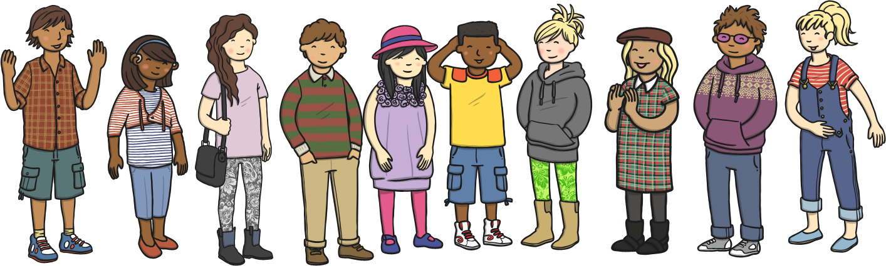
Respecting the Rights of Others
We can listen to everybody’s thoughts and ideas.
We can let people be who they want to be and not make fun of them or laugh at them.
We can take time to learn about and learn from people who are different from us.
We can take time to show care and love to others.
We can help people who are sad, lonely or frightened.
We can include everyone.
We can be kind to everyone.
We can show respect for the rights of others in lots of ways.

Slide 13
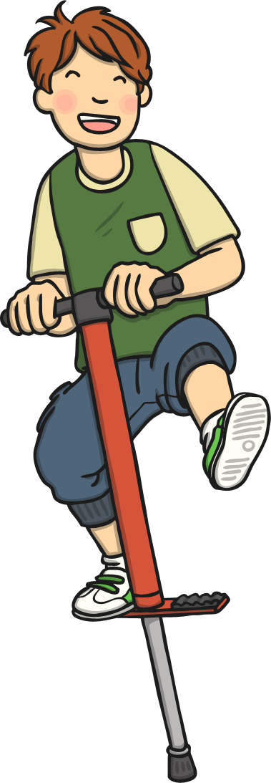
Respecting the Rights of Others
Can you think of any other ways to show respect for the rights of others?
Consolidating
Reflecting

Slide 14
Consolidating

Slide 15
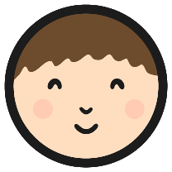
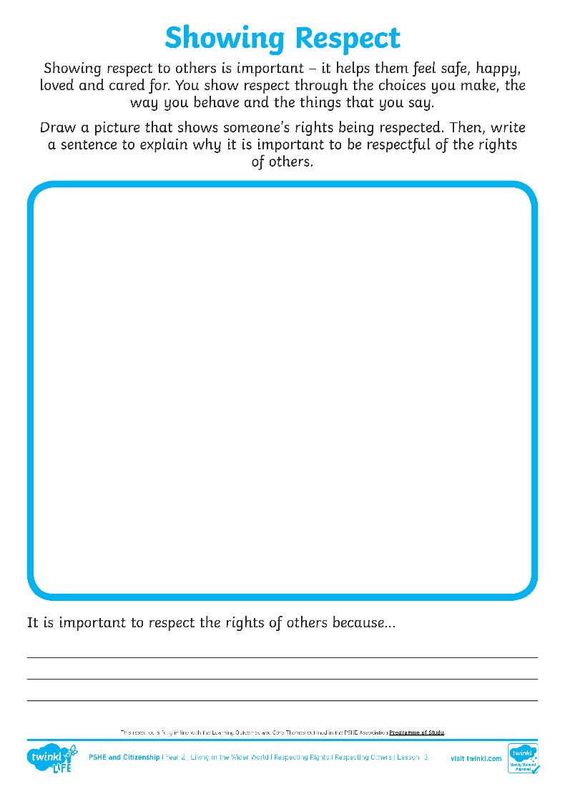
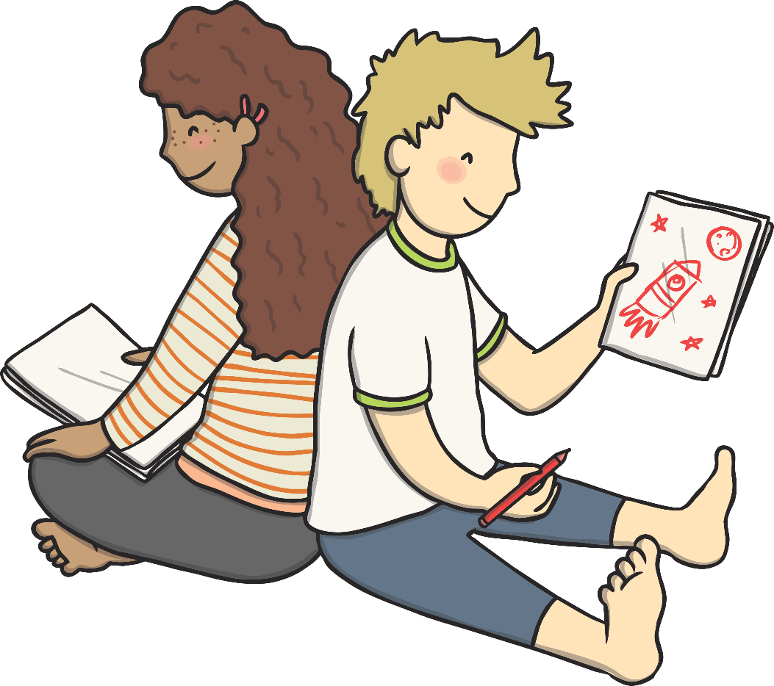
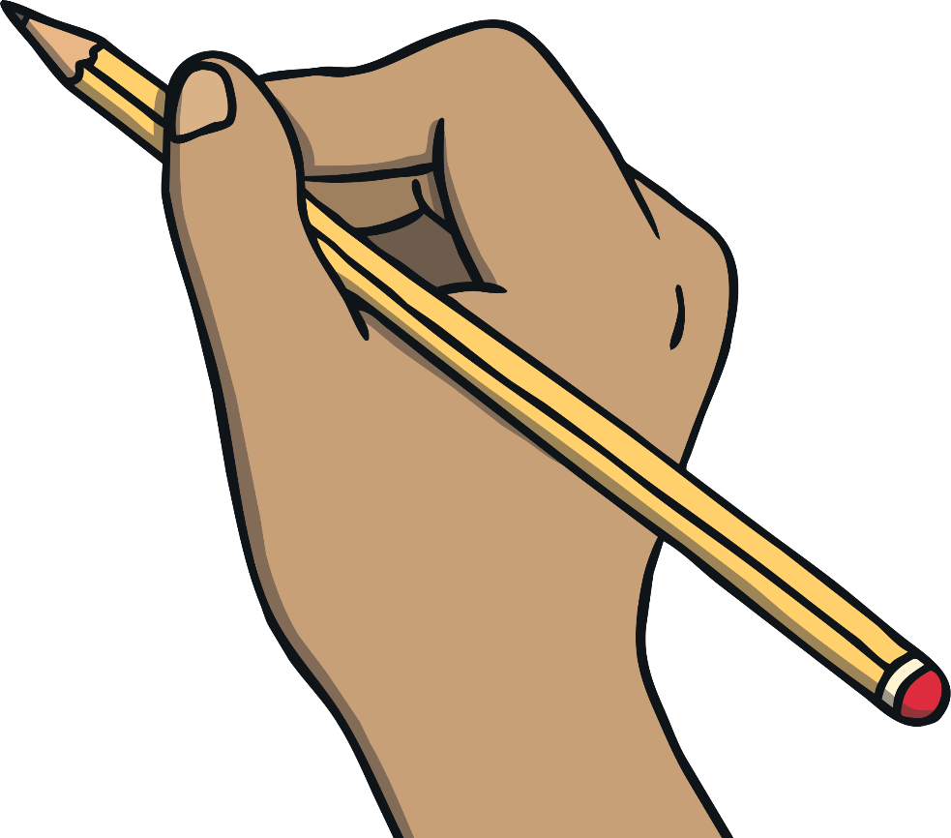
Showing Respect
Then, write a sentence to explain why it is important to be respectful of the rights of others.
Draw a picture that shows someone’s rights being respected.

Slide 16
Reflecting

Slide 17
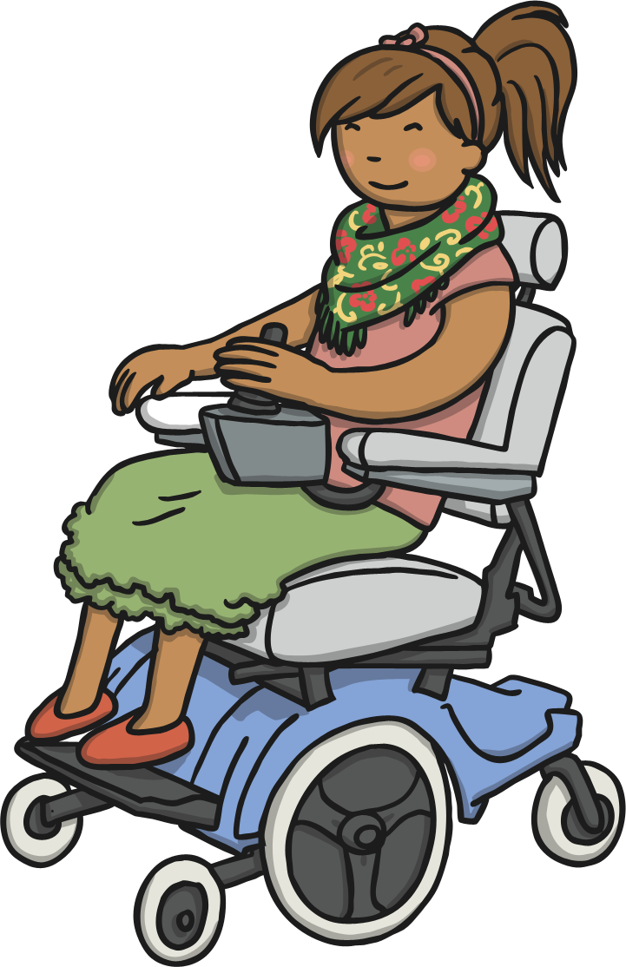
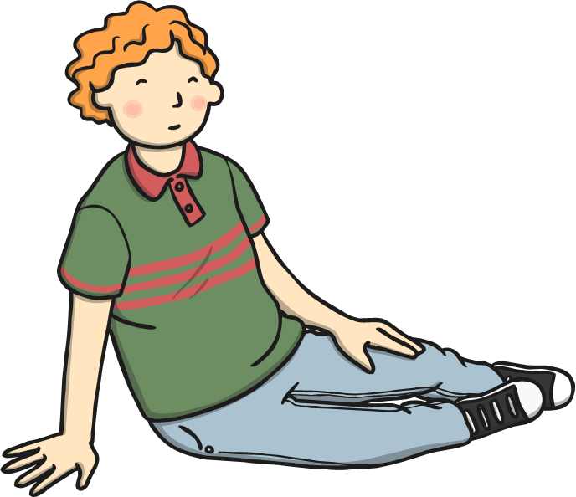
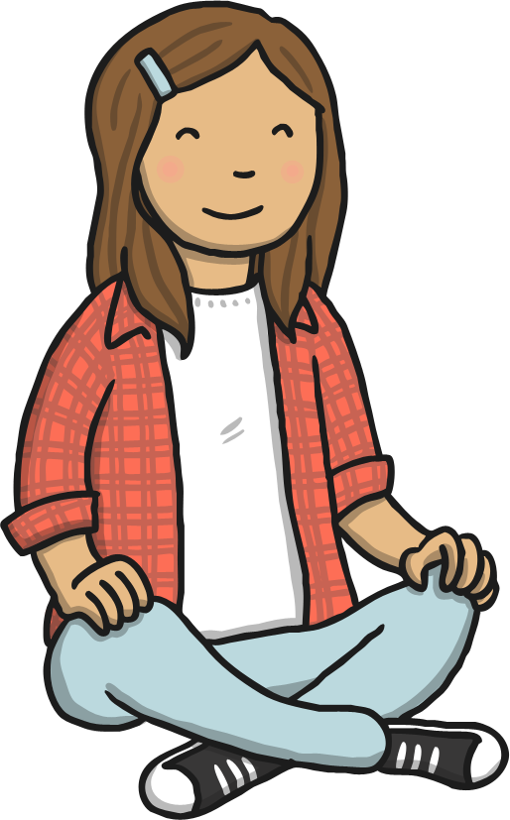
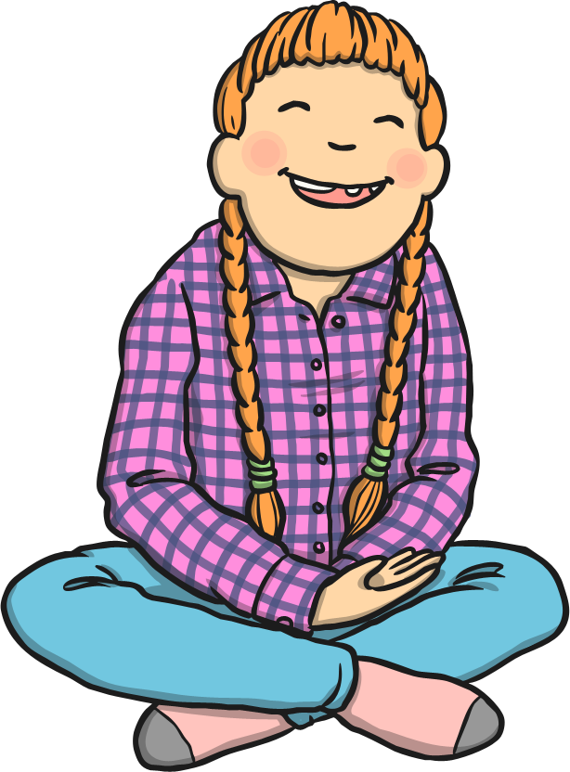
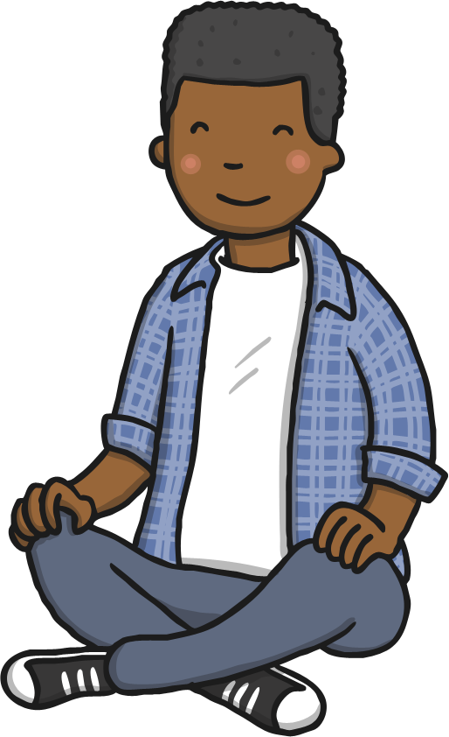
Rights without Respect
When people’s rights are not respected, they can feel sad, angry, lonely and frightened. These feelings can lead to people falling out with each other.
Showing respect for the rights of others is important – it helps all people to feel safe, loved and cared for. It can help all people feel happy inside.
Take a moment of quiet to think about this and then share your thoughts with the class.
How do you think people feel when their rights aren’t respected?

Slide 18
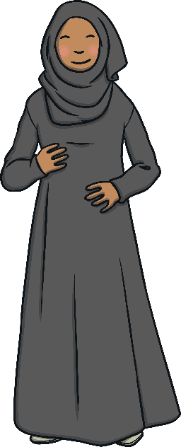
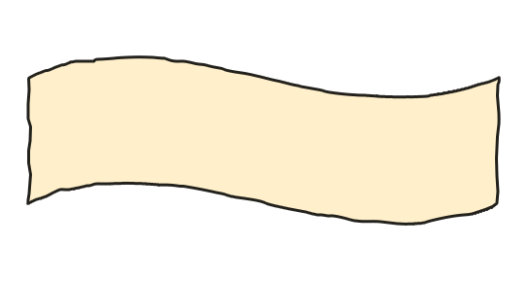
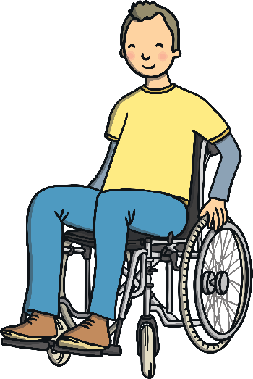
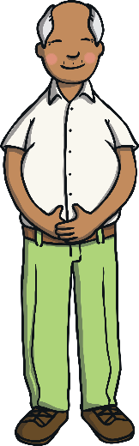
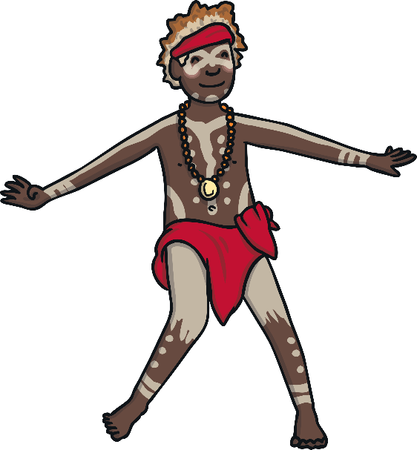
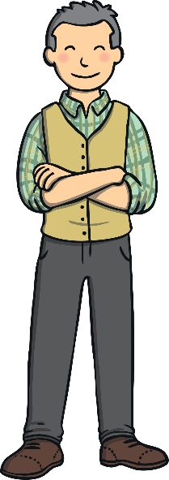
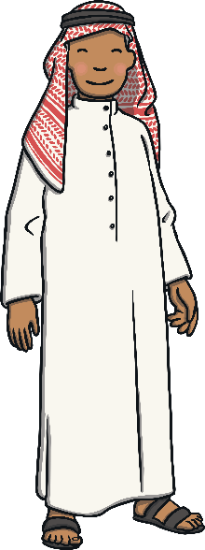
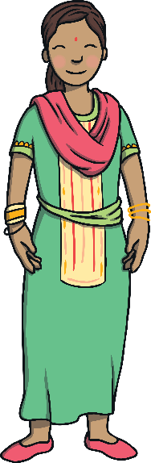
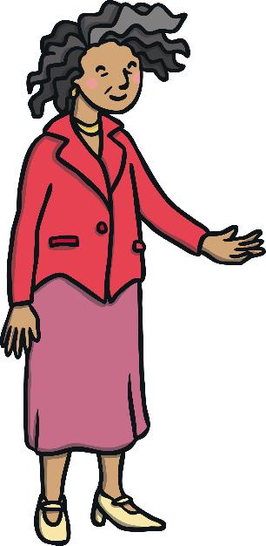
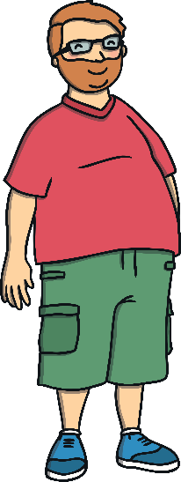
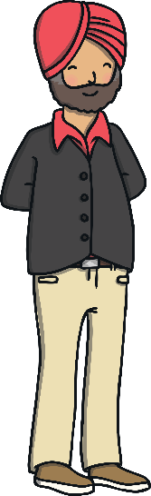
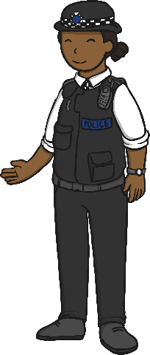
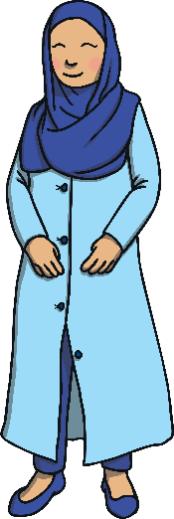
Rights without Respect
There are people all over the world working really hard to make sure that people’s rights are respected. We can do our bit by respecting the rights of others in school and in our
local community.
Let’s be a rights-respecting class and help others feel happy on the inside!

Slide 19
The Big Questions

Slide 20
The Big Questions
What could happen if we didn’t show respect for the rights of others?
How can we show respect for the rights of others?
How are you going to
use what you have
learnt today?

Slide 21
Aim
I can show respect for the rights of others and understand why this is important.
Success Criteria
I understand that all people have the same rights.
I can explain what respect means.
I can decide if people’s rights are being respected or not.
I can think about how people might feel if their rights are not respected.
This resource is fully in line with the Learning Outcomes and Core Themes outlined in the PSHE Association’s Programme of Study.

