Slide 1
PSHE and Citizenship
Health and Wellbeing | Safety First
PSHE and Citizenship | Year 2 | Health and Wellbeing | Safety First | Staying Safe at Home | Lesson 2

Slide 3
Aim
I know how to stay safe at home.
Success Criteria
I can identify dangers in the home.
I understand that household products, including medicines, can
be harmful.
I can identify ways to stay safe at home.
This resource is fully in line with the Learning Outcomes and Core Themes outlined in the PSHE Association’s Programme of Study.

Slide 4
The Big Questions

Slide 5


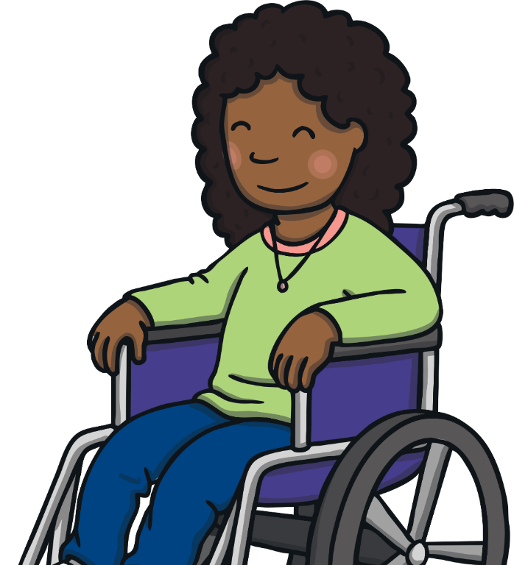
The Big Questions
Which objects in our home can
be dangerous?
What can we do to keep ourselves safe at home?

Slide 6
Reconnecting

Slide 7

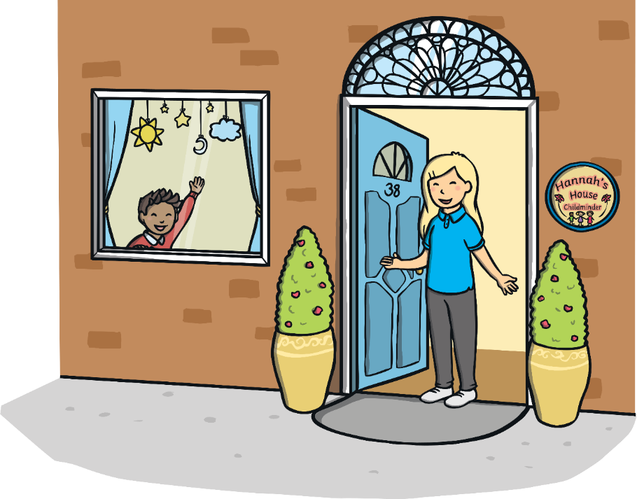
What’s the Danger?
Mostly, our homes are safe places. However, there are some objects that can be dangerous and can cause injuries around the home. We need to be aware of the dangers and how to keep ourselves safe.

Slide 8
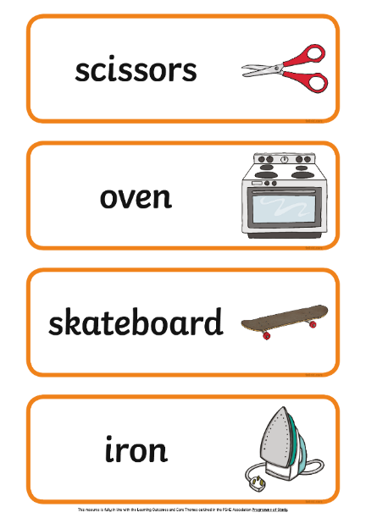
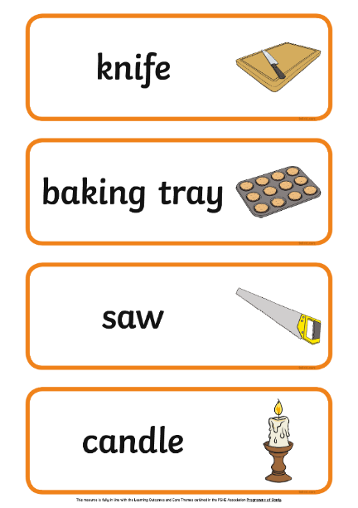
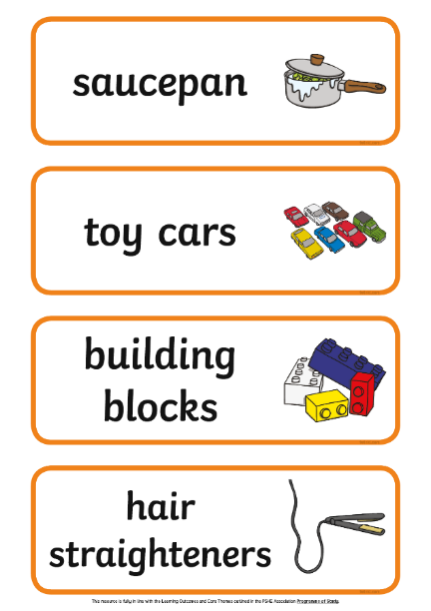
What’s the Danger?
In your groups, you are going to look at some pictures of household objects. Discuss why these objects might be dangerous and see if you can sort them into three sets.
Make sure everyone in the group gets to speak and share their ideas.

Slide 9

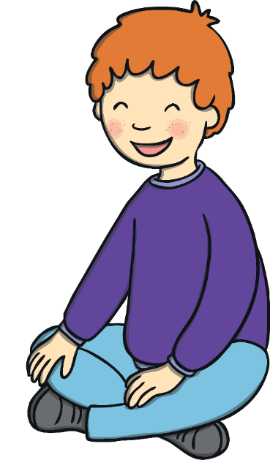
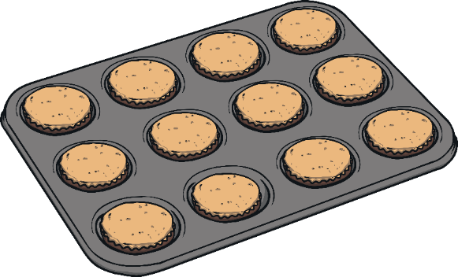


What’s the Danger?
How did you find that challenge?
You might have grouped the objects into:
things that are sharp;
things that are hot;
things that you can trip over or slip on.
Was it tricky?
How did you sort the cards out?
Did your group members all agree?
Were you surprised that all of these objects could
be considered dangerous?

Slide 10
Exploring

Slide 11

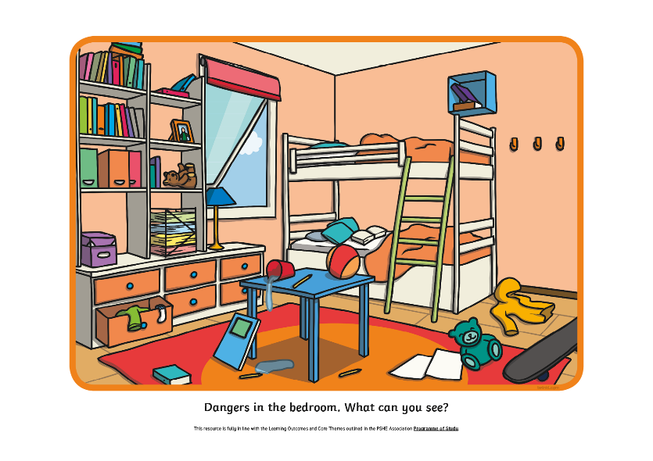
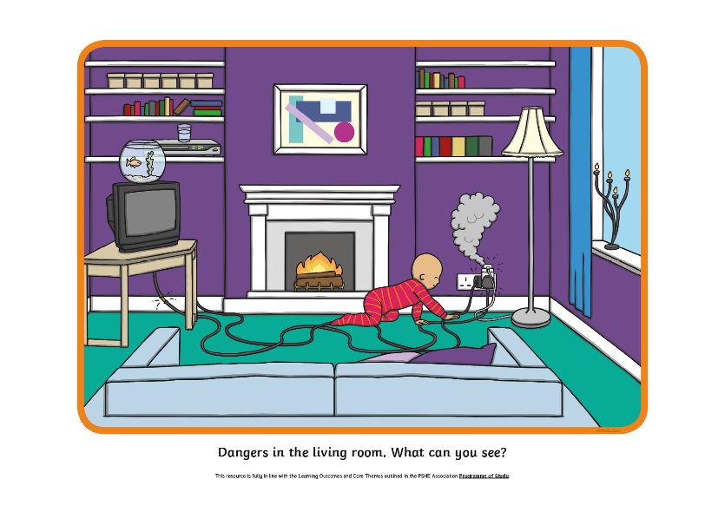
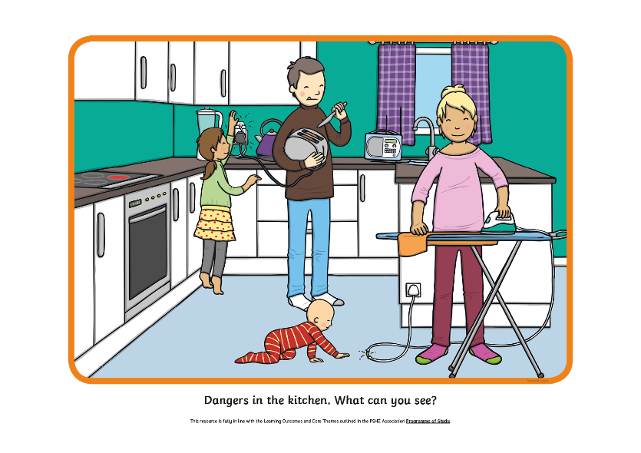
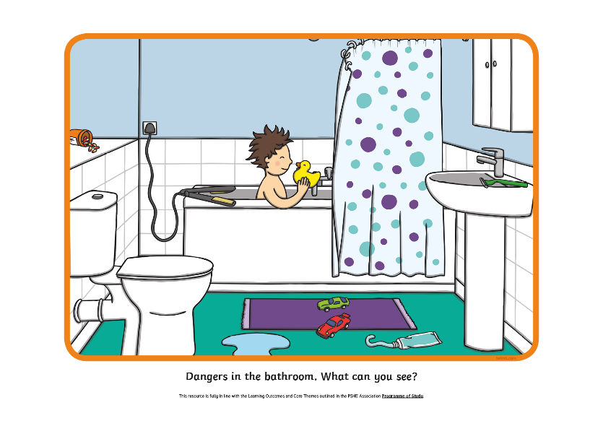
Spot the Hazards
There are different hazards or dangers in different rooms in our homes. With your partner, look carefully at the pictures in your pack and see if you can spot all of the hazards.
Next image

Slide 12
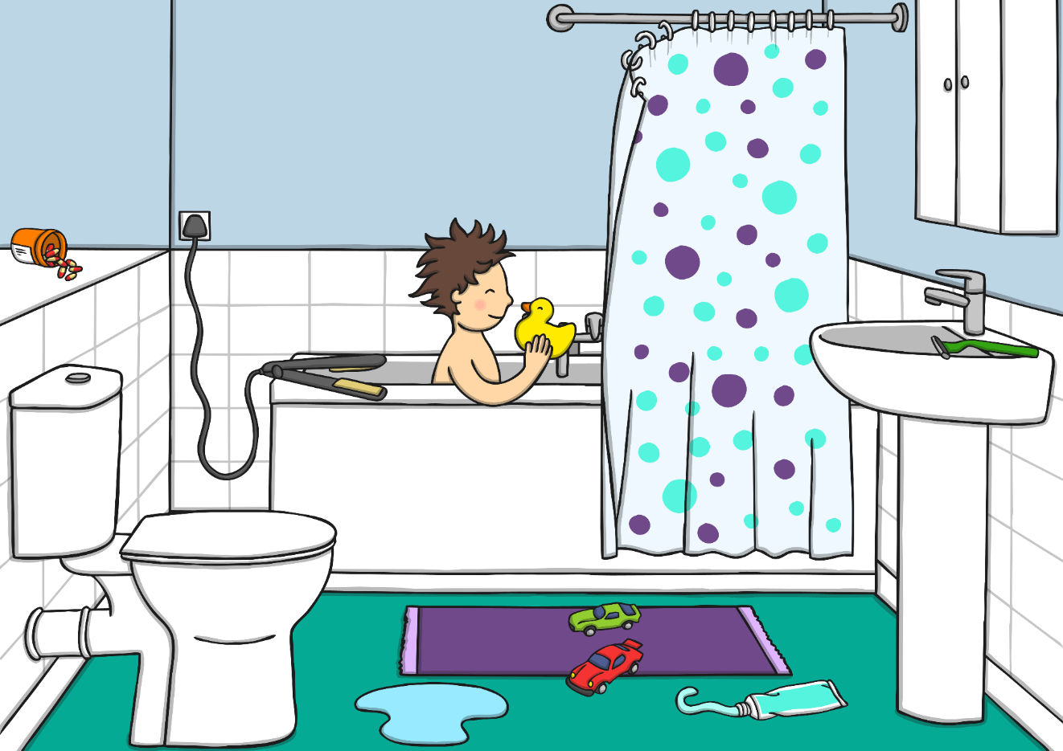
Spot the Hazards
What hazards did you spot in the bathroom?
What could the child in the picture or another member of their family do to make this room safer?

Slide 13
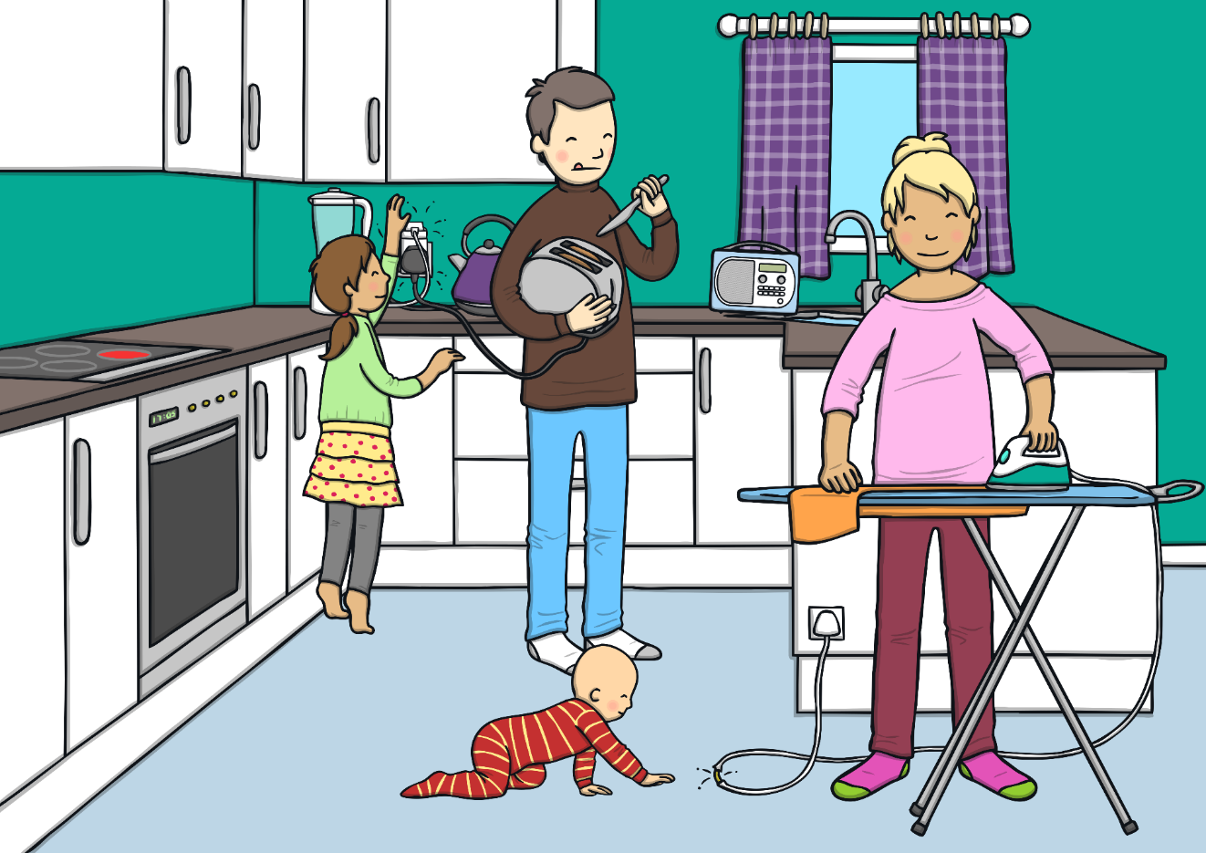
Spot the Hazards
What hazards did you spot in the kitchen?
What could the child in the picture or another member of their family do to make this room safer?

Slide 14
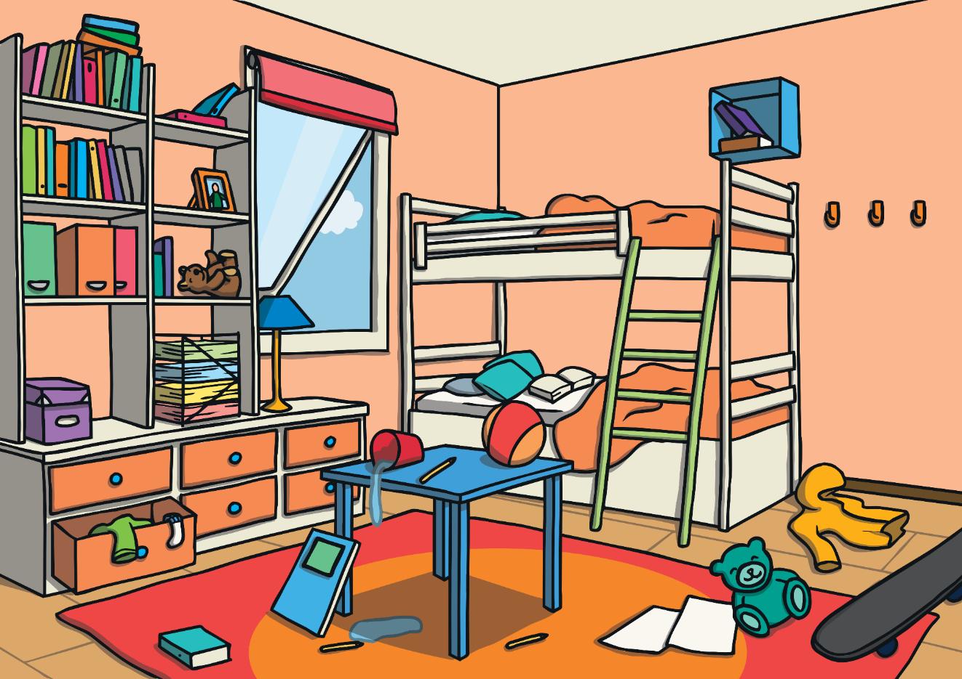
Spot the Hazards
What hazards did you spot in the bedroom?
What could the child in the picture or another member of their family do to make this room safer?

Slide 15
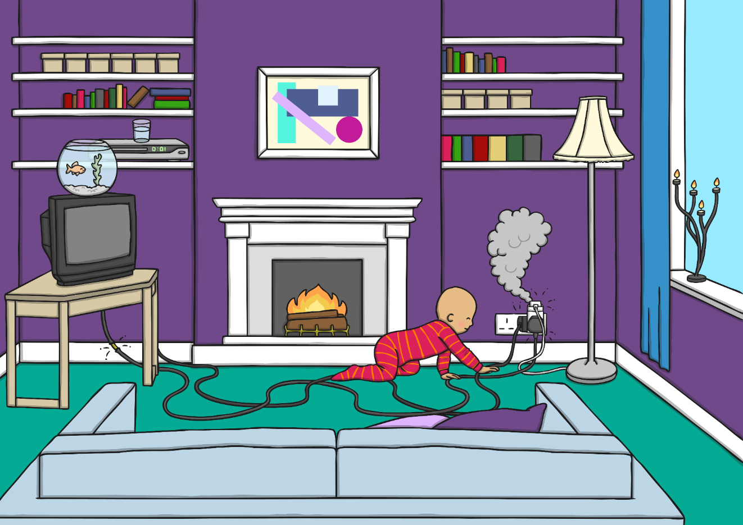
Spot the Hazards
What hazards did you spot in the
living room?
What could the child in the picture or another member of their family do to make this room safer?

Slide 16

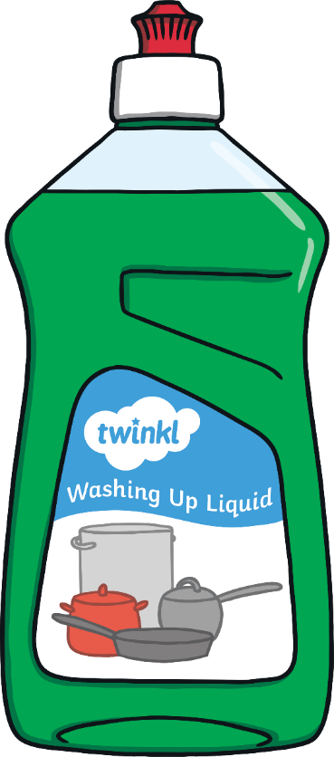
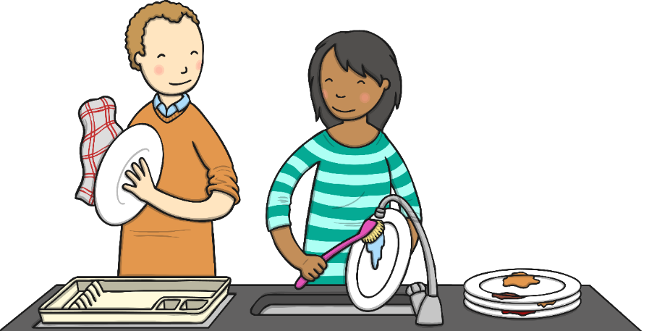
Can I Drink It?
In the bathroom and the kitchen, there are
household products that can be dangerous.
Many liquids are poisonous and must never
be drunk.
We need to remember that these are for adults to use.

Slide 17

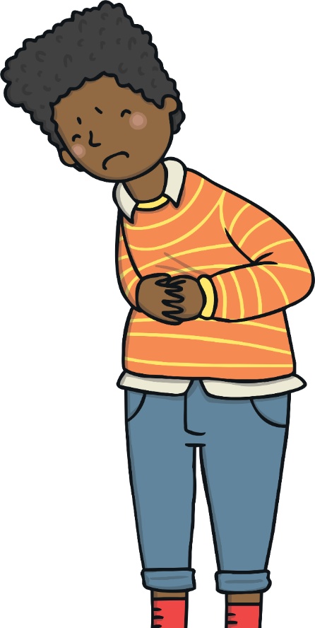
Can I Drink It?
In the kitchen, there might be drinks that are not suitable for children.
Alcohol is only for grown-ups to drink
It would make a child ill if they drank it.

Slide 18

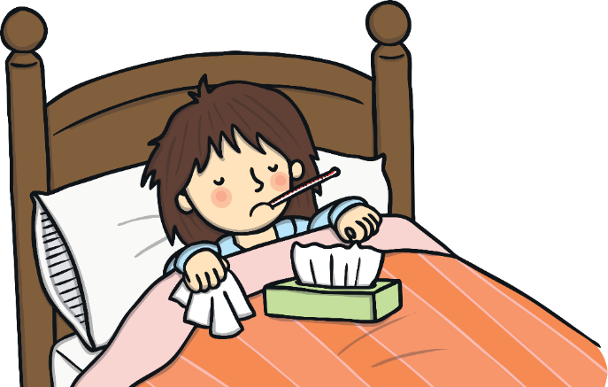
Can I Drink It?
Medicines are for drinking but only when a grown-up can help and can make sure we are having the right medicine and the right amount.
Taking the wrong medicine or having too much can make us very ill.

Slide 19









Can I Drink It?
Let’s vote on whether or not it is safe to drink these liquids.
Thumbs up for ‘yes’, thumbs down for ‘no’ and thumbs sideways for ‘sometimes’ or ‘not sure’.
Yes. Fruit juice is fine for children to drink but remember, too much is bad for your teeth.
Sometimes. Medicine is fine to drink but only if you are poorly and a trusted adult has said that you can drink it.
No. Household cleaning liquids are poisonous.
No. Beer is alcohol and alcoholic drinks are only for adults to drink.
Consolidating
Reflecting

Slide 20
Consolidating

Slide 21

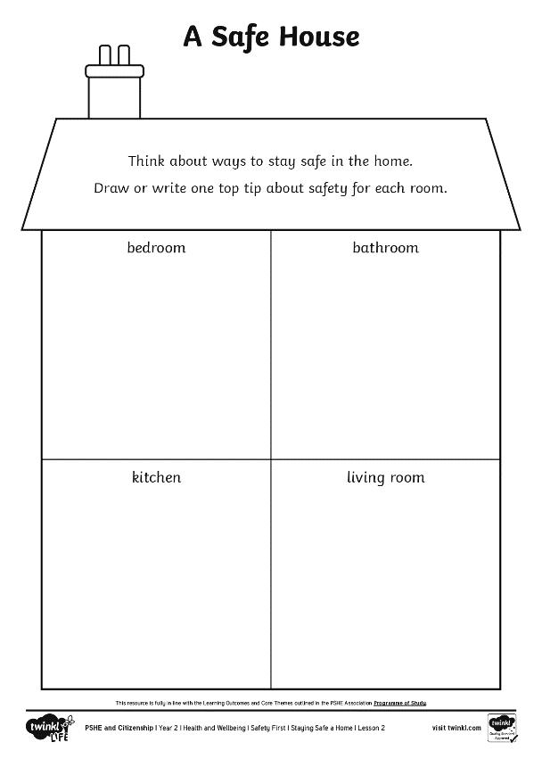

A Safe House
We have learnt a lot about dangers in the home. Now, let’s think positively about how we can stay safe in our homes.
On your A Safe House Activity Sheet, you are going to write or draw one tip for staying safe in each room of the house.

Slide 22
Reflecting

Slide 23
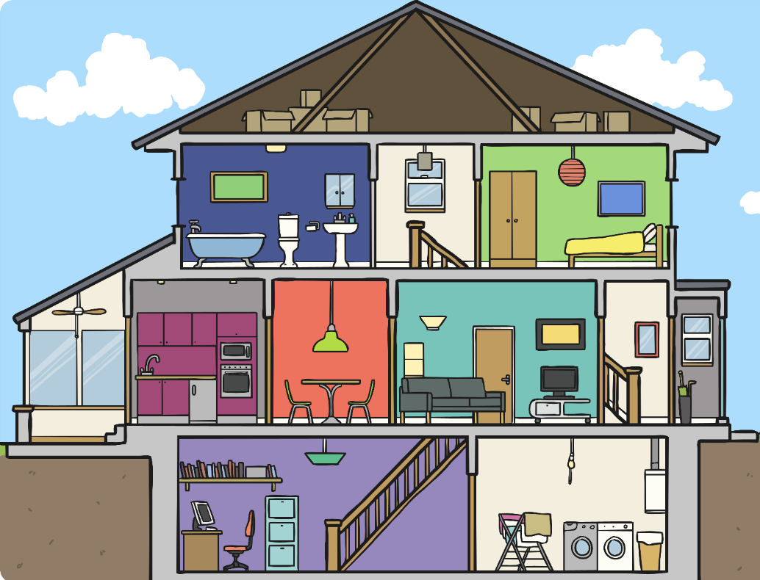
In My Home
Let’s go around the class and hear everyone’s contribution.
It’s time to think about how we can use what we have learnt today in our own homes.
There will be lots of ways that you and your families stay safe in your home already.
Think about one thing you do in your home that keeps you and your family safe.

Slide 24
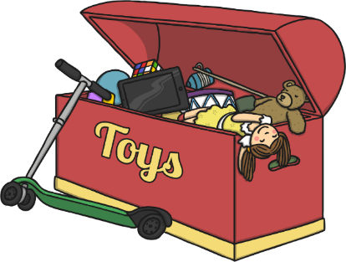
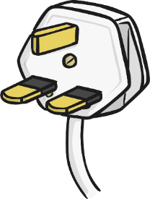

In My Home
There are many ways to stay safe at home. Did anyone say any of these?
Put toys away so no one trips over them.
Keep medicines and pills out of reach of children.
Check that the batteries in the smoke alarms
are working.
Keep sharp tools locked away.
Stay out of the kitchen when someone is
cooking hot things.
Never touch household products, like bleach.
Wipe up spills so no one slips.
Unplug electrical devices when they are not in use.

Slide 25
The Big Questions

Slide 26
The Big Questions
Which objects in our home can be dangerous?
What can we do to keep ourselves safe at home?
What have you learnt today that you can share with your parent
or carer when you go home?

Slide 27
Aim
I know how to stay safe at home.
Success Criteria
I can identify dangers in the home.
I understand that household products, including medicines, can
be harmful.
I can identify ways to stay safe at home.

