Slide 2
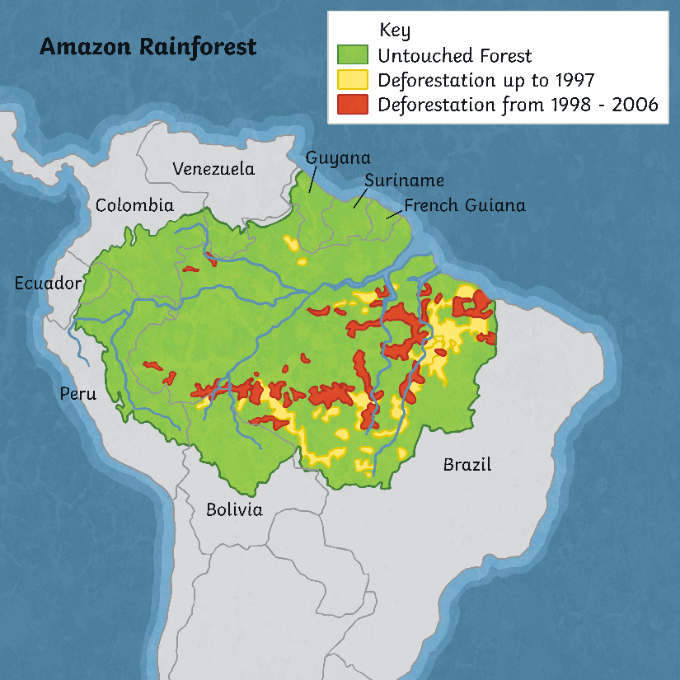
The Amazon Rainforest
The Amazon rainforest is the world’s largest rainforest.
It spreads across parts of nine countries in South America.
The biggest part of the Amazon rainforest is in Brazil. People tell us that the Amazon rainforest are ‘the lungs of the Earth’. This is because the plants turn carbon dioxide into oxygen, which humans and animals need to breathe.

Slide 3
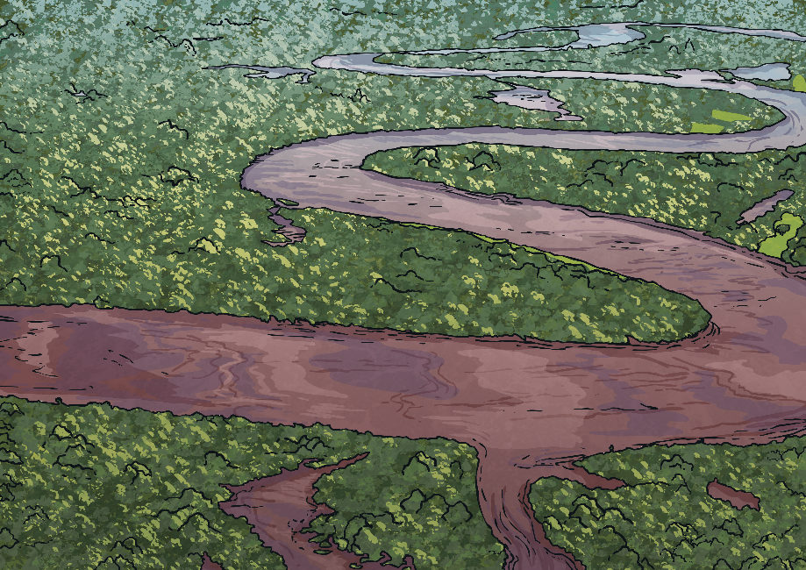
How Many Amazon Tribes Are There?
The Amazon rainforest receives its name from the Amazon river, which you can see in the picture.
It is home to more than 400 tribes, also known as tribal peoples These tribal peoples have always lived in the Amazon rainforest, which makes it their ancestral home.
Laws allow tribal peoples to live in their lands. Different organisations that protect human rights have said that these lands belong to the tribes that live in them and need to be protected.
Sadly, these tribes are in danger, especially those that have had no contact with other people.

Slide 4
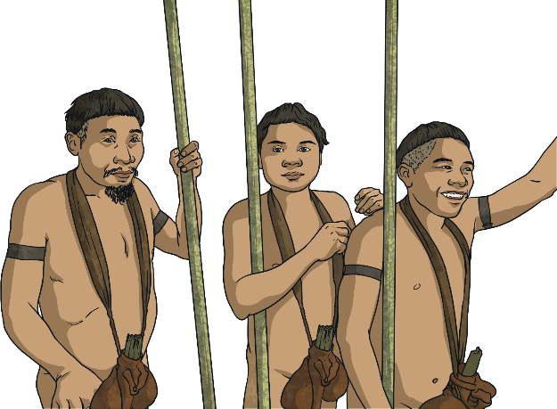
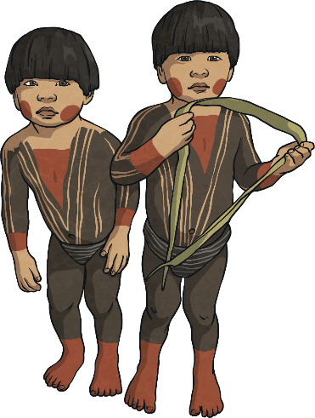
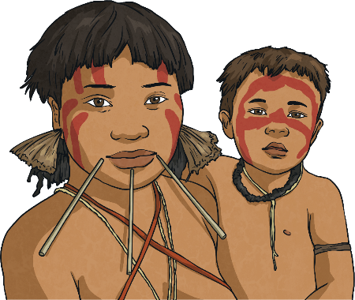
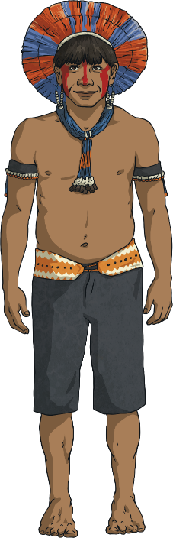
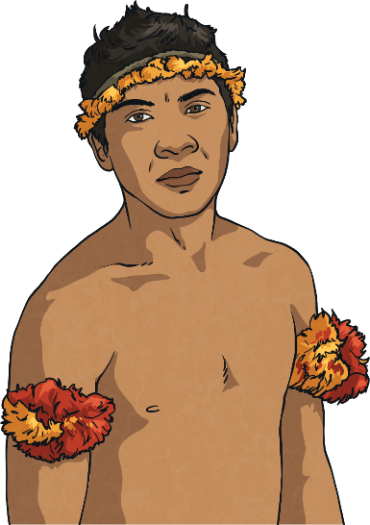
Different Tribes
The Yanomami are the largest tribe in South America. There are about 35,000 of them in the Amazon Rainforest.
The Tupi were one of the most numerous tribes in Brazil. But many have died from disease and illness.
The Korubo are one of the tribes living western Brazilian Amazon. These are an uncontacted tribe.
The Awá live in the eastern Amazon rainforest. There are approximately 350 members, 100 of which are uncontacted, which means they have never met anyone from outside their tribe!
The Kayapo live in a big area that spreads across different parts of Brazil. They live
along the Xingu river and there are about 9,000 surviving.

Slide 5
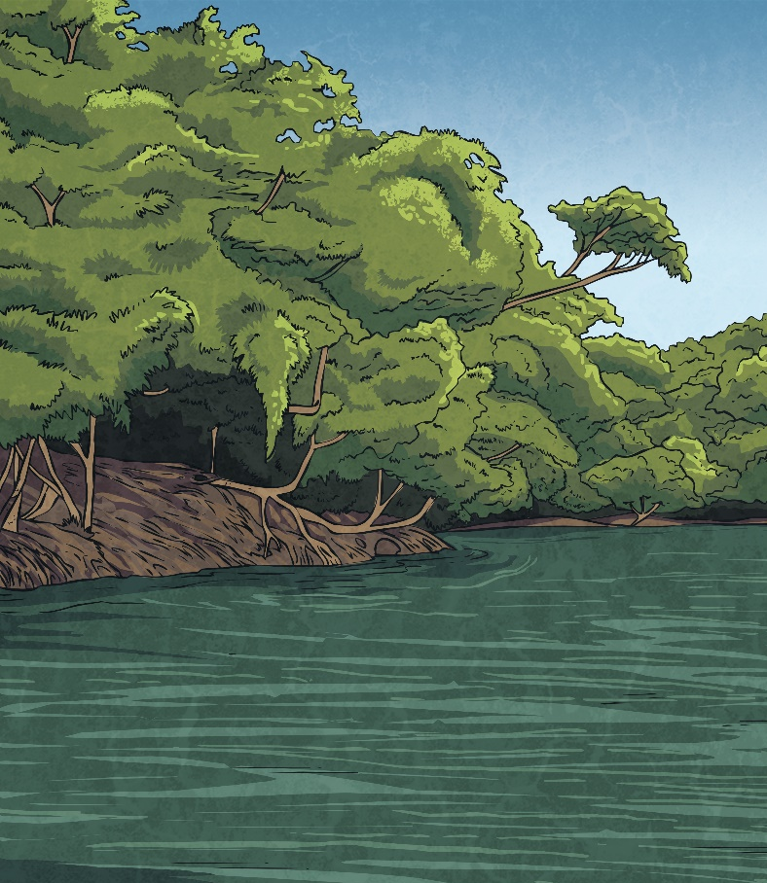
Guardians of the Rainforest
Scientists have discovered that the lands of tribal peoples act as barriers to deforestation (cutting down trees and destroying the rainforest).
Scientists have watched tribal areas in Brazil. These are lands that have been protected for the tribes so that deforestation cannot happen there. They found that deforestation was worse outside tribal areas.
This shows that Amazon tribes have a truly respectful and environmentally friendly lifestyle and that we can consider them guardians of the rainforest.

Slide 6
Tribal Talking Sticks
Decorative sticks can be traced to the tribal use of “Talking Sticks”, which were symbolic sticks held by members of the tribe while having a tribal council meeting. While holding the stick, you had the right to speak.
Your Task:
To find a suitable stick to become your ‘Talking Stick’ and paint or decorate it to show your personality. There are many different designs you can try.
Look at the next page for ideas. We can’t wait to see how your designs turn out!

Slide 7

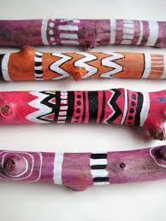
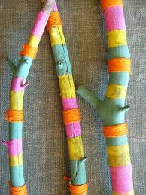
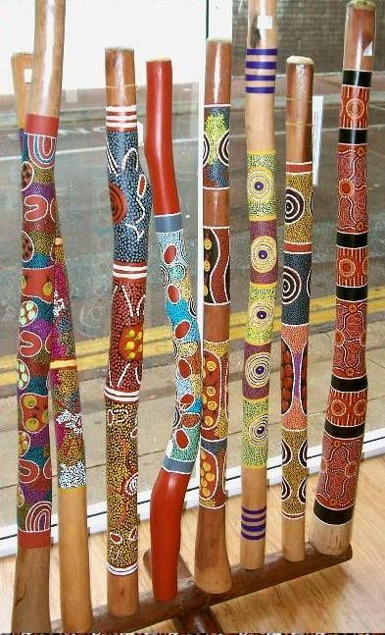
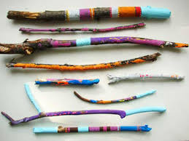

Examples of Design
You could even create a wall hanging with your designs!

