Slide 1
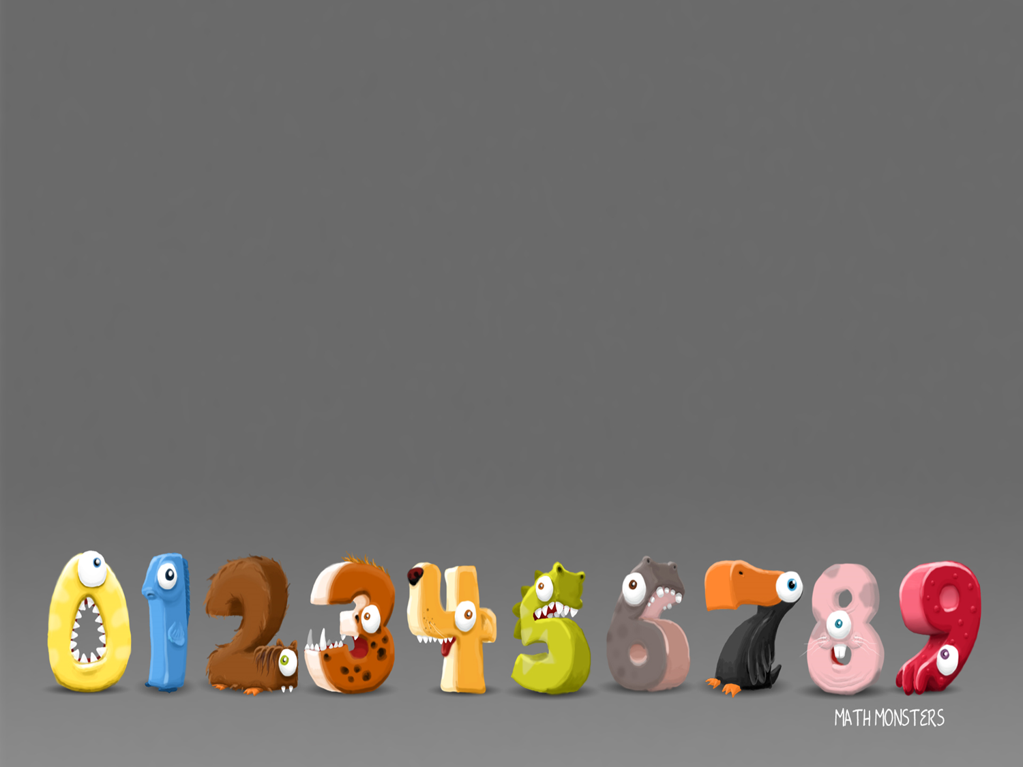
5/2/2021
LO: Make equal groups – by sharing and grouping

Slide 2
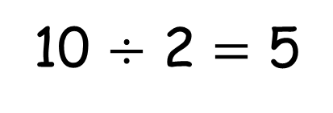
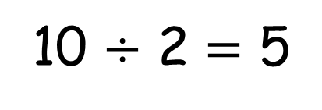
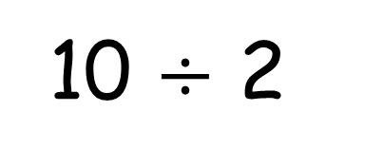
10 $÷$ 2
Sharing
10 $÷$ 2 $=$ 5
Grouping
10 $÷$ 2 $=$ 5

Slide 3
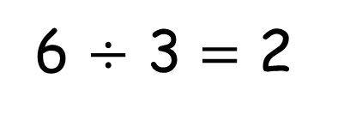
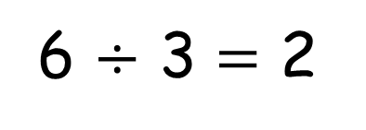
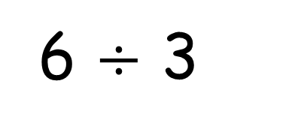
6 $÷$ 3
Sharing
6 $÷$ 3 $=$ 2
Grouping
6 $÷$ 3 $=$ 2

Slide 4
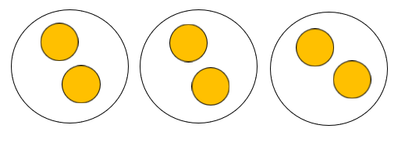
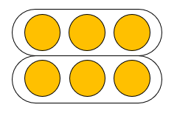
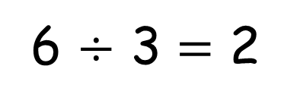
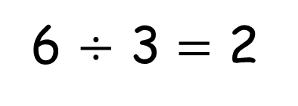
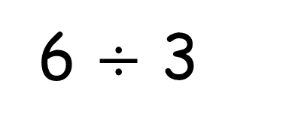
6 $÷$ 3
Sharing
Grouping
6 $÷$ 3 $=$ 2
6 $÷$ 3 $=$ 2
How many groups we are sharing between
How many in each group

Slide 5
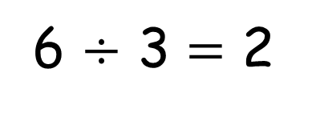
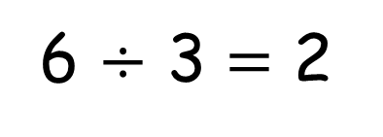
6 $÷$ 3
Sharing
Grouping
6 $÷$ 3 $=$ 2
6 $÷$ 3 $=$ 2
How many are in each group
How many groups we can make

Slide 6

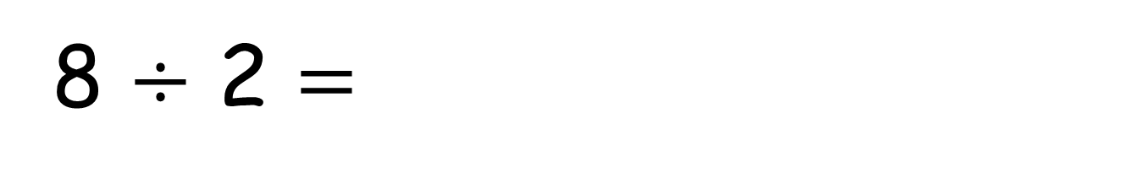
8 $÷$ 2 $=$
4
0 2 4 6 8 10 12 14
4 jumps of 2 are equal to 8

Slide 7

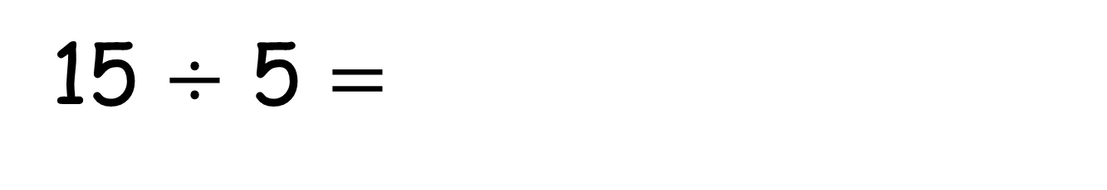
15 $÷$ 5 $=$
3
Have a think
0 5 10 15 20 25 30 35
3 jumps of 5 are equal to 15

Slide 8


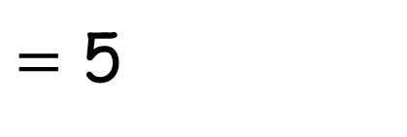

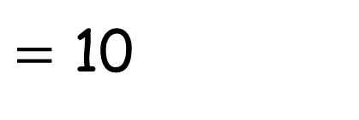



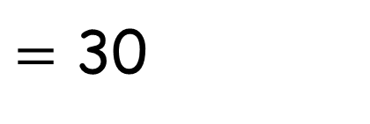



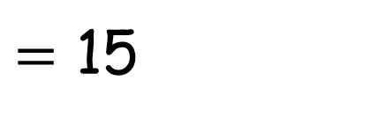
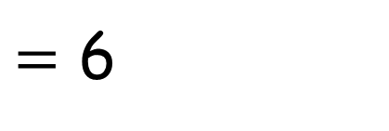


30$\text{÷}$1
$=$ 30
30$\text{÷}$5
$=$ 6
30$\text{÷}$2
$=$ 15
30$\text{÷}$6
$=$ 5
30$\text{÷}$3
30$\text{÷}$7
$=$ 10
$=$
30$\text{÷}$4
$=$

Slide 9
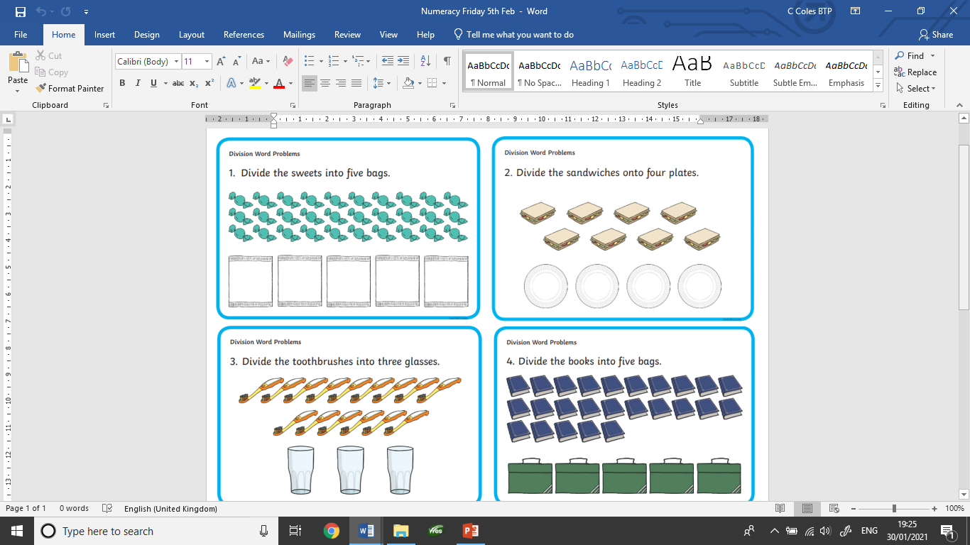
Your task today.
Use counters and your knowledge
of sharing and grouping
to work out these problems.
Think about how many items there are altogether then how many groups you need.

