Slide 1
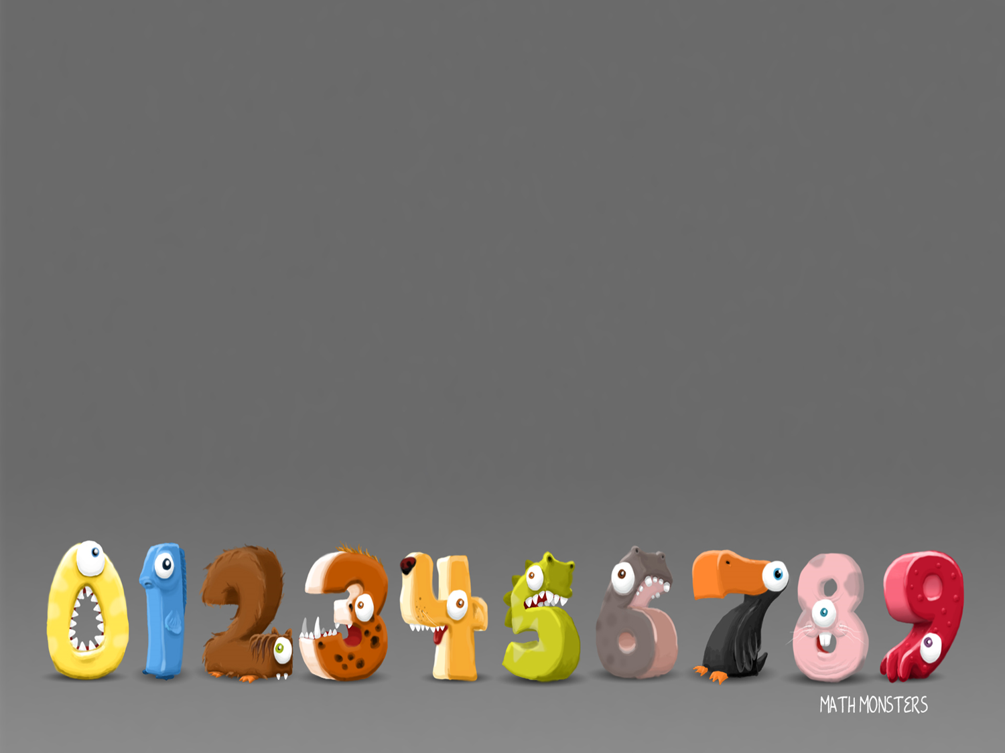
1/2/2021
LO: Odd and Even numbers

Slide 2
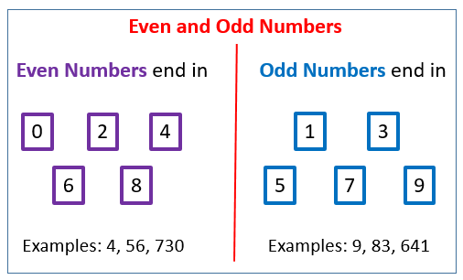
Can you think of any odd or even numbers?

Slide 3
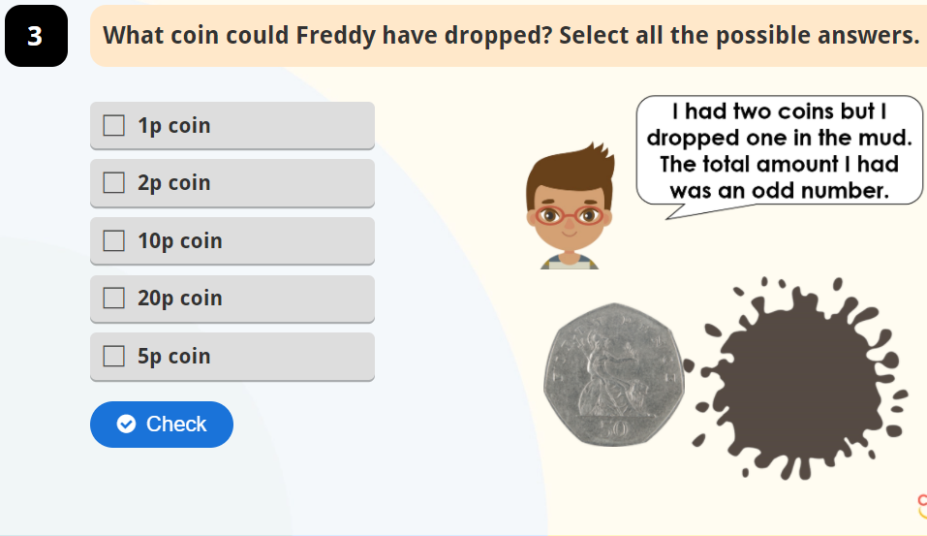

Slide 4
A way to work out if a number is odd or
even is to try and share that number into
two equal groups. If it shares equally it is
even, if you can’t share it equally it is odd.
e.g. 4 ÷ 2 = 2
3 ÷ 2 = 1 with 1 left over

Slide 5



Here are 5 flowers.
Can the flowers be shared
equally between 2 pots.

Slide 6
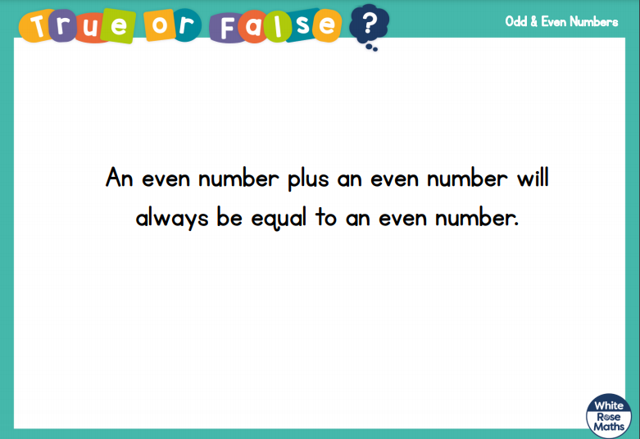

Slide 7
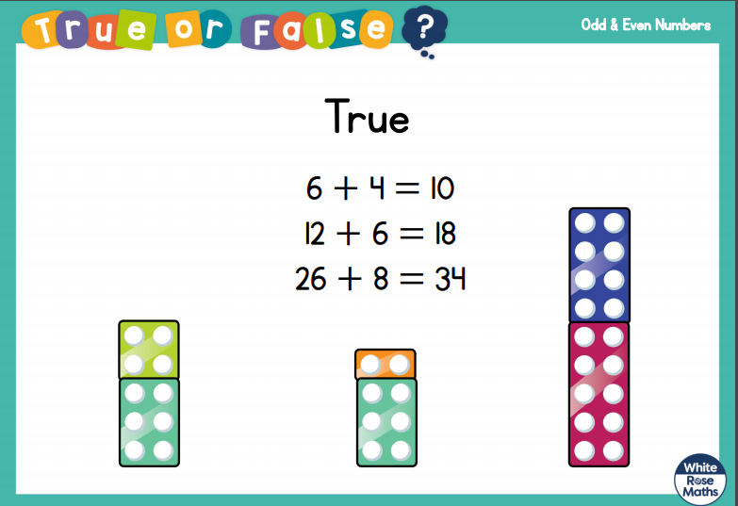

Slide 8
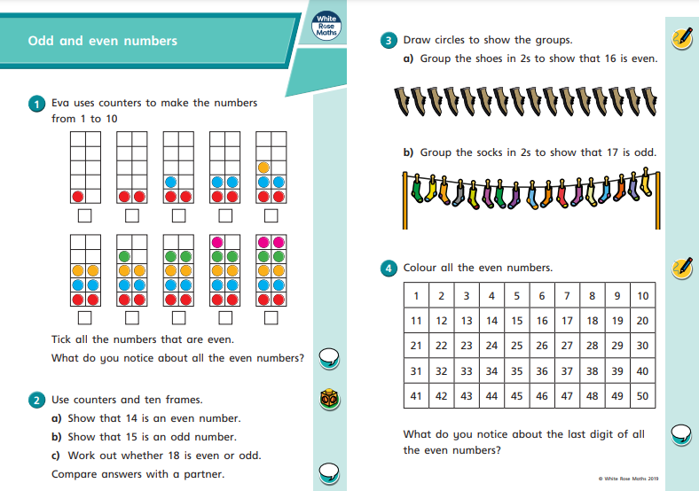
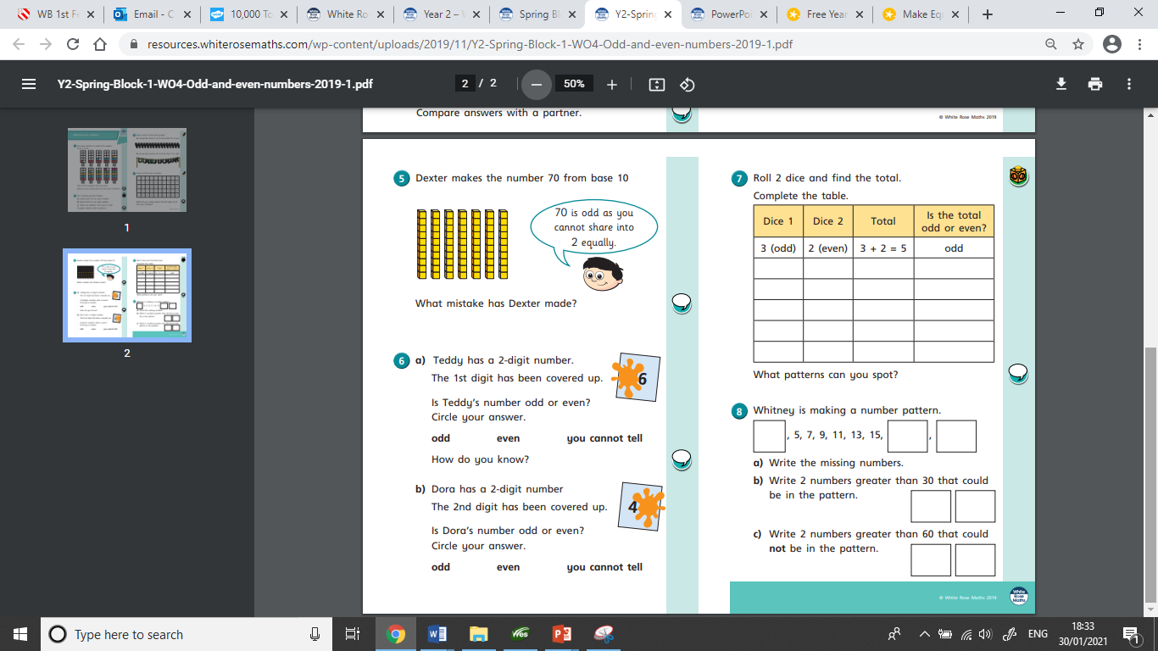
This is the worksheet set today.

Slide 9
2/2/2021
LO: Practical activity:
making equal groups- sharing

Slide 10
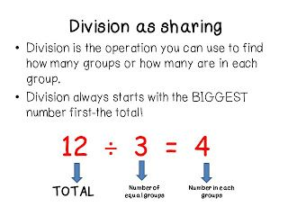

Slide 11
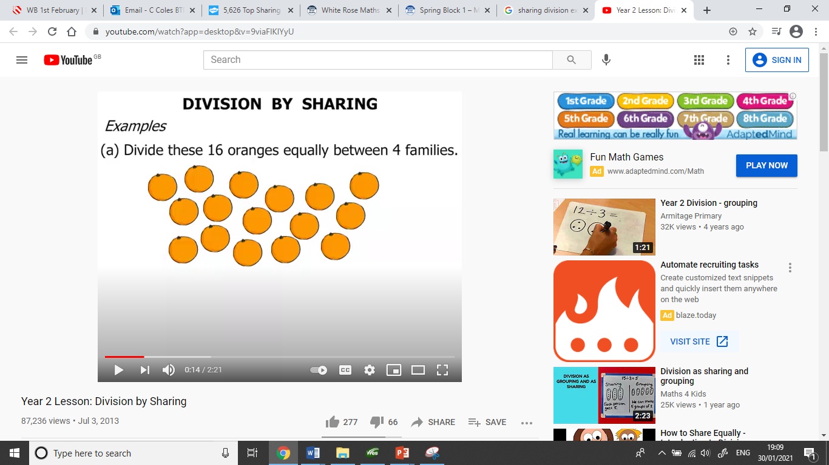

Slide 12
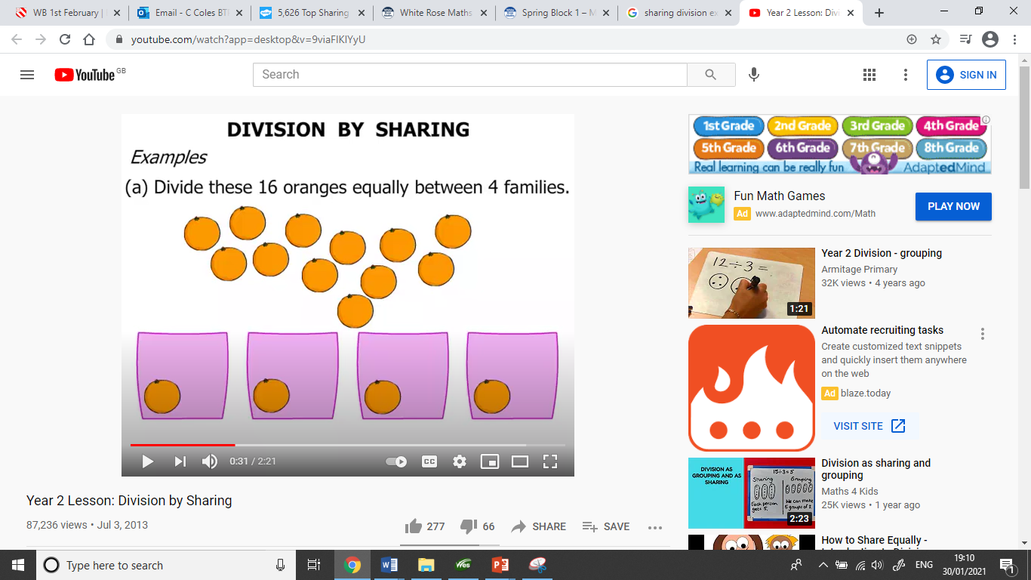
When you are sharing remember to share 1 at a time to each group.

Slide 13
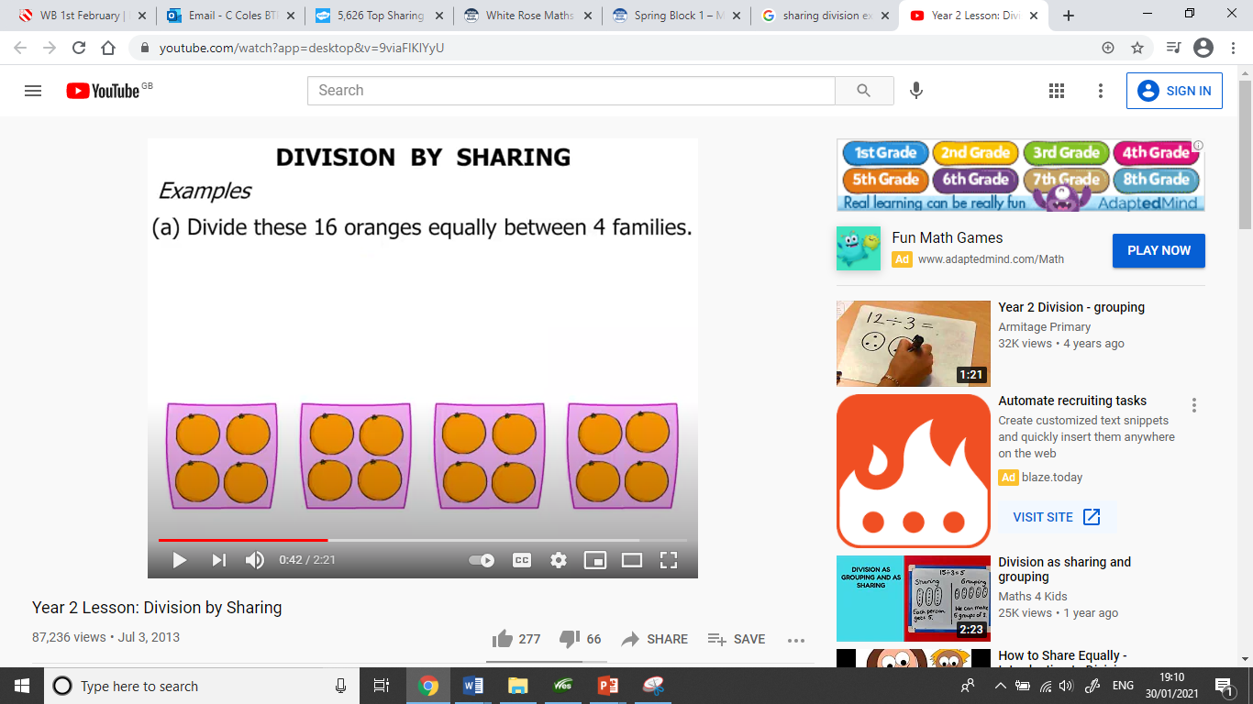
When you have shared them all check the groups are equal.
What would the sum be for this question?.

Slide 14
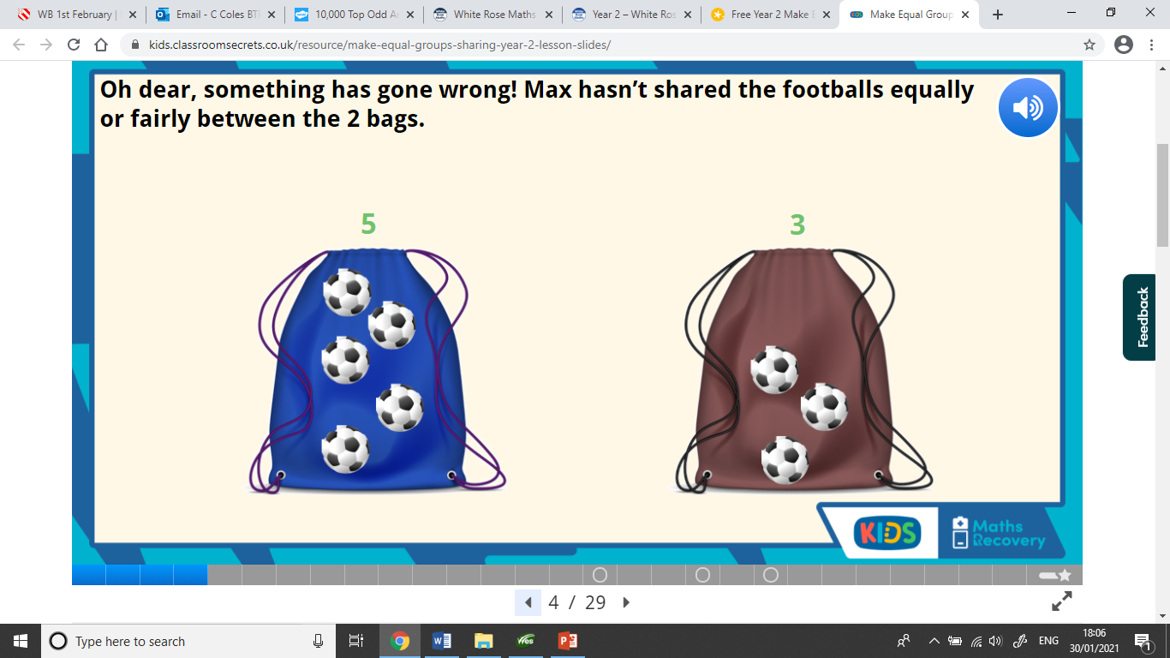

Slide 15
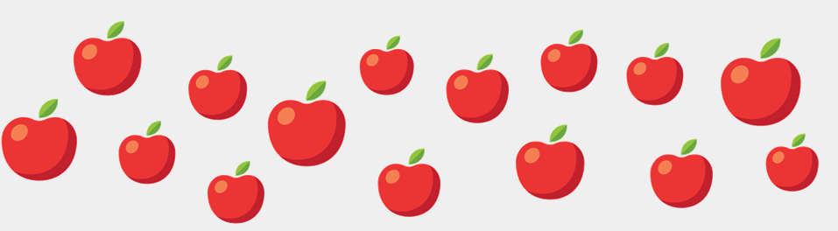
Share the apples into equal groups. Complete the stem sentence.
 | is shared into |  | groups of

Slide 16
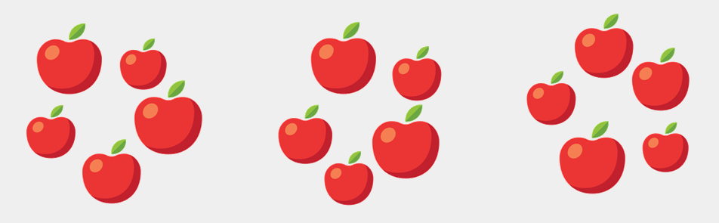
Share the apples into equal groups. Complete the stem sentence.
15 | is shared into | 3 | groups of | 5

Slide 17
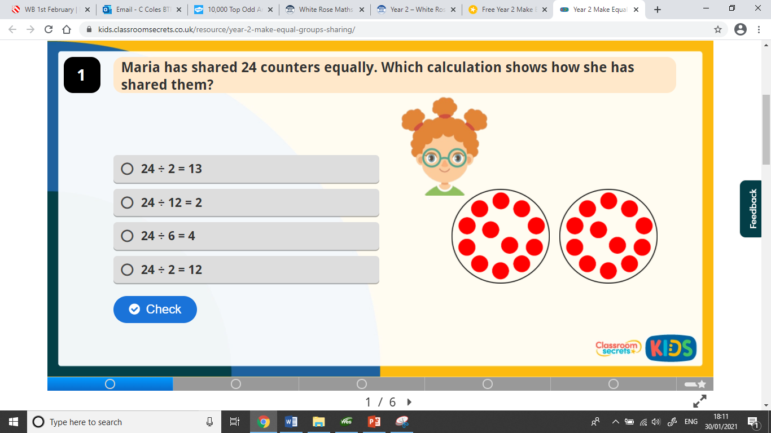

Slide 18
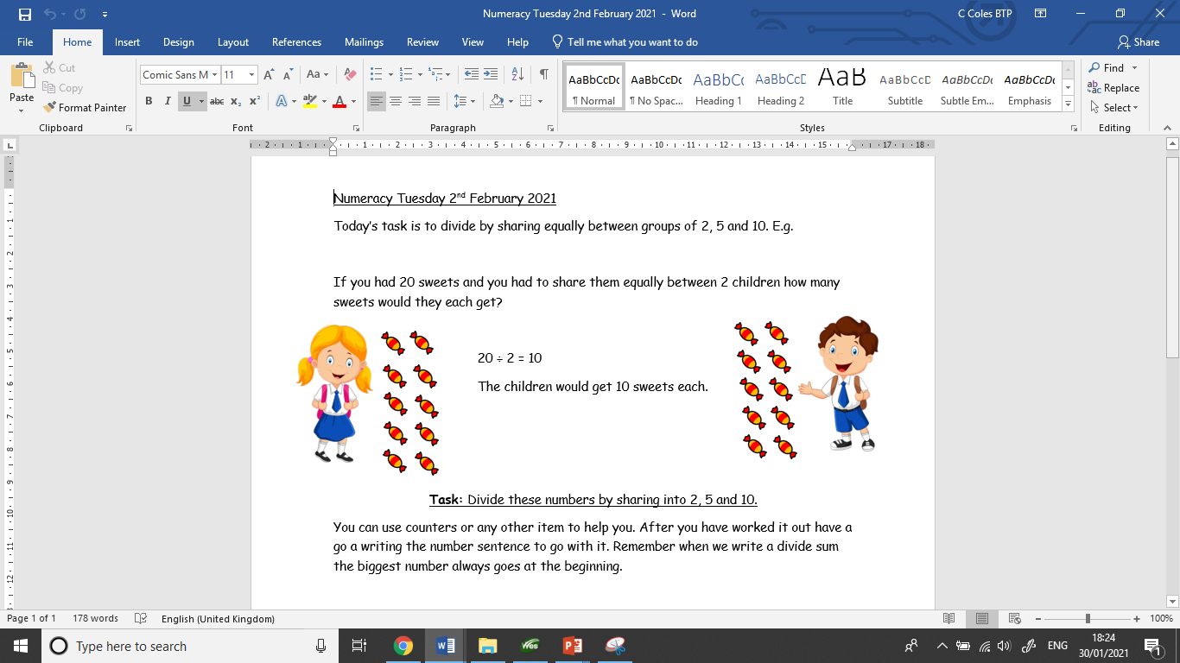
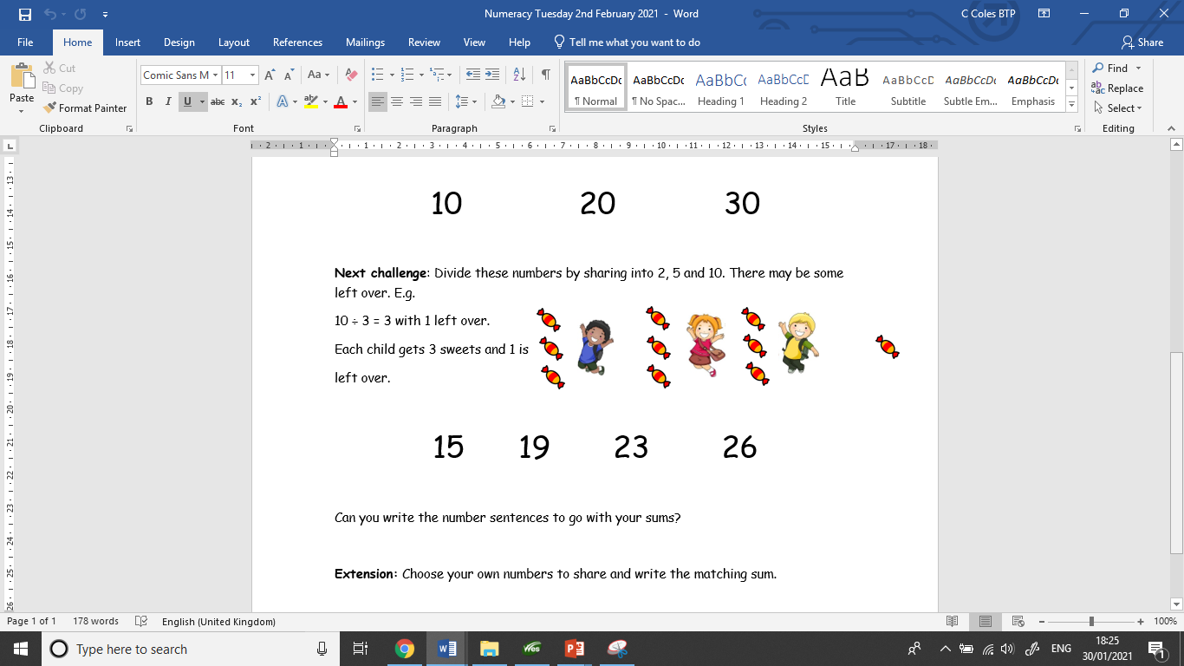
Your set task today.

Slide 19
3/2/2021
LO: Make equal groups - sharing

Slide 20
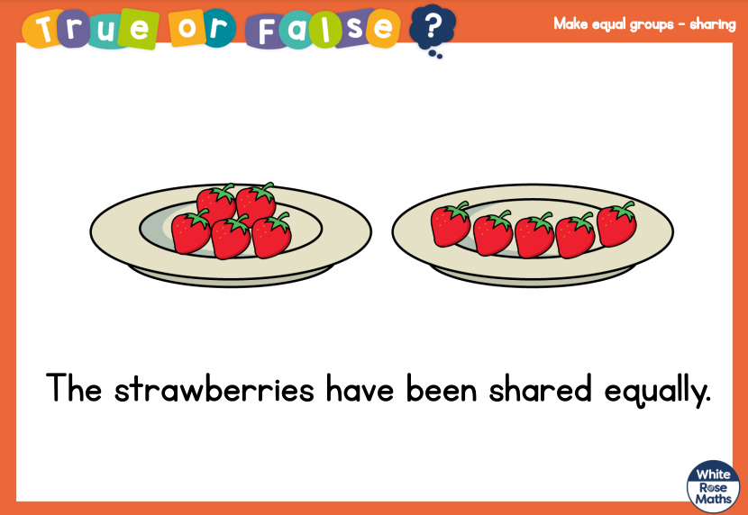

Slide 21
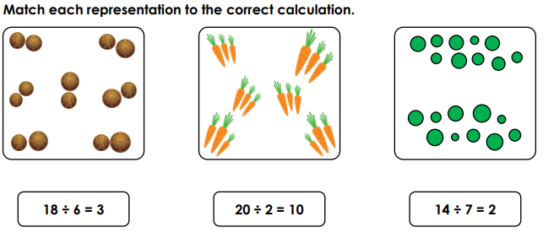

Slide 22
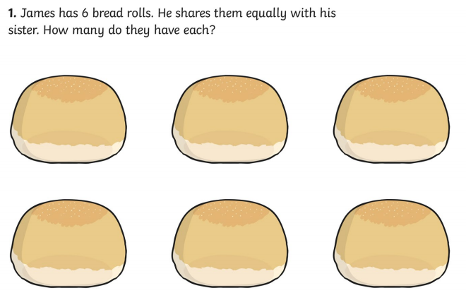

Slide 23

Complete the number sentence
12 | ÷ |  | =

Slide 24
Complete the number sentence
12 | ÷ | 4 | = | 3

Slide 25
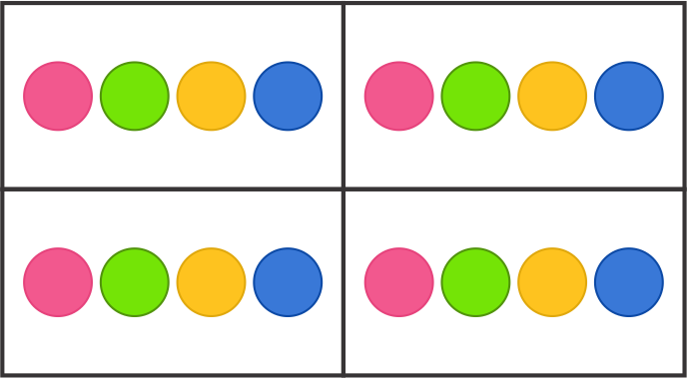
What would the sum be for this picture?.

Slide 26
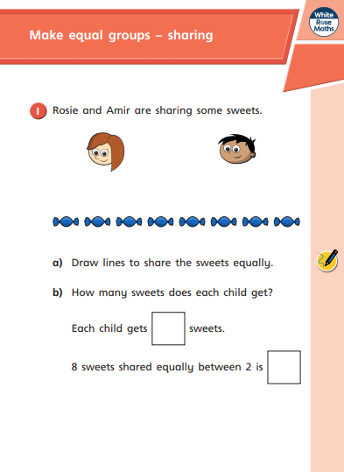
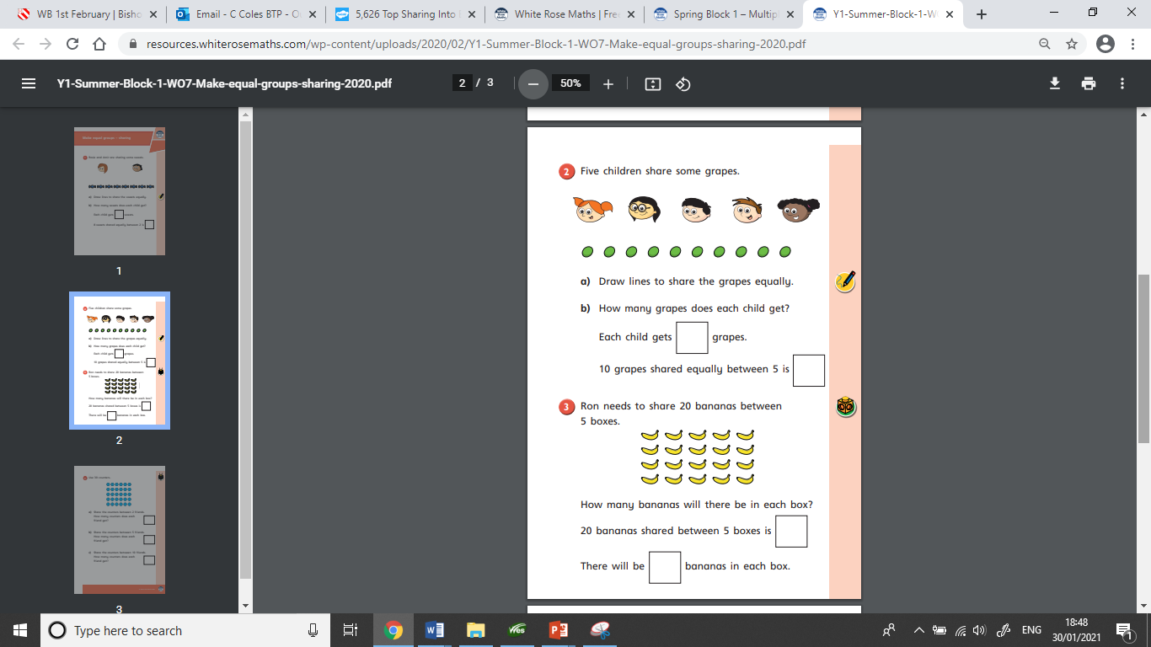
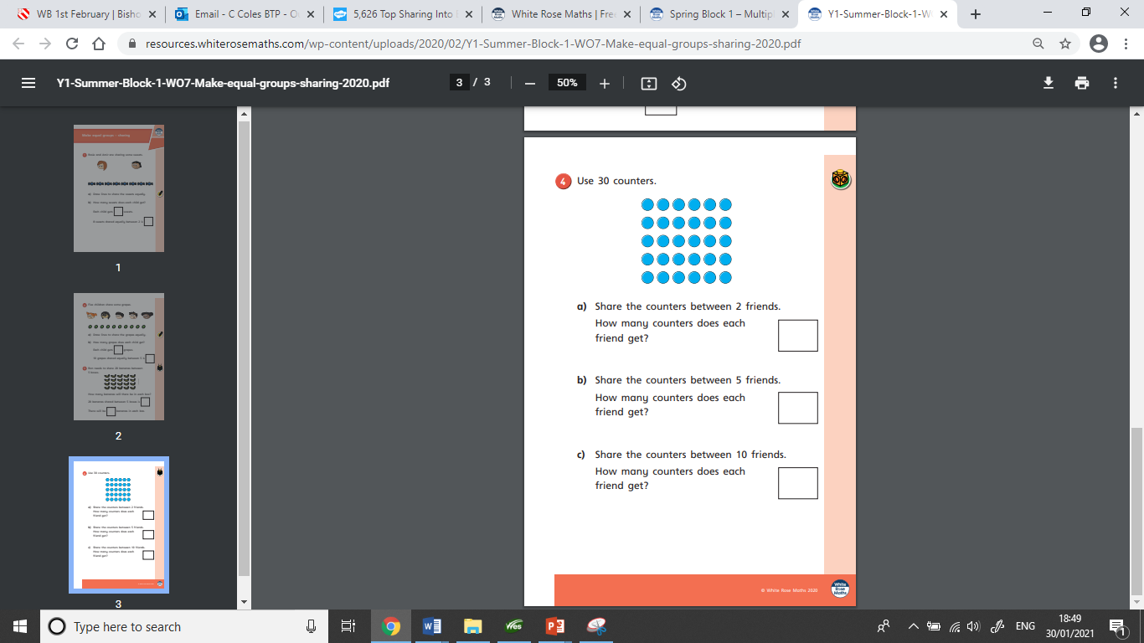
This is the worksheet set today.

Slide 27
4/2/2021
LO: Make equal groups - sharing

Slide 28
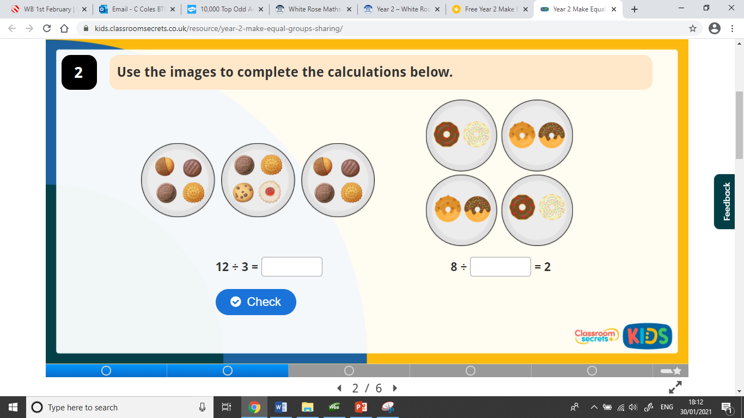

Slide 29
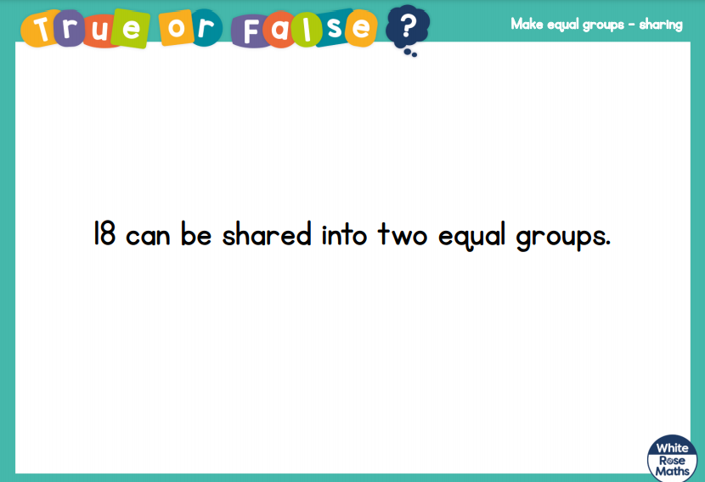

Slide 30
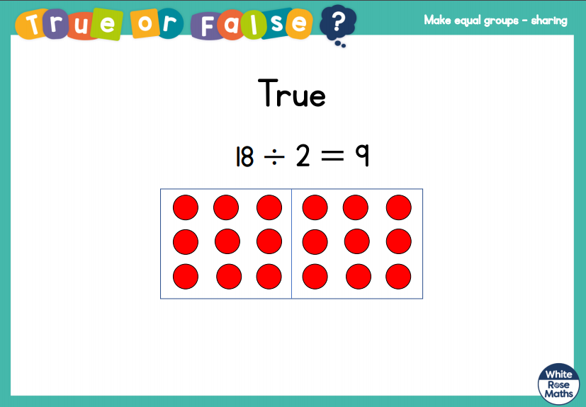

Slide 31
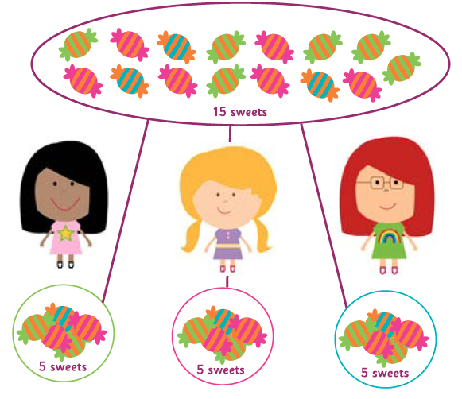
Is this correct?

Slide 32
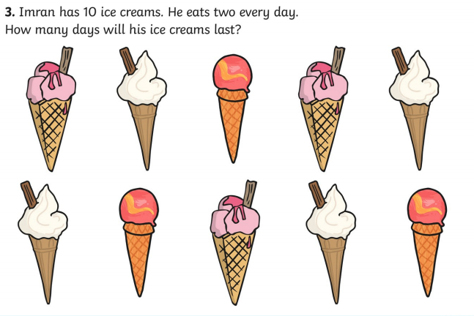
10 ÷ 2 = 5

Slide 33
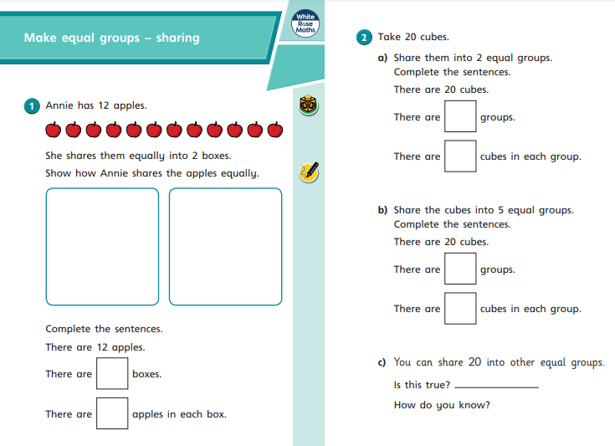
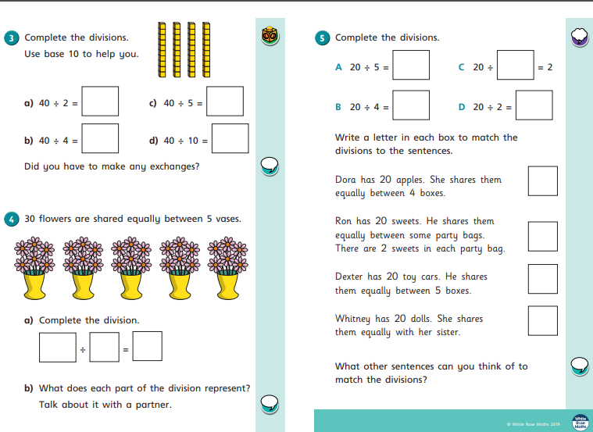
This is the worksheet set today.

