Slide 1

Monday 16th November 2020

Slide 2
This week’s Red words
them
said
went
when
this

Slide 3
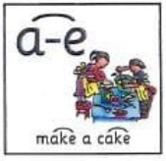
Today’s sound is
a-e

Slide 4
a-e words
brave
shape
bake
make
plane
snake

Slide 5
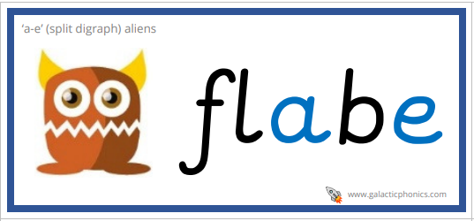
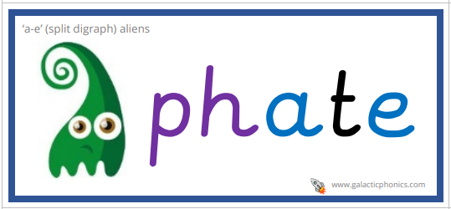
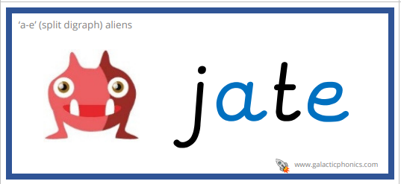
a-e alien words

Slide 6
a-e sentences
Look over there, I can see a long green snake.
I went to the shop to get some star shaped cakes.
When are we going to go outside to see the big plane? said the girl.

Slide 7
Tuesday 17th November 2020

Slide 8
This week’s Red words
them
said
went
when
this

Slide 9

Today’s sound is
i-e

Slide 10
i-e words
five
smile
daytime
Mike
kite

Slide 11

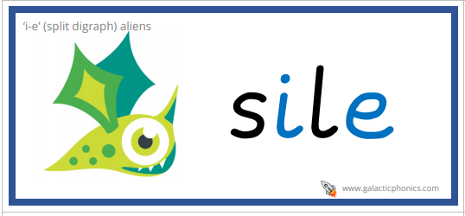
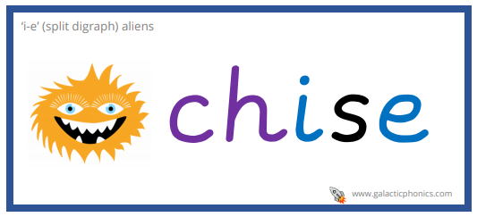
i-e alien words

Slide 12
i-e sentences
When should we go for our bike ride today?
There are nine big beehives in the park.
I can see the beautiful prizes in the sunshine.

Slide 13
Wednesday 18th November 2020

Slide 14
This week’s Red words
them
said
went
when
this

Slide 15

Today’s sound is
o-e

Slide 16
o-e words
episode
nose
explode
home
wrote
rope

Slide 17

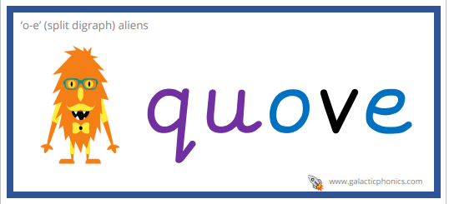
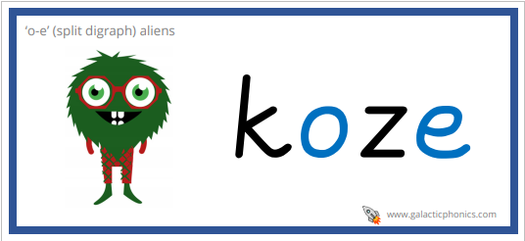
o-e alien words

Slide 18
o-e sentences
They were watching their favourite episode of Go Jetters.
Have you seen the note that I wrote to send home? Said the girl.
My home is in Rome. It is a city in Italy, have you been there this year?

Slide 19
Thursday 19th November 2020

Slide 20
This week’s Red words
them
said
went
when
this

Slide 21
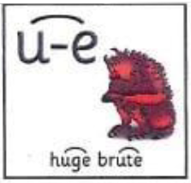
Today’s sound is
u-e

Slide 22
u-e words
volume
perfume
June
confused
rude

Slide 23

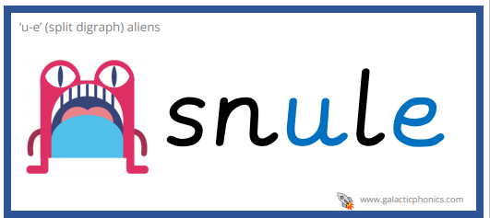
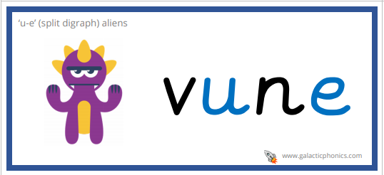
u-e alien words

Slide 24
u-e sentences
Where should we go on holiday in June?
The rude girl said she liked my sweet perfume.
The volume was high but I was confused because I still couldn’t hear it.

Slide 25
Friday 13th November 2020

Slide 26
This week’s Red words
them
said
went
when
this

Slide 27
This weeks sounds

Slide 28
Words
amuse
tune
telephone
flute
throne
joke
dude

