Slide 1

Friday 21st May 2021
L.O. To answer questions about a story using evidence from the text.

Slide 2
This week we have been reading the story Leaf by Sandra Dieckmann. Today you are going to use the words in the text to answer questions about this story. Let’s practise answering some questions in a full sentence.
We must remember to …
Use the words in the question to start our answers
Use capital letters, finger spaces and full stops.
Support our answers using evidence in the text. (What words tell you the answer)

Slide 3
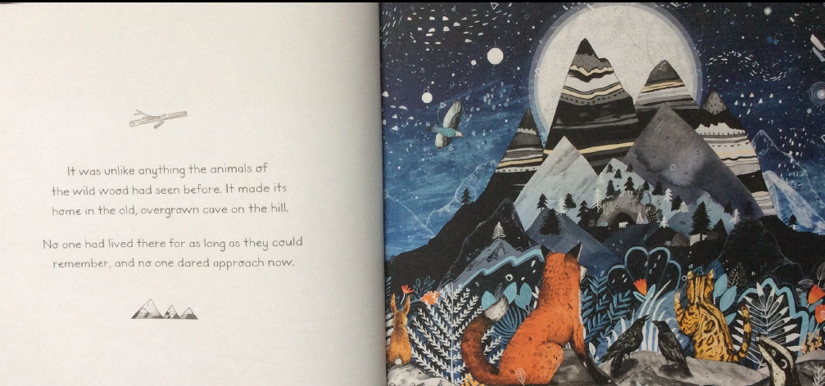
Let’s answer some questions together.
Where did the mysterious animal live?

Slide 4
Let’s answer some questions together.
Where did the mysterious animal live?
The mysterious animal made its home in the old, overgrown cave in the hill.

Slide 5
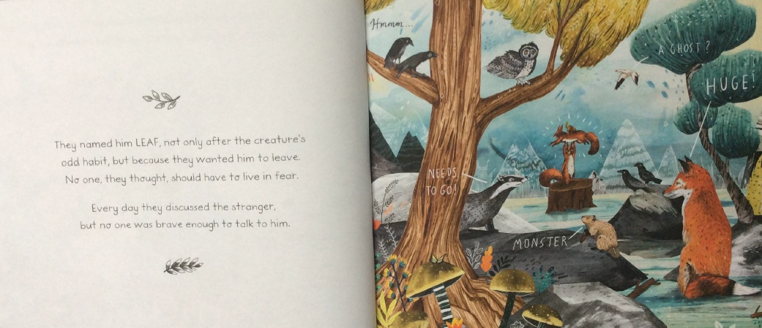
Why did the animals call the mysterious animal Leaf?

Slide 6
Why did the animals call the mysterious animal Leaf?
The animals called the mysterious animal leaf because he collected leaves and they wanted him to leave.

Slide 7
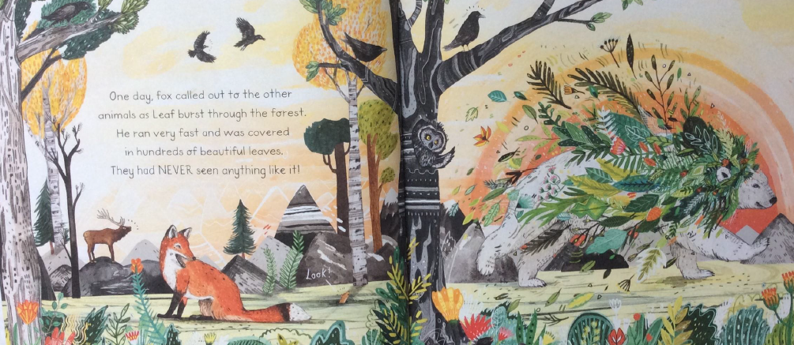
What adjective did the author use to describe the leaves?

Slide 8
What adjective did the author use to describe the leaves?
The author used the word ‘beautiful’ to describe the leaves.

Slide 9
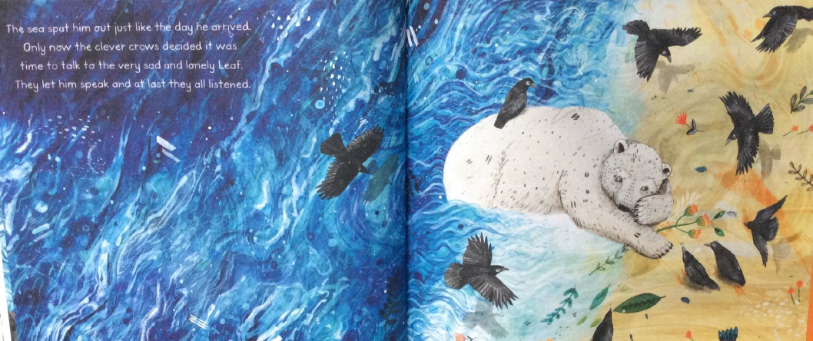
How did Leaf feel when he was washed up on the shore?

Slide 10
How did Leaf feel when he was washed up on the shore?
I think that Leaf felt very upset when he was washed up on the shore. I know this because the author says that he felt ‘sad’ and ‘lonely’.

