Slide 1


Slide 3

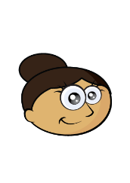
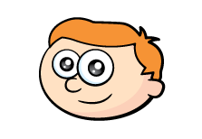
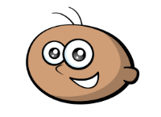

Finding a quarter means making
4 equal groups.
There are 8 balloons.
Do I have a quarter of the balloons?

Slide 4
Finding a quarter means one of
4 equal groups
I like to start by finding a half.
4
A half of 8 is
A quarter of 8 is
2

Slide 5

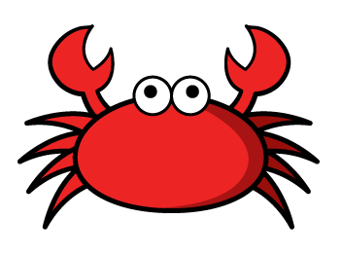
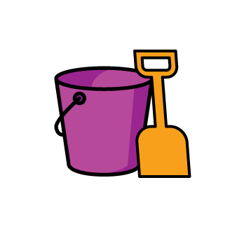
Can you find a quarter of the crabs?
Have a think
One half of 12 is
6
3
One quarter of 12 is

Slide 6
Build an array of 16.
First find half.
Then find a quarter.

Slide 7



If this is a quarter, what is the whole?
Have a think
A quarter of is
4
1
A half of is
4
2
The whole is
4

Slide 8
Begin with 4 blocks.
If this is a quarter… what is a half?
What is the whole?

