Slide 1
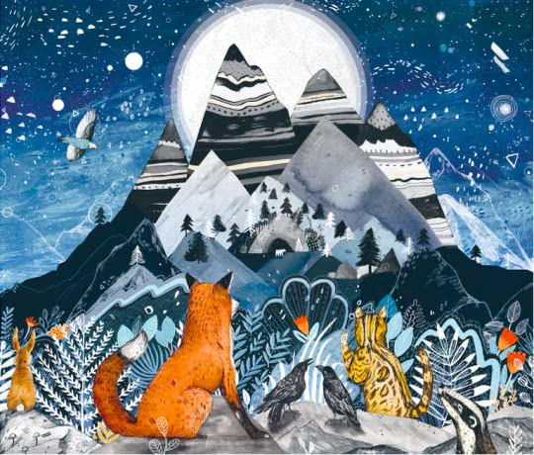
Wednesday 19th May 2021
LO: To create language in the landscape using adjectives and similes
Extension: To use metaphors.
trees
mountains
moon
stars
rocks
cave
sky
peaks

