Slide 1
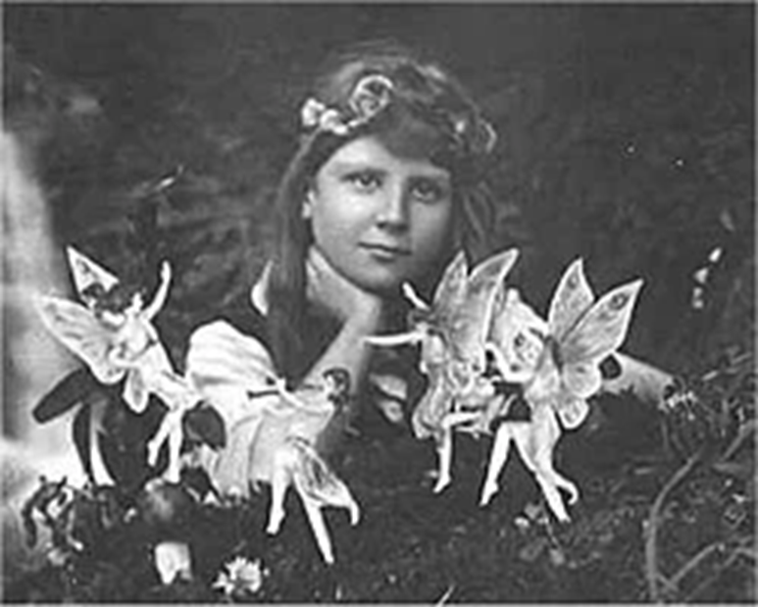
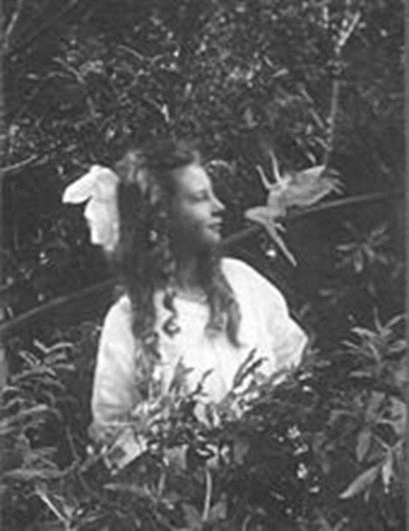
Monday 17th May 2021 LO: To write about whether you believe in something or not.
Monday 17th May 2021 LO: To write about whether you believe in something or not.

