Slide 1

Monday 17th May 2021

Slide 2
This week’s Red words
them
went
about
people
that

Slide 3

Today’s sound is
ow

Slide 4
ow words
frown
powder
gown
shower
crown
town

Slide 5

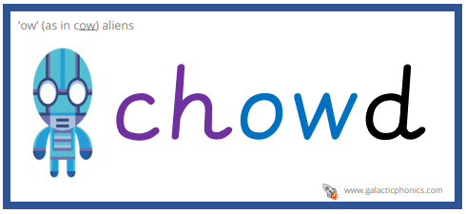
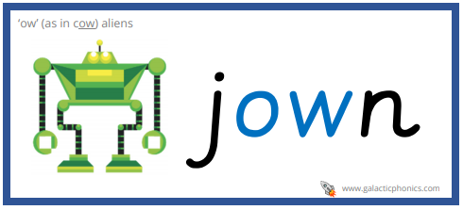
ow alien words

Slide 6
ow sentences
The small child who was frowning told me about their day.
The busy town had a huge shop which sold showers to lots of people.
There is a beautiful Queen who wears lovely blue gowns and shiny crowns.

Slide 7
Tuesday 18th May 2021

Slide 8
This week’s Red words
them
went
about
people
that

Slide 9
Today’s sound is
ow

Slide 10
ow words
down
clown
flower
brown
power
allow

Slide 11
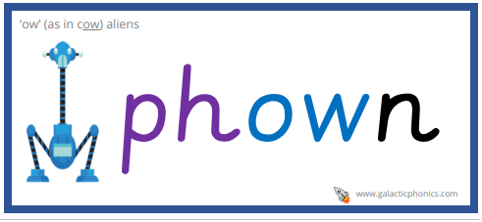

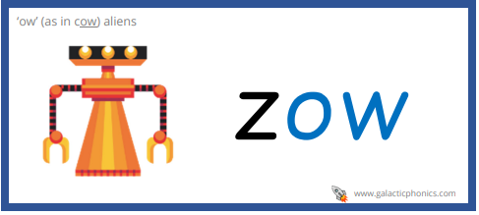
ow alien words

Slide 12
ow sentences
A lot of people are scared of clowns, but I think that they are funny.
In Rapunzel the witch wanted the flower because it gave here powers to stay young.
I have always had dark brown hair and I was not allowed to change it.

Slide 13
Wednesday 19th May 2021

Slide 14
This week’s Red words
them
went
about
people
that

Slide 15
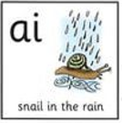
Today’s sound is
ai

Slide 16
ai words
tail
daisy
rainbow
chain
train

Slide 17
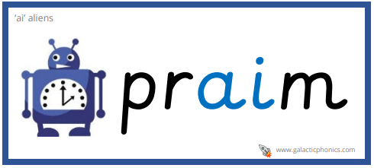
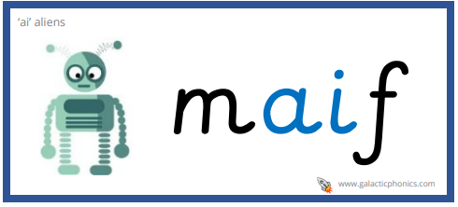
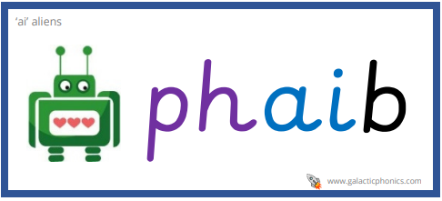
ai alien words

Slide 18
ai sentences
Daisy is the name of a flower and can be a person’s name.
I went outside for a long walk and I saw a beautiful rainbow.
The long train journey I went on was packed with lots of people.

Slide 19
Thursday 22nd October 2020

Slide 20
This week’s Red words
them
went
about
people
that

Slide 21
Today’s sound is
ai

Slide 22
ai words
afraid
raisin
entertain
sail
paid

Slide 23

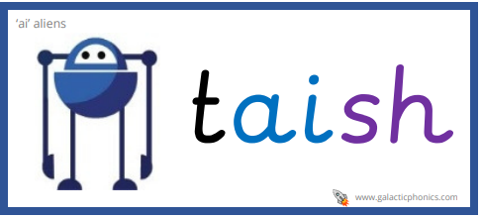

ai alien words

Slide 24
ai sentences
What is your favourite healthy snack? “Mine are raisins” said one of the people behind me.
My friend asked me if I would like to go out sailing with them.
The evening entertainment on the ship was a singing show so I paid to go.

