Slide 1
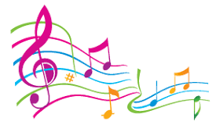
L.O. Compose your own samba rhythm.

Slide 2
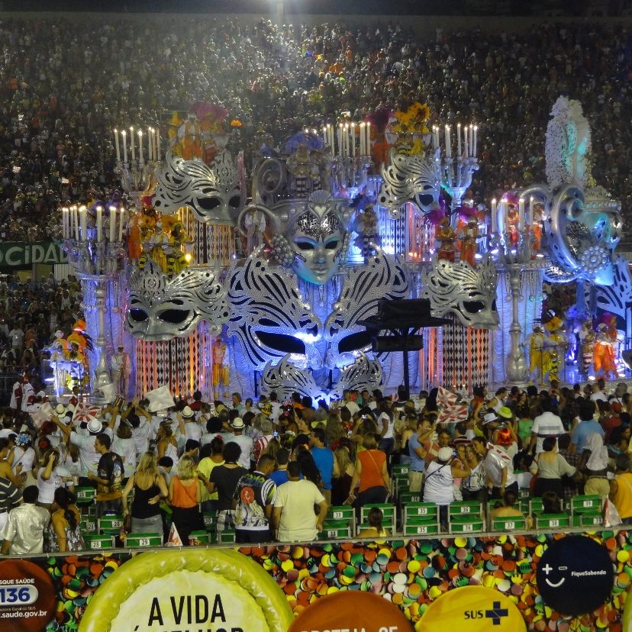
Today you are going to learn about samba music. Samba music is played during carnivals such as the Rio Carnival which takes place in Rio de Janeiro (Brazil).
A carnival is a big festival where there is a lot of music, dancing and people dressing in colourful costumes.
The carnivals in Brazil are famous for the amazing costumes.
The carnival takes place during Lent and begins on the Friday before Ash Wednesday. It can last for four days. Thousands of people go to see the carnivals.

Slide 3
Use the links below to listen to some samba music.
What instruments do you think are being played?
Describe the tempo of the music (speed).
Do you like this type of music?
How would you dance to this type of music?
https://www.youtube.com/watch?v=9ztLCSwg6k0 – Rio Carnival
https://www.youtube.com/watch?v=yZWPYGbcVR8 – Samba Music Mix

Slide 4
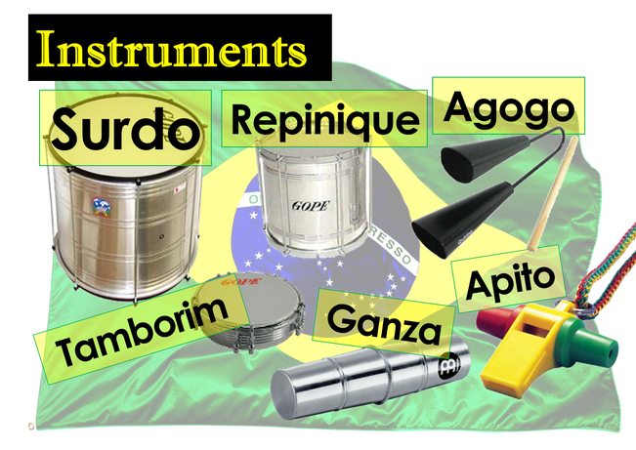
Samba music can be played on any percussion instrument (An instrument that is struck, scraped or has internal beaters e.g. it rattles.) but often special instruments are used at carnivals. These are shown below.

Slide 5
Samba Instruments
Surdo – The ‘Heartbeat’ of the Samba Band. Their patterns DRIVE the Samba.
Repinique – The repinique is a metal-shelled drum tuned to a high pitch and is often the loudest part of the band. The word Repinique comes from the verb “to call”, so it is the calling drum.
Agogo – Set of two (or three) pitched cowbells played with a beater. Plays a syncopated lively part with high and low notes.
Tamborim – Plays the ‘Groovy’ rhythms with a multi-pronged beater.
Ganza – These are metal shakers which give the “cricket in the background” sound. The ganza is a metal tube containing beans, rice or gravel.
Apito – This is a whistle with 3 holes which vary the pitch so that you can play tunes. It is used for calling and leading, played by the group leader to indicate the sections of the piece

Slide 6
Now it is your turn to create a samba rhythm using the musical instrument you have made or anything you can find around the house that can be tapped or shaken to make a sound.
Samba music is made by layering up sounds.
Choose an instrument then choose a tempo ( speed) to play that instrument at. You could use an animal name to help you know how many beats to hold the note for e.g. fish 1 beat, frog 2 beats, tadpole 2 beats the same speed as the fish.
Next choose another instrument to play at the same time as the first instrument but use a different beat. You may need to ask family members to help you.

Slide 7
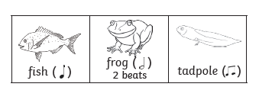
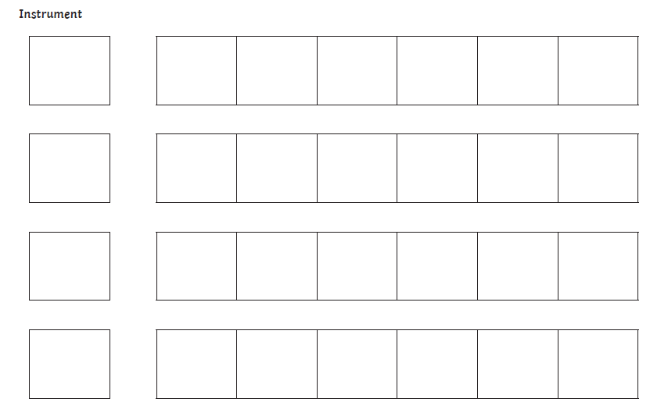
Resources
Cut out the fish, frog and tadpole pictures provided and stick them on the sheet to compose your own rhythm.

Slide 8
Party Time
Now you have composed your samba rhythm it is time play your instruments, sing and dance. Below is a link to videos which can help you learn some carnival dance moves.
https://www.youtube.com/watch?v=0UL2iWMAU4k – Just Dance Samba (Couples Dance)
https://www.youtube.com/watch?v=nbs79mpN73M – Just Dance Individual Samba

