Slide 1

Wednesday 24th March
PSHE – L.O. To understand why it is great to be friends with people who are different to ourselves.

Slide 2
In the story the Smeds and the Smoos by Julia Donaldson the two groups of creatures are not allowed to be friends because they are different to each other.
Use the link below to listen to the story.
https://www.youtube.com/watch?v=i2nYuA7pMGs

Slide 3
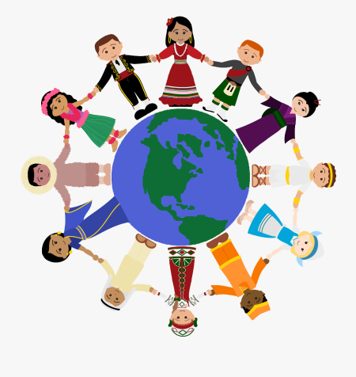
Just like the Smeds and the Smoos, we are all different. Lets think about why it is good to share ideas, be friends with and take part in traditions with people who are different to ourselves.
Here are some differences between people from around the world.

Slide 4
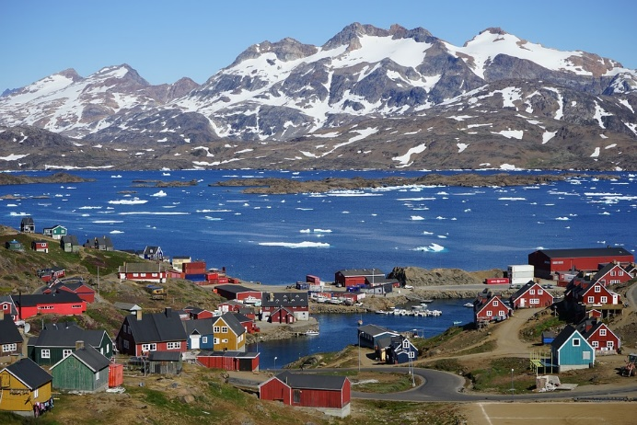

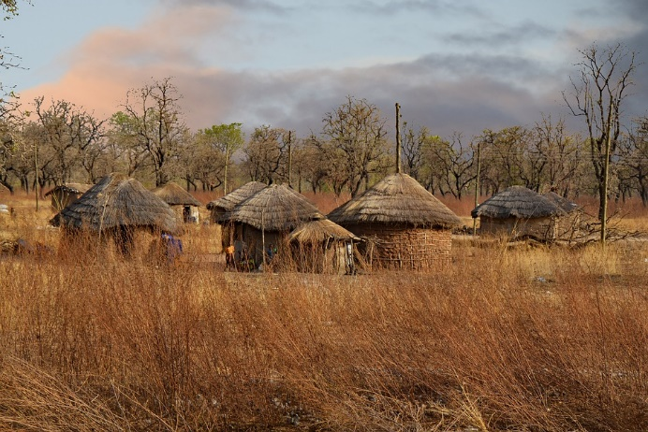
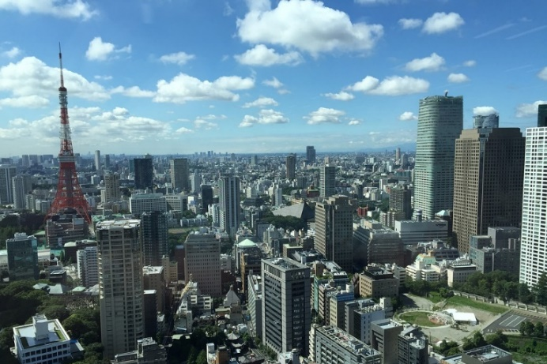
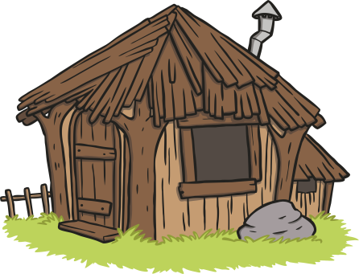
Homes from Around the World

Slide 5
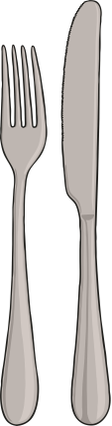
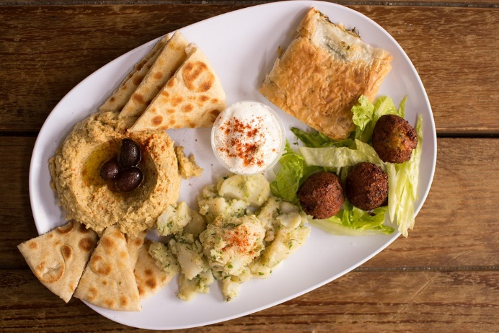
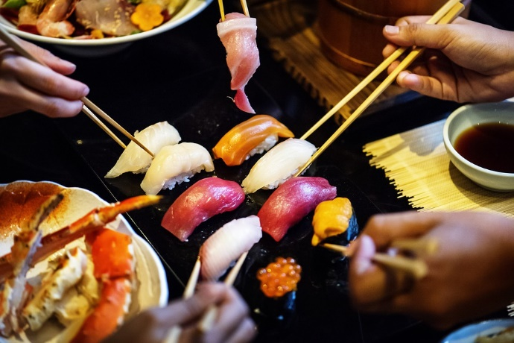
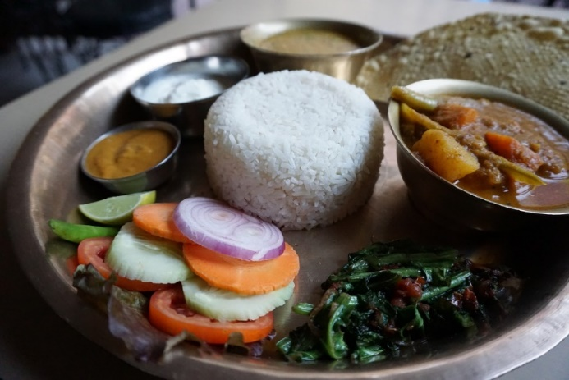
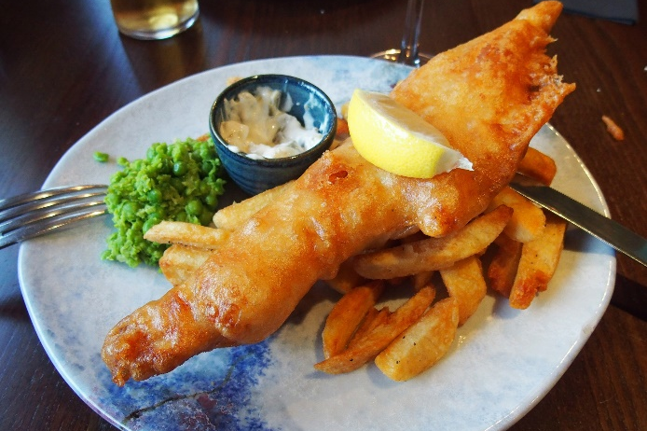
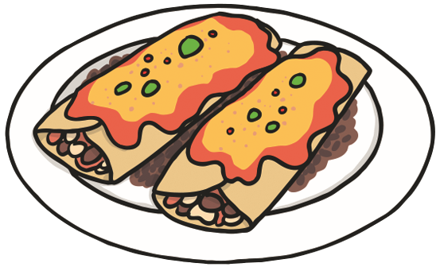
Food from Around the World

Slide 6
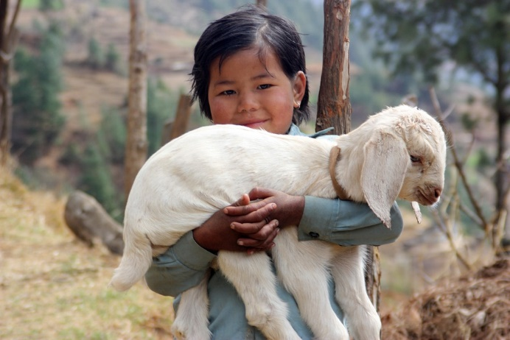
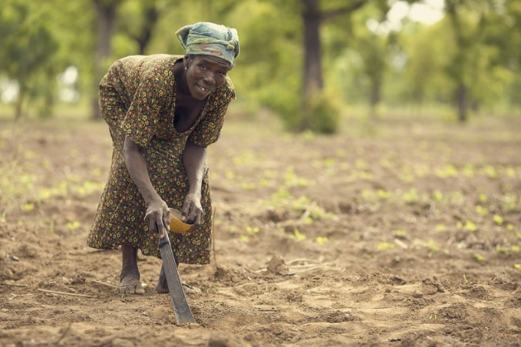
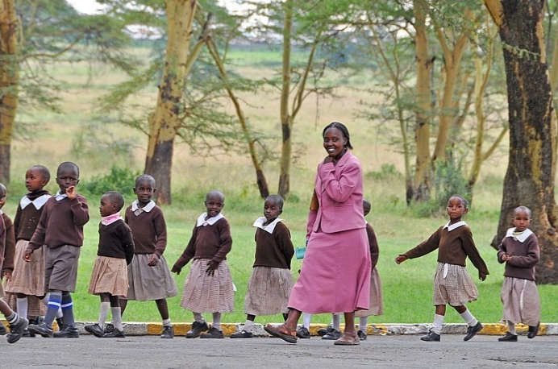
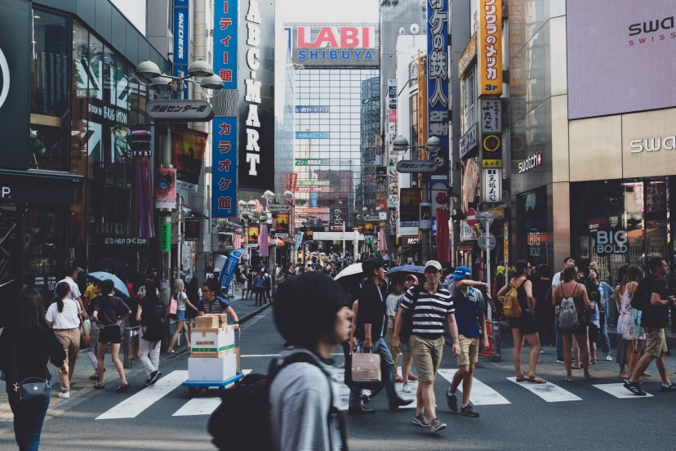
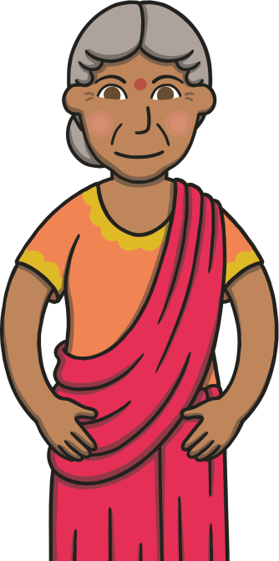
People Around the World

Slide 7
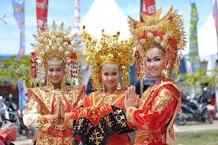
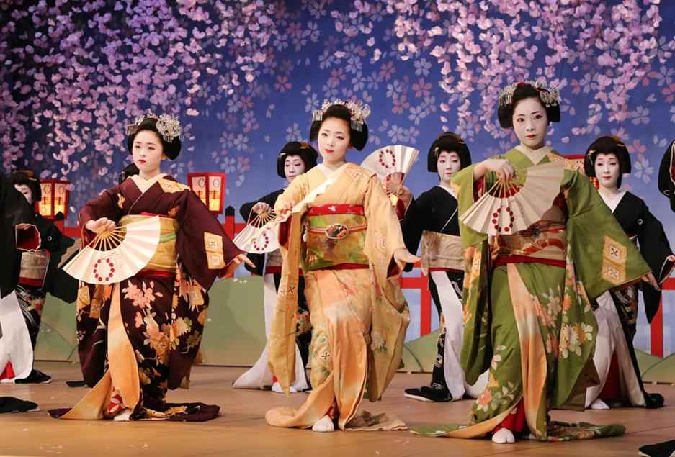
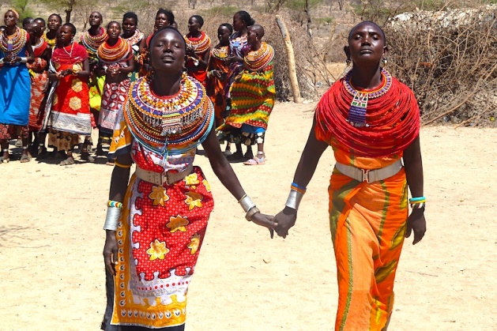

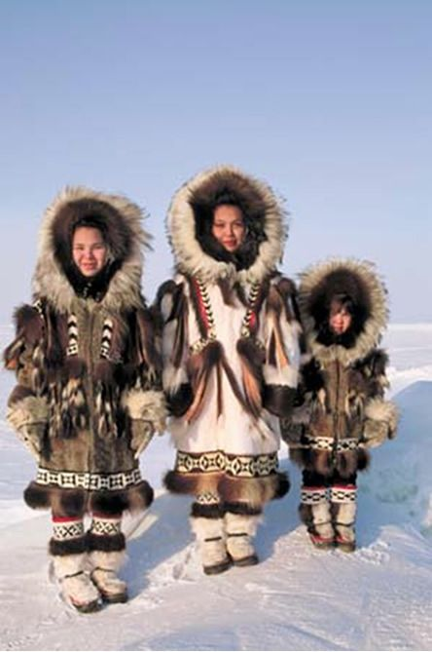
Different Traditional Clothing
Thailand
Japan
Kenya
Scotland
Alaska

Slide 8


United Kingdom
Who?
Children usually live with a parent or parents and siblings.
Grandparents usually live in a different place but children may visit them.
What’s Home?
Families live in a flat (apartment) or a house, sometimes with a
garden. Some children have their own bedroom but some share.
What’s for Dinner?
The mother or the father cooks meals and some families sit around a table together and talk. Food usually comes from a supermarket and can sometimes be delivered to the house! Sometimes, families order a takeaway or
go out to a restaurant to eat.
Did You Know…?
Some children tidy and clean around the house and earn pocket money!

Slide 9

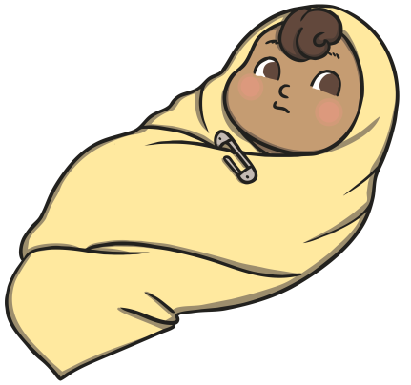
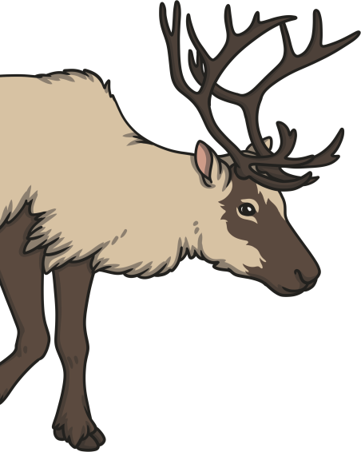
Greenland
Who?
Most families living in Greenland are Inuit. Family is very important and children may live with grandparents, aunties, uncles and cousins.
What’s Home?
Most families live in homes made from stone or wood. In the summer, families may live in tents made from furs or skins. There are
no roads between towns.
What’s for Dinner?
Fresh fruit and vegetables come from other countries because the land is mostly ice. Families go hunting and fishing for reindeer, seal and whales. Food should be shared with the
whole family.
Did You Know…?
Babies are often given the
name of a family member
who has died so that person may never
be forgotten.

Slide 10

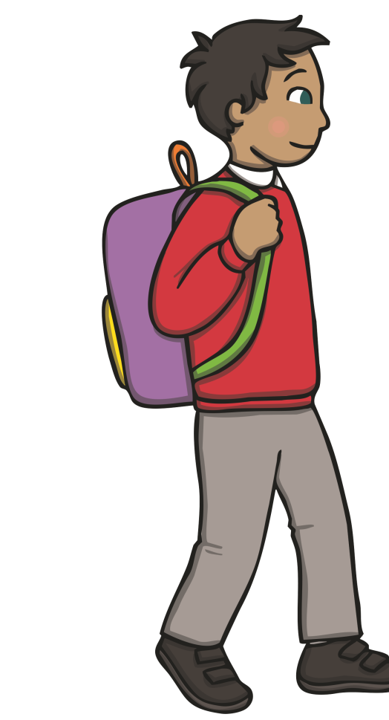
Brazil
Who?
Most families are large and stay close together because family is very important. Children often live with their parents and grandparents.
What’s Home?
Most Brazilians live in cities. Families may live in small apartments and some families live in a ‘favela’ neighbourhood.
What’s for Dinner?
Families eat together. Lunch is usually the biggest meal of the day.
A popular meal is rice and black beans. Meals often end with a strong cup of coffee.
Did You Know…?
Children usually only go to school in the morning
or afternoon.

Slide 11



Japan
Who?
Children usually live with their parents. Grandparents may live nearby. Families meet often for meals and special occasions. Fathers often work long hours away from home.
What’s Home?
Families usually live in small apartments or houses. Children may sleep in the same room as their parents. People usually sleep on futons on the floor.
What’s for Dinner?
Meals are usually cooked by the mother. Rice and miso soup are popular for all three meals of the day. Chopsticks or spoons are used. Families often
sit on cushions on the floor at a low table to eat.
Did You Know…?
5th May is a special day to
celebrate children and to say thank you to mothers.
It is called Kodomo no Hi
(Children’s Day).

Slide 12

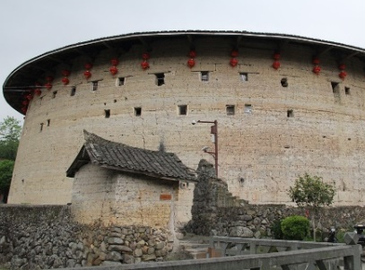
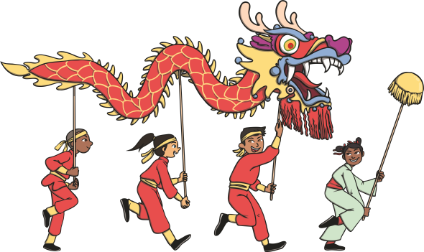
China
Who?
Children often live with their parents, grandparents and even great-grandparents! In the past, families were only allowed to have one child. Children are taught to always respect and obey their parents or elders.
What’s Home?
Families in cities live in flats in tall housing blocks. In the countryside, whole families live together in a simple house.
What’s for Dinner?
Meals are usually cooked by the mother. The same meal may taste different in different parts of the country. Food is cooked in a wok and eaten with chopsticks.
Did You Know…?
In Fujian, a whole
village lives in a
building called
a roundhouse!

Slide 13

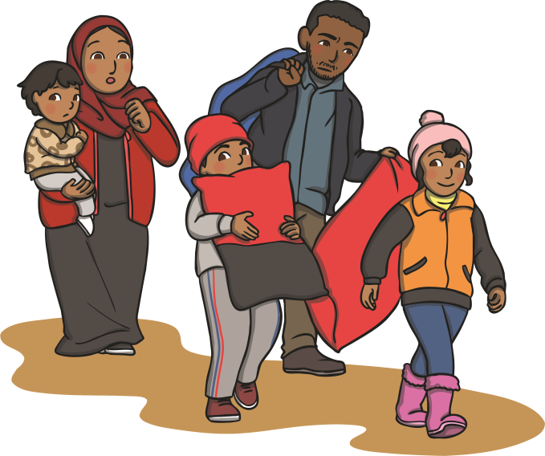
Syria
Who?
Family life is very important. Children usually live with their parents and grandparents but others meet up every day. Children must do what they are told because they must always respect their parents.
What’s Home?
Sadly, there is a war in Syria now. Many families have split up and many people are now refugees. This means they are living very far from home.
What’s for Dinner?
Meals are cooked by the mother. Lunch is the biggest meal of the day and is between 2 o’clock and 3 o’clock. Meze has as many as 30 little dishes! Then, coffee and sweets come at the end.

Slide 14

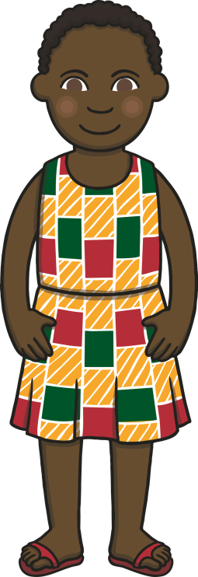

Kenya
Who?
Families are very important and always help each other. Many children are also looked after by their aunts, uncles and grandparents and family friends.
What’s Home?
Usually, people in cities live in houses or apartments made of stone or cement. Elsewhere, some people live in huts of thatch and dried mud.
What’s for Dinner?
The women in the family usually cook the meals. Breakfast is chai (tea) and bread but lunch and dinner are usually stews. Dessert can be delicious local fruits, such as mango.
Did You Know…?
4 in 10 people in
Kenya are 14 years
old or younger.

Slide 15

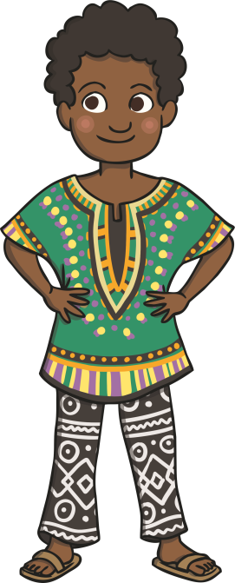
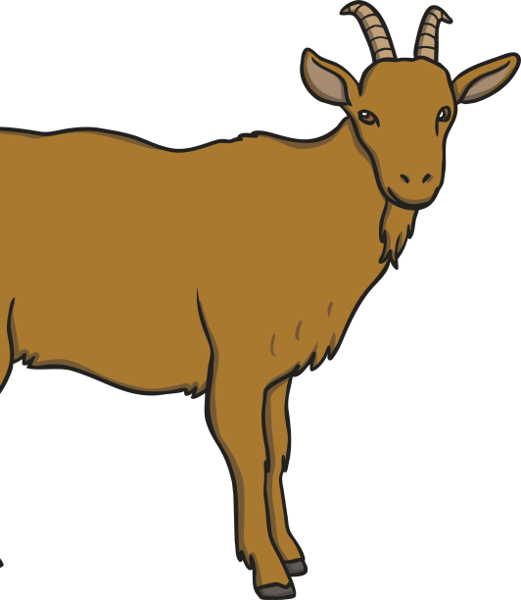
Ghana
Who?
Many families live together in large groups. Sometimes, women stay with their own families even after getting married. Sometimes, men have more than one wife. When a boy grows up, he can go to live with his father or uncle.
What’s Home?
Most families live in the countryside. Homes are all on the ground floor. The rooms go around a square courtyard.
What’s for Dinner?
Usually, families eat a soup or stew for main meals made from yams or plantains. Families keep chickens and goats for special occasions.
Did You Know…?
People in Ghana speak English first and sometimes local languages too.

Slide 16

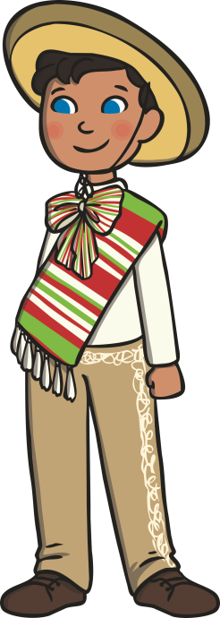
Mexico
Who?
Children usually live with their parents. Sometimes, children may live with their grandparents too. Families join together for big occasions, such as weddings or festivals.
What’s Home?
Many families live in apartments or small houses. The windows look into a small, square courtyard. Some people build their own houses and paint them bright colours.
What’s for Dinner?
The most important meal is in the afternoon. Main meals have corn,
spicy chilli peppers and beans.
Many families eat tortillas with
their meals.
Did You Know…?
Say ‘yes’ by pointing a
finger up then curling
it up and down quickly.

Slide 17
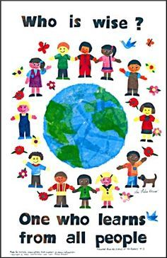
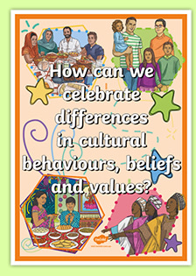

Your Task
Design a poster to tell the Smeds and Smoos why it is great to be friends with people who are different to ourselves. What can we learn from each other? Can we share clothing ideas, music, recipes, artwork and traditions? Decorate your poster in anyway you choose.

