Slide 1
Queen Victoria’s Life Monday 22nd March 2021
L.O. Use dates to order the events in Queen Victoria’s life on a timeline.
1819
1901

Slide 2
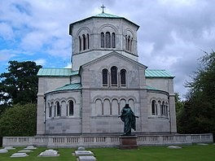
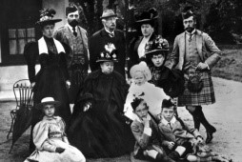

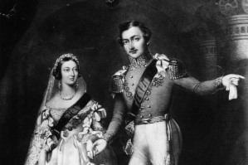
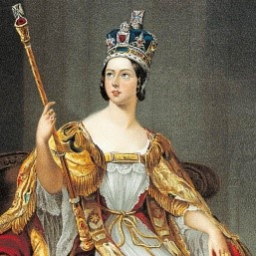
1901 Queen Victoria dies. |  | 1857 Victoria gives birth to the last of her 9 children | 1819 Queen Victoria is born. | 1840 Queen Victoria marries Prince Albert. | 1837 Victoria is crown Queen.
1901 Queen Victoria dies. |  | 1857 Victoria gives birth to the last of her 9 children | 1819 Queen Victoria is born. | 1840 Queen Victoria marries Prince Albert. | 1837 Victoria is crown Queen.

