Slide 2
Last week we began learning about Queen Victoria.
What can you remember about Queen Victoria’s life?
Watch the video to remind yourself if you need to.
https://www.bbc.co.uk/bitesize/topics/zkrkscw/articles/zfdkhbk

Slide 3
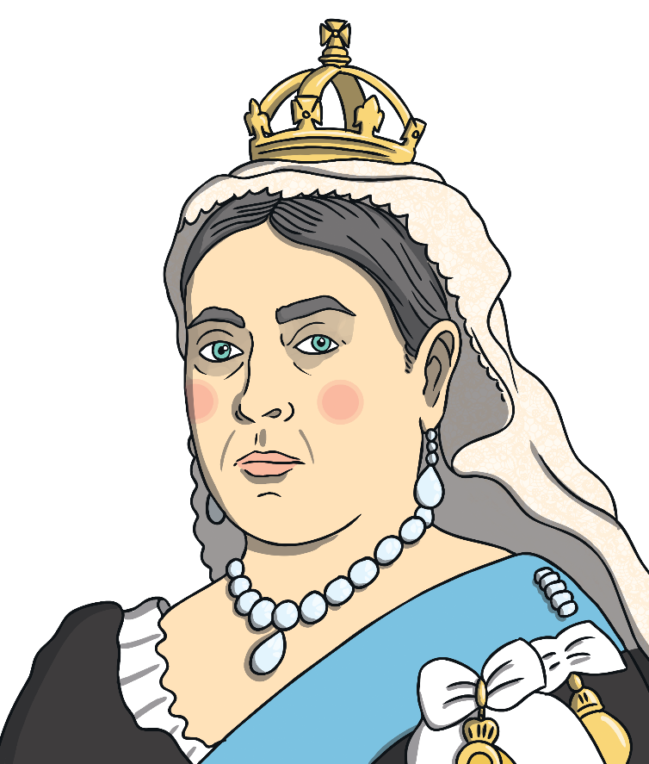
Who was Queen Victoria?
Queen Victoria is one of the most famous monarchs in British history.
She is so famous that a period of history is named after her: The Victorians.

Slide 4
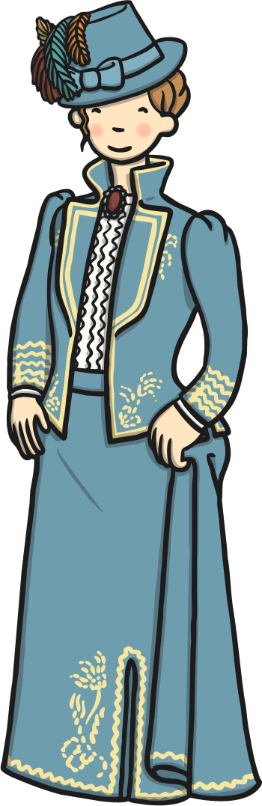
Childhood
Victoria was born on 24th May 1819 in London.
Her father, Edward, Duke of Kent died in 1820, when she was only a baby.
She lived in Kensington Palace with her mother, Victoria, Duchess of Kent.
Victoria didn’t go to school but had a tutor teach her at home.
Victoria could speak many languages, including German, French and Italian.

Slide 5
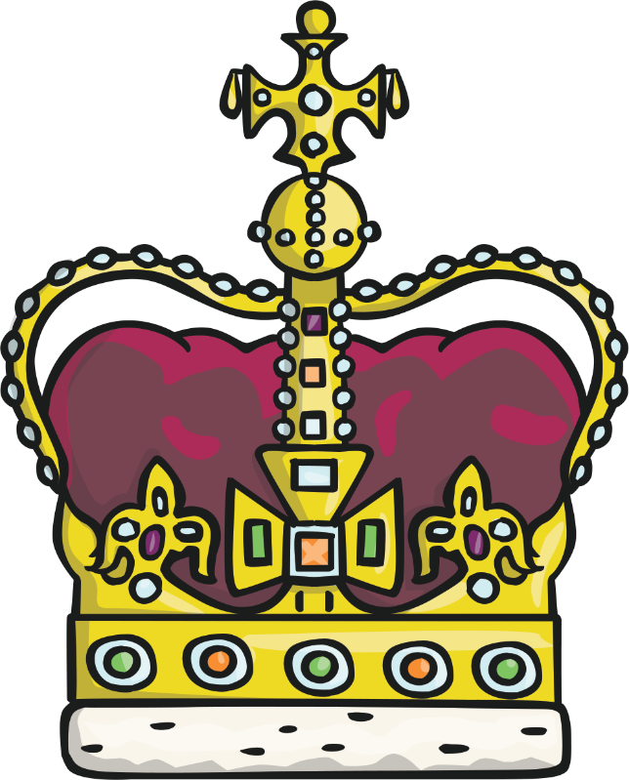
Family
Queen Victoria’s father, Edward, was the son of King George III.
After George III and his successor, George IV, Victoria’s uncle became King William IV.
William had no surviving children who could become the next king or queen after he died so Victoria became her uncle’s heir.

Slide 6
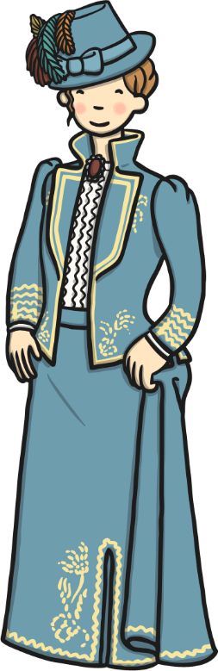
Early Reign
Victoria became queen in 1837 aged 18.
Her coronation was on 28th June 1838 at Westminster Abbey. It lasted for 5 hours and was a spectacular event.
She married her cousin, Prince Albert, in 1840 and together they had nine children.
Sadly, Albert died in 1861 aged just 42. Victoria was so upset by his death she wore black clothing for the rest of her life.

Slide 7
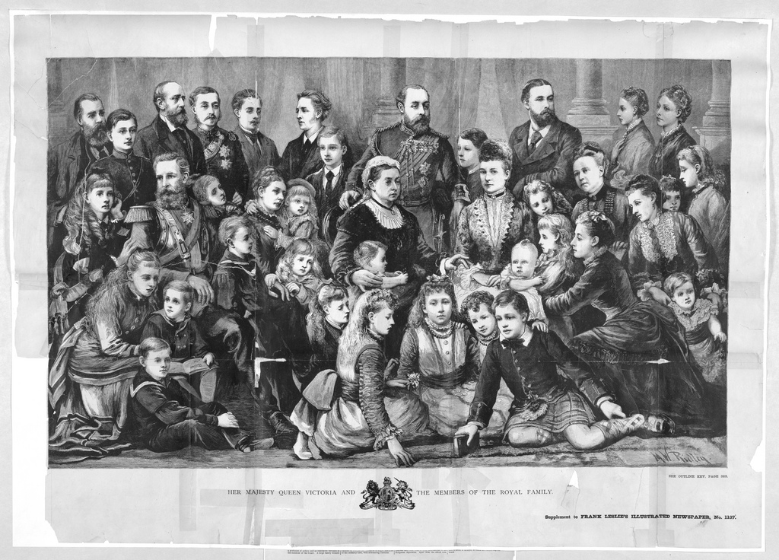
Children
Queen Victoria had four sons and five daughters.
The names of her children were Victoria, Albert, Alice, Alfred, Helena, Louise, Arthur, Leopold and Beatrice.
Queen Victoria also had 42 grandchildren.

Slide 8

Life as Queen
Queen Victoria reigned for 63 years and 7 months. She reigned longer than any king or queen before her. She is still the second longest reigning monarch after Queen Elizabeth II, who passed her record on 9th September 2015.
During her reign, Victoria oversaw 10 Prime Ministers in the UK and many more in other countries she ruled around the world.

Slide 9
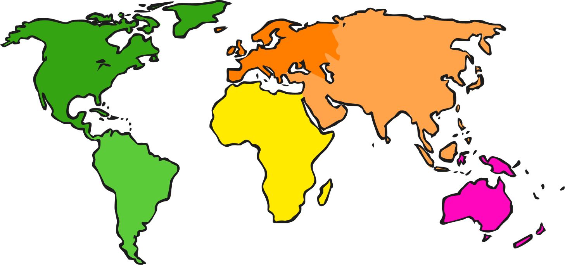
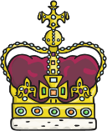
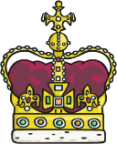
The British Empire
Queen Victoria ruled a huge empire that spread around the world.
The Empire was made up of lots of countries, including Canada, Australia, New Zealand, India and Jamaica.
In 1876, Victoria also became Empress of India.

Slide 10
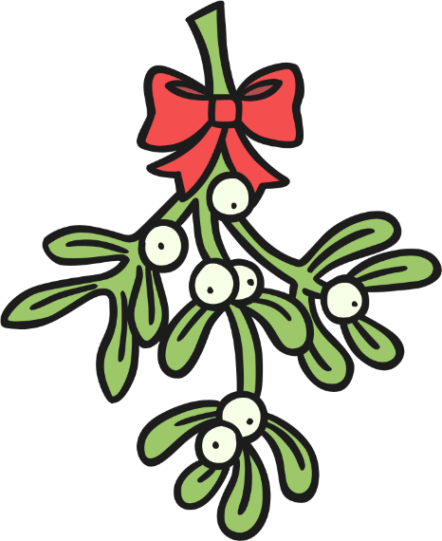
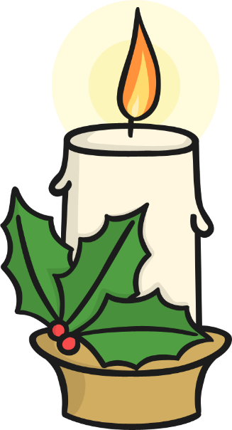
Christmas with The Royal Family
Many Christmas traditions, such as Christmas trees and sending cards, came from Germany.
When Prince Albert married Victoria, he brought these traditions to the UK and made them popular around Britain.
Victorian Christmas trees would be decorated with candles, gingerbread and sweets.
Before then, people may have brought in branches of holly or some mistletoe.

Slide 11
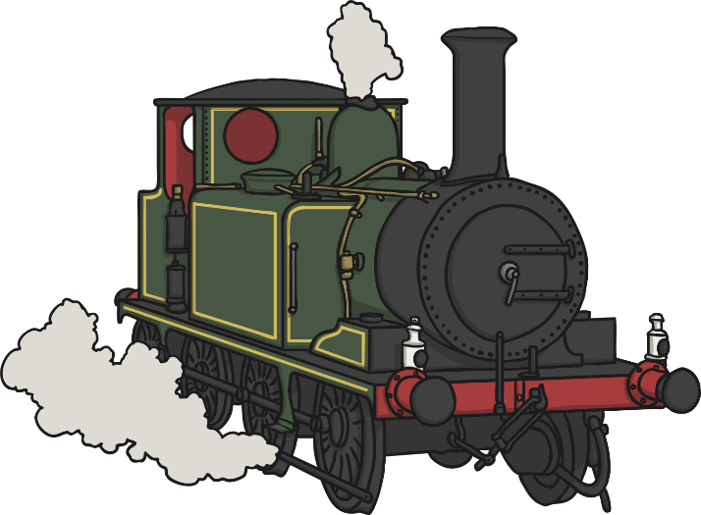
Interesting Facts
In 1842, Victoria rode on a train for the first time, from London to Windsor.
Victoria was very small, only about
5ft tall.
Victoria’s name is actually Alexandrina Victoria but was always just known as Victoria. Her family often called her ‘Drina’.
Victoria is known as the ‘Grandmother of Europe’ as many of her children and grandchildren married into other European royal families.

Slide 12
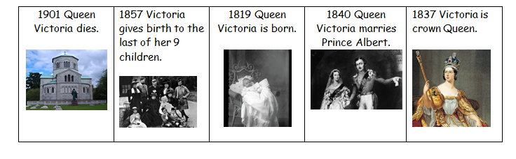
Your Task
Your task today is to order the events in Queen Victoria’s life. Remember to look carefully at the dates to help you.

