Slide 1

Tuesday 23rd March 2021

Slide 2
This week’s Red words
You
are
the
no
my

Slide 3
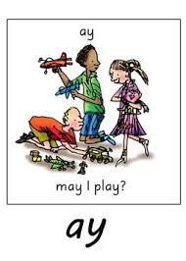
Today’s sound is

Slide 4
ay words
holiday
tray
crayon
stay
spray
play

Slide 5
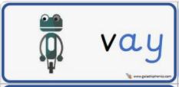
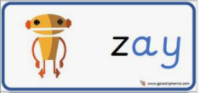
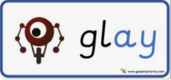
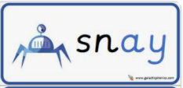
ay alien words

Slide 6
ay sentences
Can I play with you today?
I will pay for the holiday in May.
We will all play with clay on Monday.

Slide 7
Wednesday 24th March 2021

Slide 8
This week’s Red words
You
are
the
no
my

Slide 9
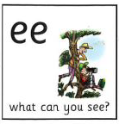
Today’s sound is
ee

Slide 10
ee words
three
sleep
speech
Queen
street
week

Slide 11
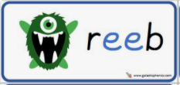

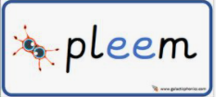
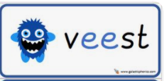
ee alien words

Slide 12
ee sentences
Did you meet the Queen?
My dad said to keep my feet off the seat.
I have lost three teeth this week.

Slide 13
Thursday 25th March 2021

Slide 14
This week’s Red words
You
are
the
no
my

Slide 15

Today’s sound is
igh

Slide 16
igh words
knight
high
delight
right
bright

Slide 17
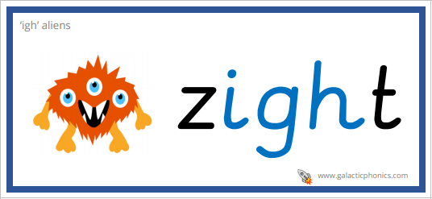
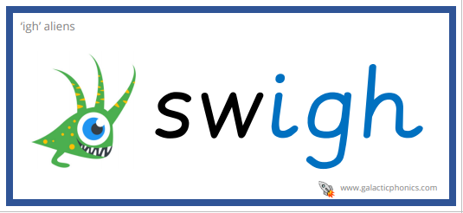
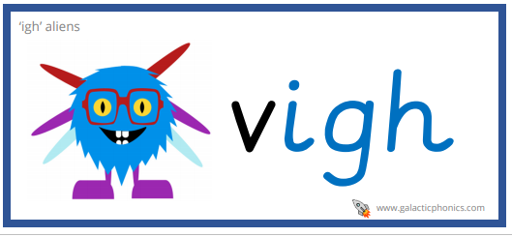
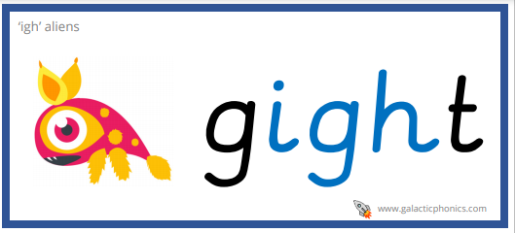
igh alien words

Slide 18
igh sentences
At the end of the street turn right.
Can you please put on the light.
Her dog had a fright at night.

Slide 19
Friday 26th March 2021

Slide 20
This week’s Red words
You
are
the
no
my

Slide 21

Today’s sound is
ow

Slide 22
ow words
snow
window
blow
yellow
pillow

Slide 23
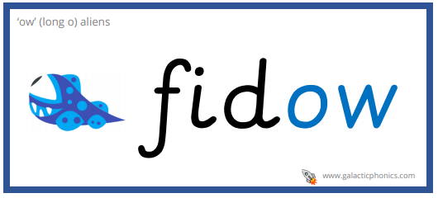
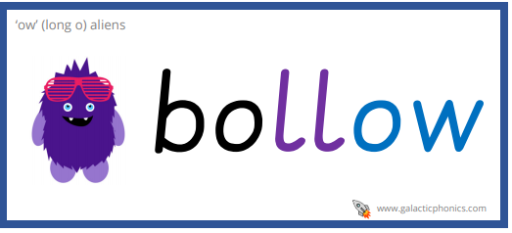
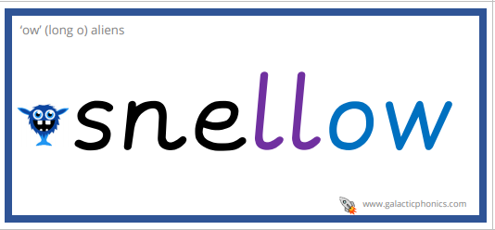
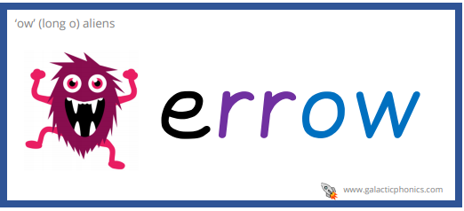
ow alien words

Slide 24
ow sentences
The wind made the snow blow everywhere.
There is a beautiful rainbow.
I have a yellow bow tie.

Slide 25
Friday 26th March 2021

Slide 26
This week’s Red words
You
are
the
no
my

Slide 27
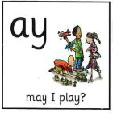
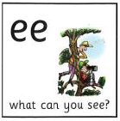

This weeks sounds

