Slide 1
LO: To write a diary of Adriana
Friday 2nd July 2021

Slide 2

Let’s remember who is in our story?
Antipholus of Ephesus (rich merchant married to Adriana)
Antipholus of Syracuse (looking for his brother and mother)
Dromio of Ephesus (funny servant of Antipholus of Ephesus)
Dromio of Syracuse (funny servant of Antipholus of Syracuse)

Slide 3
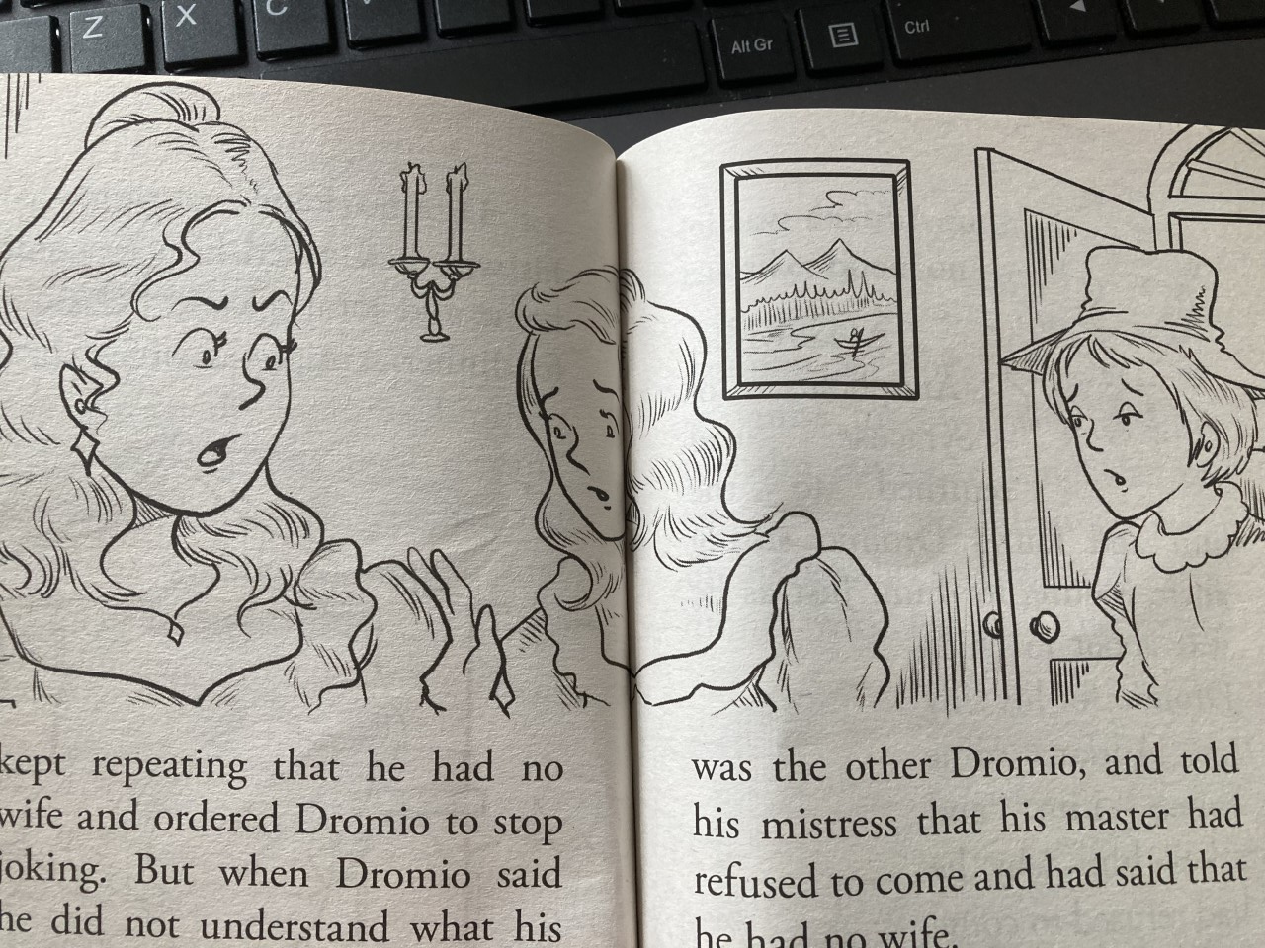
Let’s keep reading…
Read p.31 to p.38

Slide 4
What can you remember about this story?
So far in this story, Antipholus of Syracuse had told Dromio of Ephesus that he had no wife or home, when he asked him to come home for dinner.
Antipholus of Sycaruse was forced to go to dinner with Adriana and her real husband wasn’t allowed in the house and became jealous! What a mess!

Slide 5
Your Task:
You will be writing the diary of Adriana.
Dromio of Ephesus came back to the house and told his mistress that his master had refused to come and said that he had no wife!
How would Adriana feel?
This made Adriana mad and she was full of jealousy. Her sister, Luciana, who lived in the same house, tried her best to calm her, but Adriana was in no mood to listen.
What might Adriana think?

Slide 6
Your Task:
You will be writing the diary of Adriana.
Adriana came before Antipholus of Syracuse and asked him why he refused to come. Antipholus tried to explain that he had not come home because he did not have a home here, which only angered her even more!
What would she say to Antipholus?
How do you think the meal went? What would it be like having dinner with someone who didn’t know you?
She was furious with Antipholus for refusing to recognise her, he was forced to go to his brother’s house for dinner with Adriana and Luciana! What a tricky meal it must have been!

Slide 7
Now…
Write a diary from the viewpoint of Adriana after her dinner with Antipholus. Use the pronoun I and don’t forget to use the past tense. Use ‘ed’ endings and ‘ing’ endings for your verbs.
What feelings would she have had?
What would she have thought?
What would she have done?
How would Antipholus have acted (if he had no idea who she was?)
What might he have said?

Slide 8
Example
Dear Diary,
I can’t believe what happened today! My husband Antipholus pretended that he was not married to me and he told me that he had no home here.
I am so angry with him. How can he hurt my feelings like this? I am very confused and upset because we have been married for so long.
At dinner, he did not go near me or hug me. He acted as if he didn’t know me or Luciana.
What has happened to him?

