Slide 1

Monday 26th April 2021

Slide 2
This week’s Red words
they
of
old
have
were

Slide 3
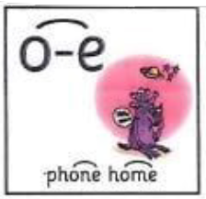
Today’s sound is
o-e

Slide 4
o-e words
alone
backbone
phone
rose
stone
hope

Slide 5
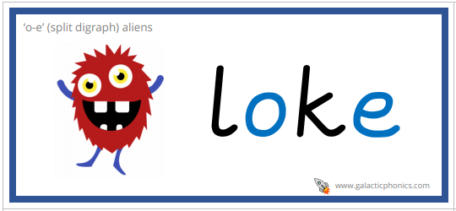


o-e alien words

Slide 6
o-e sentences
They are going to the park to find a rose and a stone.
I hope that when I'm old that I don’t hurt my backbone.
They were alone and needed to phone their friend.

Slide 7
Tuesday 27th April 2021

Slide 8
This week’s Red words
they
of
old
have
were

Slide 9
Today’s sound is
o-e

Slide 10
o-e words
episode
nose
explode
home
wrote
rope

Slide 11

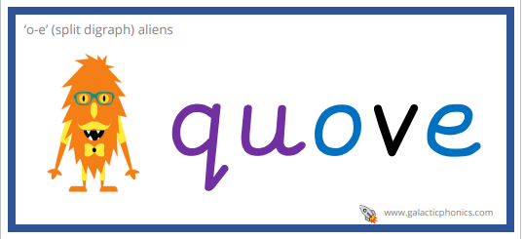
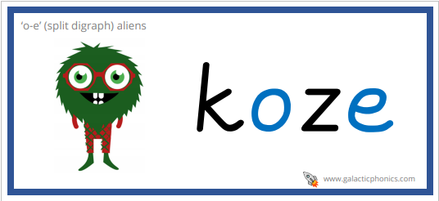
o-e alien words

Slide 12
o-e sentences
They were watching their favourite episode of Go Jetters.
Have you seen the note that I wrote to send home? Said the girl.
My home is in Rome. It is a city in Italy, have you been there?

Slide 13
Wednesday 28th April 2021

Slide 14
This week’s Red words
they
of
old
have
were

Slide 15
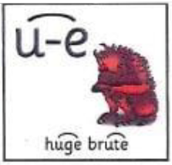
Today’s sound is
u-e

Slide 16
u-e words
refuse
cube
cute
fortune
tube

Slide 17
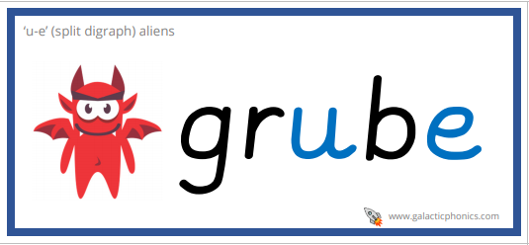
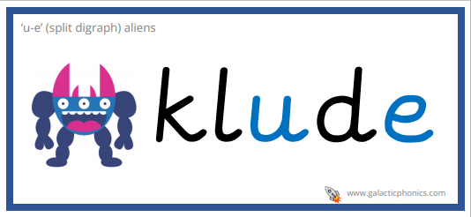
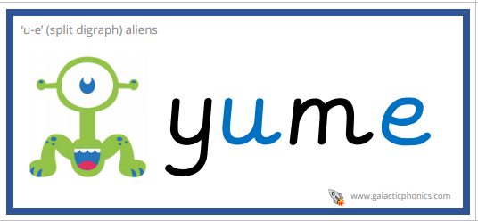
u-e alien words

Slide 18
u-e sentences
They were making a fortune using a cube.
The little black cat is so cute! Said the old man.
They refused to get off of the tube because it was cold.

Slide 19
Thursday 29th April 2021

Slide 20
This week’s Red words
they
of
old
have
were

Slide 21
Today’s sound is
u-e

Slide 22
u-e words
volume
perfume
June
confused
rude

Slide 23

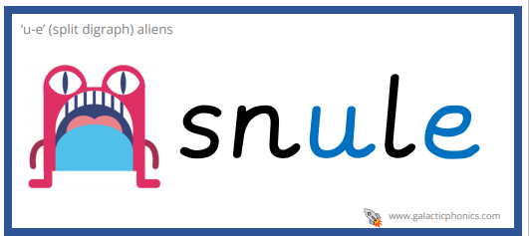
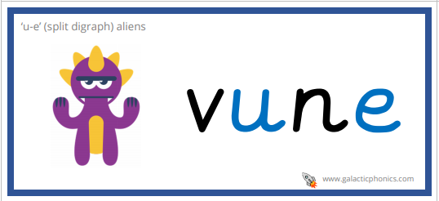
u-e alien words

Slide 24
u-e sentences
Where should we go on holiday in June?
The rude girl said she liked my sweet perfume.
The volume was high but I was confused because I still couldn’t hear it.

Slide 25
Friday 30th
April 2021

Slide 26
This week’s Red words
they
of
old
have
were

Slide 27
This weeks sounds

Slide 28
Words
amuse
tune
telephone
flute
throne
joke
dude

