Slide 1
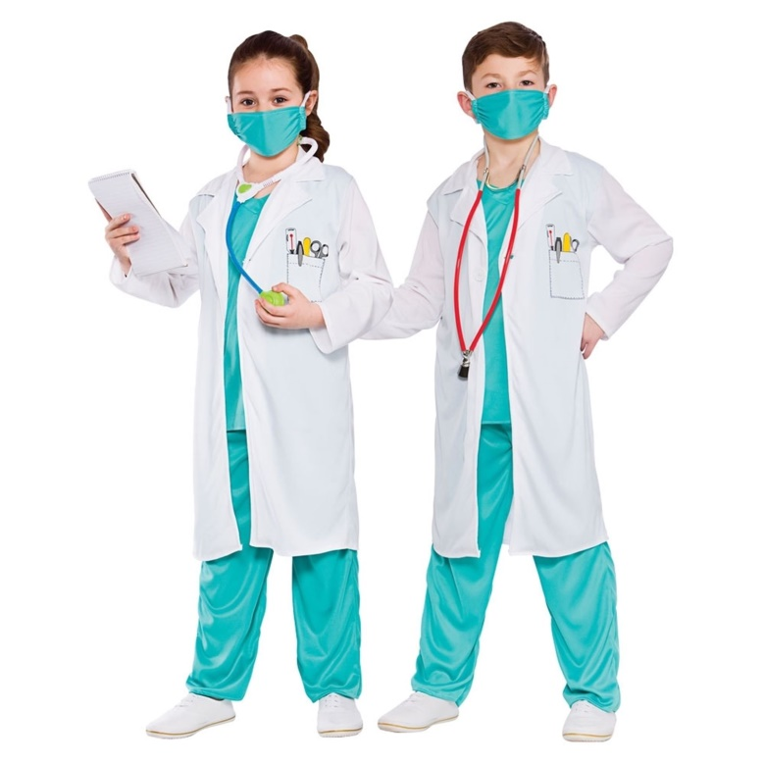
L.O. To learn know how to help yourself and others if injured or unwell.

Slide 2
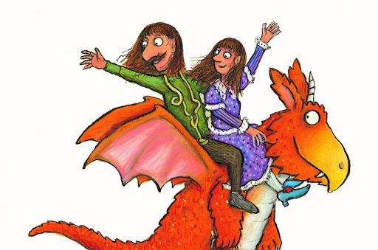
Today you are going to learn how to be like the flying doctors and help people who are ill or injured.
Let’s take a quiz to see what you already know.

Slide 3
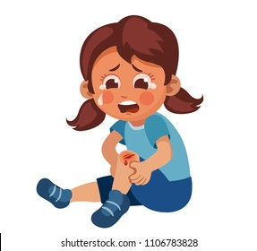
Pair Talk
What should you do to help to heal a small cut?

Slide 4
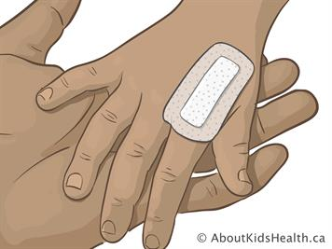
Answer
If you have a small cut the first thing you should do is clean it with soap and water or an antiseptic wipe. This will stop the cut becoming infected. You can then cover the cut with a plaster to keep the cut clean. You would only need to call 999 and go to hospital if the cut was very deep or didn’t stop bleeding.

Slide 5
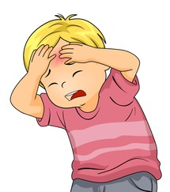
Pair Talk
What should you do if you bump your head?

Slide 6
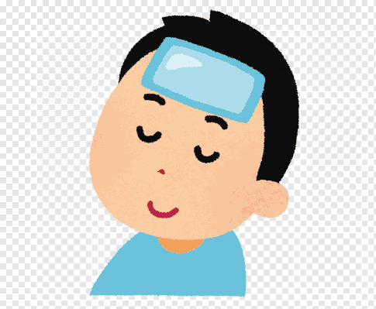
Answer
You should place something cold on the area of your head you have bumped. You could use an ice pack, paper towel or even a bag of frozen peas.
If you feel sick, dizzy or sleepy you must tell an adult. If seriously hurt you should dial 999 and go to hospital.

Slide 7
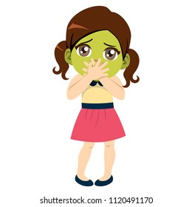
Pair Talk
What should you do if you feel dizzy or sick?

Slide 8
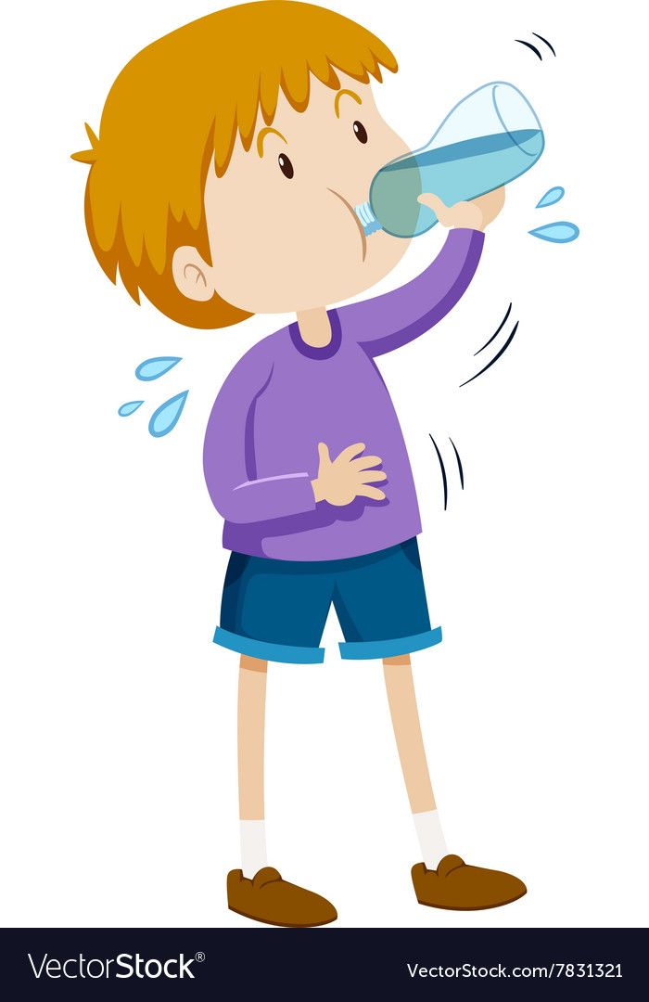
Answer
You should make sure that you have had enough to eat and drink. You should sit still and not run about. You could try going to the toilet if you have stomach ache. If you think you might be sick stay close to a bathroom.

Slide 9
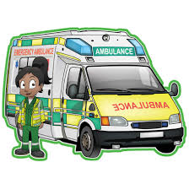
If you have a serious emergency you should dial 999.
The person who answers the phone will ask you what the emergency is and whether you need an ambulance, the Fire Brigade or the Police. You should say you need an ambulance.
They will then ask you where you are and what your name is? Do you know your address so that you can call for an ambulance at home?
Then they will ask you what
has happened and will send
some paramedics to help you.

Slide 10
Watch this episode of Operation Ouch to find out what to do in an emergency.
https://www.youtube.com/watch?v=CNxNIsQ_SzY
In this video you will find out what to do if …
Someone gets burnt
Someone has an asthma attack
Someone is unresponsive or not breathing
Someone has a serious allergic reaction
Someone has swallowed something poisonous

Slide 11
Your Task
Role play what to do in different situations.
or
Make a poster to tell people what to do if injured or unwell.

