Slide 1
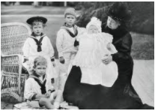
Topic: Geography
Thursday 18th March
L.O. To find out about Queen Victoria’s royal holiday home: Osborne House

Slide 2
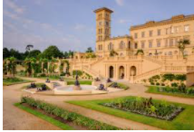
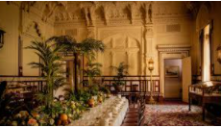
We are going to find out about Queen Victoria’s family holiday home.
Osborne House

Slide 3
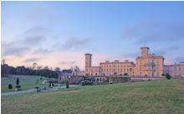
Osborne House
We will find out more from watching these clips:
Behind the scenes at Osborne/Queen Victoria’s Holiday Home
https://www.youtube.com/watch?v=Sa4kK5oTyUU
A behind the scenes look at Swiss Cottage
https://www.youtube.com/watch?v=36JQt7_l6xw
Queen Victoria’s Private beach & bathing machine
https://www.bbc.co.uk/news/av/uk-18867194

Slide 4
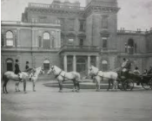
Facts about Osborne House
It is on an island called The Isle of Wight.
It is by the seaside, on the coast.
It was Queen Victoria’s family holiday home.
Her 9 children had their own wooden house in the garden, called Swiss Cottage.
Queen Victoria had her own ‘bathing machine’!
Miss Coles has visited there!
Let’s look at our task sheet.

Slide 5
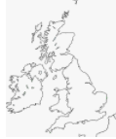
16.3.21. Location & Facts about Queen Victoria’s life at Osborne House.
Use an atlas to find the Isle of Wight in the United Kingdom (UK).
Mark it on your UK map. This is where Osborne House is.
Record 2 facts you have found interesting about Osborne House & Queen Victoria.

