Slide 1
LO: To write a thank you letter.
Wednesday 17th March 2021

Slide 2
Today we will be writing a thank you letter to the Flying Doctors from a character that they helped in the text.
Can you remember which characters the Flying Doctors helped?
Let’s revisit the book to find out.

Slide 3
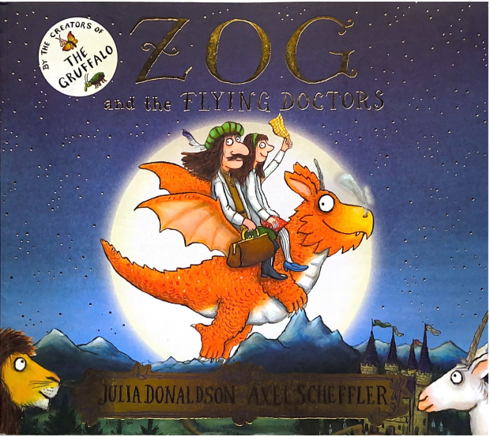

Slide 4
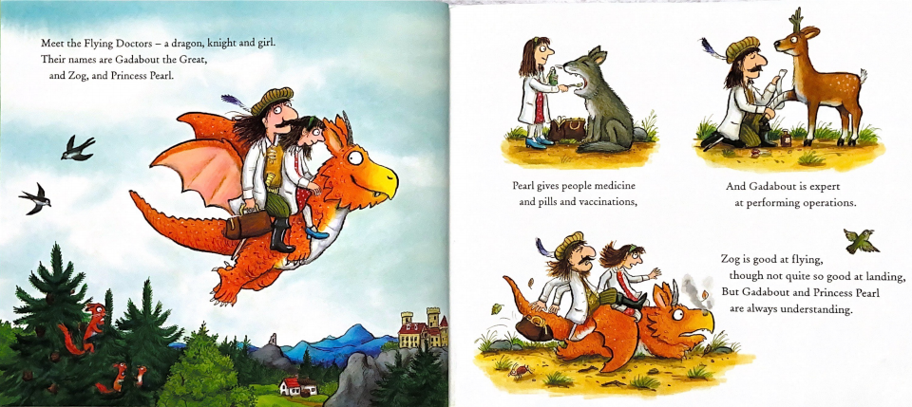

Slide 5
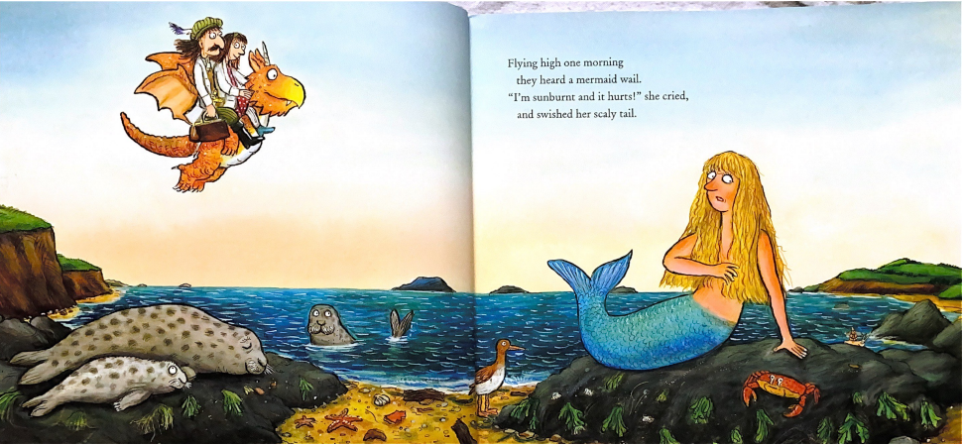

Slide 6
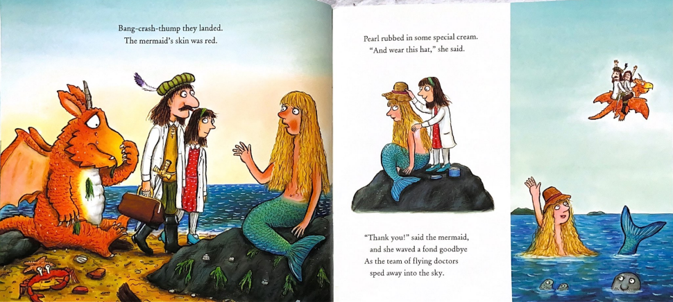

Slide 7
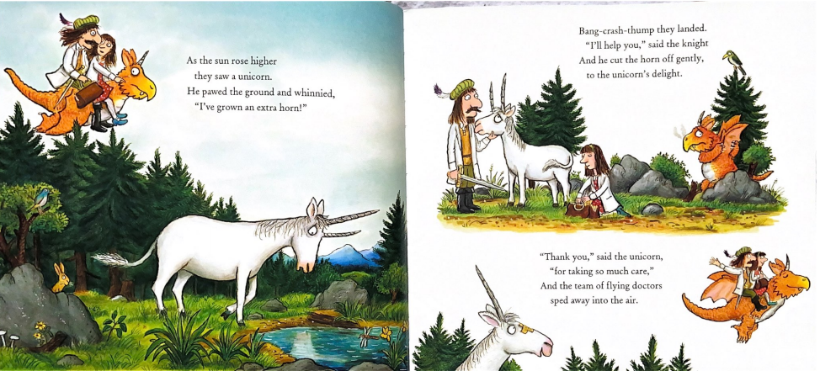

Slide 8
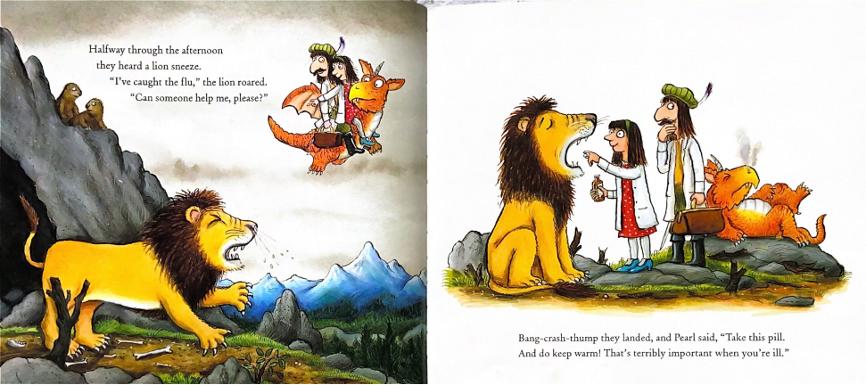

Slide 9
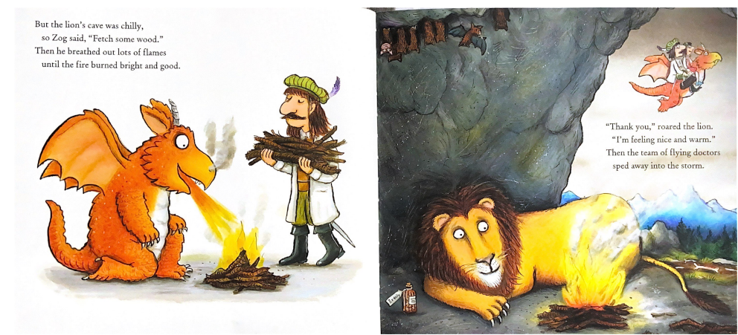

Slide 10
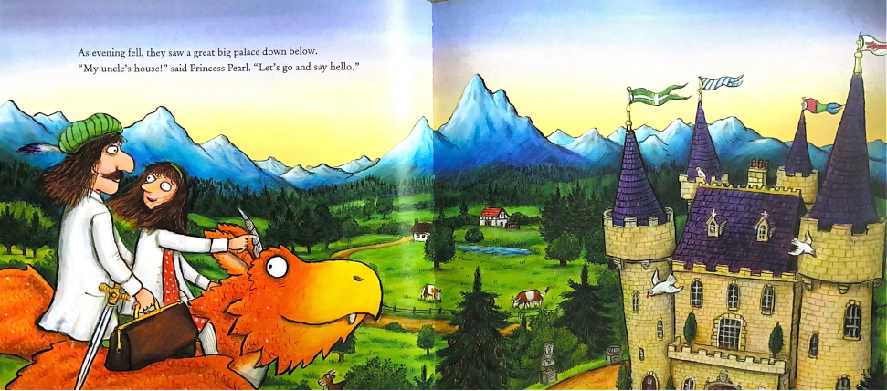

Slide 11
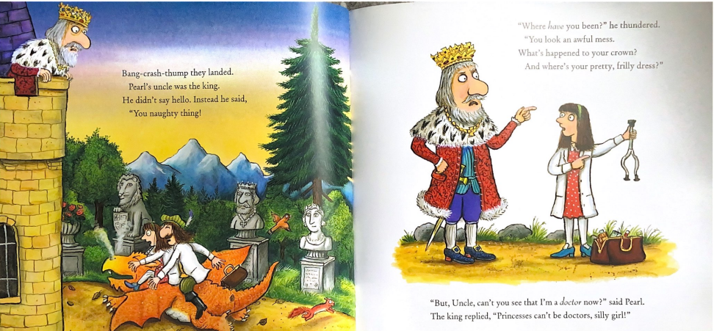

Slide 12
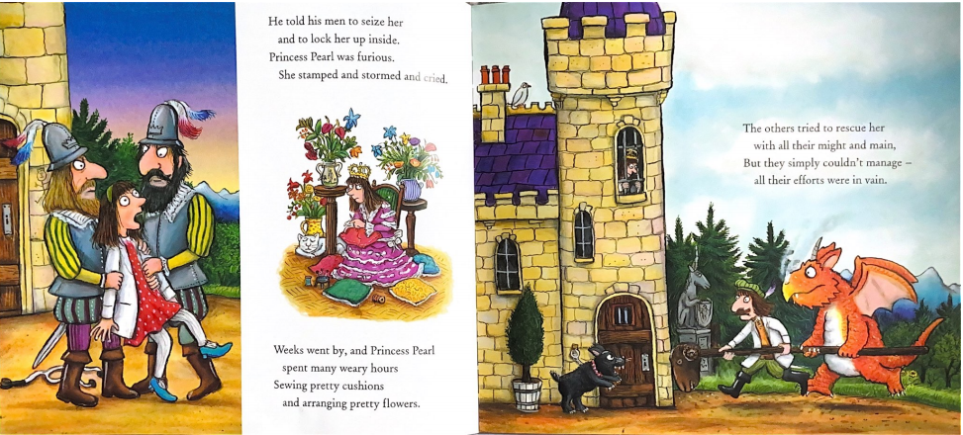

Slide 13
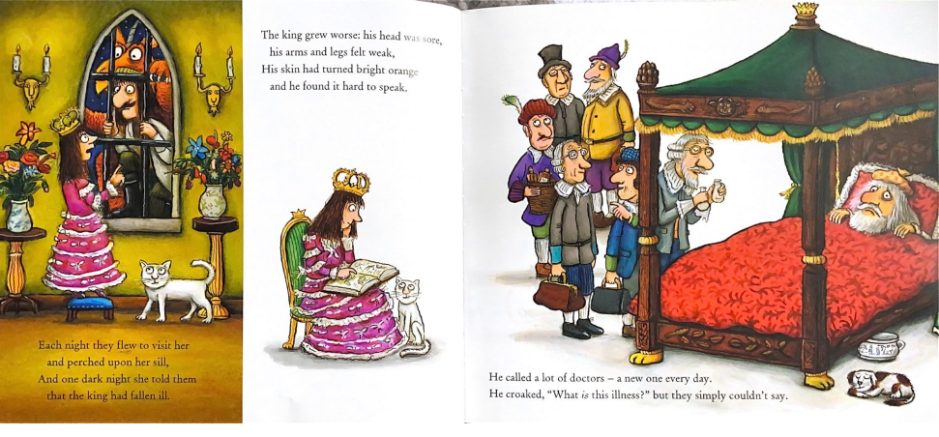

Slide 14
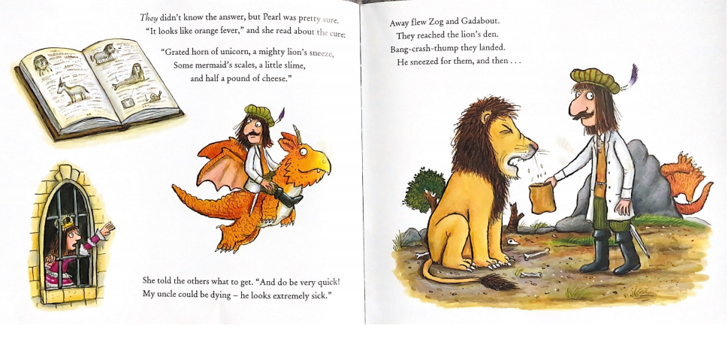

Slide 15
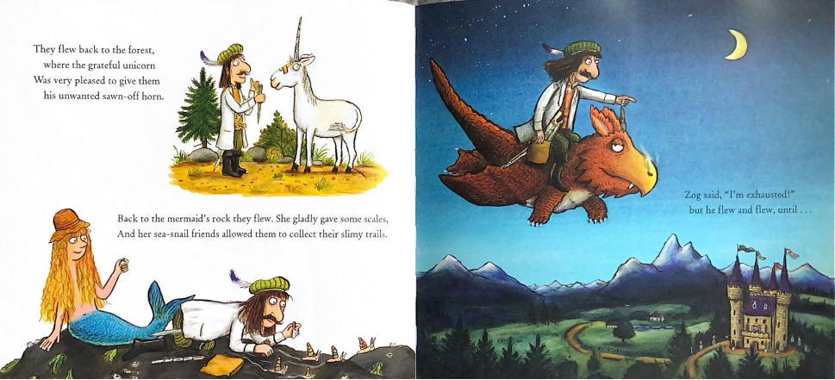

Slide 16
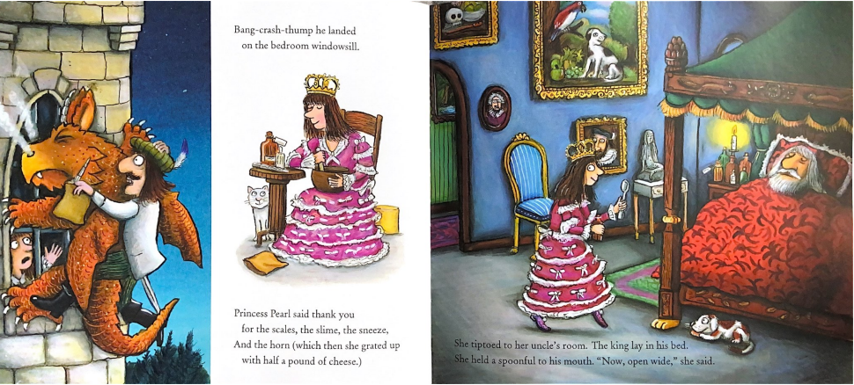

Slide 17
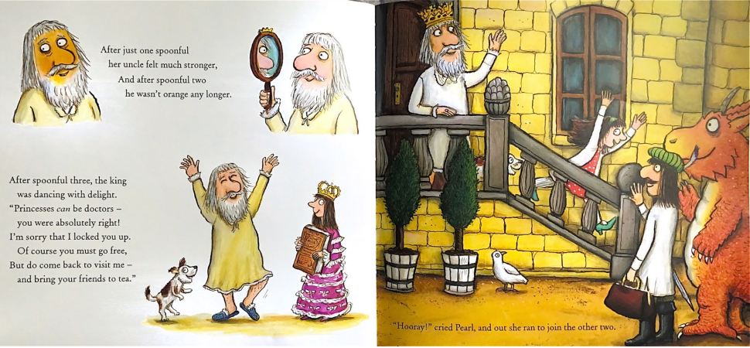

Slide 18
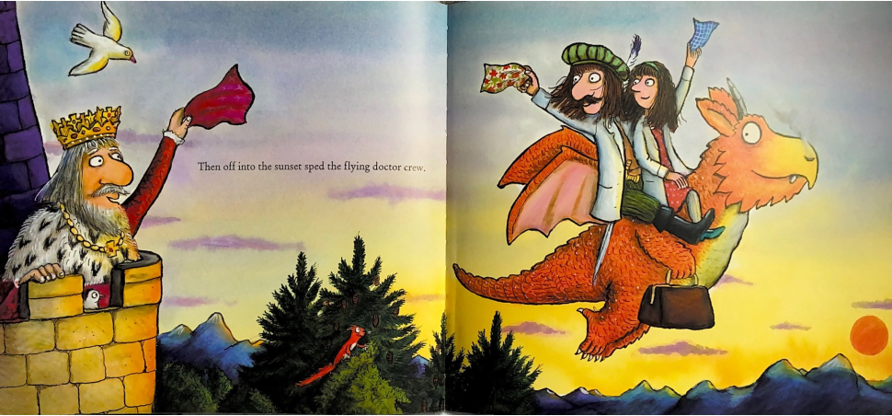

Slide 19
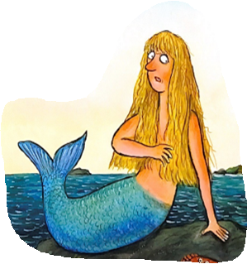
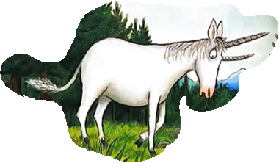
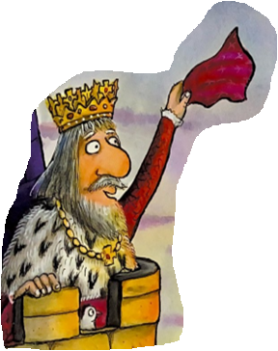
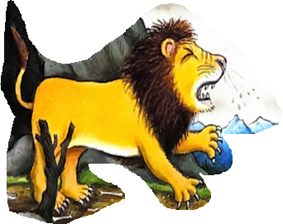
How many did you remember?
Which character will you pretend to be?

Slide 20
Read the example letter from The King to Princess Pearl.
What features of a letter can you spot?

Slide 21
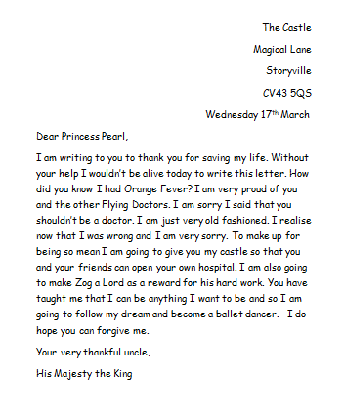
Address of the person
writing the letter.
The date
Write Dear then the name of the person you are writing to.
Say why you are writing the letter.
Include a question.
Explain what you are going to do to say thank you.
Finish with Yours sincerely or Your very thankful friend.

Slide 22
Your Task
Write a letter to the Flying Doctors from a character that they have helped on paper.
Edit the example letter or type a new letter to the flying Doctors from a character they have helped.

