Slide 1
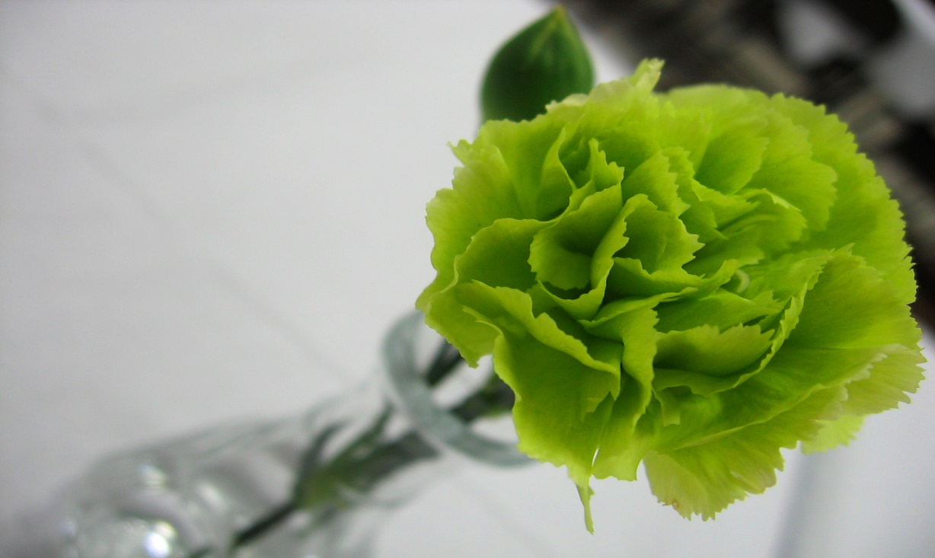
Science
Friday 9th July
L.O. Do white carnations change colour if we put them in coloured water?

Slide 2
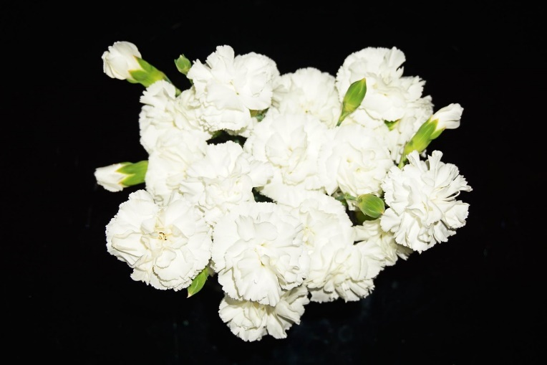
We are going to investigate how water travels up the stem of a plant.
We will use food colouring to see how this happens.
Watch the video. https://www.youtube.com/watch?v=Fp7JCcewjaY

Slide 3
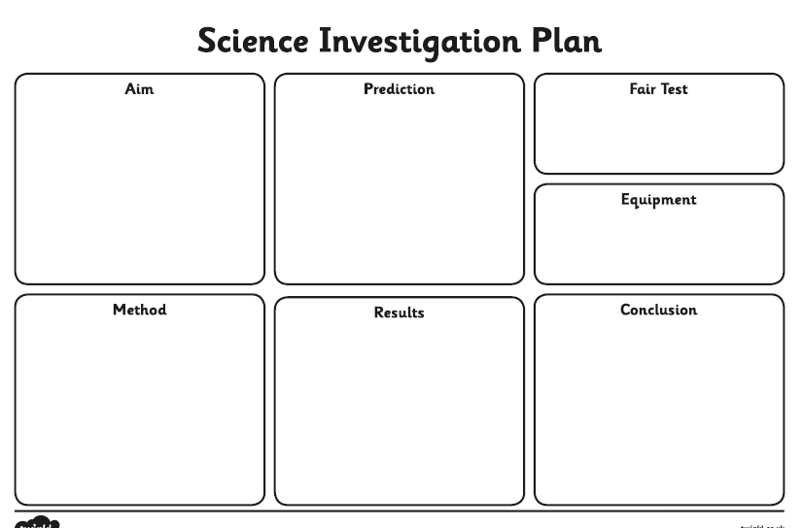
Your Task: Complete the following sections of your Investigation Plan
Aim – what we are trying to do
Prediction – draw and write what you think will happen
Fair test – what did we change? What did we keep the same?
Equipment – what resources did we need?
Method – what did we do?

Slide 4
9.7.21 Do white carnations change colour if put into coloured water?

