Slide 1
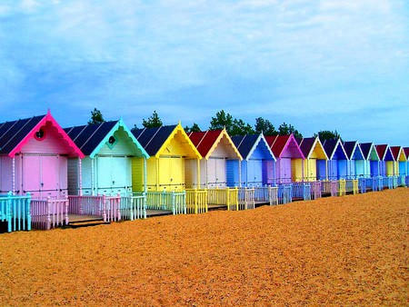
Art/DT
LO: To design a beach hut.

Slide 2
What are beach huts for?
Beach huts are generally used as a shelter from the sun or wind, changing into and out of swimming attire and for the safe storing of some personal belongings. Some beach huts incorporate simple facilities for preparing food and hot drinks by either bottled gas or occasionally mains electricity.

Slide 3
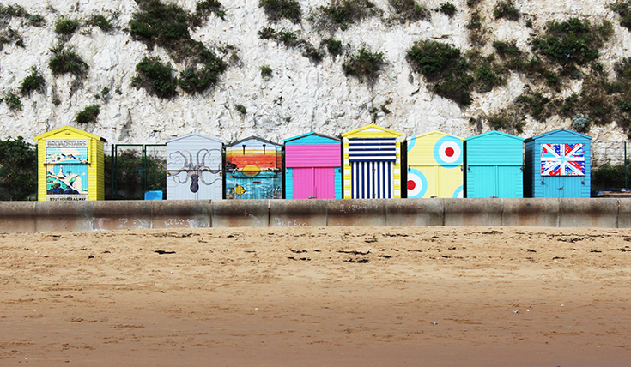
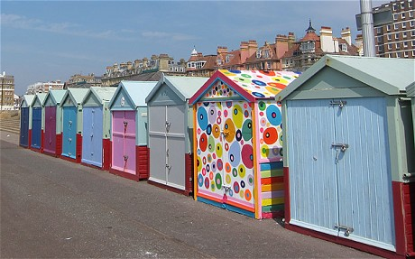
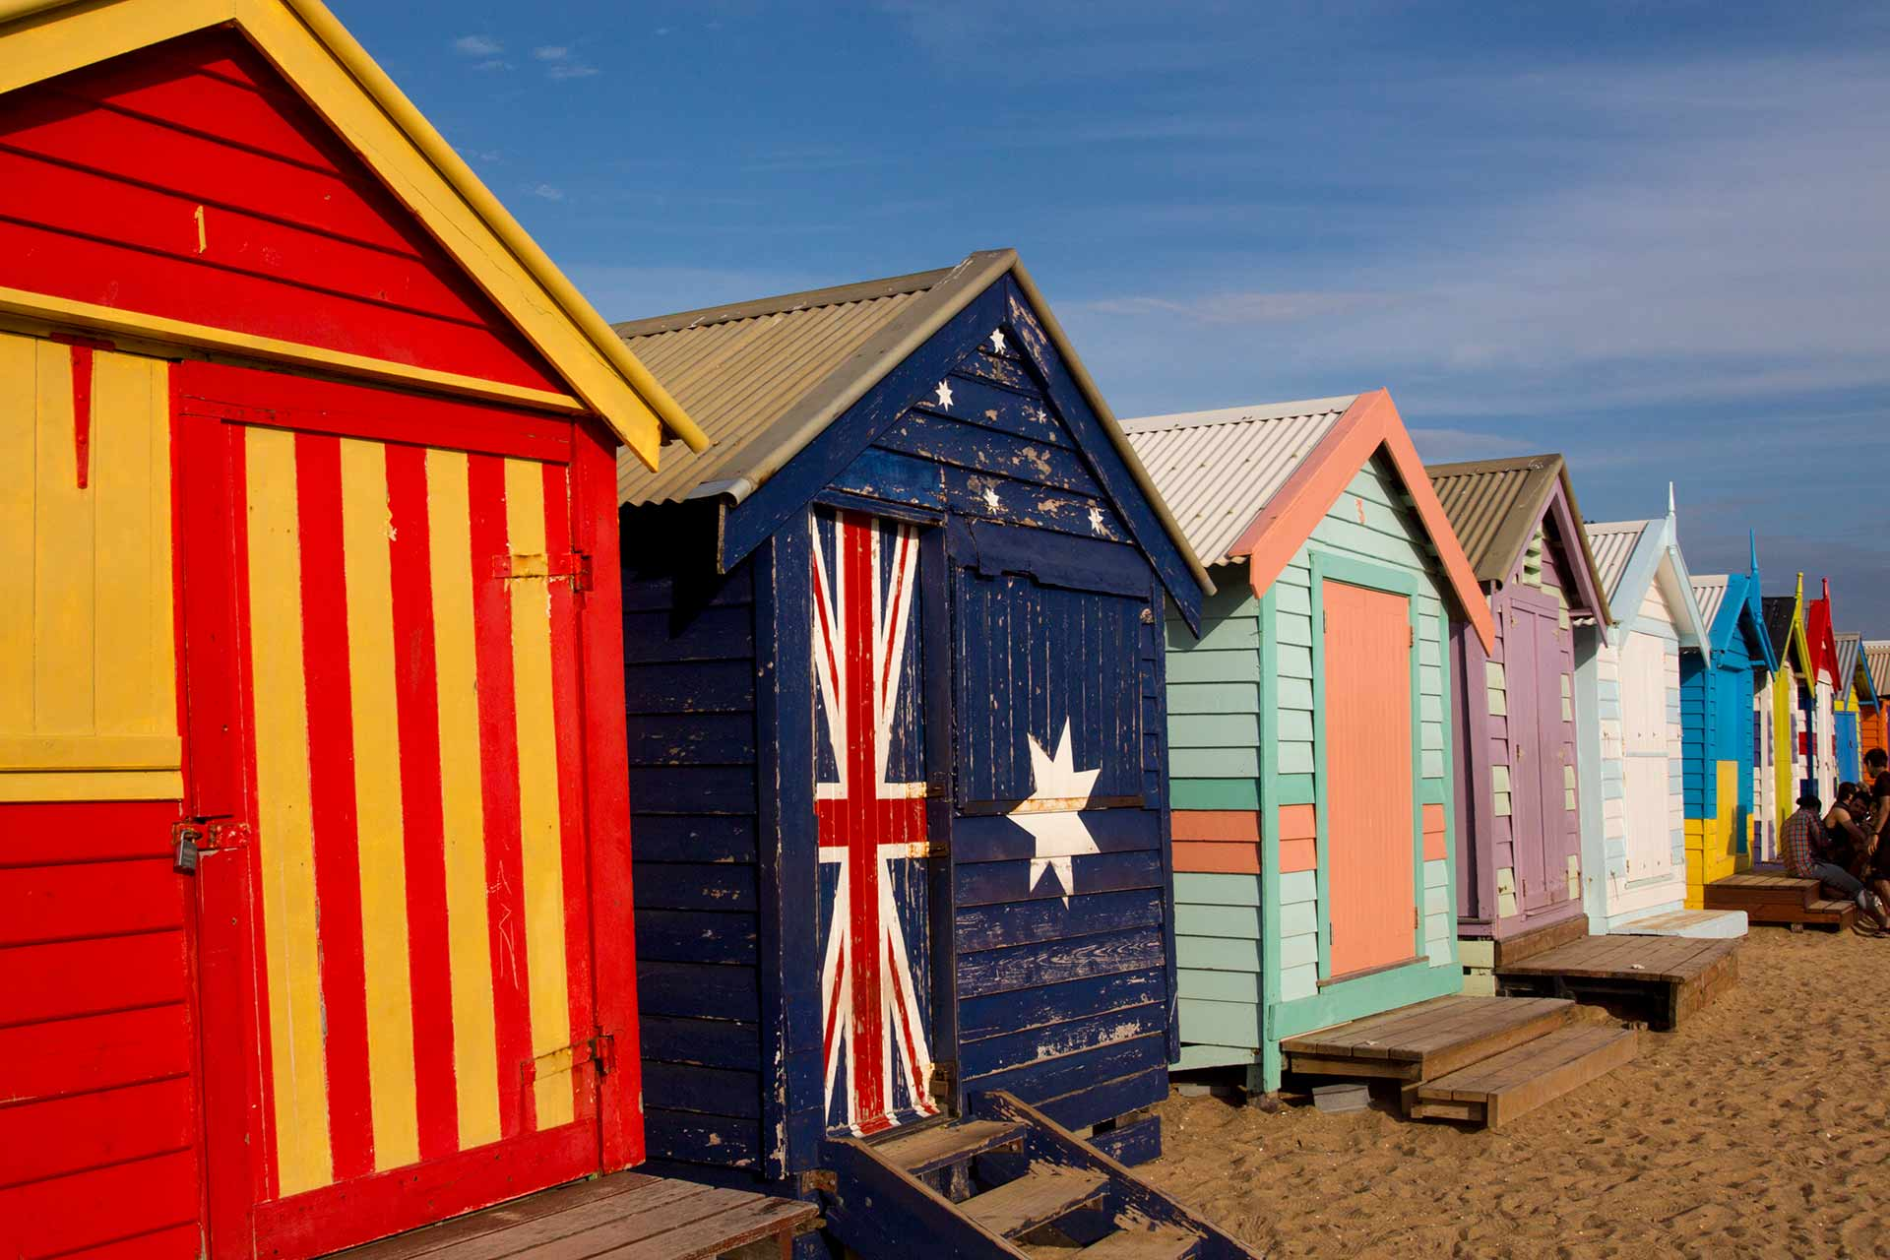
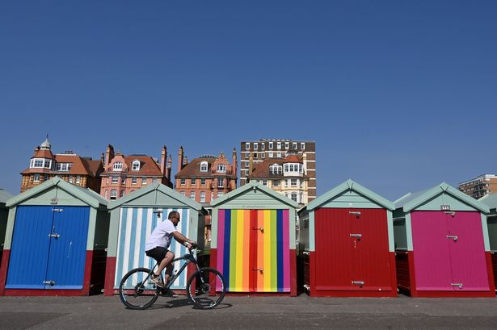
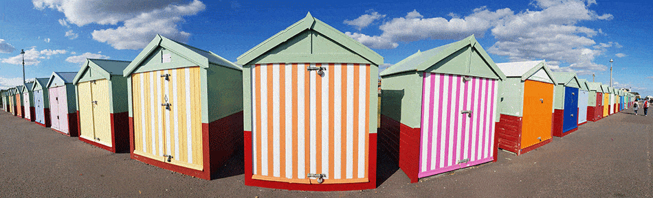
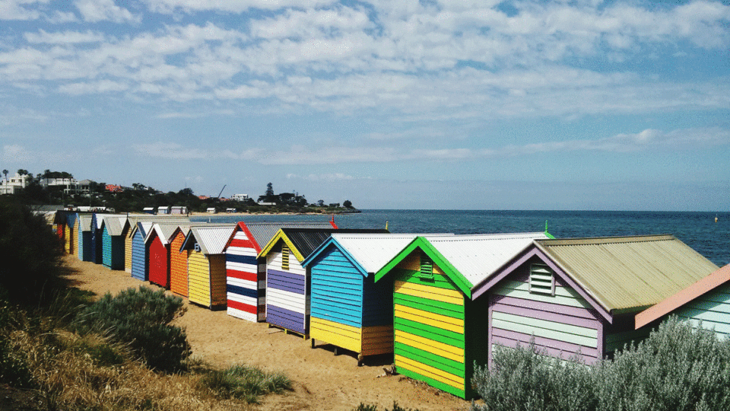
We are going to look at different beach hut designs.

Slide 4
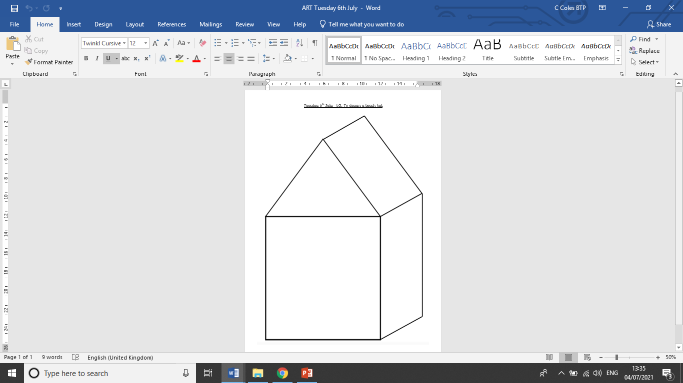
Today’s task:
Design your own beach hut.

