Slide 1
LO: To create a design for a necklace commissioned by Antipholus of Ephesus
Monday 5th July 2021

Slide 2
About this story.
So far we know that having two sets of twins staying in one city can cause a lot of problems for everyone!
It can cause, upset, pain and confusion.
Let’s see what happens next!

Slide 3

Who is in our story?
Antipholus of Ephesus (rich merchant married to Adriana)
Antipholus of Syracuse (looking for his brother and mother)
Dromio of Ephesus (funny servant of Antipholus of Ephesus)
Dromio of Syracuse (funny servant of Antipholus of Syracuse)

Slide 4
Let’s Read some more of the story
Read p. 38 to p.44
On the road, Antipholus of Sycaruse was summoned by a goldsmith who gave him a chain. Antipholus declared that the chain was not his, but the goldsmith insisted that it had been made on his special orders, and leaving the chain in his hand, he left.
Antipholus of Ephesus had ordered it for his wife Adriana… but it had been given to Antipholus of Sycaruse instead!

Slide 5
Your Task:
Think about what the necklace might look like that Antipholus ordered for his wife.
What colour will the necklace chain be? What precious stones will be on it?

Slide 6



Now…let’s look at the different metals it could be…you could mix the metals
gold
silver
rose gold

Slide 7
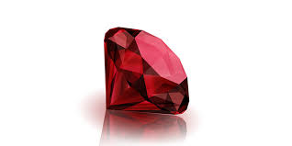
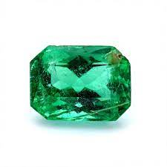

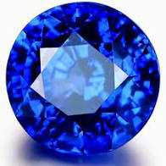
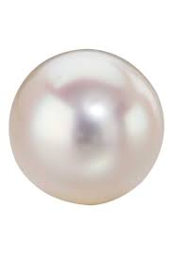
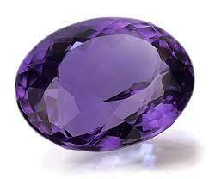
Now…let’s look at the different precious stones it could have
ruby
emerald
diamond
sapphire
pearl
amythest

Slide 8
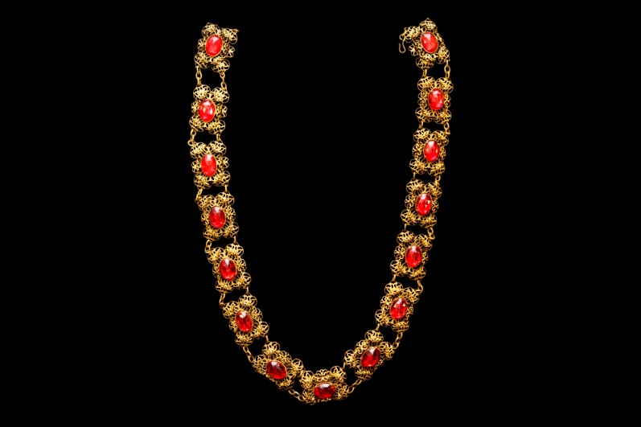
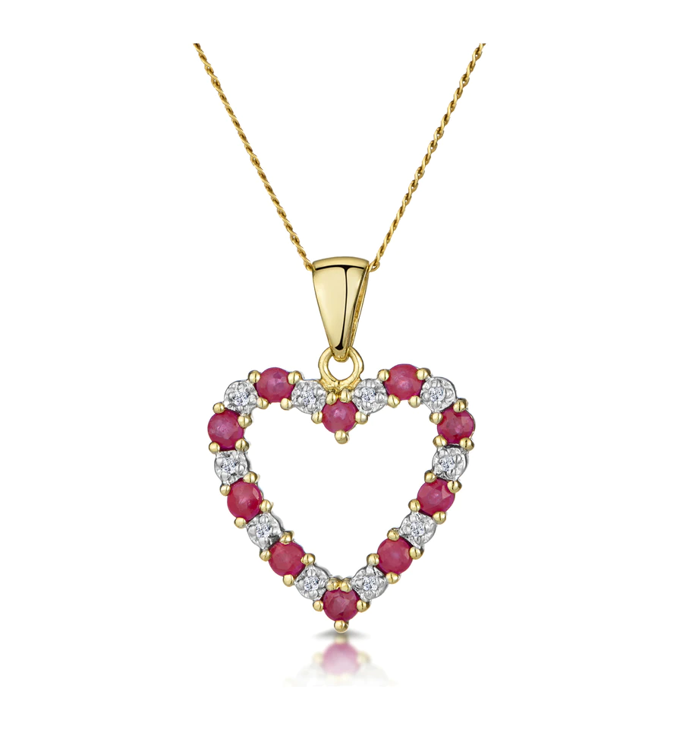
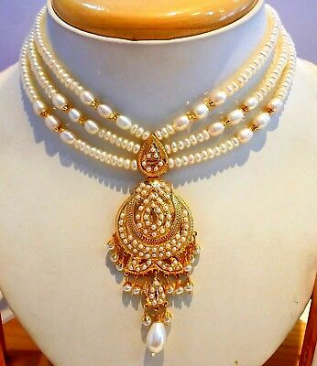
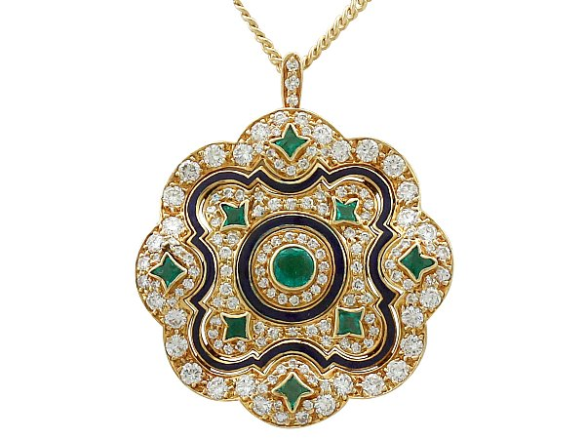
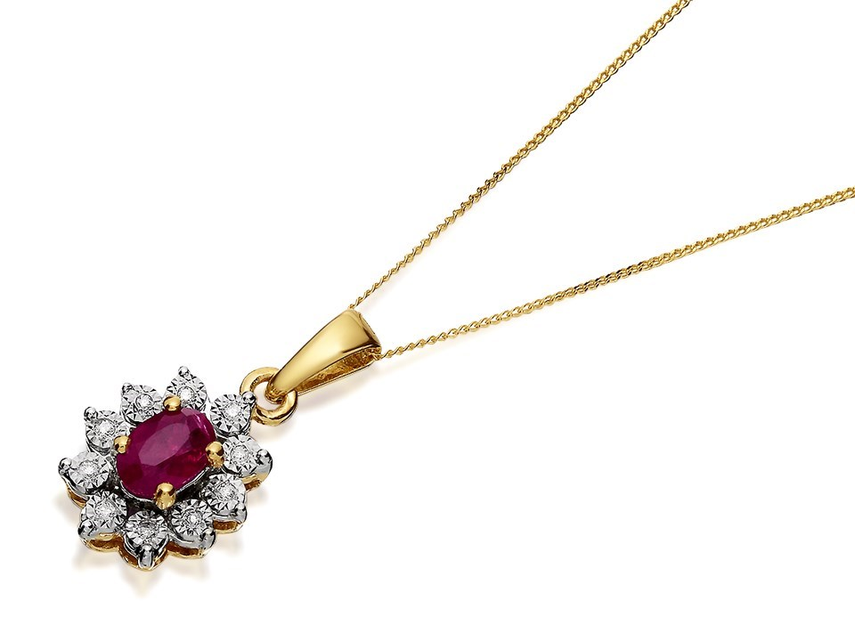
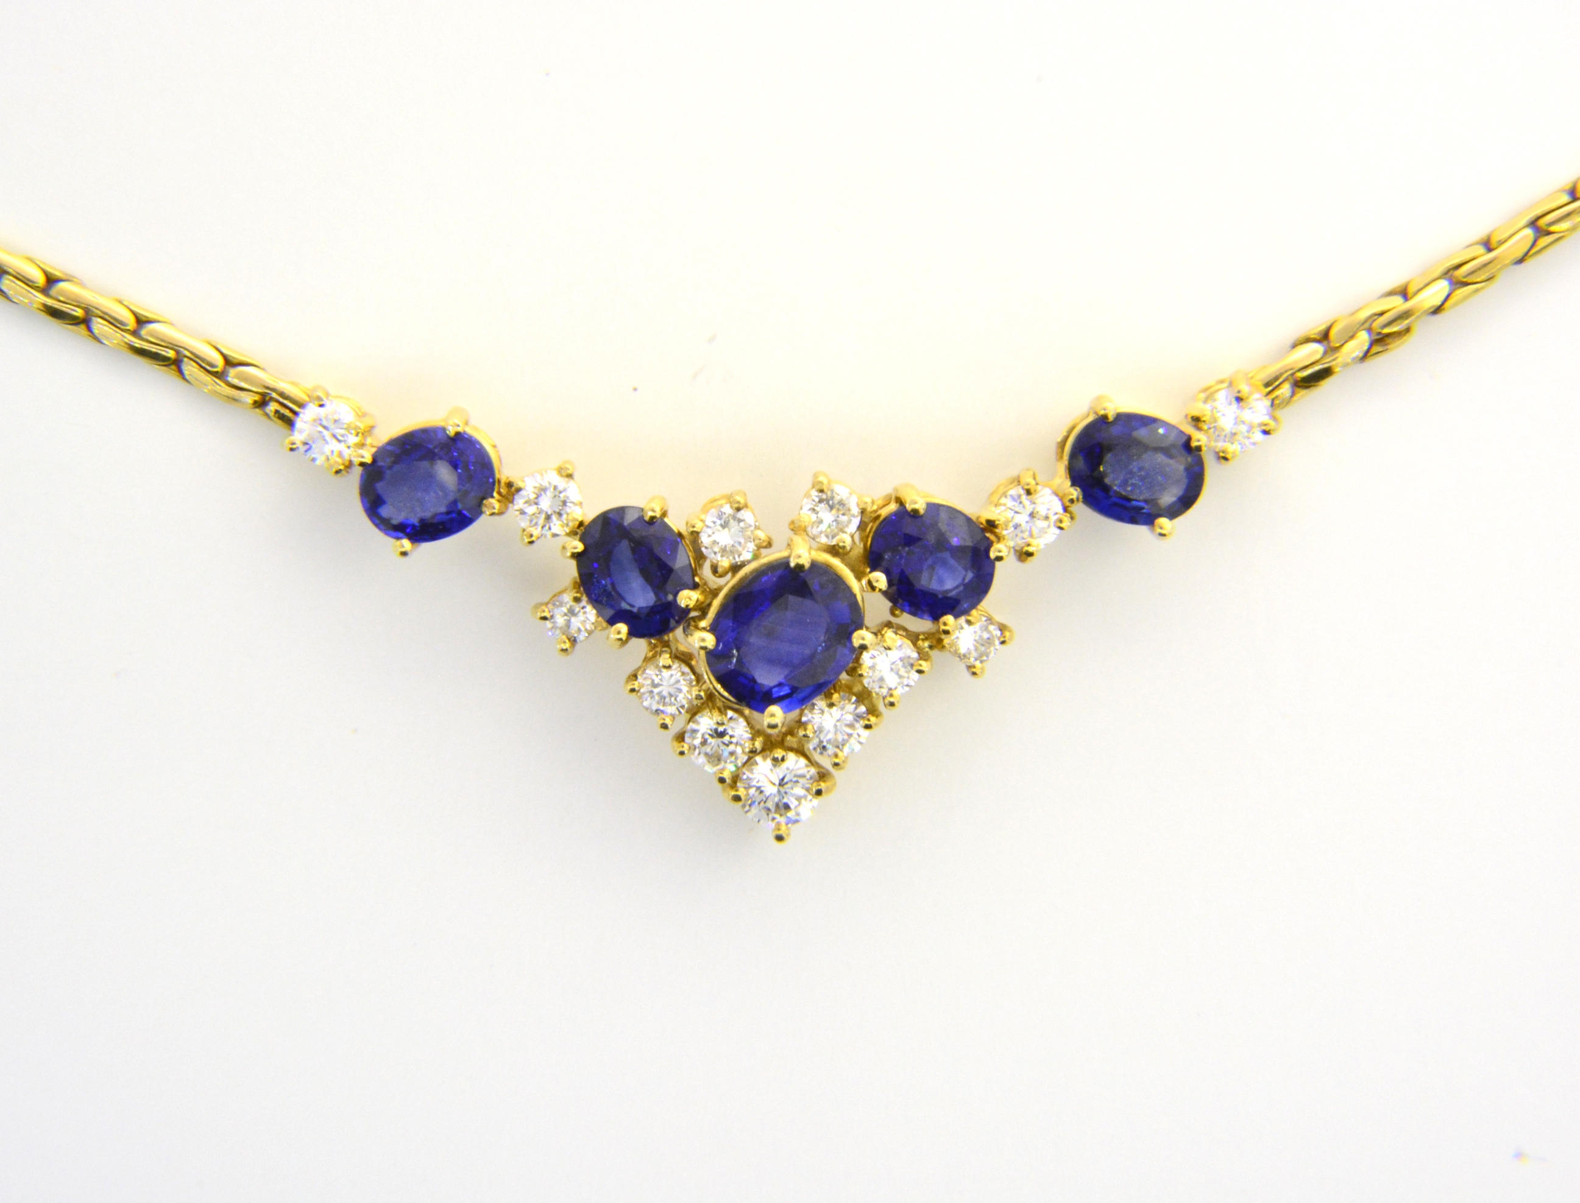
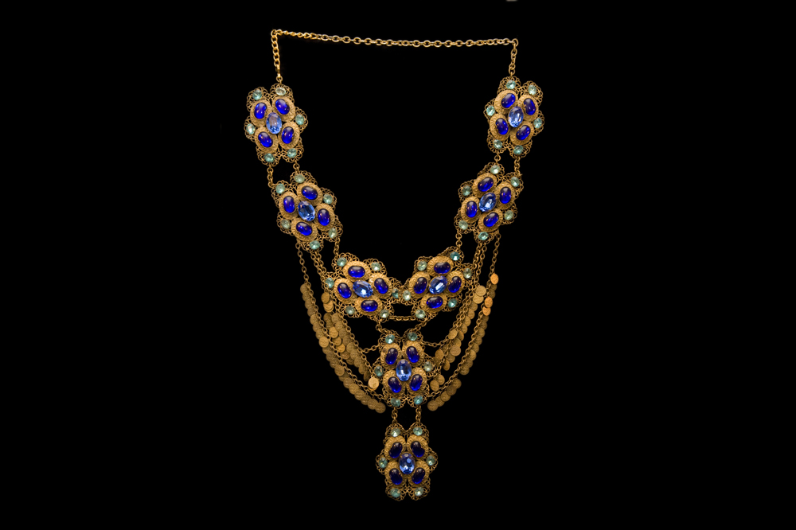
Here are some different styles of necklace

Slide 9
What you need to do.
You need to design a necklace thinking about the materials, style and effect that you want.
Once you have designed it, you will need to:
- Label the design using a ruler
- Write about the necklace, explaining why you chose it and why you think Adriana would like it.

