Slide 1
Wednesday 27th January 2021
L.O. -To discuss what you like and dislike about a book.
-To think about how a book could be improved.

Slide 2

Lets revisit the story together.

Slide 3
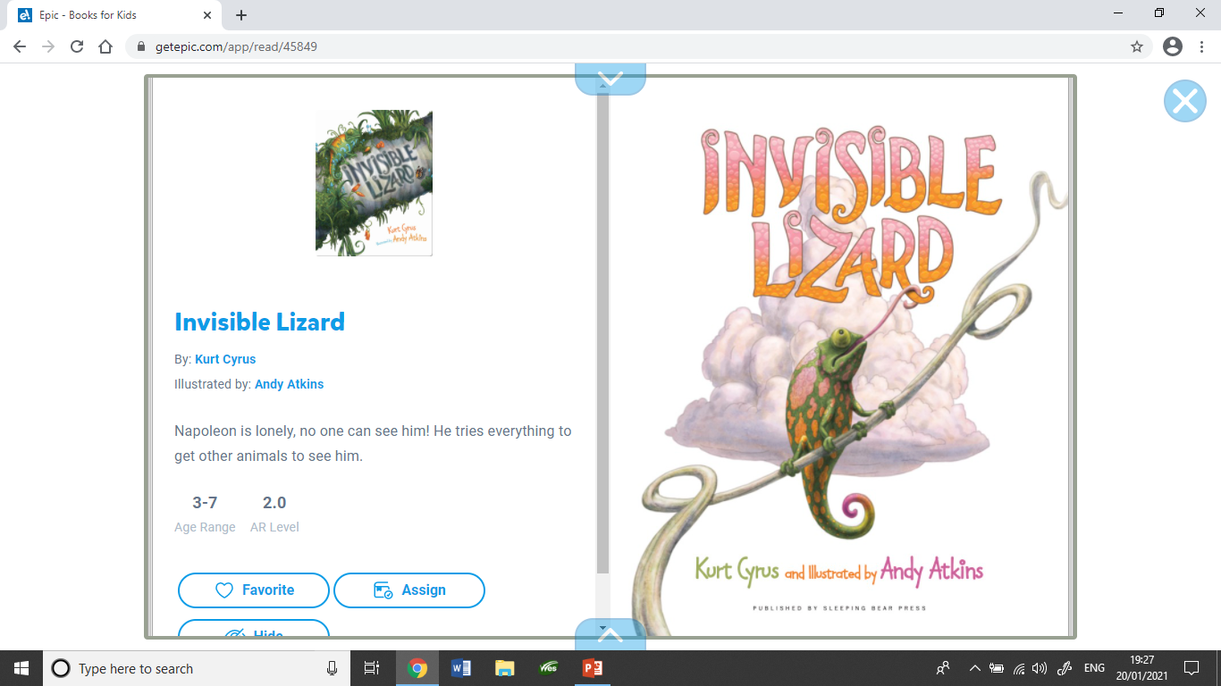

Slide 4
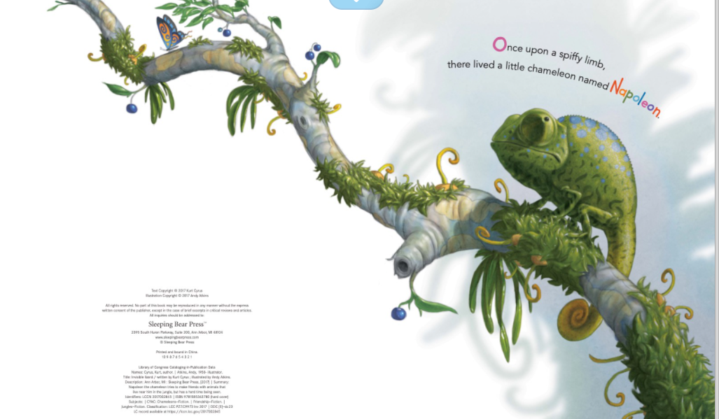

Slide 5
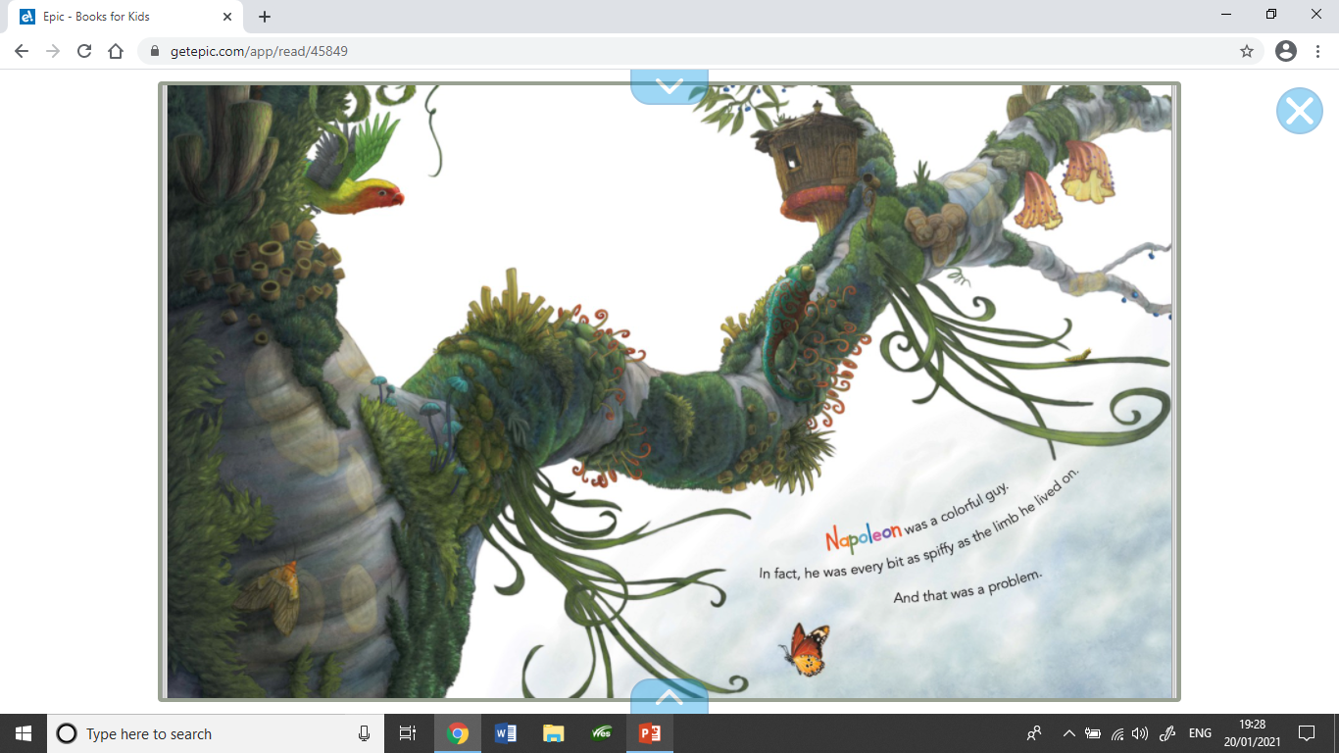

Slide 6
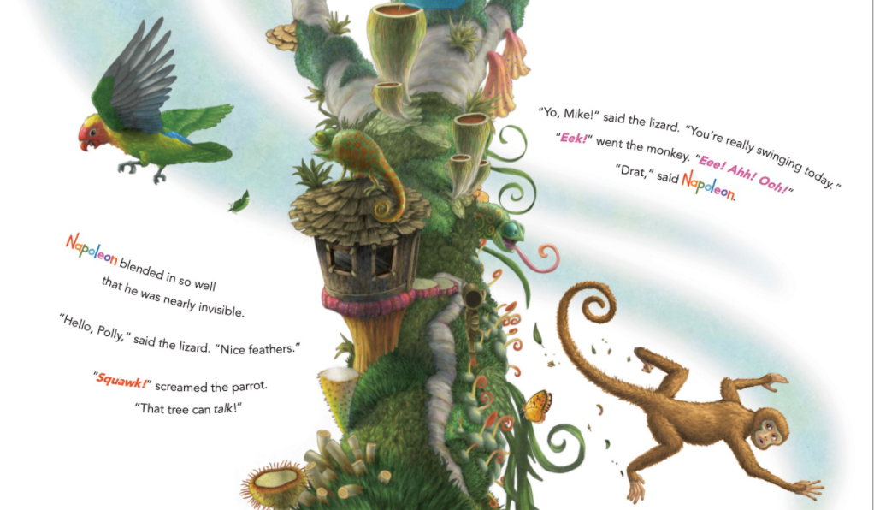

Slide 7
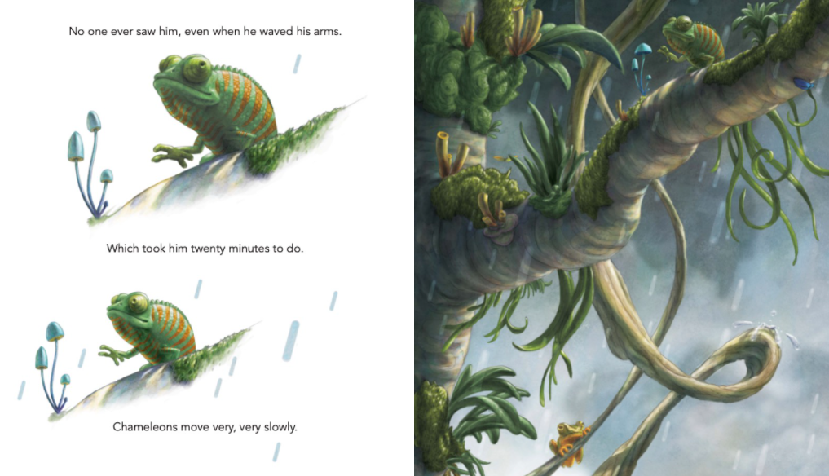

Slide 8
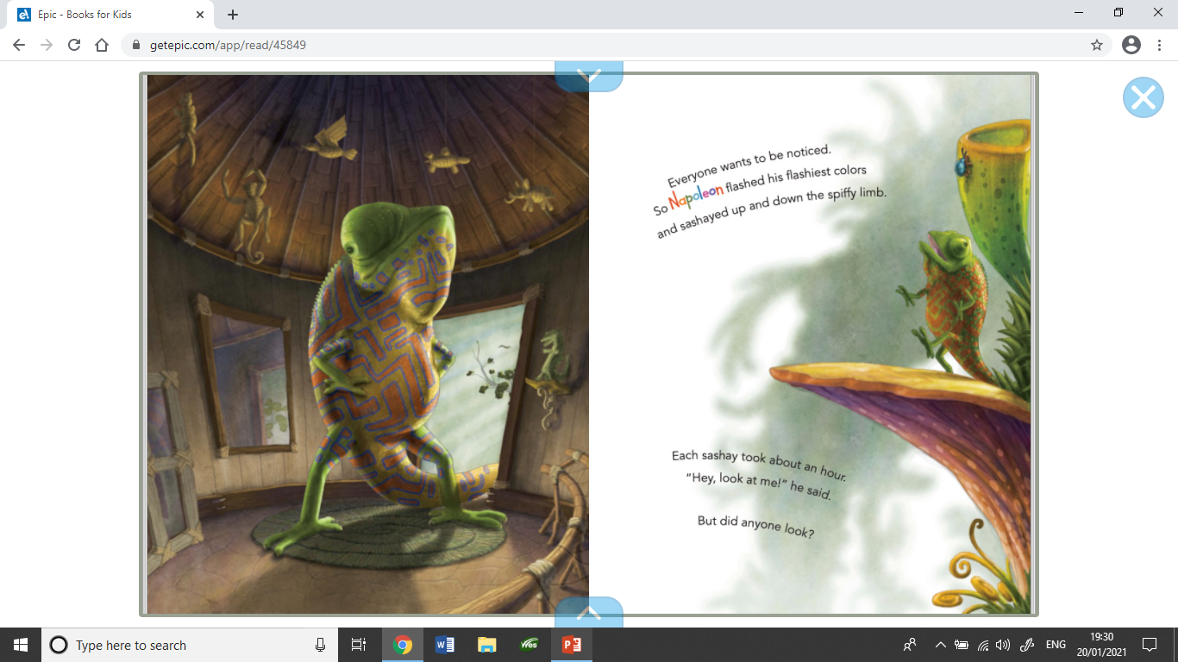

Slide 9
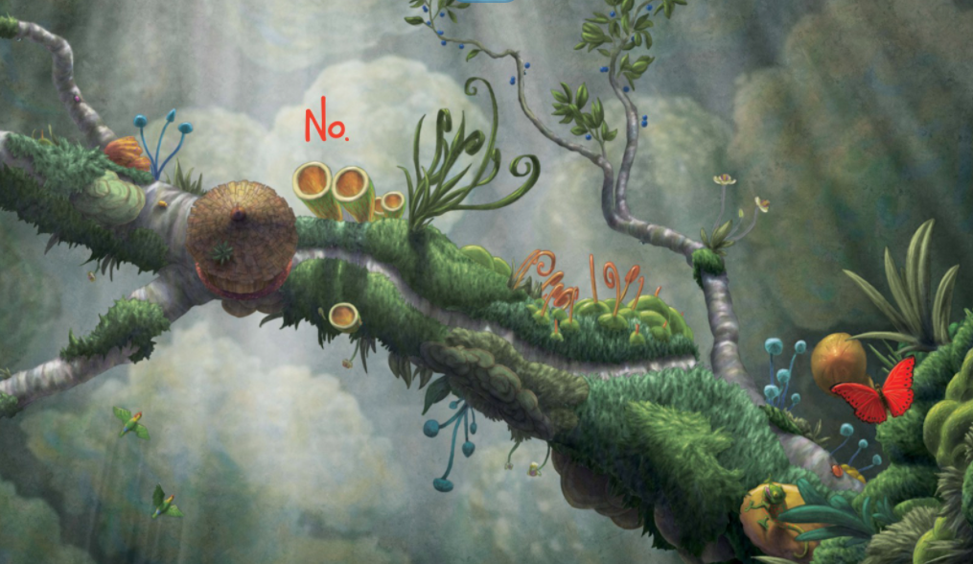

Slide 10
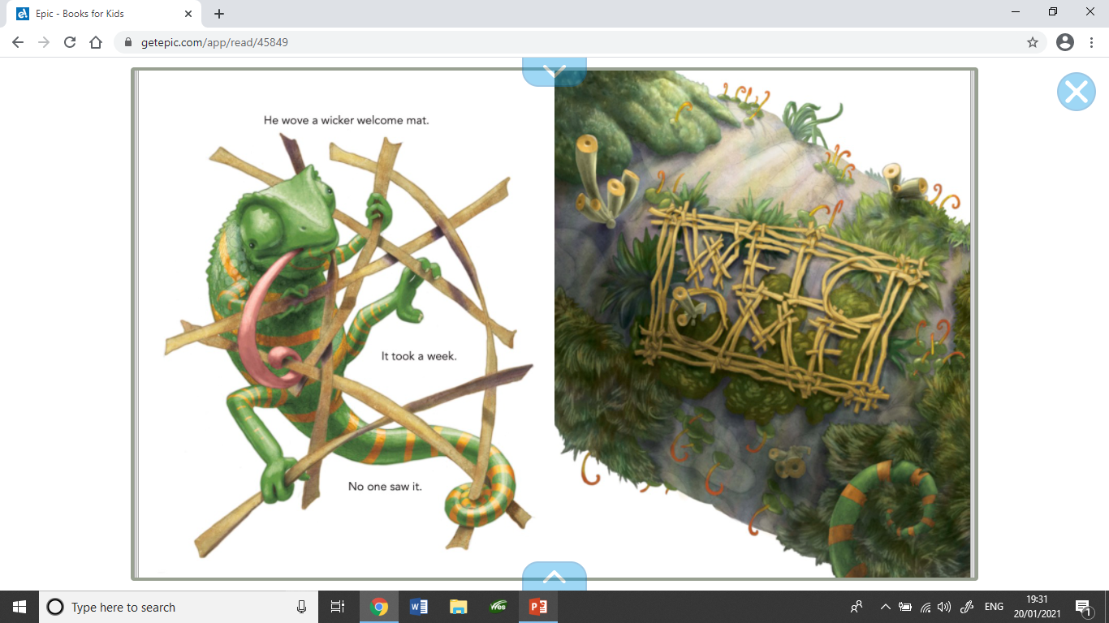

Slide 11
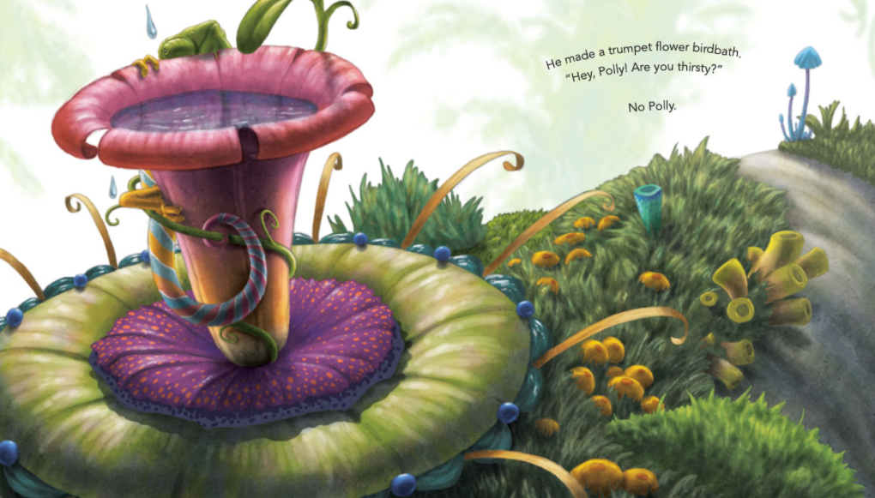

Slide 12
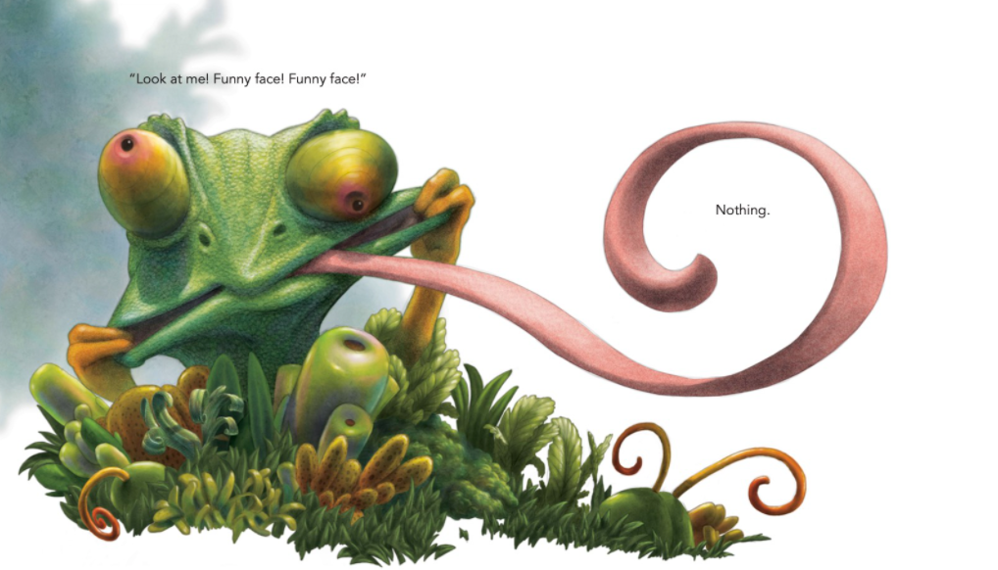

Slide 13
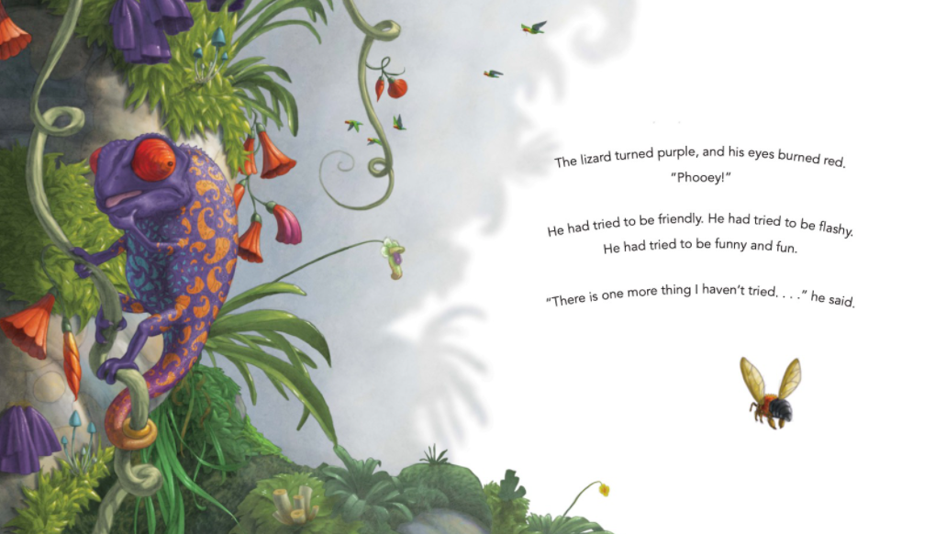

Slide 14
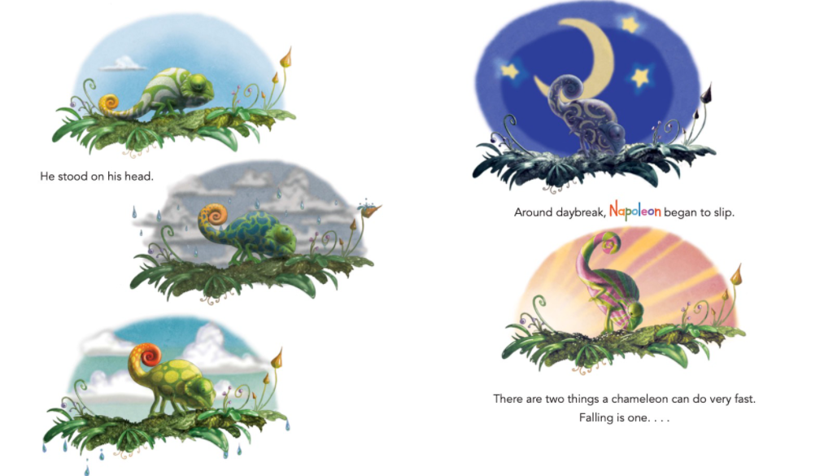

Slide 15
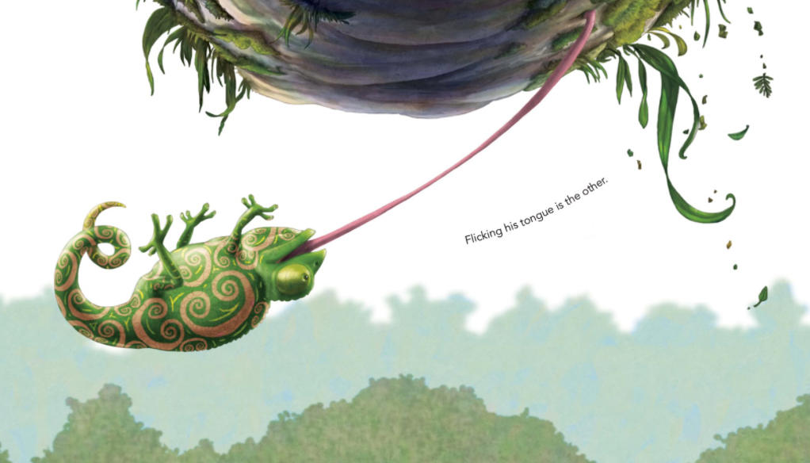

Slide 16
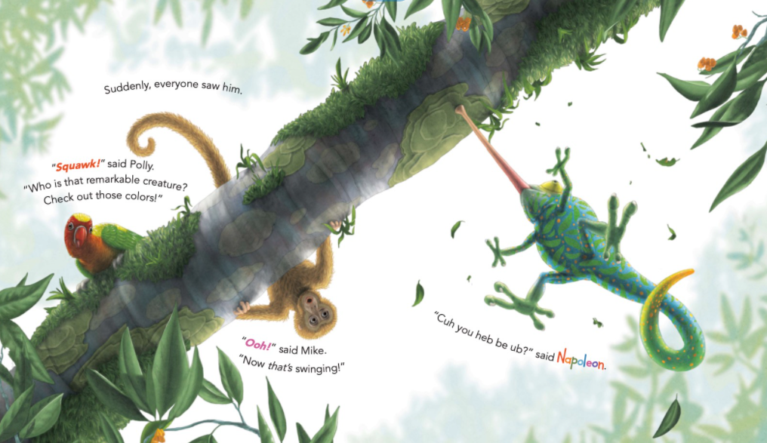

Slide 17
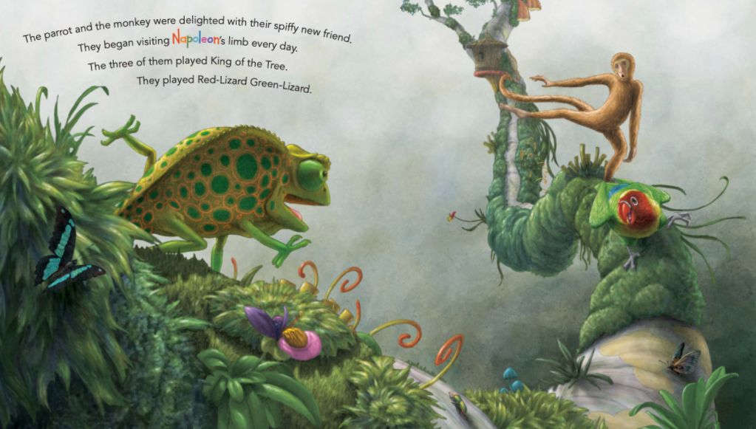

Slide 18
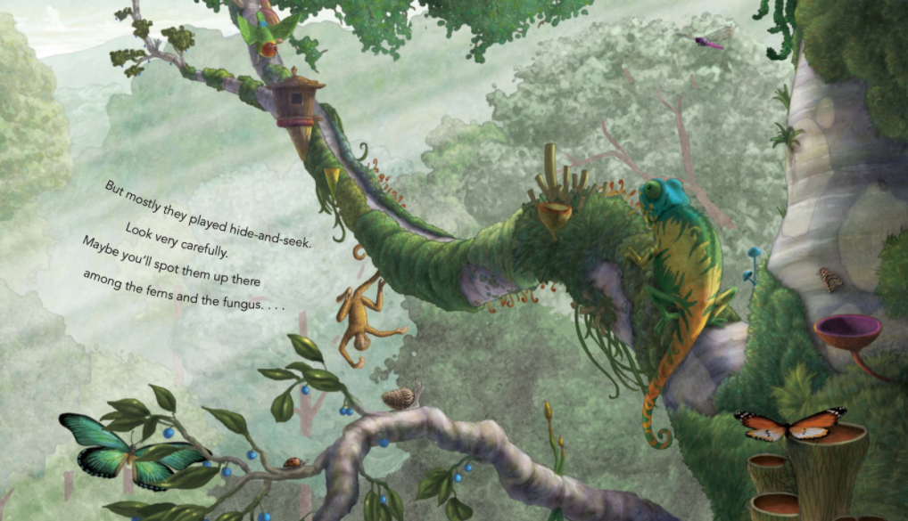

Slide 19
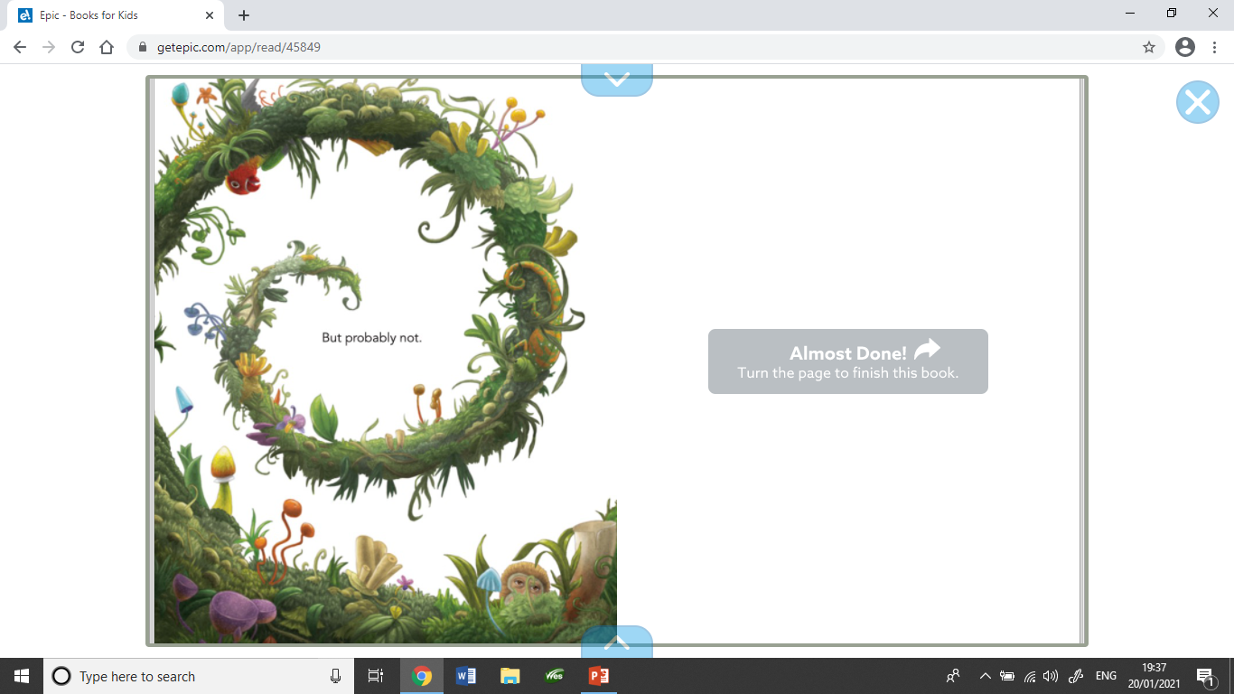

Slide 20
Discuss
What did you like about this story?
What did you dislike about this story?
Would you recommend this story to a friend?
Remember to explain your answers.

Slide 21
Your Tasks Today
Option 1 – Design a new front cover for the story ‘The Invisible Lizard’
and/or
Option 2 – Write a book review about ‘The Invisible Lizard’. This is where you write about what you thought about the book.

