Slide 1
Tuesday 26th January 2021
LO: To consider a situation from a character’s viewpoint.

Slide 2
In the story ‘The Invisible Lizard’ Napoleon is trying to get the attention of the other creatures in the rainforest, but no matter what he did, nobody noticed him.
Let’s take a look at some of the things he did.

Slide 3
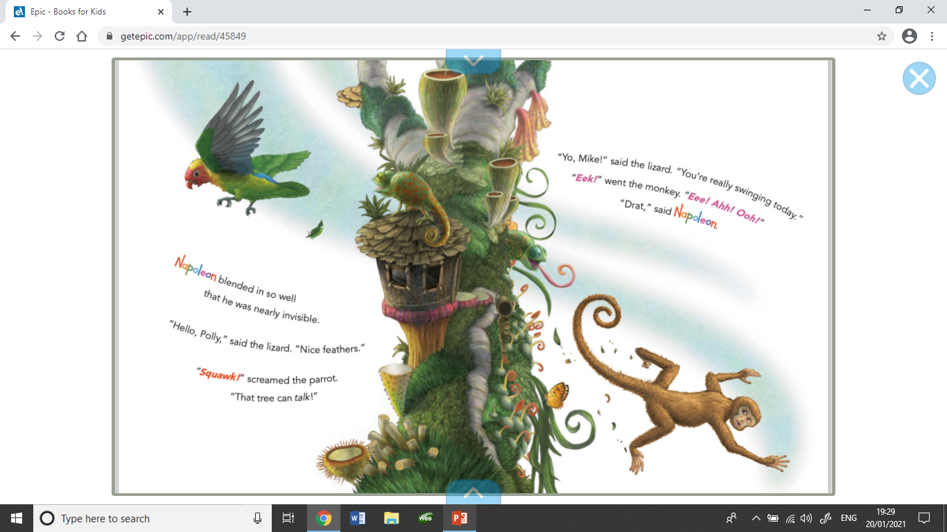
He tried speaking to the animals.

Slide 4
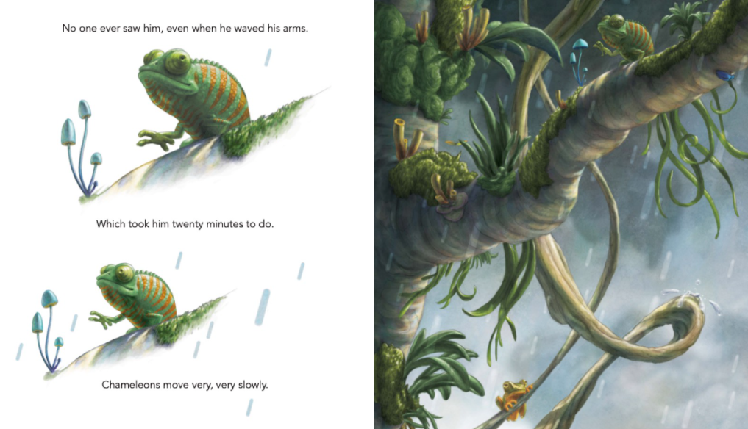
He waved at the animals.

Slide 5
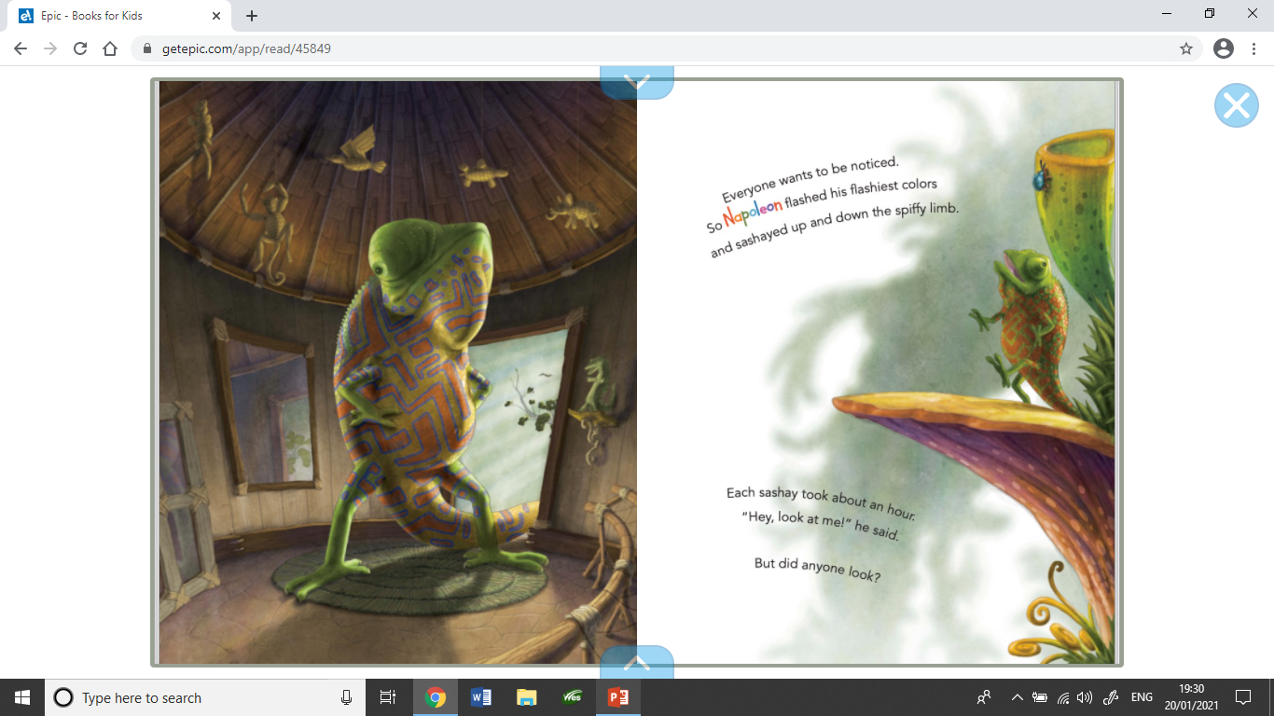
He flashed his flashiest colours.

Slide 6
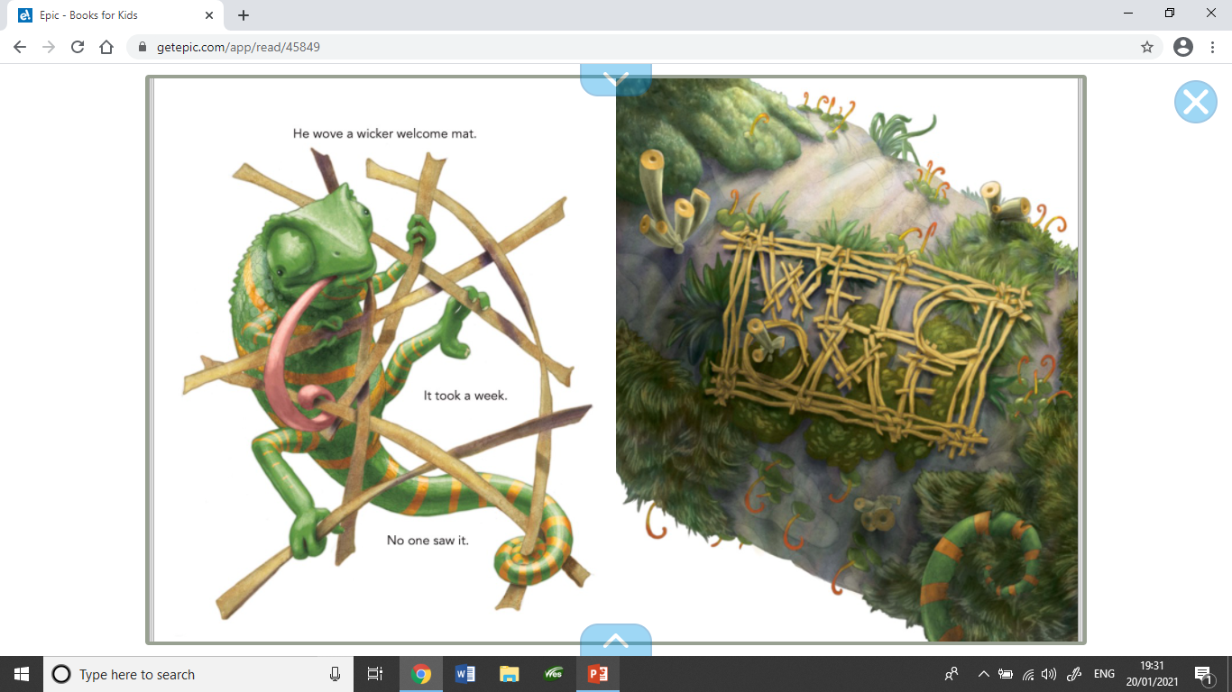
He wove a welcome mat.

Slide 7
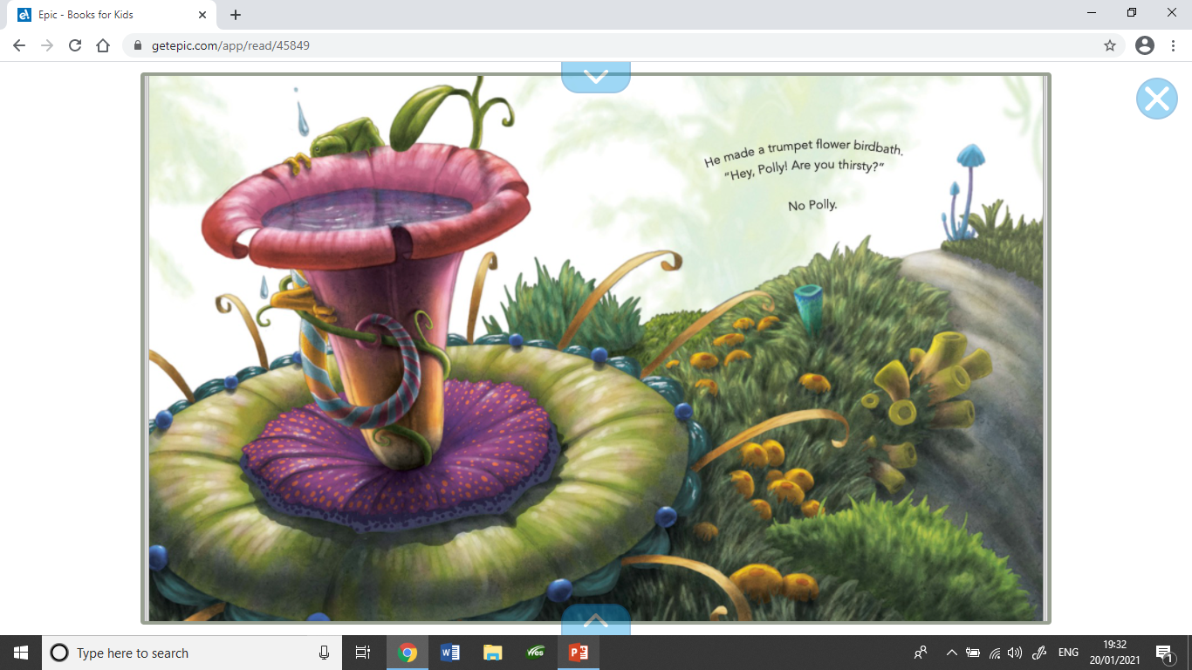
He made a trumpet flower birdbath.

Slide 8
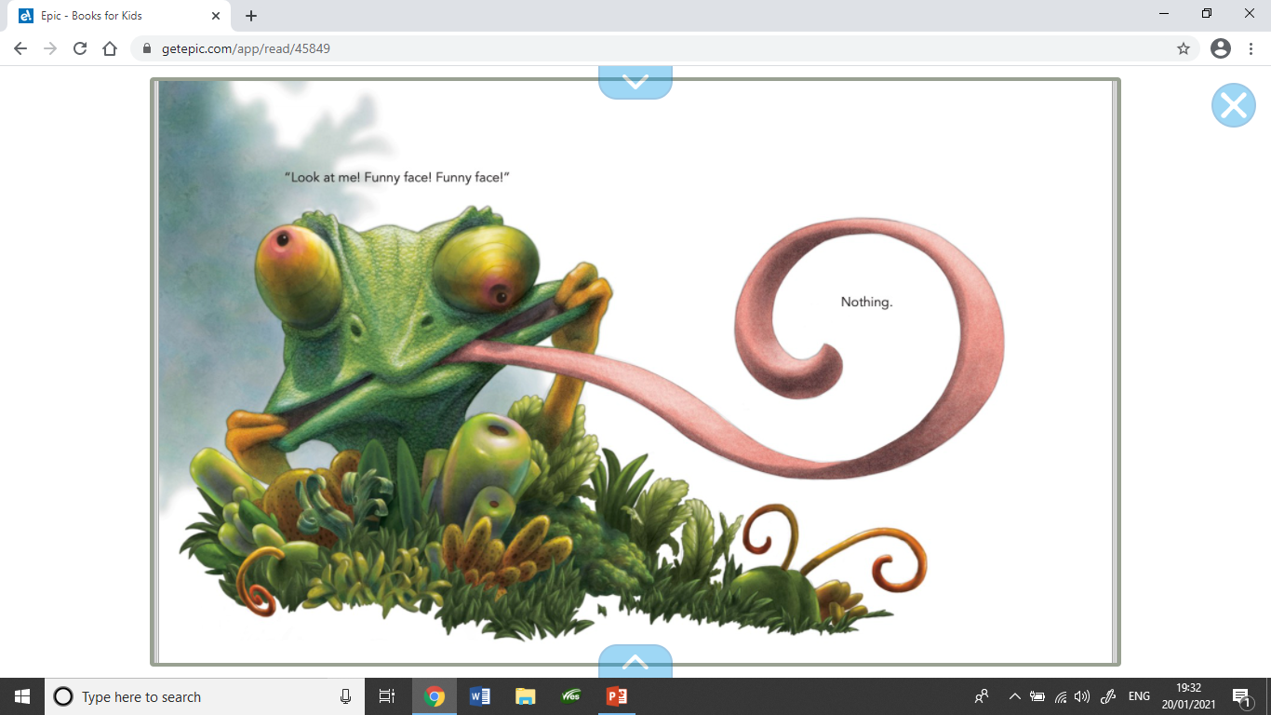
He even pulled a funny face.

Slide 9
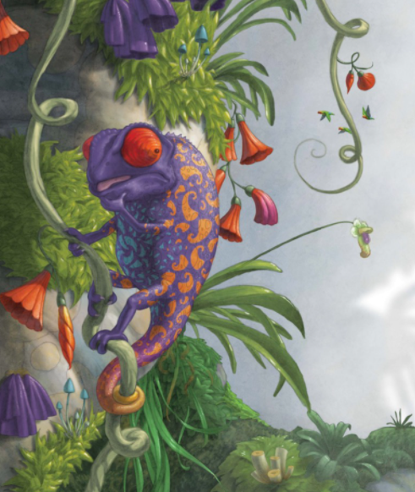
None of Napoleon’s ideas seemed to work.
Discuss – What would you do if you were Napoleon. How could you make the other creatures notice you?

Slide 10
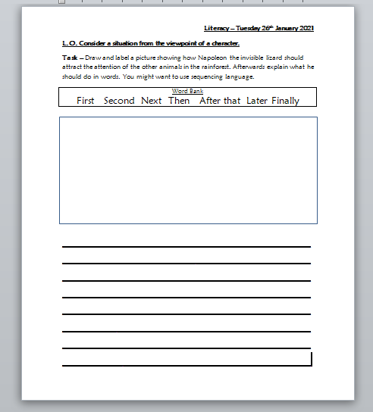
Your Task Today
Draw and label a picture of what Napoleon should do next to attract the attention of the other animals in the rainforest.
Next explain what he should do. You might want to use sequencing words such as first, next, then, after that, finally.

Slide 11
Example
First Napoleon should collect some enormous leaves, vines and strong branches. Then he should use the vines to tie the branches and leaves together to make a parachute. Next he should collect some of the most colourful flower petals he can find. After that he should carry the parachute and petals to the top of the tallest tree he can find. Finally he should use the parachute to safely jump out of the tree while letting go of the beautiful petals. All of the animals will notice him when he appears to make it rain all of the colours of the rainbow.

