Slide 1
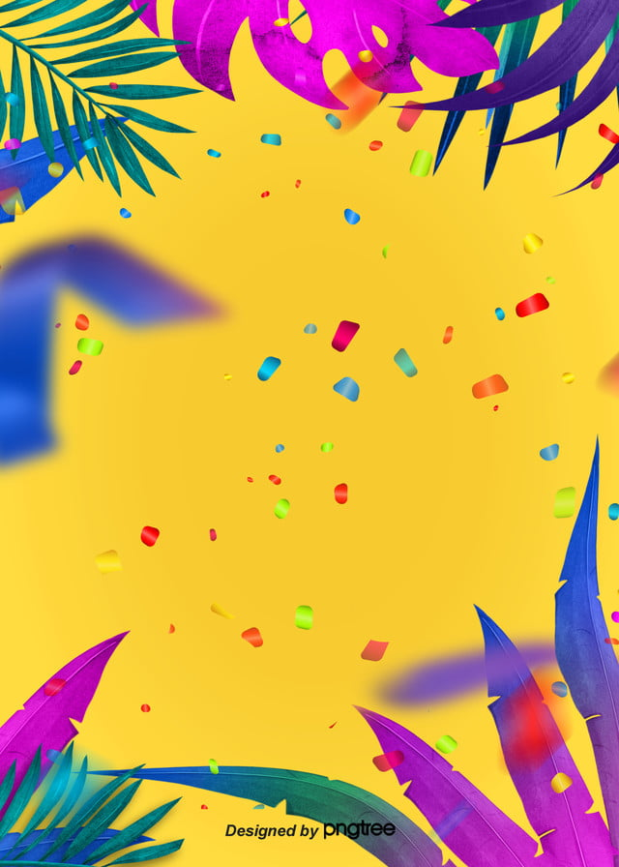
Monday 25th January
Art
LO: To design and create your own carnival headdress or mask.

Slide 2
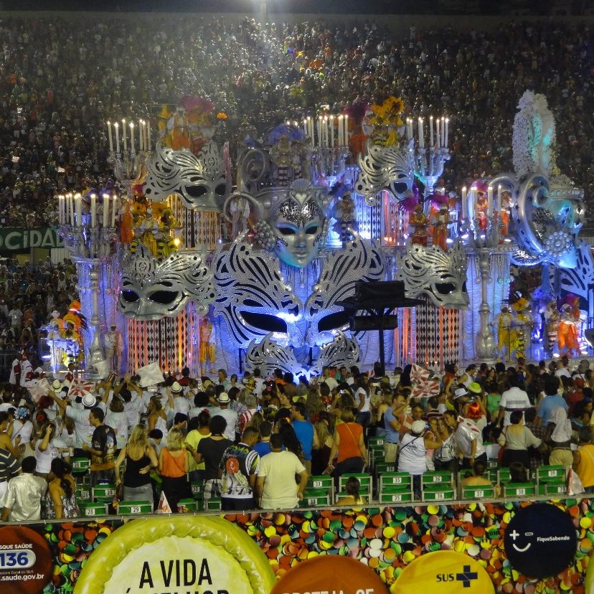
Brazilian Carnivals
(Carnaval do Brasil)
A carnival is a big festival where there is a lot of music, dancing and people dressing in colourful costumes.
The carnivals in Brazil are famous for the amazing costumes.
The carnival takes place during Lent and begins on the Friday before Ash Wednesday. It can last for four days. Thousands of people go to see the carnivals.

Slide 3
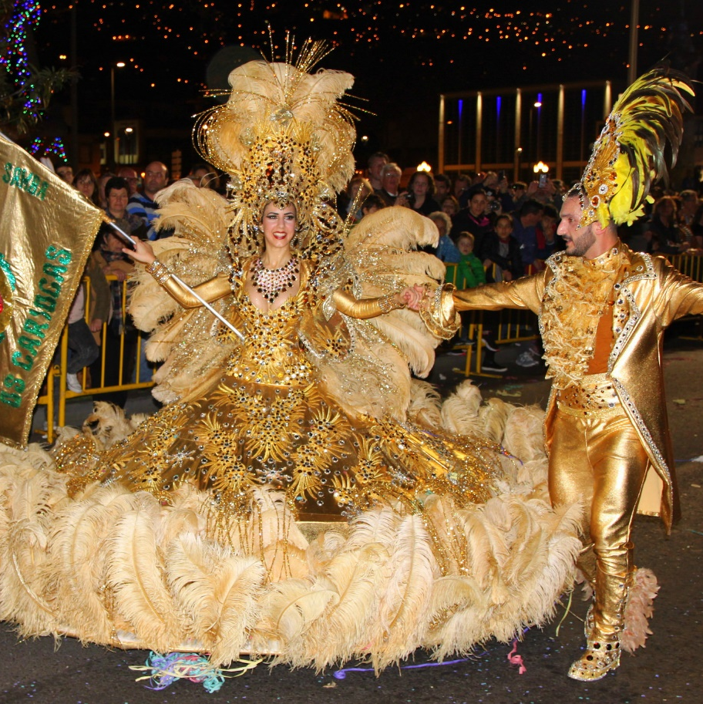
Costumes
The costumes are bold and brightly coloured. They often have fancy masks. People spend a long time getting everything just right.
What do think about this costume?

Slide 4
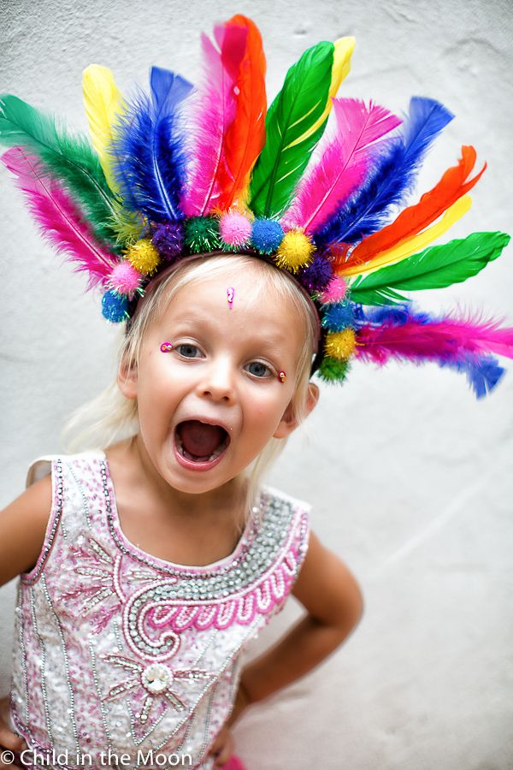
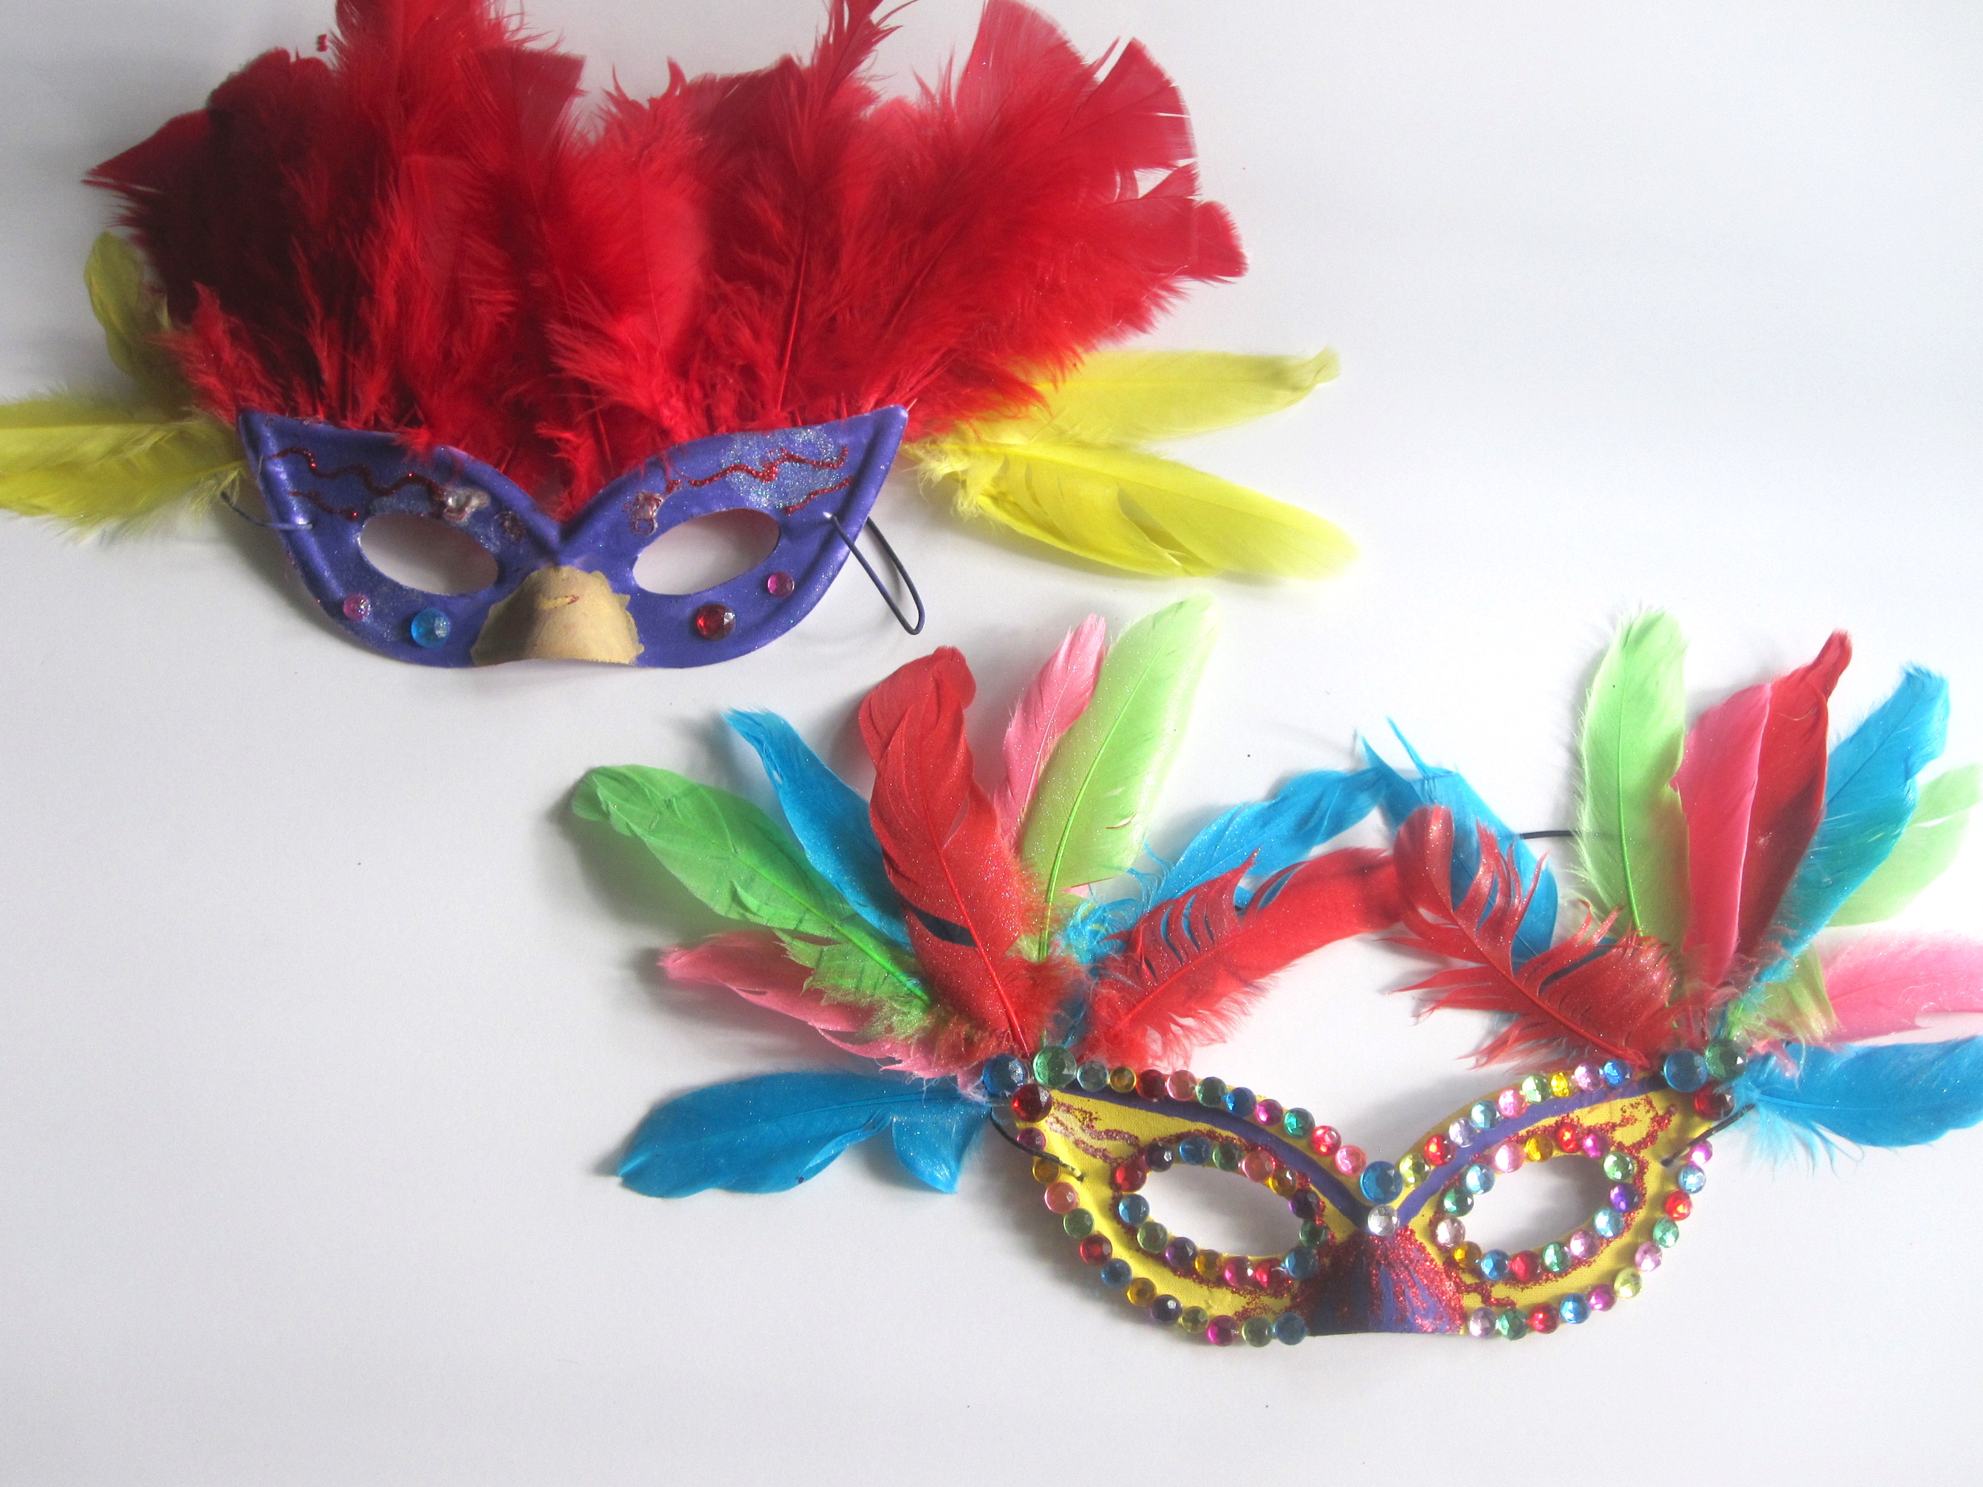
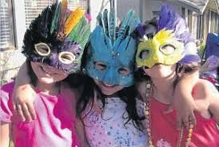
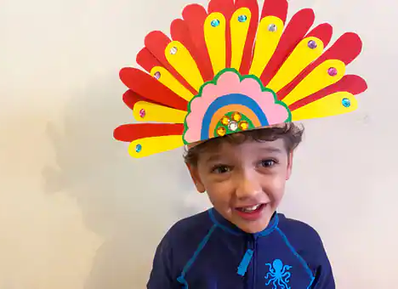
Here are examples of carnival headdresses.
Design your own headdress or mask. Think about the materials you have at home. Paper plates, cereal boxes for card, feathers, plain paper and pens, coloured paper, paint, stickers, beads, painted pebbles, glitter. You can use pretty much anything! Be creative!

Slide 5
Task 1: Design Stage: Draw what your end product might look like and label it clearly showing what materials you want to use. (You can print this out or just use plain paper)
Task 2: Make Stage (This can be done over a number of days!)
Below are two useful links to website that show different creative ways of making carnival masks or headdresses. You can use these ideas or come up with your own.
You may need to scroll down these sites to get to the instructions!
Web Link to Make a Carnival Mask:
Web Link to Make a Carnival Headdress:

