Slide 1
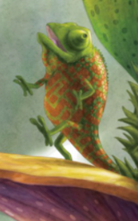
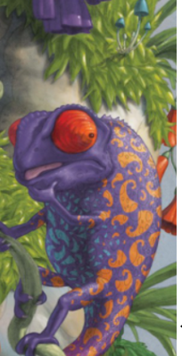
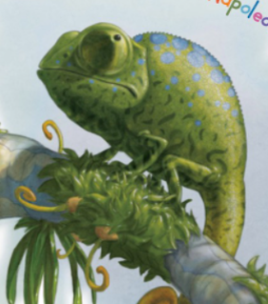
Monday 25th January 2021
LO: To Think about where Napoleon might hide and describe him using adjectives and similes.

Slide 2
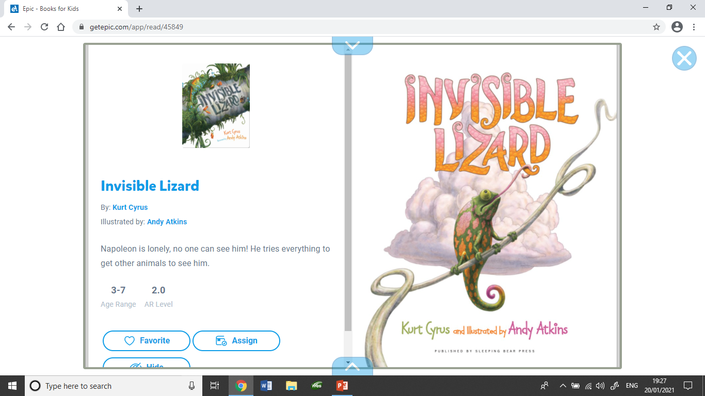

Slide 3
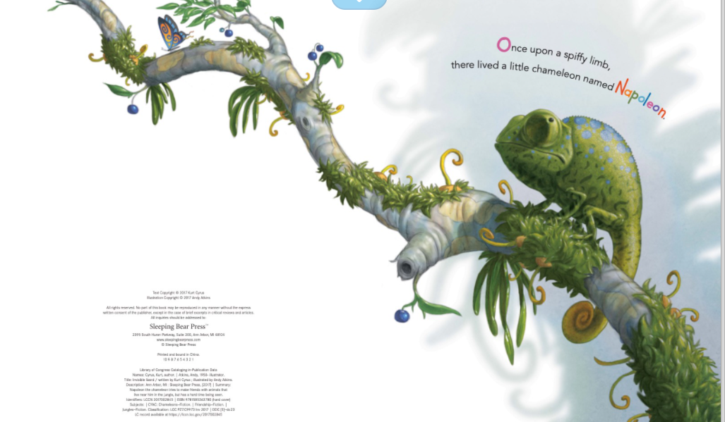

Slide 4
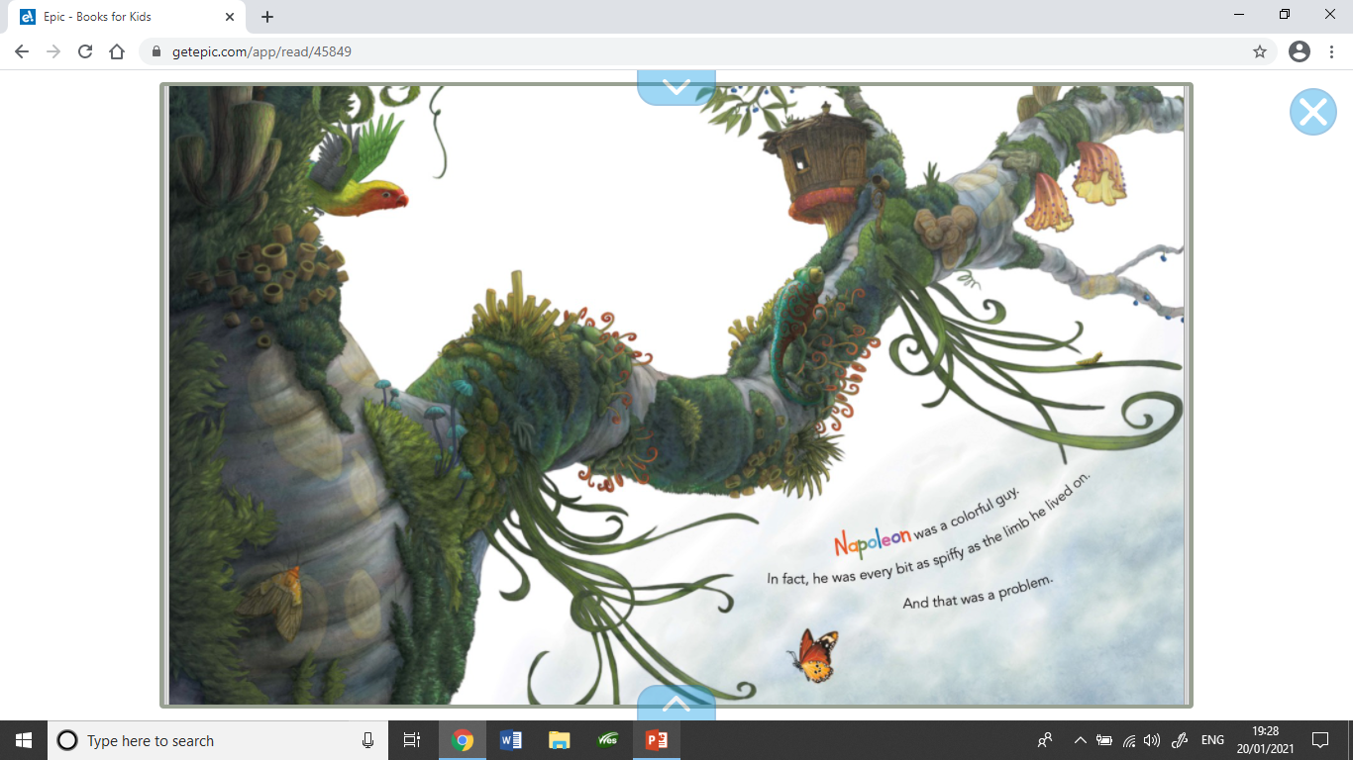

Slide 5
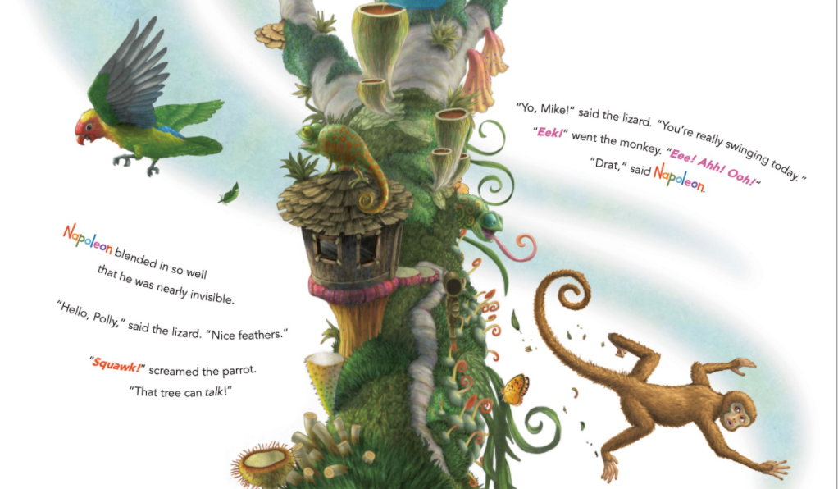

Slide 6
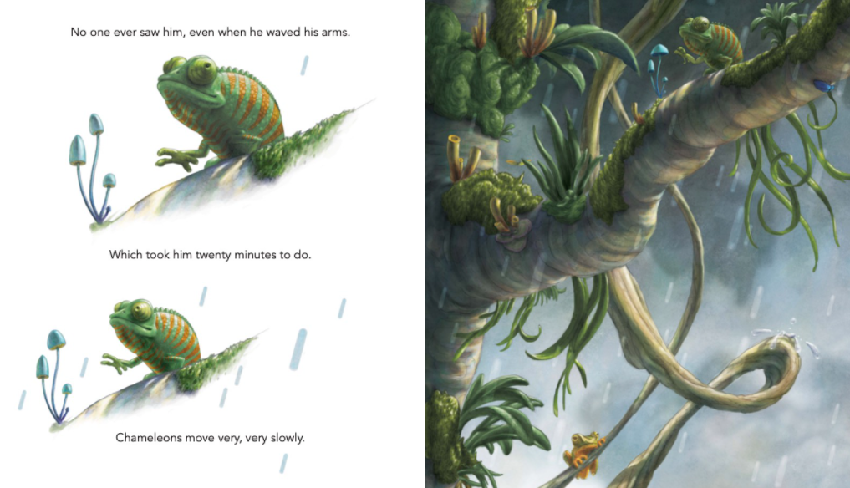

Slide 7
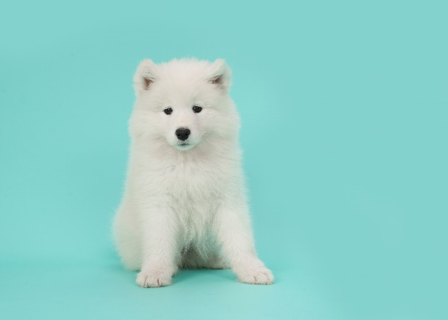
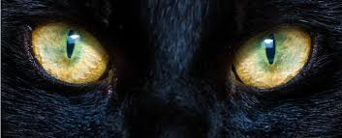
What are adjectives and similes?
What is an adjective?
An adjective is a word that describes a noun (thing/object).
Eg. tiny, colourful, exciting, impressive.
What is a simile?
A simile is a phrase that compares one thing to another.
You would use the words ‘as’ or ‘like’ to compare the things.
Eg. The dog’s fur was as white as snow.
The cat’s eyes were like lanterns in the dark.

Slide 8
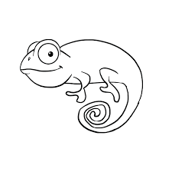
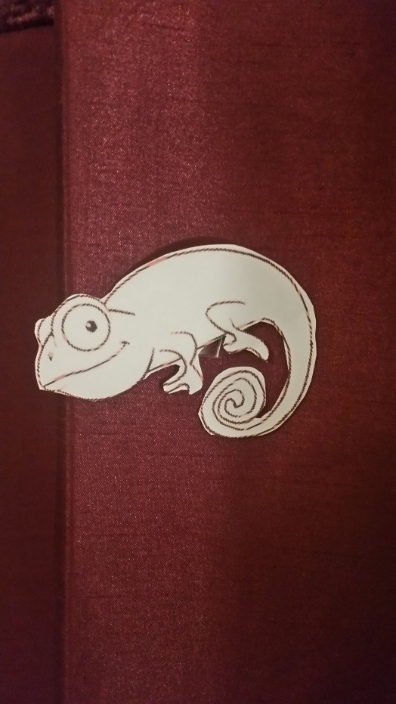
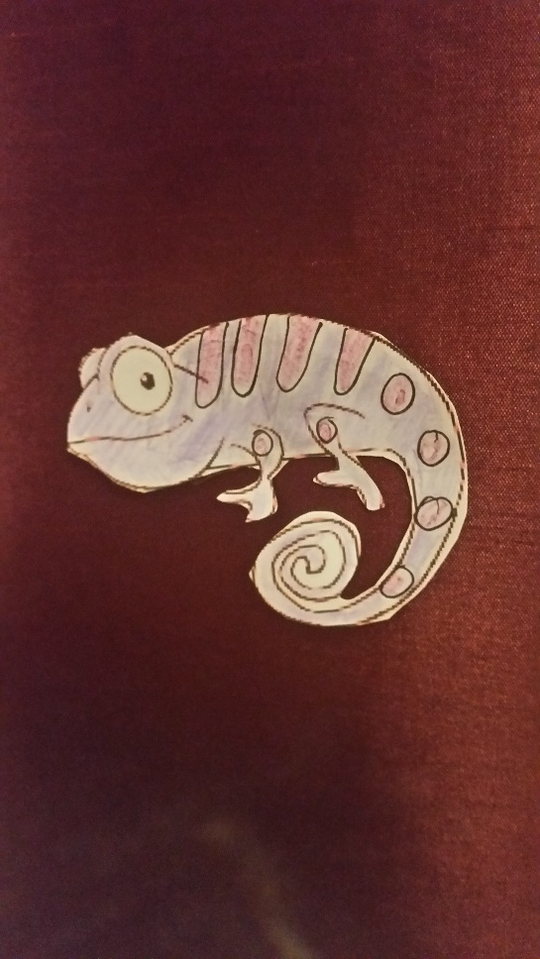
Think about where Napoleon might hide in your house or garden.
What colours might he become to blend in?
This is Napoleon!
He turned up in my lounge on my curtain!

Slide 9


How could we describe Napoleon hiding in my curtain?
Think of using adjectives in your first sentence.
Napoleon’s skin turned a beautiful, brilliant shade of purple.
Then think of a simile for your second sentence.
Instantly, his skin looked as purple as a ripe, juicy plum.
or
Instantly, his skin looked like a bunch of pretty lavender.

Slide 10
Your Task Read up to page 5 of the book on the PowerPoint.
Think about what would happen if Napoleon visited your house/garden. Where might he hide?
Task 1) Print out the 3 templates of Napoleon (or draw 3 of your own) and colour them to match a different place he might hide.
Task 2) To write two sentences for each chameleon, one using adjectives only and the second include a simile.
You can either:
Complete the template using PowerPoint and upload pictures of your chameleons from your camera. Type in your sentences in the boxes provided.
Print out the template and draw a picture of Napoleon in his hiding places and write your sentences.
Create your own pictures and sentences on a blank piece of paper based on the template given.
In all options you should include:
- Capital letter at the start of a sentence.
- Full stop
- Hard: use a fronted adverbial such as instantly, suddenly, all of a sudden to start your sentence.
- Easy: Write one sentence for each chameleon using adjectives only.

Slide 12
How could you describe Napoleon the Chameleon if he hid in your house?
What might he look like?
Hiding Place 1:
Hiding Place 2:
Hiding Place 3:

