Slide 1
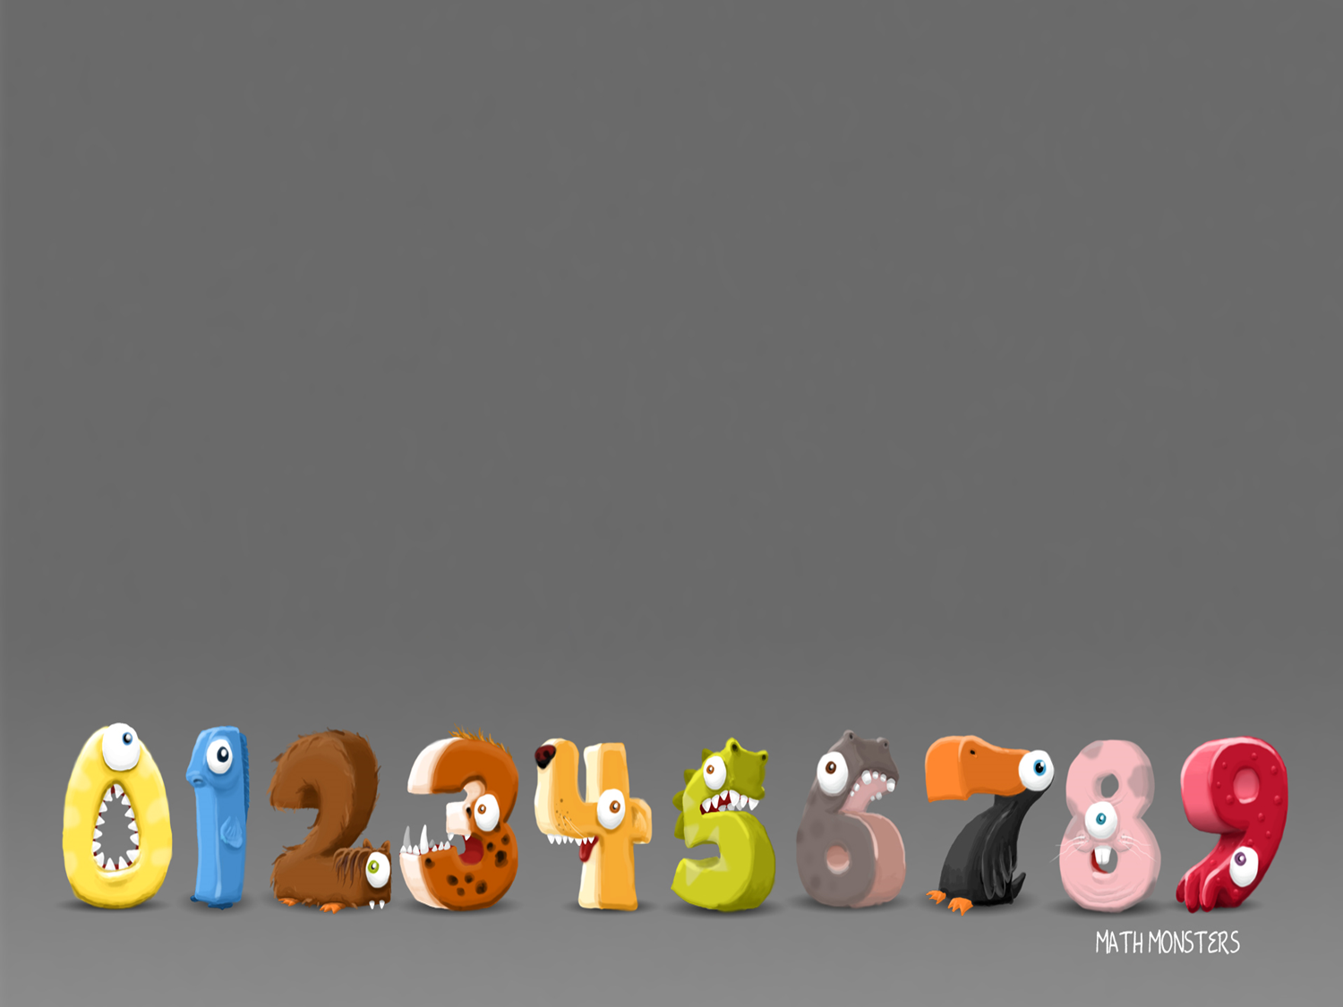
25/1/2021
LO: Multiplication sentences using the x symbol

Slide 2
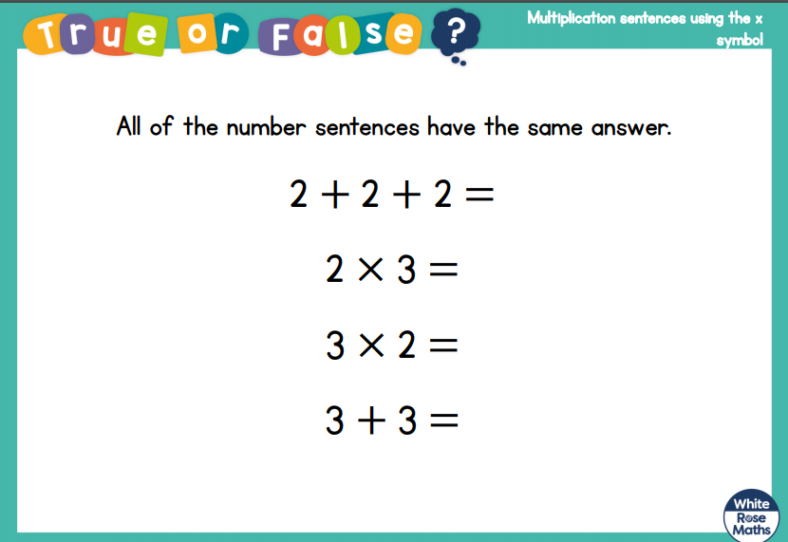

Slide 3
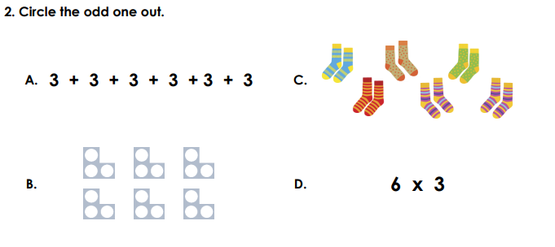

Slide 4
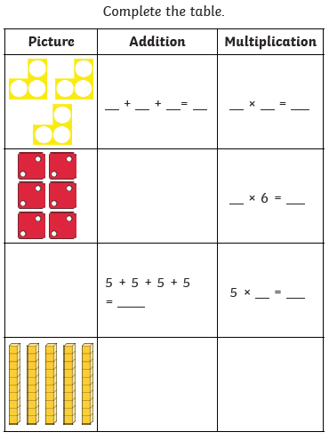
3 + 3 + 3 = 9 3 x 3 = 9
2 + 2 + 2 + 2 + 2 + 2 = 12
6 x 2 = 12
5 + 5 + 5 + 5 = 20 5 x 4 = 20
10 + 10 + 10 + 10 + 10 = 50
5 x 10 = 50

Slide 5
Would you rather…
4 x 5
cupcakes
2 x 9
cupcakes
or

Slide 6
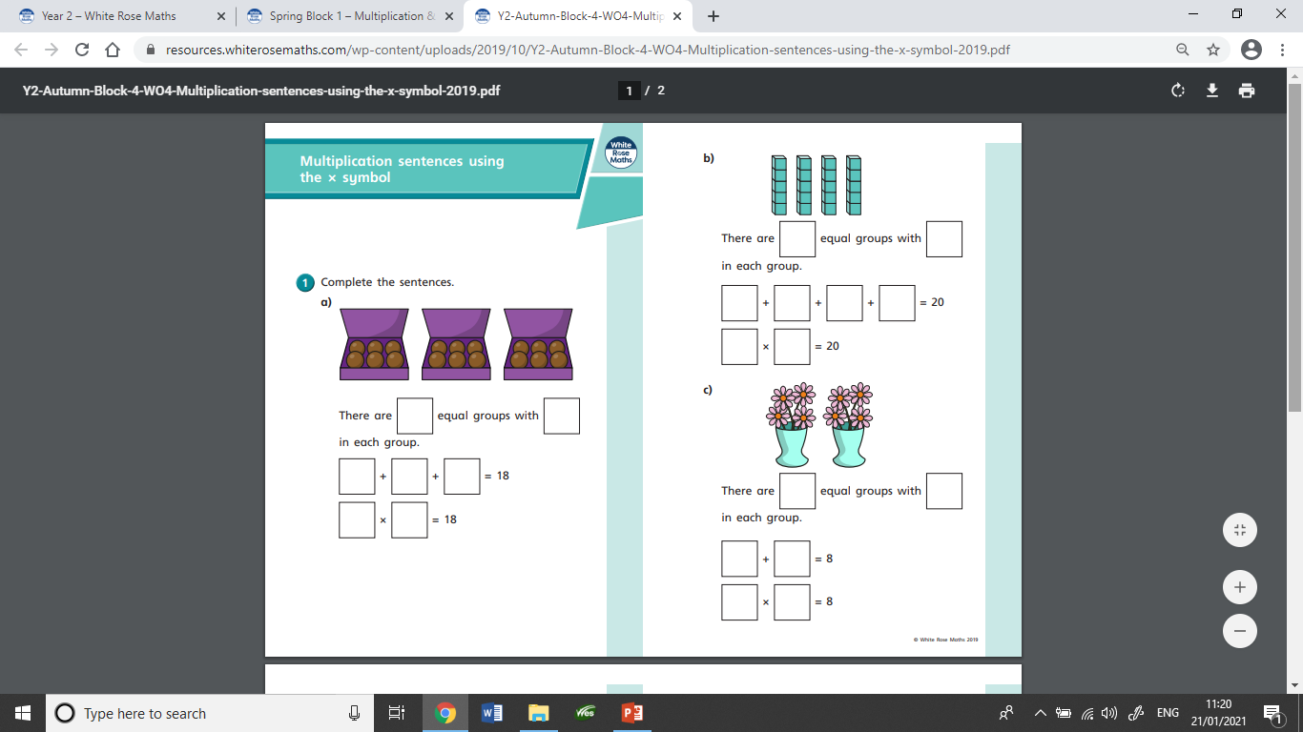
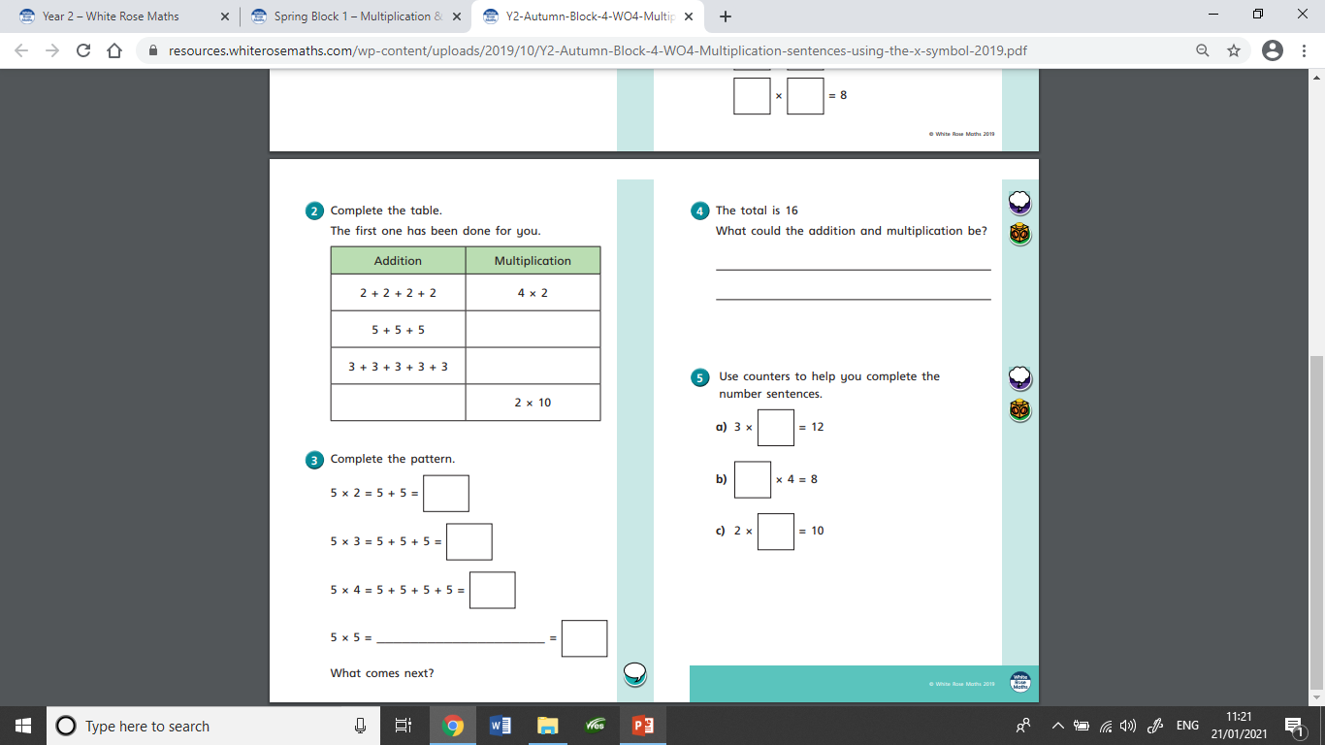
This is the worksheet set today.

Slide 7
26/1/2021
LO: Multiplication sentences from pictures

Slide 8
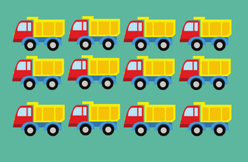
What sums could we write about this array?
3 + 3 + 3 + 3 = 12
4 + 4 + 4 = 12
3 x 4 = 12
4 x 3 = 12

Slide 9
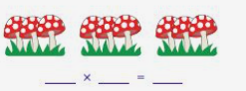
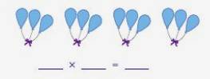
What multiplication sums go with these pictures?
3 x 3 = 9
3 x 4 = 12
4 x 3 = 12

Slide 10
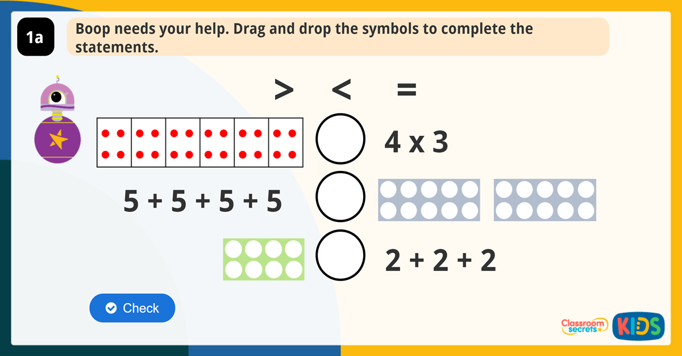

Slide 11
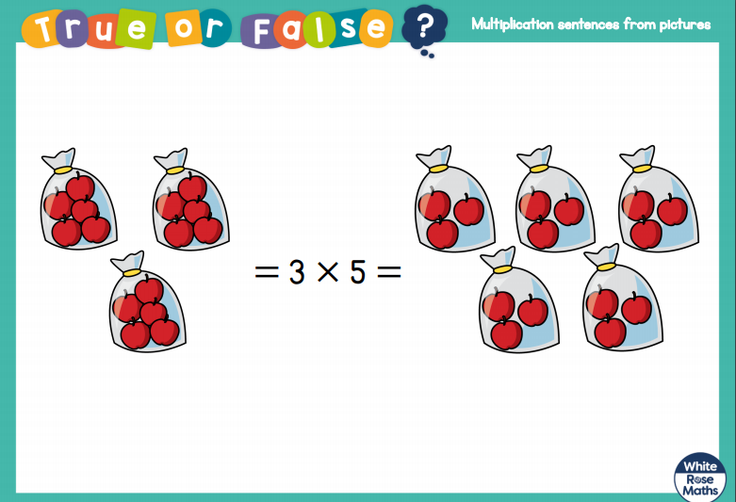

Slide 12
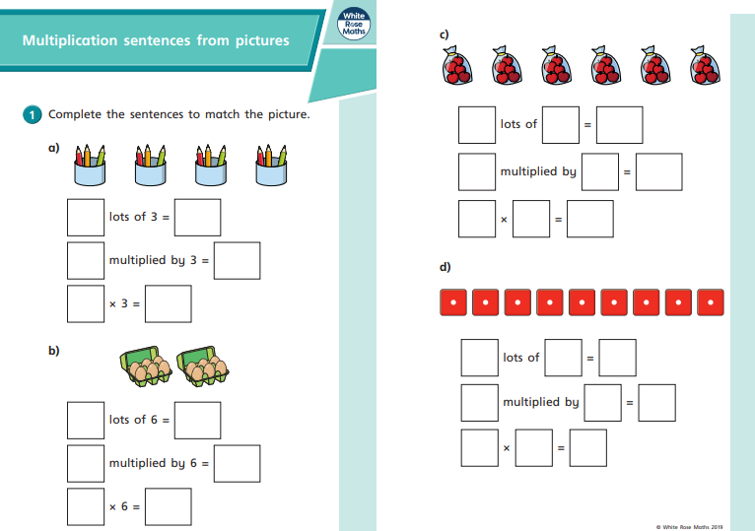
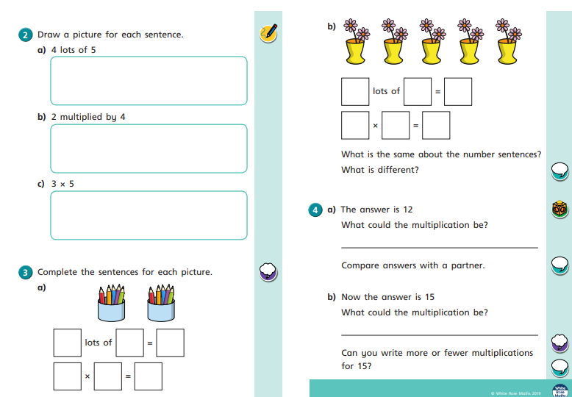
This is the worksheet set today.

Slide 13
27/1/2021
LO: Practical Activity:
Make equal groups (grouping)

Slide 14
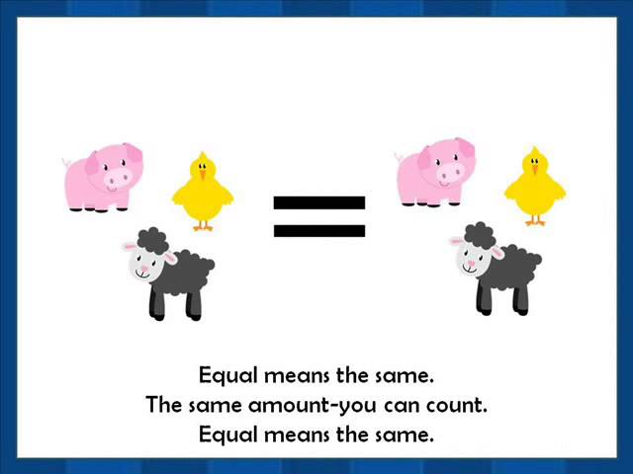
Recap: What does the term equal mean?

Slide 15
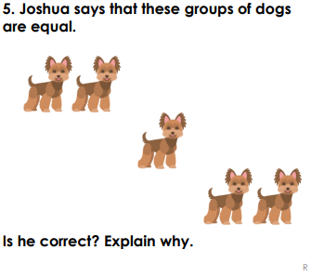
Are these groups equal?

Slide 16
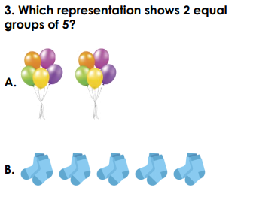
A shows 2 equal groups of 5
B shows 5 equal groups of 2

Slide 17


12
There are frogs.
Can you place these frogs into groups of 4?
There are 3 groups with 4 frogs in each group.

Slide 18
2
Grouping is easier if you make rows and columns.
How many groups of 3 are there?
There are groups of 3
4

Slide 19
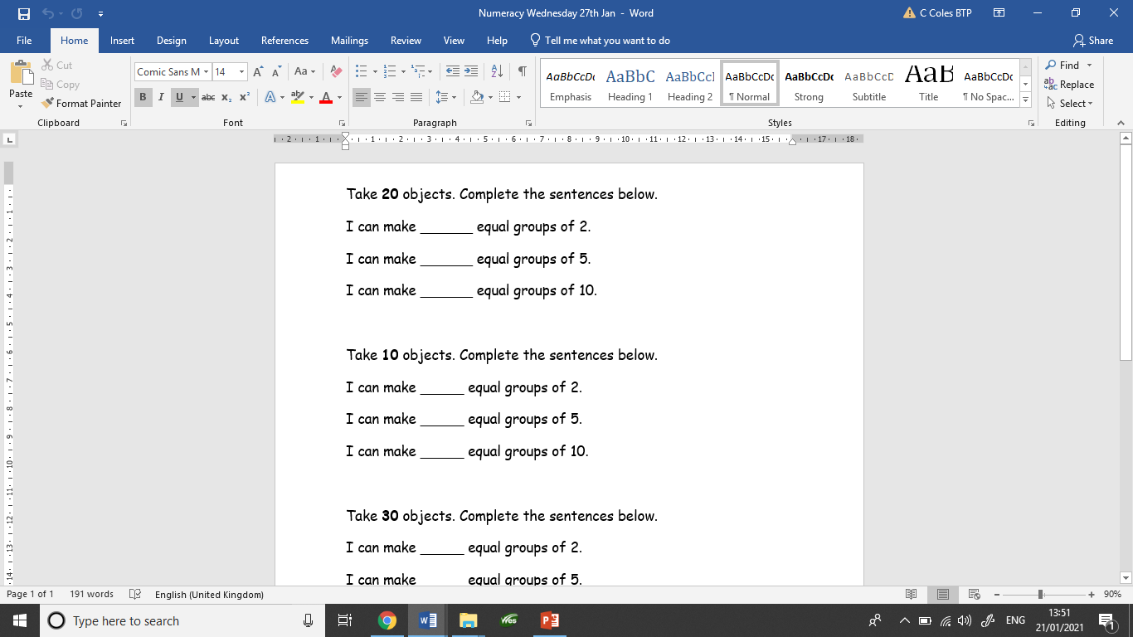
Today’s task
Your task for today is to practise making equal groups from a given number.

Slide 20
28/1/2021
LO: Make equal groups - grouping

Slide 21
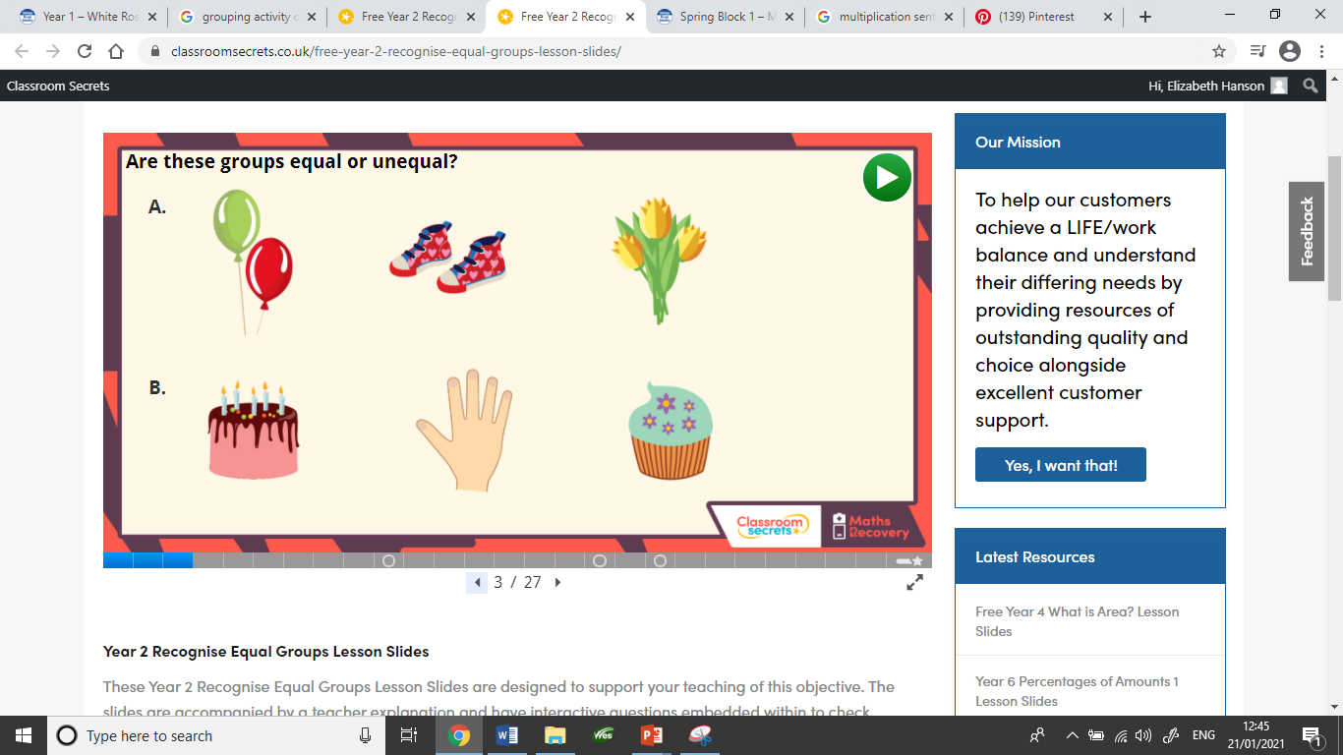

Slide 22
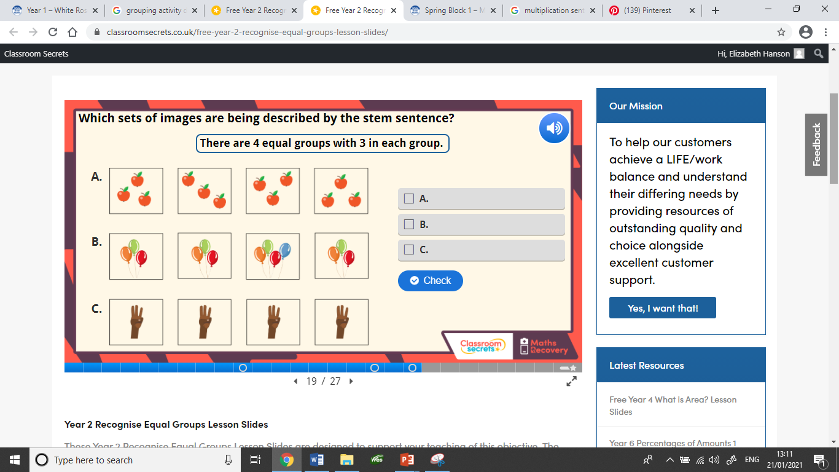

Slide 23
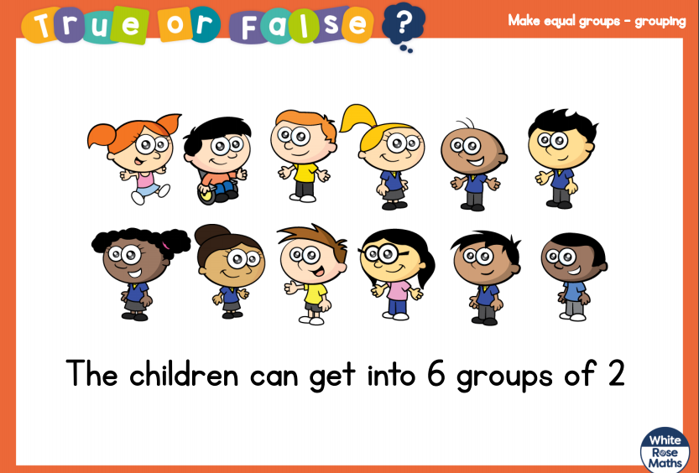

Slide 24
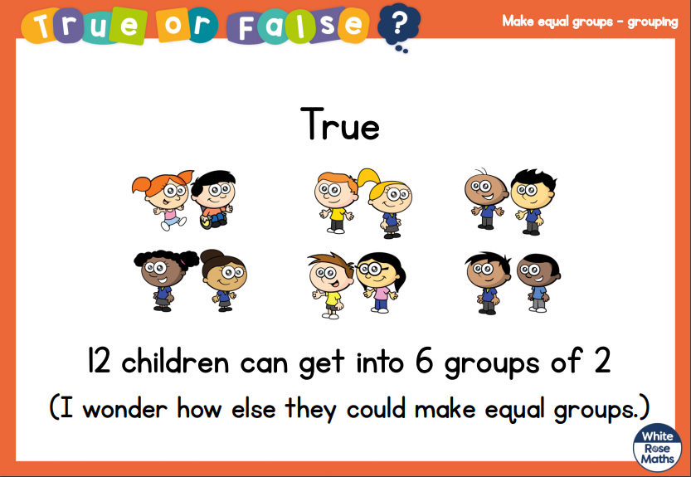

Slide 25
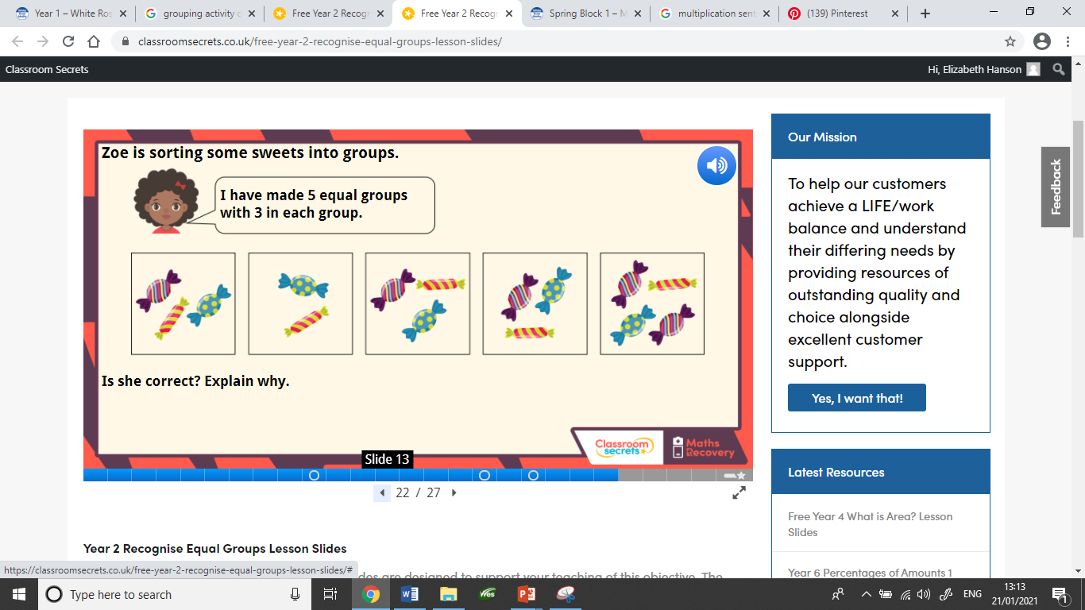

Slide 26
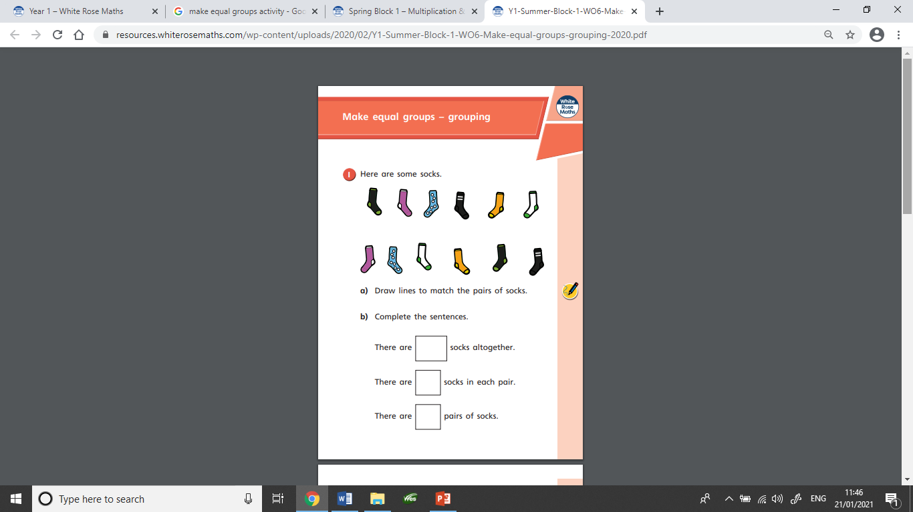
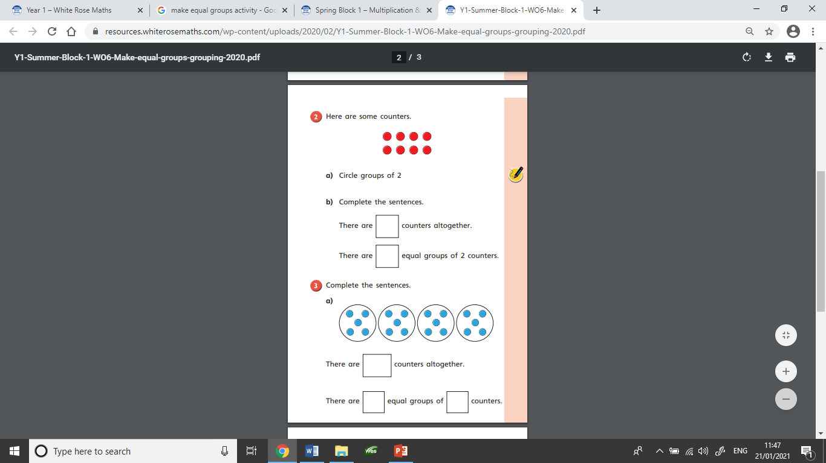
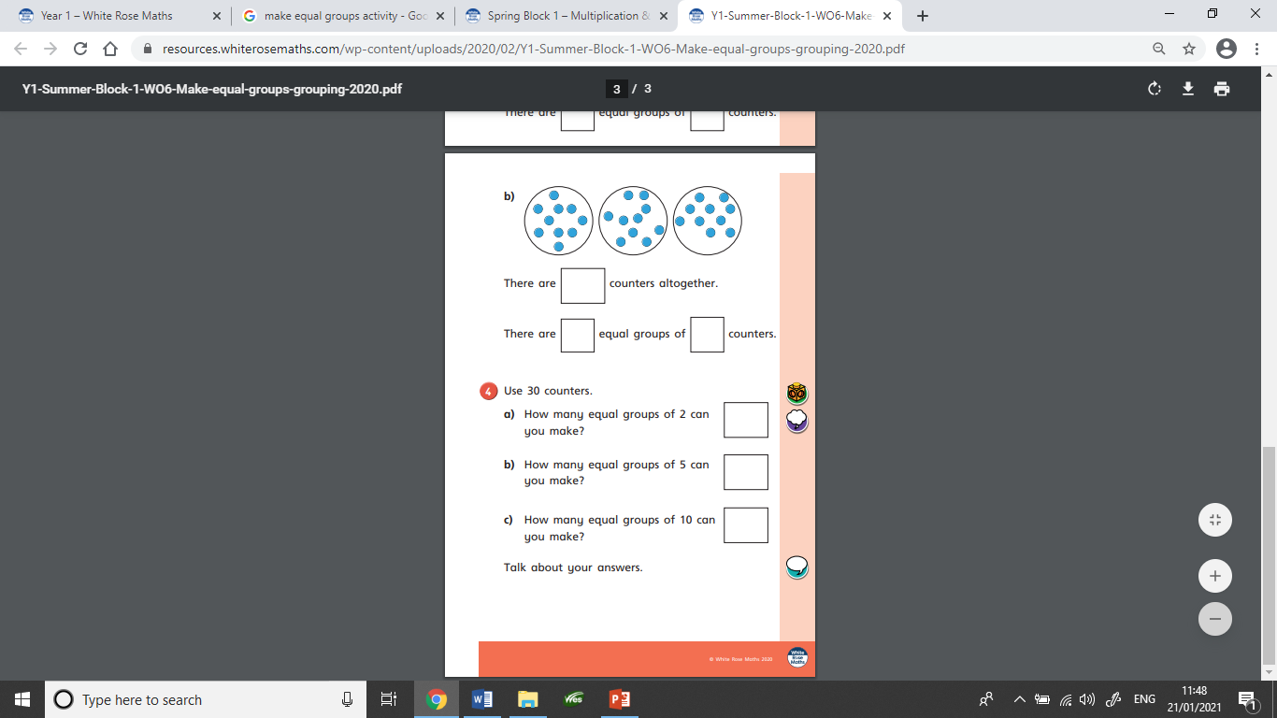
This is the worksheet set today.

Slide 27
29/1/2021
LO: Make equal groups - grouping

Slide 28
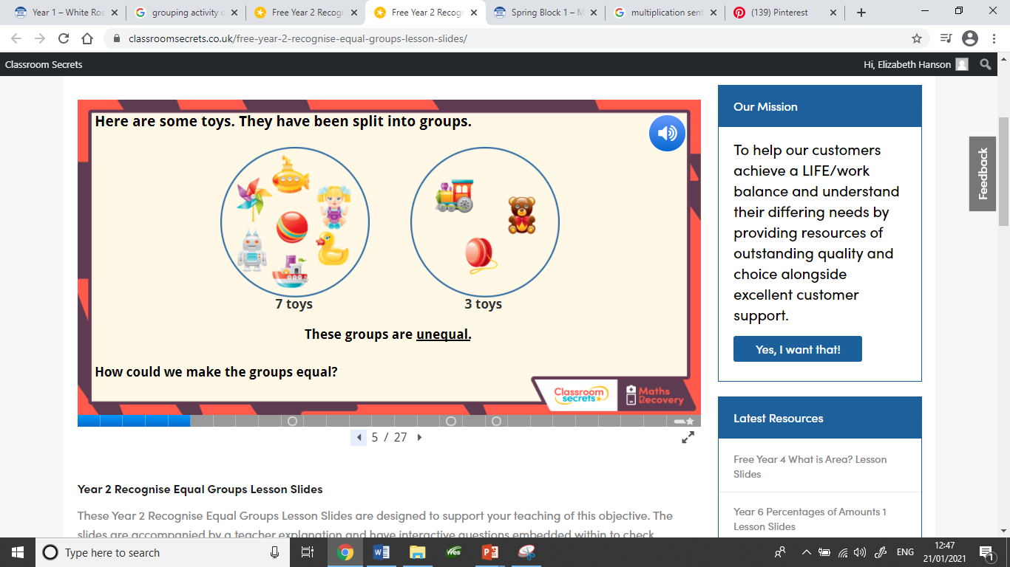

Slide 29
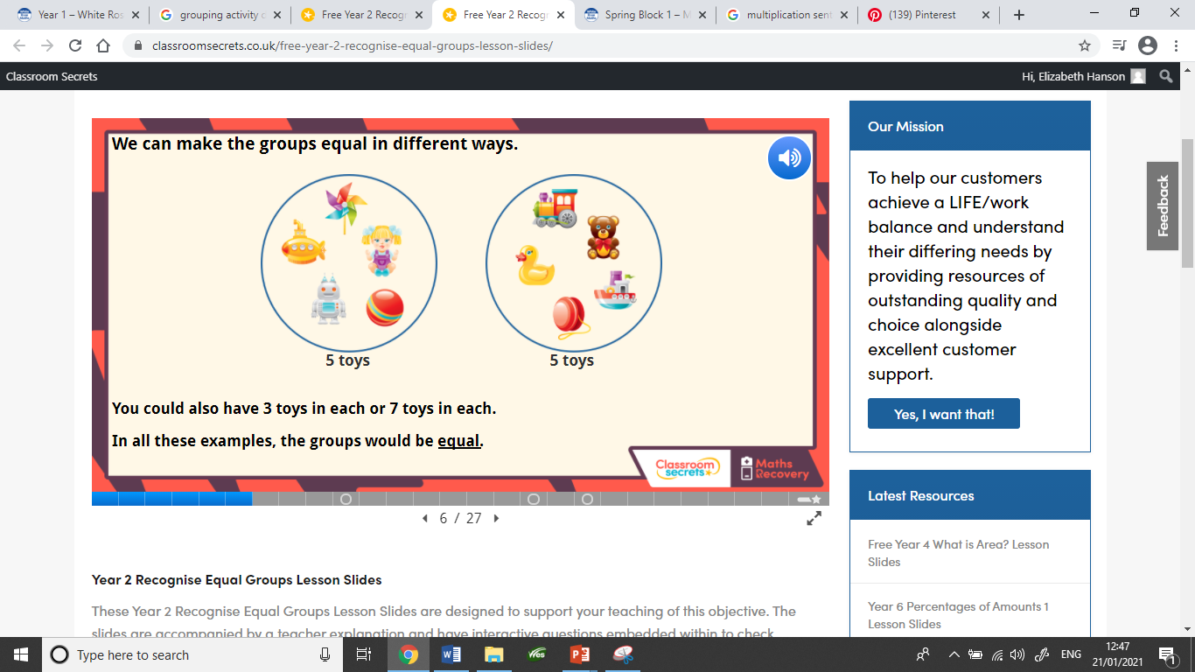

Slide 30
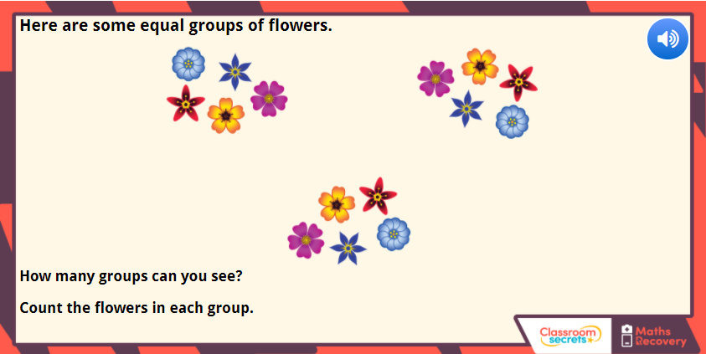
There are __ equal groups with __ in each.

Slide 31
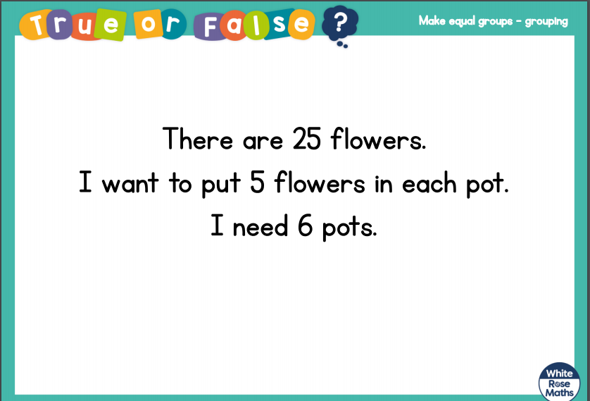
There are

Slide 32
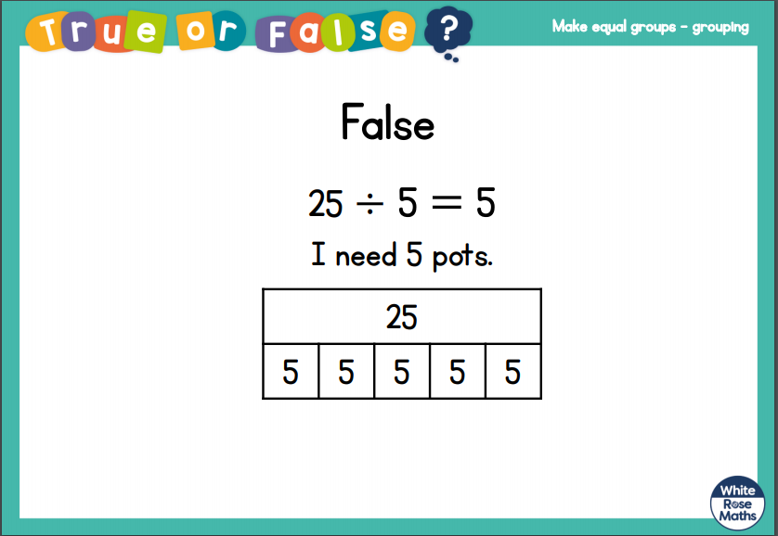

Slide 33
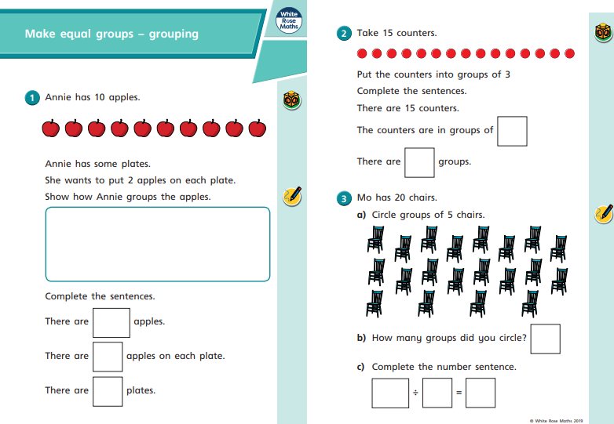
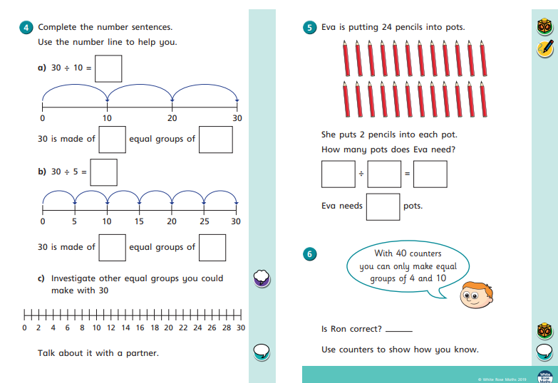
This is the worksheet set today.

