Slide 1

Friday 8th January 2021
LO: To describe a story setting.
SC: To use adjectives

Slide 2
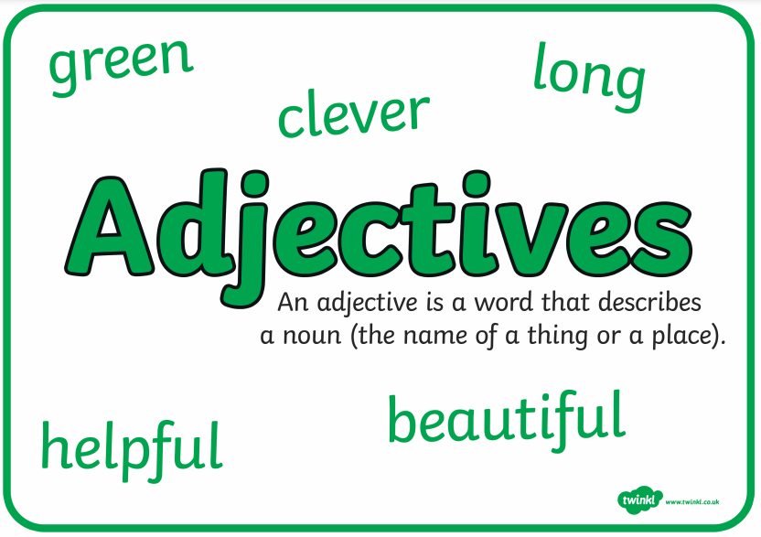
What is an adjective?

Slide 3
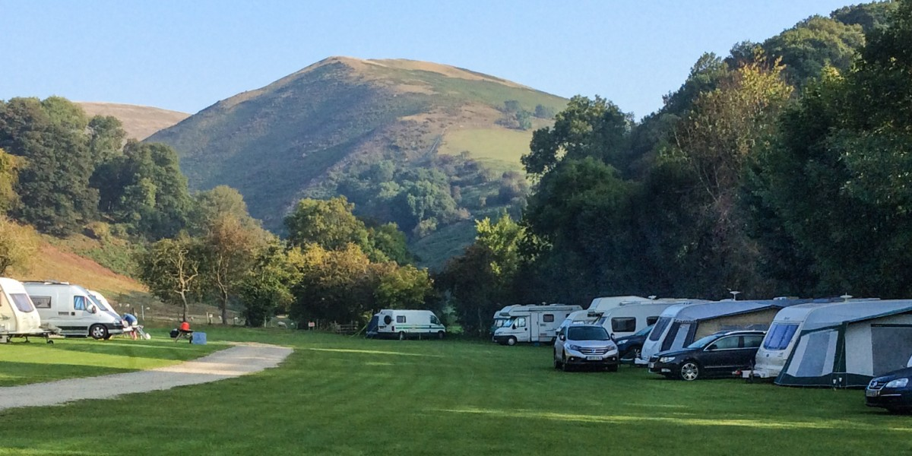
What adjectives could you use to describe this …

Slide 4
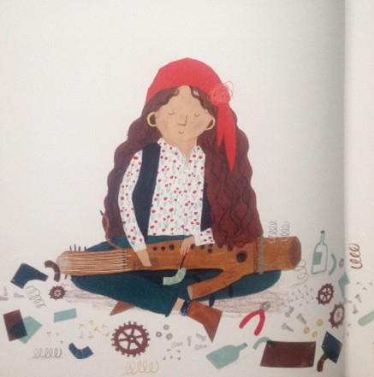
Look at this picture from the story. What adjectives could you use to describe this picture of Ossiri?

Slide 5
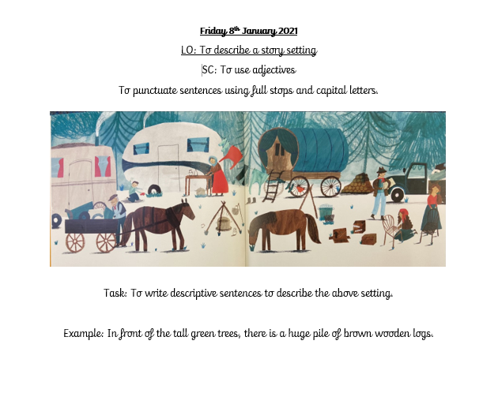
Your Task today: Worksheet available.
Your Task today: To write sentences to describe this setting.
Lets come up with some together.

Slide 6
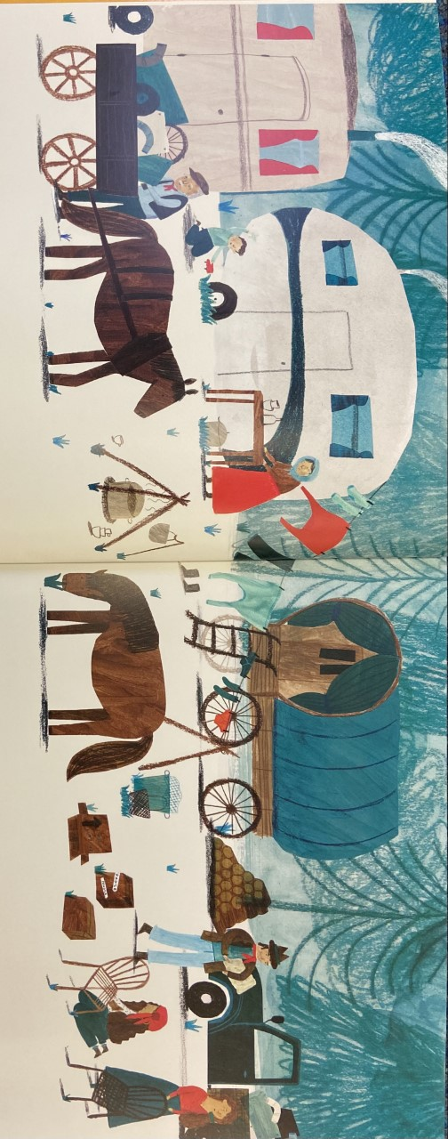
Looking at this picture, what adjectives could you use to describe this setting.
The busy people are all wearing something red.
The dark brown horses are eating green grass.

Slide 7

Think!
What adjectives did you use?
What or who were you describing?

