Slide 1

Wednesday 6th January 2021
LO: To make predictions about a character.
To use descriptive language to describe character / personality.

Slide 2
What sort of book is this?
Fiction (story) or Non-Fiction (fact)?

Slide 3

Look at this picture.
What can you see that might give us some clues about the little girl and her family?

Slide 4
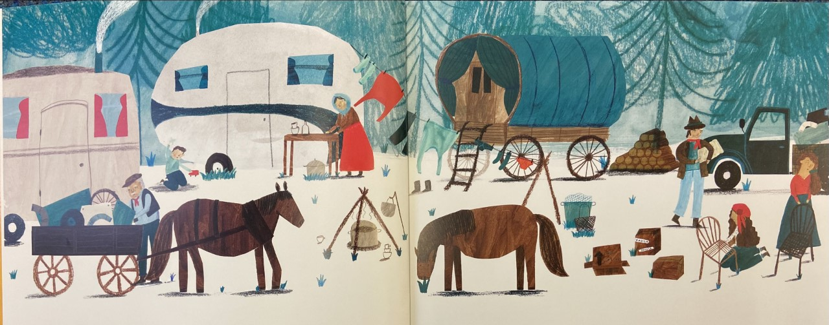
Look at this picture.
What do you think their lives might be like?

Slide 5

Look at this picture.
Who do you think this girl might be?
What is her role in her community?
What sort of person might she be?
What is her appearance?

Slide 6
Use adjectives (describing
words) to tell me what she
might be like.
What her clothes are like and what she does in the day? Where might she sleep?

Slide 7
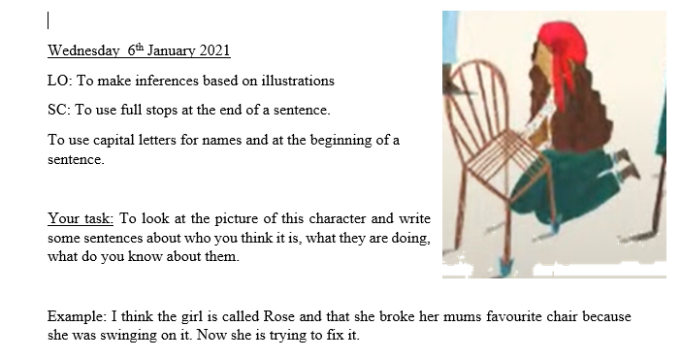
Your Task today: Worksheet available.

Slide 8
Think!
What ideas did you come up with?
Let’s think about how we could describe her.
Write a label for your picture.

