Slide 1
LO: To create your very own ‘wave’ painting
Thursday 10th June 2021

Slide 2
Take a look at these paintings.
Which is your favourite?
Why do you like it?
How do you think the artist has created the effects?
How are some of the paintings similar?
How are some of the paintings different?

Slide 3
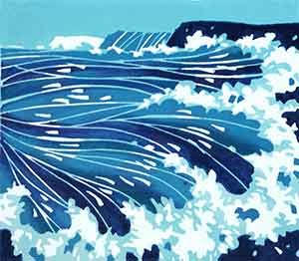
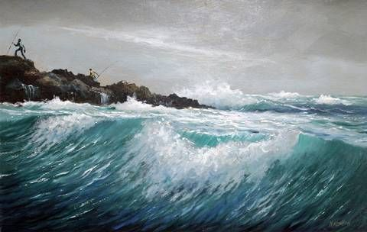
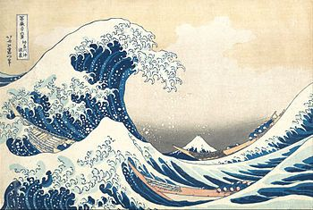
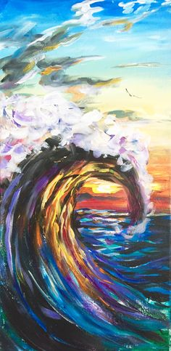
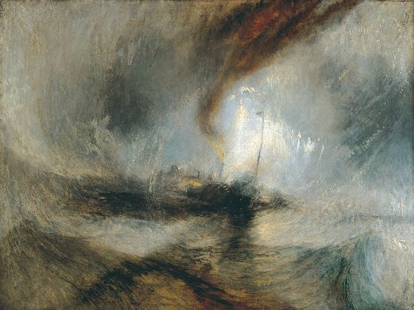
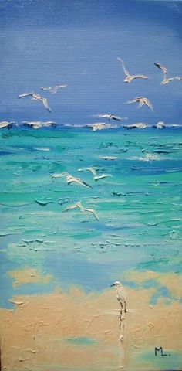
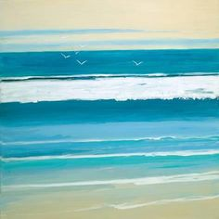

Slide 4
How will you create the effects?
Your Task:
Have a look at these paintings. Your task is to sketch your ideas for your own painting. Think about colour, style and any details you wish to add.
You will get a chance to paint your picture properly next week!
Will you use flat textures or rough?
What colours will you use?

