Slide 1
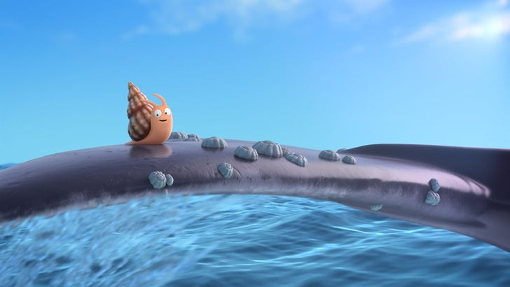
Thursday 10th June 2021
LO: To give an opinion about what a character should do using conscience alley.

Slide 2
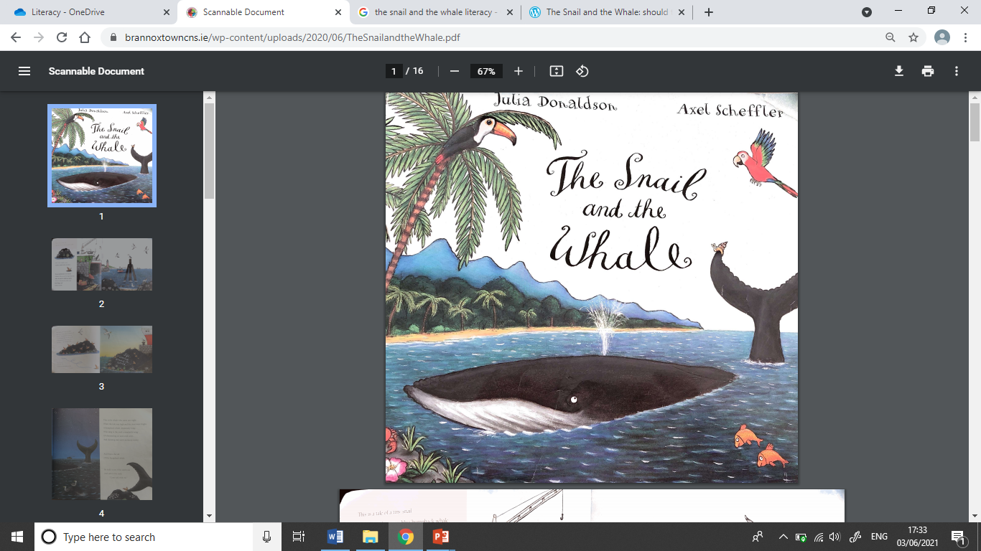

Slide 3
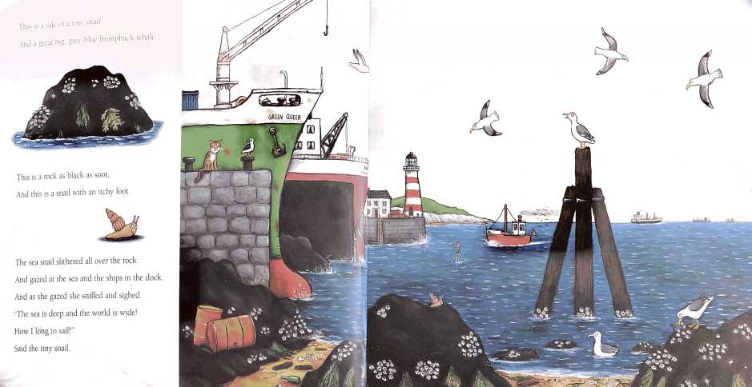

Slide 4
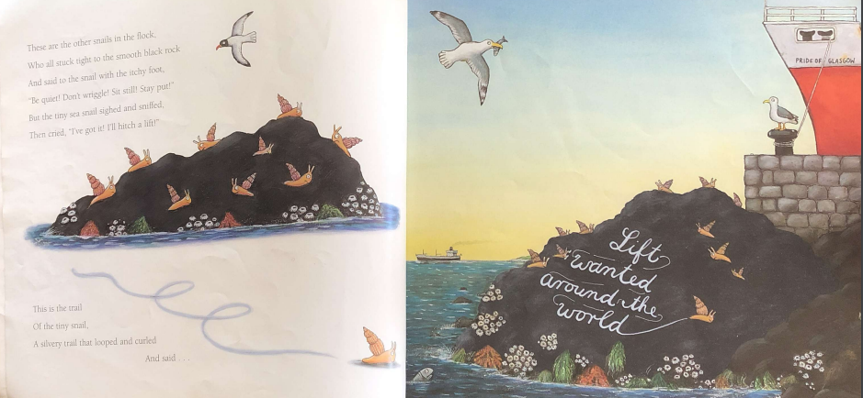

Slide 5
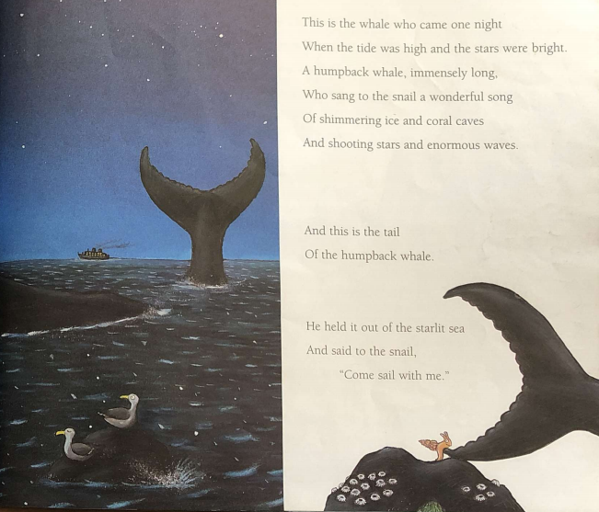

Slide 6
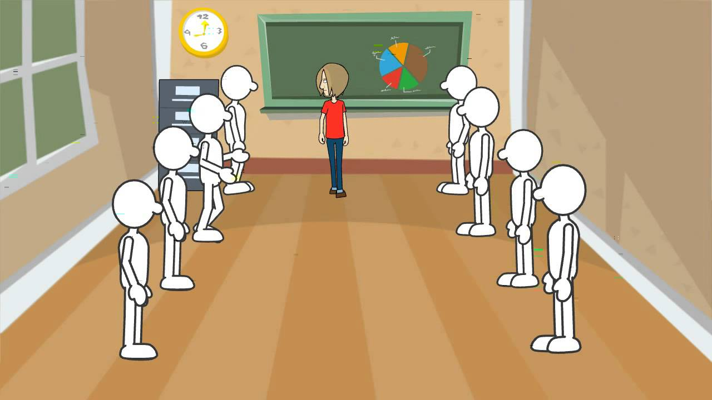
As a class participate in a conscience alley giving reasons why the snail should and shouldn’t go with the whale.

Slide 7
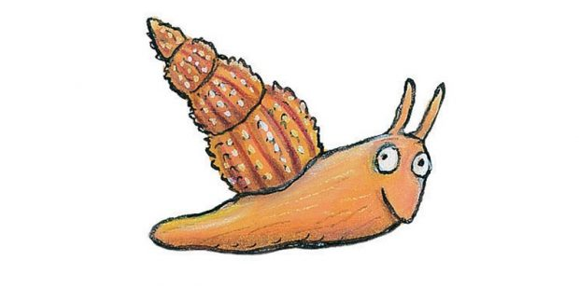
Discuss what some of the reasons the snail should/ shouldn’t go with the whale.
You shouldn’t go because the whale is a stranger.
You should go because you will get to explore the world.

Slide 8
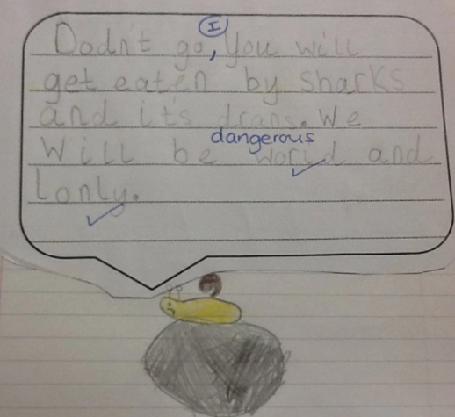
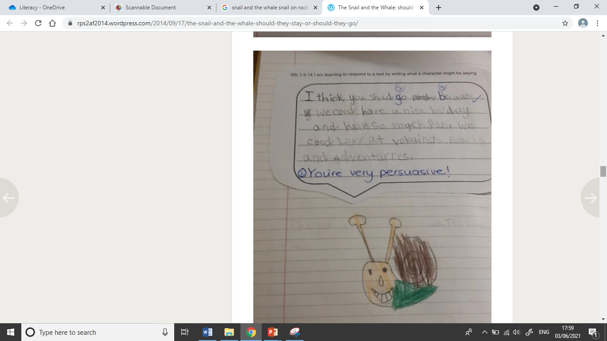
Your task: Write down why you think the snail should/shouldn’t go with the whale.

