Slide 1
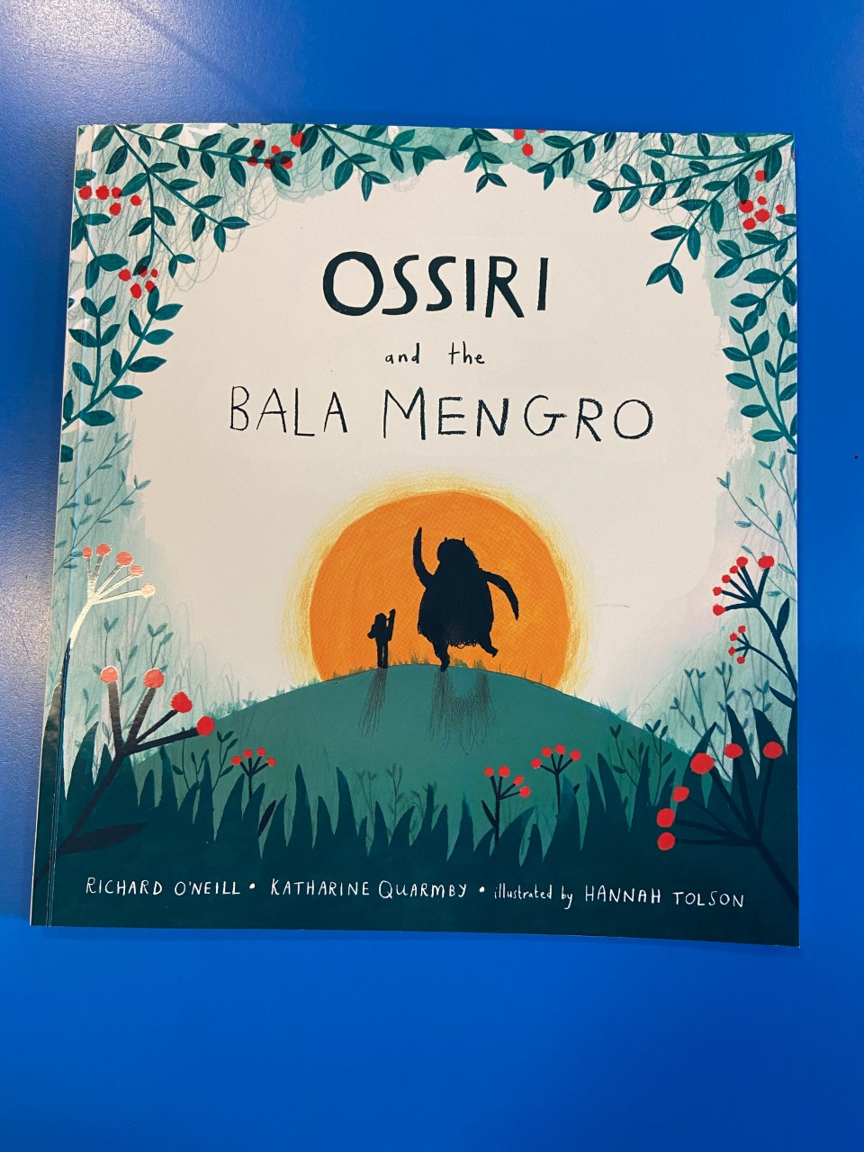
Thursday 14th January 2021
LO: To continue a story
SC: Use capital letters and full stops.
Use adjectives

Slide 2
Read page 18
Think about how Ossiri is feeling?
What is she going to do next?
What will the Bala Mengro do?

Slide 3
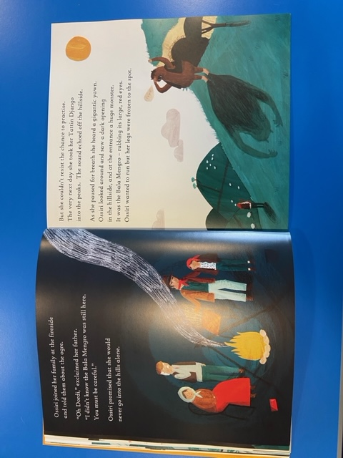
But she couldn’t resist the chance to practise. The very next day she took her Tattin Django into the peaks. The sound echoed off the hillside.
As she paused a for a breath she heard a gigantic yawn. Ossiri looked around and saw a dark opening in the hillside, and at the entrance a huge monster. It was the Bala Mengro- rubbing its large, red eyes. Ossiri wanted to run but her legs were frozen to the spot.

Slide 4
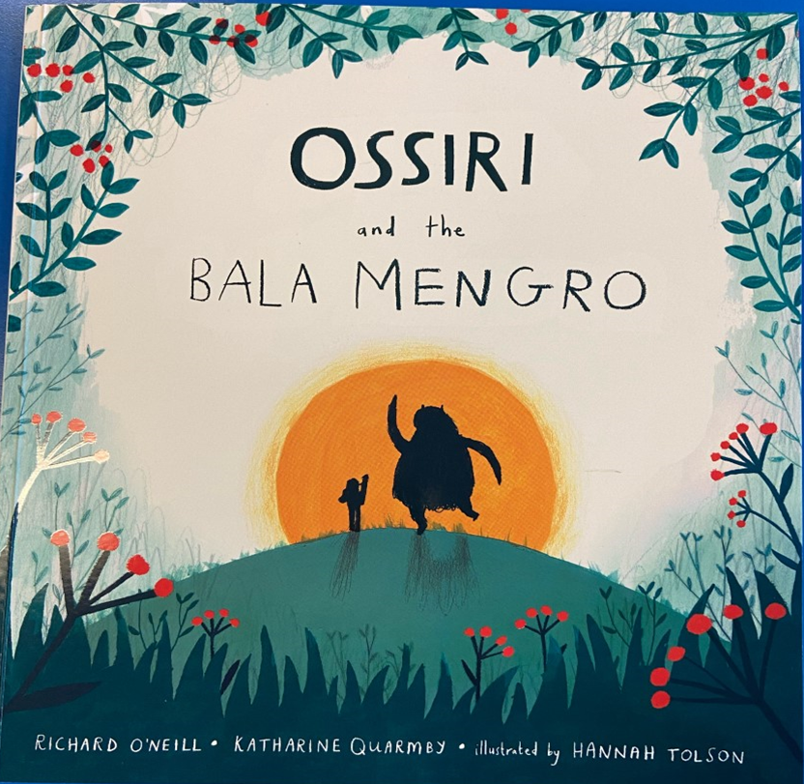
What do you think is going to happen next?
I think Ossiri is going to scream and scare the Bala Mengro. Then the Bala Mengro will be upset because he doesn’t know what he did wrong.

Slide 5
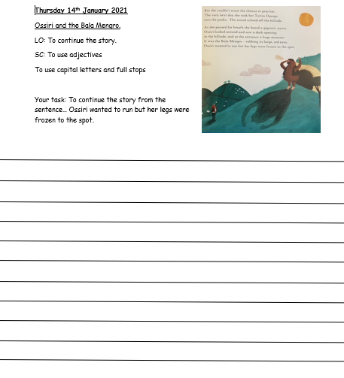
Your Task…
Your task is to continue the story from the last sentence we read which is…
Ossiri wanted to run but her legs were frozen to the spot.

Slide 6
Example
Suddenly the huge red eyed monster started to scream. Ossiri didn’t know what to do so she screamed back, the monster looked at her confused. Ossiri played her Tattin Django again and the Bala Mengro started to jump up and down covering his ears.
Remember when you are writing to use Capital letters for the beginning of a sentence and for names.

